Slide 1
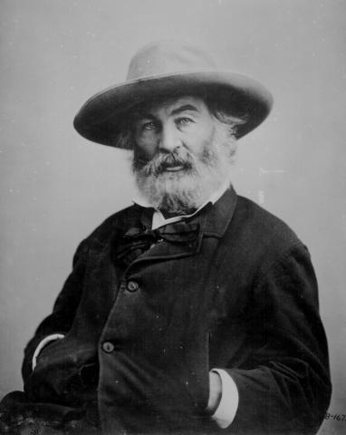
Walt Whitman (1819-1892)

Slide 2
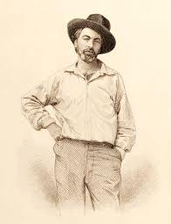
Traits
Teen prodigy, autodidact, man of many trades (journalism, printing, Civil War volunteer nurse)
Democratic activist and abolitionist
Bohemian, unconventional, “rough”, openly gay (Live Oak, with Moss; Calamus)
Influences: transcendentalism, pantheism, romanticism, republicanism
1855 Leaves of Grass, American “epic,” revised and implemented until 1892 (“deathbed” edition)
Unrhymed, long lines; rhythmic repetition, grand, bold epic tone; key presence of nature; “father of free verse”

Slide 3
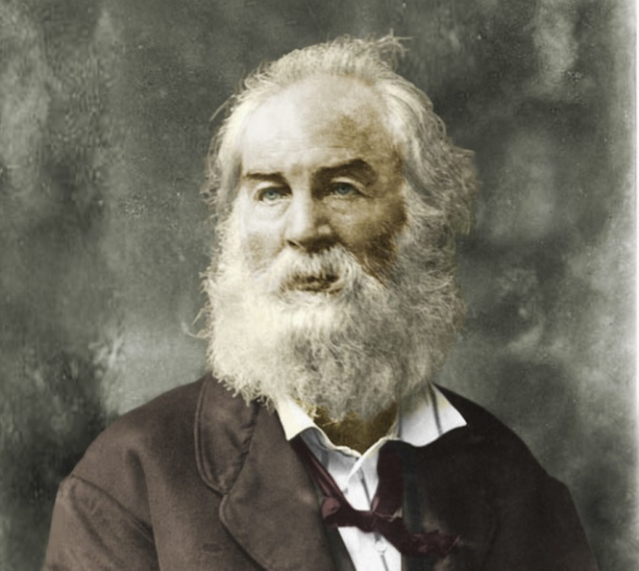
“Song of Myself” (1892 version)
Who is “myself”?
How does this beginning/theme differ from traditional epics?
Invocation
Theme
Perspective
Transcendental elements
Relation of human body to nature
Grass as a symbol
“Attitude towards books, “creeds and schools” (l. 10)
perfumes” vs “atmosphere” (ll.14-17)
“Clear and sweet is my soul, and clear and sweet is all that is not my soul” (l. 52)—meaning?
What is “the origin of all poems” (l.33)
Relation to other people (what kind?) to “Me Myself” (part 4, 7); my soul vs “the other I am” (part 5)
Part 6-7: view of death

Slide 4
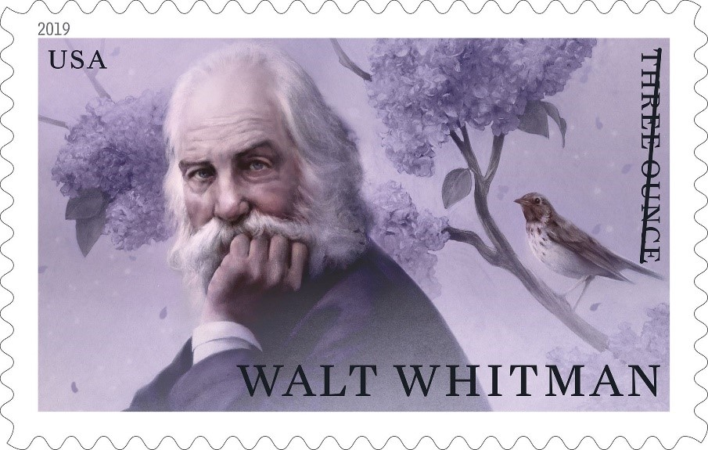
Part 8: Urban America
Part 9: Rural America
Part 10: Wild America (why references to mixed Native-Anglo marriage and runaway slave there?)
Part 11: “Twenty-eight young men”+woman
Part 12: What is the main trait of the working men?
Part 13: What connects the human to the forest world?
How does the poem create rhythm?
How is this poem American?
How is this poem an epic?

