Slide 1
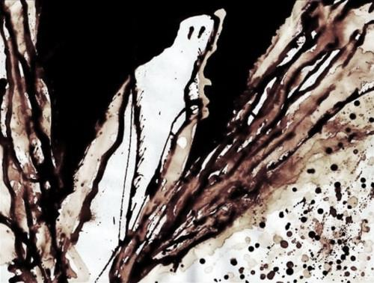
The Confessionals and the Beats

Slide 2
The Post-War Period
Period of “conformity and criticism”
suburban conservative culture, communal patriotism VS “Red Scare”
G.I. Bill veterans, young, hippies, pacifists and conspiracy theorists as questioners of the system/American Dream→ The Beats (beaten/beatific/”beat” of heart, life, public)
Confessional poetry a mix of:
modernist experiment
intense lyrical exposure (of and against taboos)

Slide 3
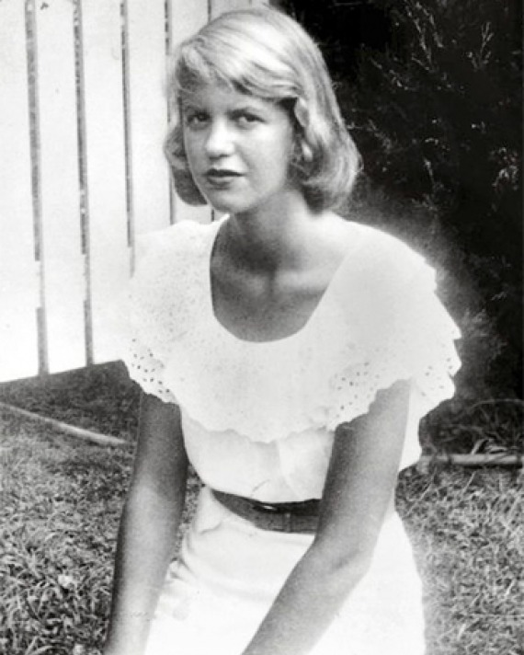
SYLVIA PLATH (1932-63)
Early poetic talent, genius IQ, good Boston and Cambridge education
Fame and “dream” marriage to Ted Hughes
BUT death of German father at 8 years and life-long depression (two prior suicide attempts, death by suicide), divorce from philandering Hughes
Posthumous Ariel and Pulitzer prize; also Bell Jar (autobiofiction)

Slide 4
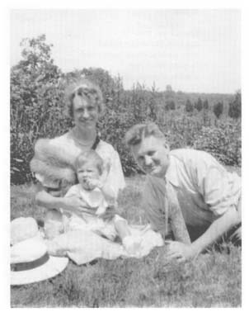
“Daddy”
Title vs content, tone
Portrait of Otto Plath (older, patriarchal, authoritarian, amputated foot and early death due to diabetes)
Why did she “have had to kill” him? Why “devil” and “bastard” and “vampire”?
Why comparison to Nazis? Why does “every woman adore a Fascist”?
Description of her marriage as Electra complex/masochism
Final line: “through” abandonment, breakthrough, or suicide?

Slide 5
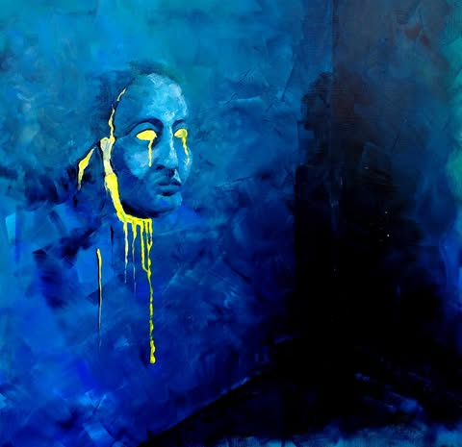


They Real Cool…
Elena Volioti
Eleni Zouveleki
Evelyn Sabatakou
Christos-Thomas Tsagkas
Mariastella Tsimpidi
Natalia Toliou
Leonitsa Feta
Tatiana Filippopoulou
“WRC” by Christos-Thomas Tsagkas

Slide 6
ALLEN GINSBERG (1926-97)
poet, activist, public figure
unusual childhood: highly educated parents, mother communist and insane
Columbia scholar; met group who’d become the Beats: Gregory Corso, Neal Cassady, Jack Kerouac, William S. Burroughs
beaten/beatific anticonformist credo:
live truly, express yourself fully in all ways
eastern philosophy, drugs, sex, and black music
rejection of American Nightmare of materialism
Masterpiece “Howl” banned, obscenity trial for openly gay references

Slide 7
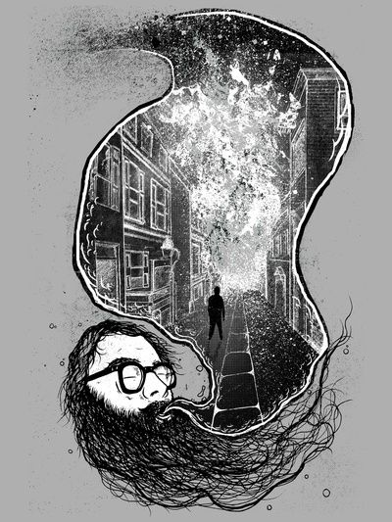
“Howl”
“Gallery 6 Reading” (1955), where Beats began
Whitmanesque free verse
Combines critique of U.S. capitalism with chronicle of Beat generation and poet’s own biography (mother/Solomon)
apocalyptic vision
I. Destruction of the best (shocking definition of the “best” re writer/fellow mental patient Carl Solomon)…
II. …as sacrifice to Moloch (symbol of?)
III. “I’m with you” refrain as chant, benediction of “lambs” (Solomon)
end: pessimistic or optimistic? A second coming?
IV. Footnote (added later): “Holy!” mantra of universal benediction/celebration
Note: the video for “Howl” from the film Ginsberg is available on my website and on youtube. Watch the entire film if you can, it’s worth it!

Slide 8
AND NOW, TIME FOR REVENGE!
Please log in at https://survey.uoa.gr/L134565 and register your evaluation of this course.
Of particular importance is the open answer, where your personal impressions and suggestions really let us know details about your experience that will help us improve the course in the future.
Mention the name of your instructor (my colleagues are innocent!).

