Slide 1
The 21st century
Gritty in the City

Slide 2
Traits
Performative, installation, technology-channelled poetry
Multivocality, multiculturalism, inflected identity
Globalism and glocalism, ecocriticism
Critical attitudes (poetry as daily response to ongoing crises)

Slide 3
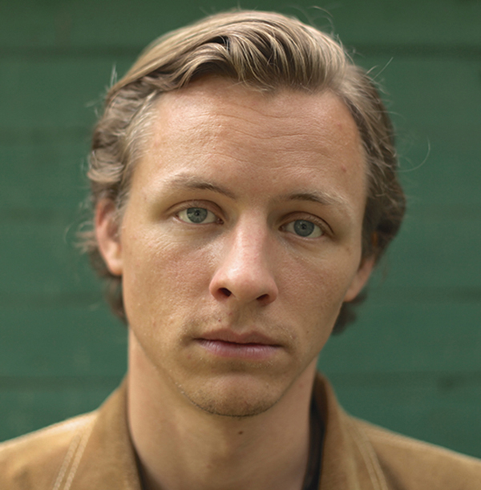
ANDERS CARLSON-WEE
Poet, university visiting writer, co-director of award-winning, poetic documentary short film Riding the Highline (2015)
Author of two chapbooks and two collections, Dynamite (2015) and The Low Passions (2019)
Recipient of the National Endowment for the Arts, Poets & Writers, Bread Loaf, Sewanee, the Napa Valley Writers’ Conference and a slew of other fellowships and prizes
Winner of the 2017 Poetry International Prize.

Slide 4
“How-To”
If you got hiv, say aids. If you a girl,
say you’re pregnant––nobody gonna lower
themselves to listen for the kick. People
passing fast. Splay your legs, cock a knee
funny. It’s the littlest shames they’re likely
to comprehend. Don’t say homeless, they know
you is. What they don’t know is what opens
a wallet, what stops em from counting
what they drop. If you’re young say younger.
Old say older. If you’re crippled don’t
flaunt it. Let em think they’re good enough
Christians to notice. Don’t say you pray,
say you sin. It’s about who they believe
they is. You hardly even there.

Slide 5
“How-To”
Persona of the speaker (language)
Begging as “art”—what are its main tenets?
“They” vs “you”
Begging as metaphor for…?
Controversy of “authenticity” (withdrawn July 2018 publication in The Nation; subsequently restored with a profuse apology)

Slide 6
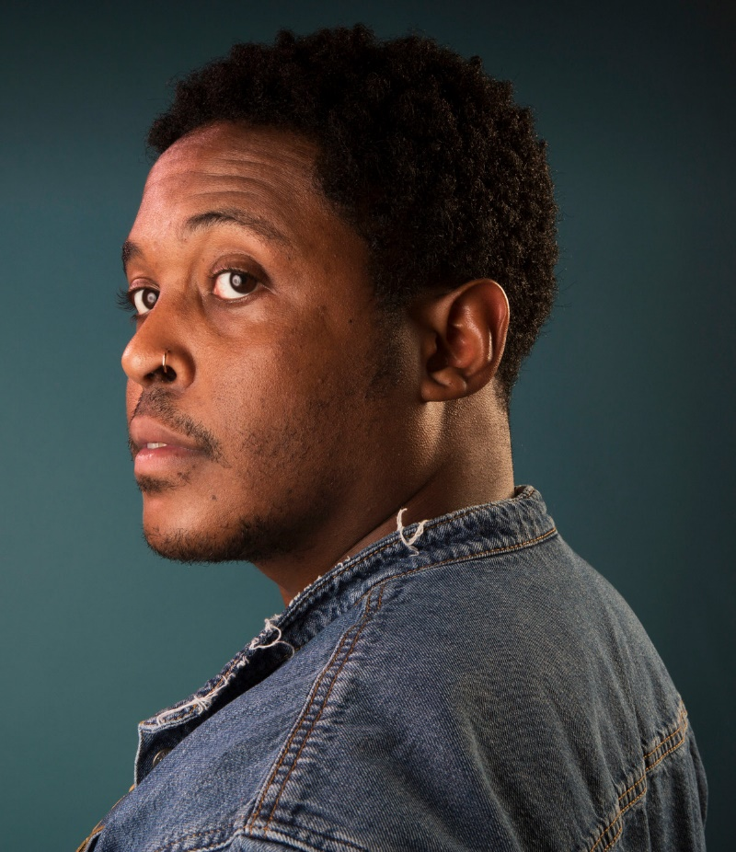
Danez Smith (1989- )
They are queer, non-binary and HIV-positive poet and performer.
Author of two chapbooks and three poetry collections so far: [insert] Boy (2014), Don't Call Us Dead: Poems (2017), and Homie (2020), all of which have received multiple significant awards, from the Lambda Literary Award and the Kate Tufts Discovery Award to the Forward Prize for Best Collection, the Midwest Booksellers Choice Award, the Pushcart Prize, and a finalist position for the National Book Award, among many others.
Recipient of fellowships from the McKnight Foundation, Cave Canem, Voices of Our Nation (VONA), and the National Endowment for the Arts; also the First Wave Urban Arts Scholarship from the UW-Madison (where he got his BA), and the Ruth Lilly and Dorothy Sargent Rosenberg Poetry fellowship from the Poetry Foundation.
Founding member of the multigenre, multicultural Dark Noise Collective; co-host of the Poetry Foundation's podcast, VS.
2011 Individual World Poetry Slam finalist and the reigning two-time Rustbelt Individual Champion, and was on the 2014 championship team Sad Boy Supper Club. In 2014 they were the award-winning festival director for the Brave New Voices International Youth Poetry Slam.

Slide 7
“The bullet was a girl”
the bullet is his whole life.
his mother named him & the bullet
was on its way. in another life
the bullet was a girl & his skin
was a boy with a sad laugh.
they say he asked for it—
must I define they? they are not
monsters, or hooded or hands black
with cross smoke.
they teachers, they pay tithes
they like rap, they police—good folks
gather around a boy’s body
to take a picture, share a prayer.
oh da horror, oh what a shame
why’d he do that to himself?
they really should stop
getting themselves killed.

Slide 8
"the bullet was a girl”
" (Poem-a-Day by the Academy of American Poets, September 3, 2015)
Why is the bullet “his whole life”?
Why are the bullet and his skin gendered?
Who is “they”? Does “they” change? To what effect?
Use of italics
What is the tone and point of the last two couplets?

Slide 9
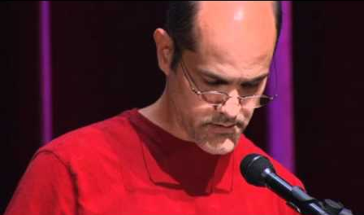
Bob Hicok (1960- )
Poet and Creative Writing MFA professor
Author of ten collections of poems so far, including The Legend of Light (1995), winner of the Felix Pollak Prize in Poetry in 1995 and named a 1997 ALA Booklist Notable Book of the Year; Plus Shipping (1998); Animal Soul (2001), a finalist for the National Book Critics Circle Award; Insomnia Diary (2004); This Clumsy Living (2007), which received the Rebekah Johnson Bobbitt National Prize for Poetry from the Library of Congress; Words for Empty, Words for Full (2010); Elegy Owed (2013), a finalist for the National Book Critics Circle Award; Sex & Love & (2016); and Hold (2018).
His work has been selected numerous times for the Best American Poetry series. Hicok has won Pushcart Prizes and fellowships from the Guggenheim Foundation and the National Endowment for the Arts,

Slide 10
“A Braid of Unknowing I Tie Before You”
From Poets Respond, April 4, 2021
A “braid” of three different narratives:
The morning star the poet sees
  Name of the star
  Sleepless at dawn
  Asking the stars for prophecy of future of humankind (is there hope for us? can we be taught?)
The students discouraged by COVID
The George Floyd murder in Minneapolis on May 25, 2020; “I can’t breathe” his final words (#BLM)
Unknowing VS optimism, humanism: how can one “deserve” the touch of star’s “light”?

Slide 11

Feedback, please?
Those of you who still haven’t done
so, please go to the following link
and log in using your
student ID information
to provide your evaluation
for this course. It won’t take long,
and it does not involve blood loss and pain, but it would mean a lot to know how this semester registered with you, and you are helping future generations of your peers. Thank you for your valuable feedback!
https://survey.uoa.gr/L134565

