Slide 1

MULTICULTURALISM
AND PLURALITY

Slide 2
From the “melting pot” to the “salad bowl”/ “smorgasbord”
After the 1960-70s, stronger minority presence in mainstream US culture
Beginning with 1990, idea of identity as flux, composite, work-in-progress
Post-modernity: change in the substance of literature (metafiction, hybrid genres, performance art, mini/flash fiction)

Slide 3


But first… some more cool!
Zeta Ralli
George Tsepelidis

Slide 4
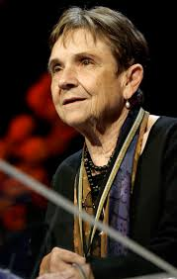
ADRIENNE RICH (1929-2012)
-Poet, feminist, anti-war activist, essayist
-superb education; Yale Younger Poets award with 1st collection; poet and activist fame yet troubled home life
-from formulaic poetry to free-verse, experimental expression
-mid-life acknowledgment of Jewish and lesbian identity

Slide 5
“Diving into the Wreck” (1973)
One of Rich’s most iconic poems
Katabasis
Switch from “alone” (ll. 12, 41), “there is no one”—l. 31) to “we”
  Who are we? (mermaid and merman,
  the drowned, the wreck)
  What does the switch mean?
Symbols:
  the ladder
  “a knife, a camera/a book of myths/ in which/ our names do not appear”: what are these symbols?
  “the thing I came for:/ the wreck and not the story of the wreck” (ll. 61-62)
Who is the diver? What is “the wreck”?

Slide 6
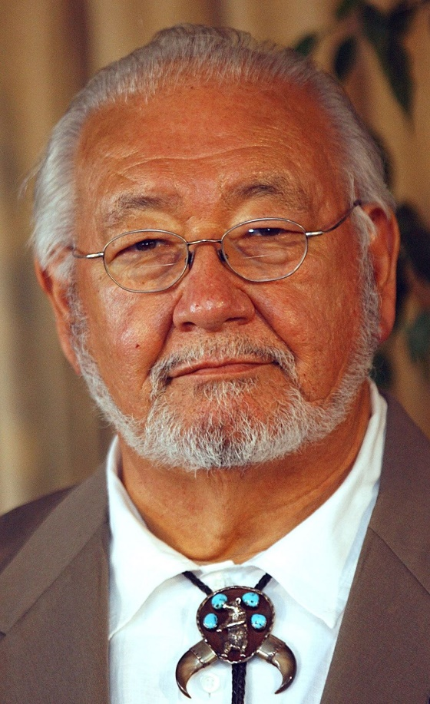
N. SCOTT MOMADAY (1934-2024)
Kiowa novelist, short story
writer, painter and poet
Family nurture in arts and letters,
Stanford PhD
1969 Pulitzer prize for Fiction,
Oklahoma Poet Laureate, 2007
National Medal of Arts
Initiated 60s-70s Native
American Renaissance with
House Made of Dawn (1968);
strong autobiographical element
Tradition discovery-transmission-enrichment (orature elements infused with text; poetry as ritual, history, politics of identity, spiritual quest)
The Way to Rainy Mountain (1969)

Slide 7
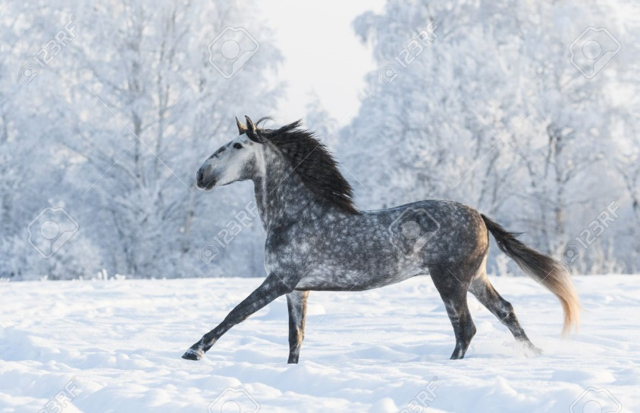
“The Snow Mare”
In my dream, a blue mare loping,
Pewter on a porcelain field, away.
There are bursts of soft commotion
Where her hooves drive in the drifts,
And as dusk ebbs on the plane of night,
She shears the web of winter,
And on the far, blind side
She is no more. I behold nothing,
Wherein the mare dissolves in memory,
Beyond the burden of being.

Slide 8
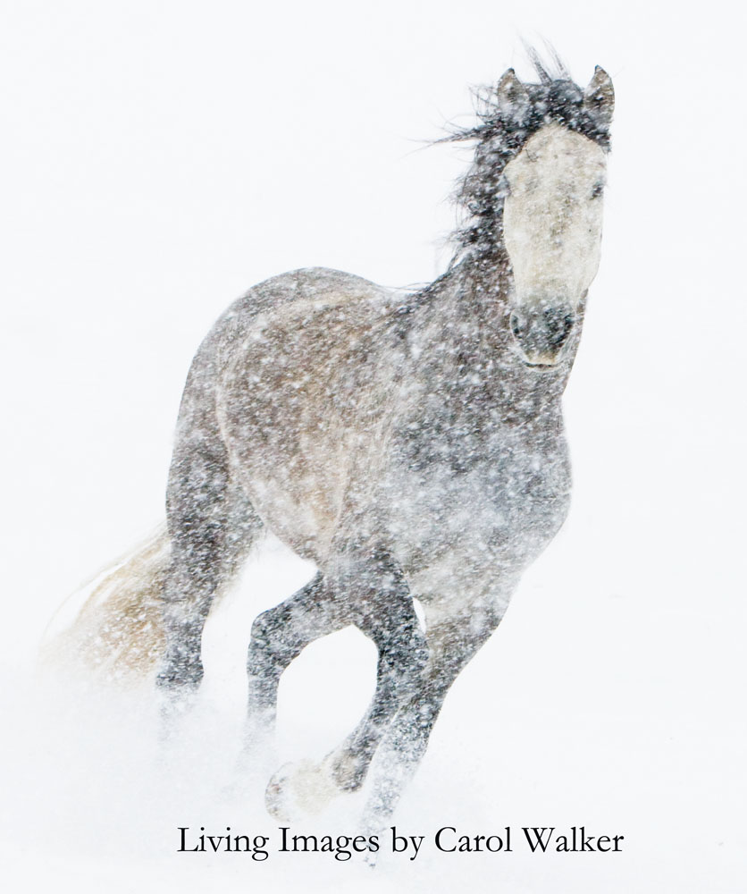
“The Snow Mare”
Importance of the horse in Great Plains Culture (vs. night-mare)
Dream vision: poet as shaman
Imagism and mysticism
Symbolism
  Color: “blue,” “snow,”
  “pewter,” “porcelain”
  Time, season
Meaning of “blind side” vs
dream
Import of last sentence:
a. for Native identity/ history
b. for poetry (c/c Wallace Stevens’s “Thirteen Ways of Looking at a Blackbird”)

