Slide 1
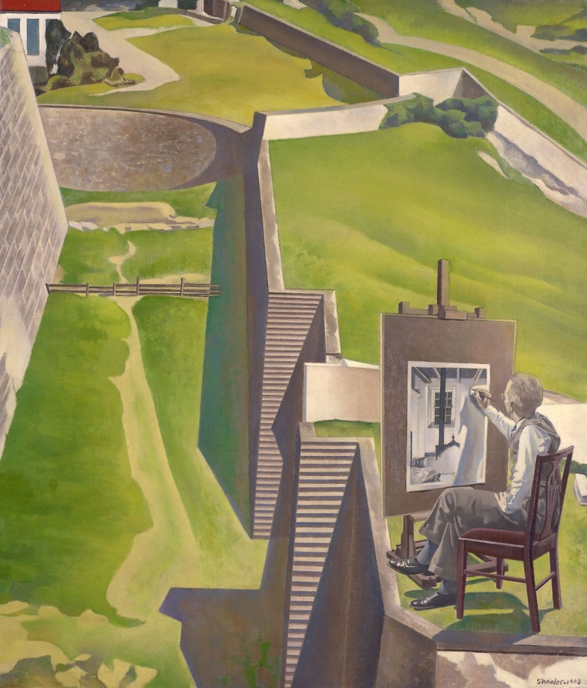
MODERNISM IN THE U.S.A.
Charles Sheeler, “The Artist Looks at Nature” (1943)
Home Poets, Part B

Slide 2
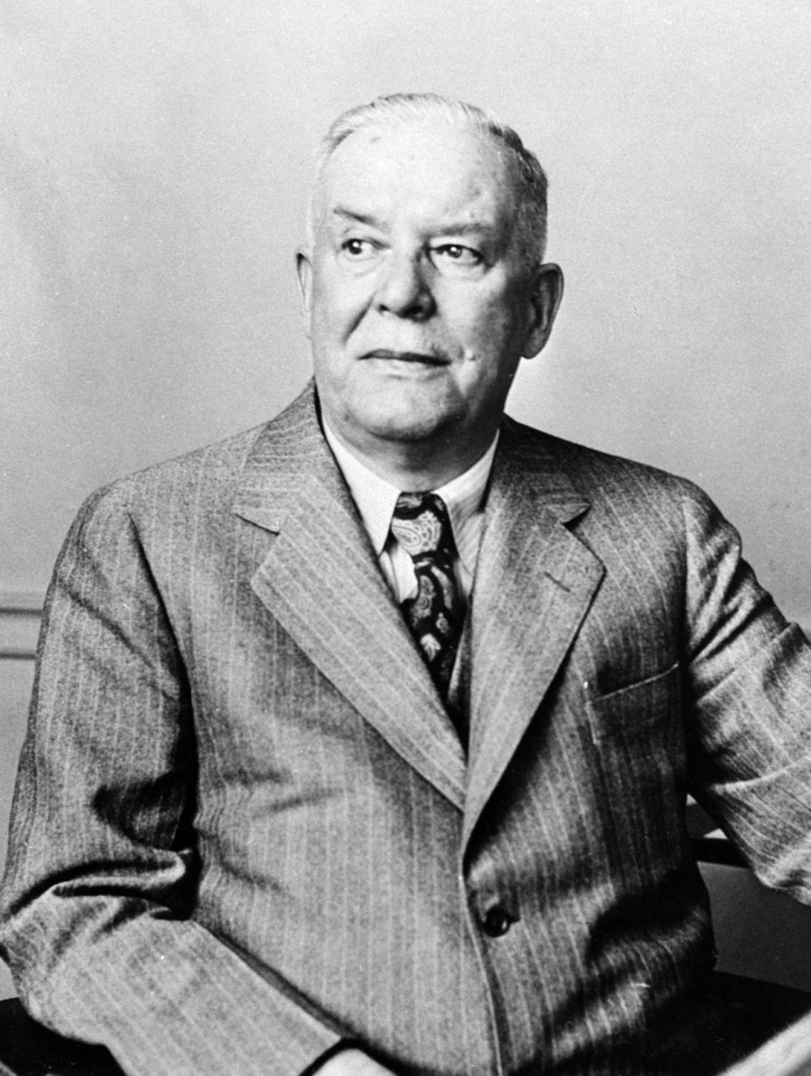
Wallace Stevens (1879-1955)
-Insurance company lawyer in Hartford, Connecticut
-Late call to vocation but lasting fame--> Pulitzer prize
-Fought with Frost and Hemingway
-Poetry an often playful oscillation between the mundane and the imaginative (in a secular way)

Slide 3
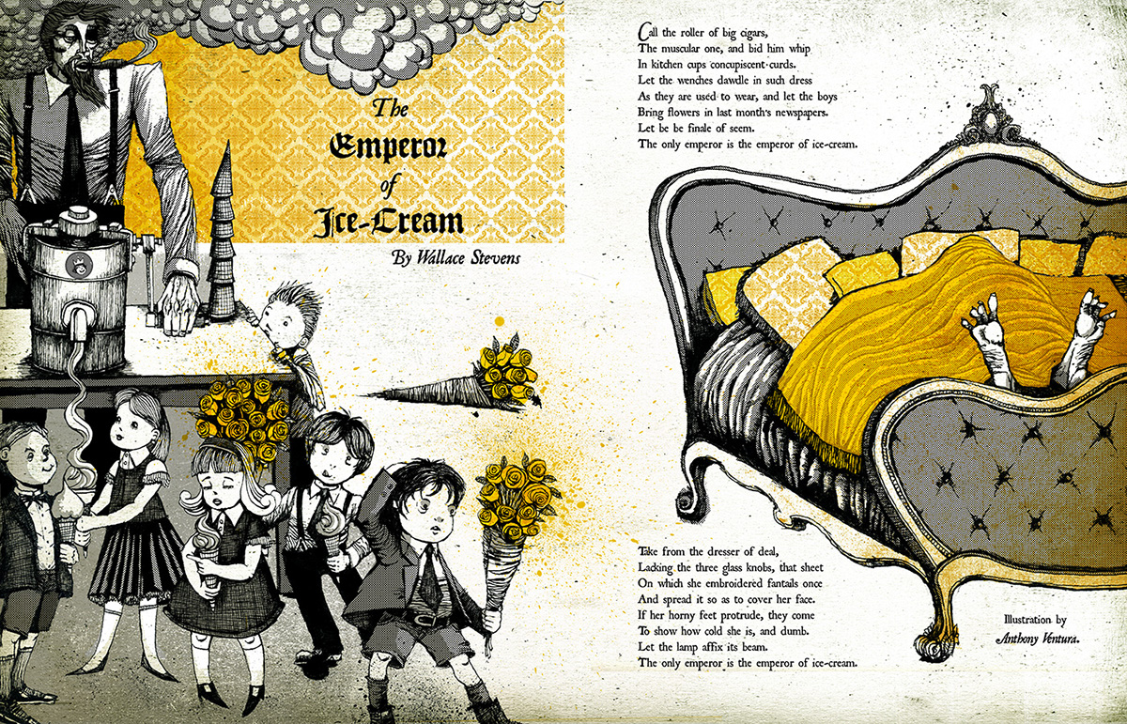

Slide 4
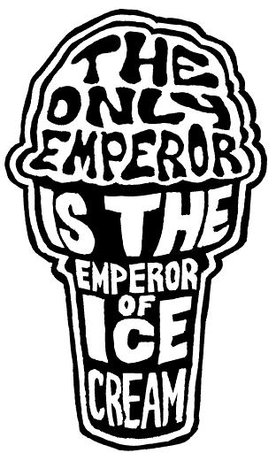
“The Emperor of Ice-Cream”
Vocabulary and tone
Symbols and metaphors:
“muscular” “roller of big cigars”
“concupiscent curds” “in kitchen cups” (alliteration)
“wenches” nicely dressed and dawdling
“flowers in last month’s newspapers”
“dresser of deal” lacking “glass knobs”
Embroidered sheet
“horny feet,” “dumb”
Lamp
“Emperor of Ice-cream
What is the purpose of irreverence?
What is the theme?

Slide 5
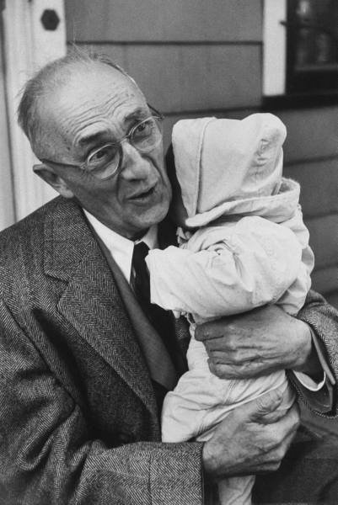
William Carlos Williams (1883-1963)
Pediatrician (and philanderer…)
“No ideas but in things” (simple, everyday American language and themes) VS movements, theories, YET experimental and fresh
Member of NY’s “The Others” (with Stevens, Marianne Moore, Mina Loy, et al.) VS High Modernism
Paterson, epic poem for Jersey town
Great influence on the Beats and the Black Mountain School

Slide 6
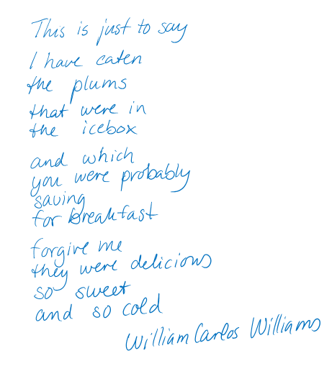
“This Is Just to Say”
Haiku influence
Is this a poem? (form, language, images)
What does the poem “just” say?

Slide 7
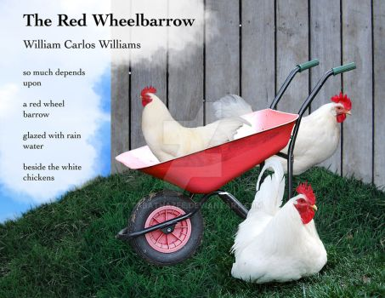
“The Red Wheelbarrow”
From image to inference of story
Symbols of color and item contrast:
Red wheelbarrow
Rain water
White chickens
What depends on the scene? Why is it “so much”?

