Slide 1
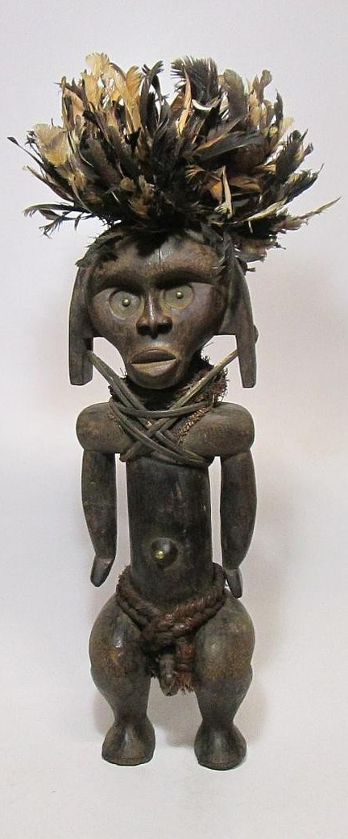
From the Harlem Renaissance to the Black Arts Movement (BAM)

Slide 2
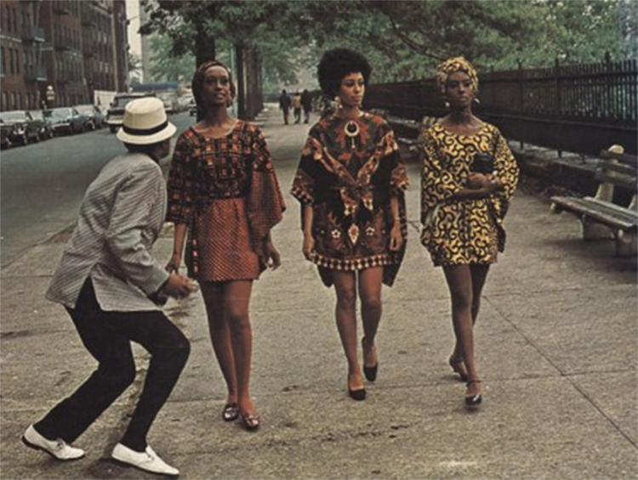
The “New Negro”
Lincoln’s Emancipation Proclamation 1/1/1863
Segregation, Jim Crow laws (“separate but equal”)
  the rural South/ urban, industrial North divide
The New Negro Anthology (1925) and Harlem, NY cultural explosion
  W.E.B. Du Bois “vs” Booker T. Washington
  Zora Neale Hurston “vs” Langston Hughes
The 1960s Civil Rights Movement:
  NAACP
  Brown vs Board of Education in 1954
  Rosa Parks 1955
  Reverent Martin Luther King Jr.’s “nonviolent resistance”
  Selma-to-Montgomery (Alabama) marches
  Black Power, Black Panthers, Malcolm X
  Civil/Voting Rights Acts of 1964-68
The B.A.M. (Imamu Amiri Baraka)

Slide 3
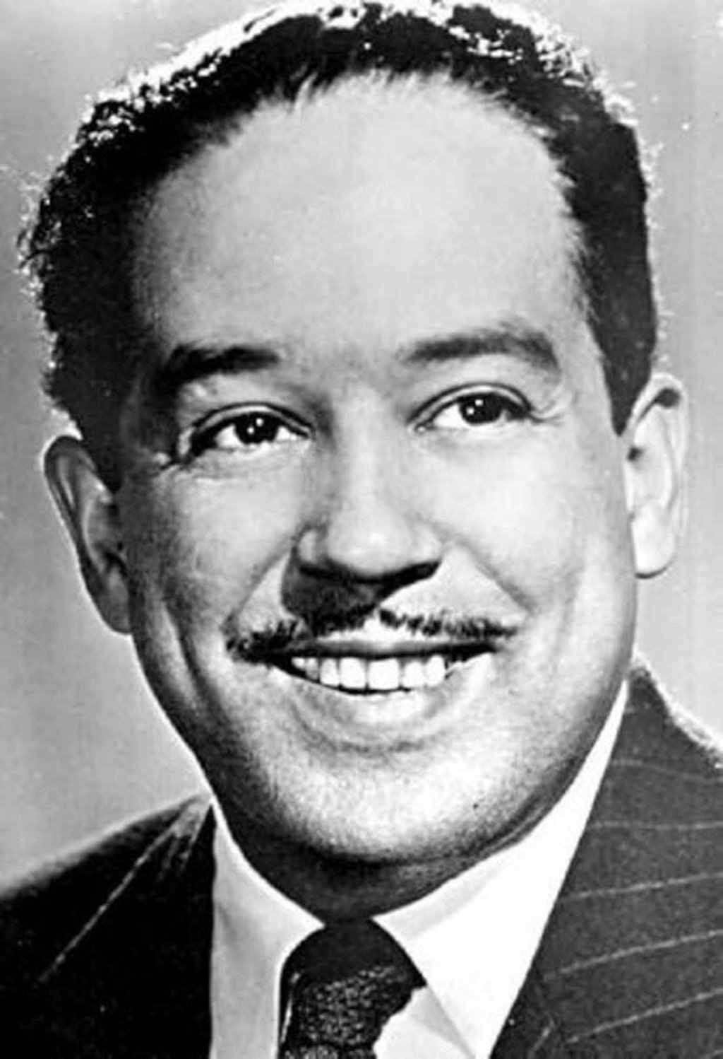
LANGSTON HUGHES (1902-67)
Foremost African-American poet of the Harlem Renaissance, author (of “Everyman” Jesse B. Semple or Simple novels), playwright, critic
Erratic childhood life (moves), sporadic education, odd jobs and world travels, yet early and prodigious engagement with poetry
Black rights/experience spokesperson and (persecuted) communist
Canonical poetic forms melded with black urban themes, idiom, humor, music (jazz improvisation)

Slide 4
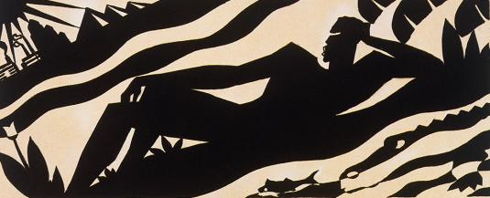
“The Negro Speaks of Rivers”
repetition; blues format, gospel derived from “call and response” patters of African orature
significance of the rivers: Euphrates, Congo, Nile, Mississippi
why “dusky” rivers? “muddy” to “golden”? Color symbolism
Biblical allusions
what does it mean to have known rivers?

Slide 5
“The negro speaks of rivers”
I’ve known rivers:
I’ve known rivers ancient as the world and older than the flow of human blood in human veins.
My soul has grown deep like the rivers.
I bathed in the Euphrates when dawns were young.
I built my hut near the Congo and it lulled me to sleep.
I looked upon the Nile and raised the pyramids above it.
I heard the singing of the Mississippi when Abe Lincoln went down to New Orleans, and I’ve seen its muddy bosom turn all golden in the sunset.
I’ve known rivers:
Ancient, dusky rivers.
My soul has grown deep like the rivers.

Slide 6
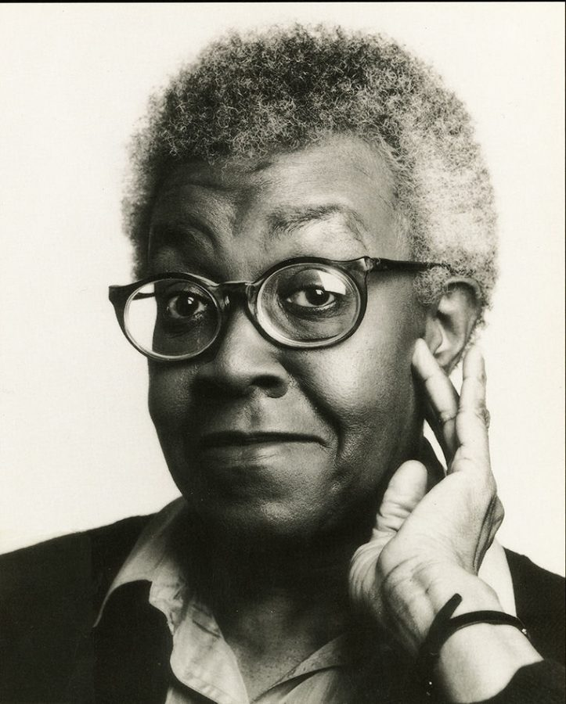
GWENDOLYN BROOKS (1917-2000)
From teen poet to first African-American to win the Pulitzer, Illinois poet-laureate, Library of Congress advisor, multi-celebrated poet, professor
“Folksy narrative” of urban poor portraits (A Street in Bronzeville, Annie Allen)
From late-HR questions of identity to 1960s BAM political activism (In the Mecca)

Slide 7
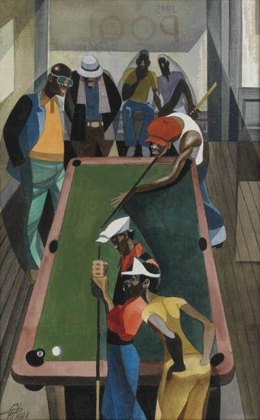
“We real cool”
  The Pool Players.
  Seven at the Golden Shovel.
We real cool. We
Left school. We
Lurk late. We
Strike straight. We
Sing sin. We
Thin gin. We
Jazz June. We
Die soon.

Slide 8

“We Real Cool”
form of the poem:
meaning of epigraph—symbolism of “Golden Shovel”
why “we” enjambment?
musical qualities
final line: self consciousness or irony?
The “WRC” challenge!
1. Chalvatzi 2. Konstantinidi 3. Papadaki 4. Pantsiou 5. Agriogianni-Arkouli 6. Papadopoulou 7. Davey

