Slide 1
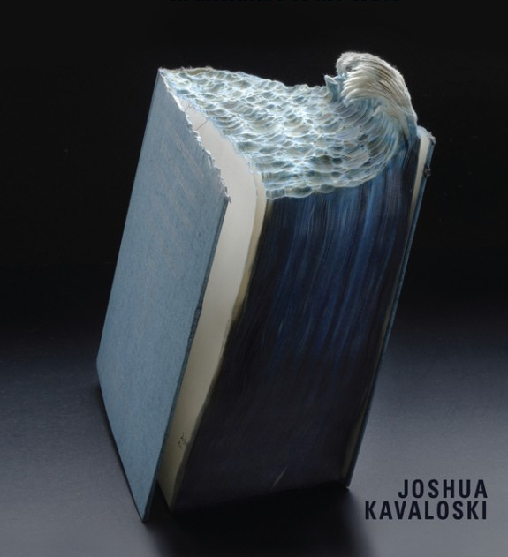
HIGH MODERNISM
The Lost Generation

Slide 2
Ezra Pound (1885-1972)
Poetical youth prodigy, “Make it new”
Initiator, nurturer and guide of top modernist movements/poets
Volatile personality, fascist lapse and harsh imprisonment in 1945, followed by 12 years in mental hospital
--> The Pisan Cantos (1948)
Controversial legacy

Slide 3
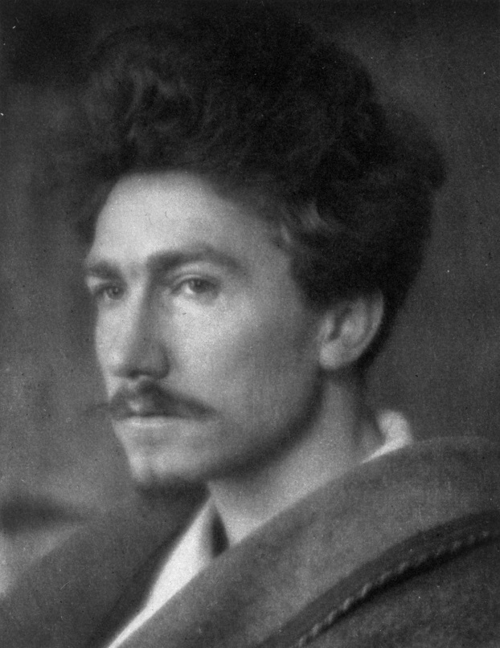
“A Pact” (1913)
-Form
-Why VS Whitman?
-Art and/as politics?
-The role of tradition (family metaphor; Harold Bloom’s “anxiety of influence”
“Let there be commerce” VS “usura”

Slide 4
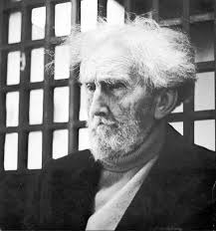
“In a Station of the Metro” (1913)
-Imagism, orientalist influence
-juxtapositions
-suggested emotion from language choice/ contrast/metaphor?

Slide 5
H.D. (Hilda Doolittle) (1886-1961)
-“HD, Imagiste”
-Cosmopolitan, affluent, bisexual, well-travelled, active in Euromodernist movement and publishing
-Classicism, myth, the occult, and psychoanalysis
-Trilogy: The Walls Do Not Fall (1944), Tribute to the Angels (1945) and The Flowering of the Rod (1946)
-Helen in Egypt (1955)

Slide 6
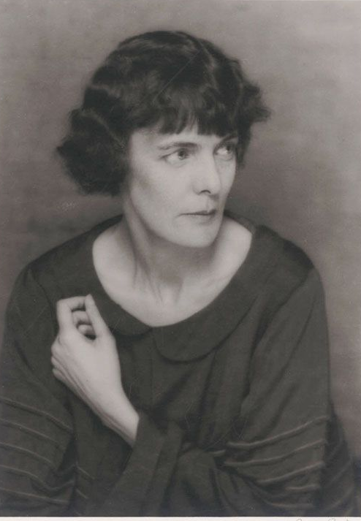
“Oread” (1914)
-imagist technique (Oriental economy and precision)
-meaning from contrast of images, elements, states
Sea/mountain; Waves/pines; (E)Motion-->meaning? (“us”)
-C/c with Percy B. Shelley’s “Ode to the West Wind”

Slide 7
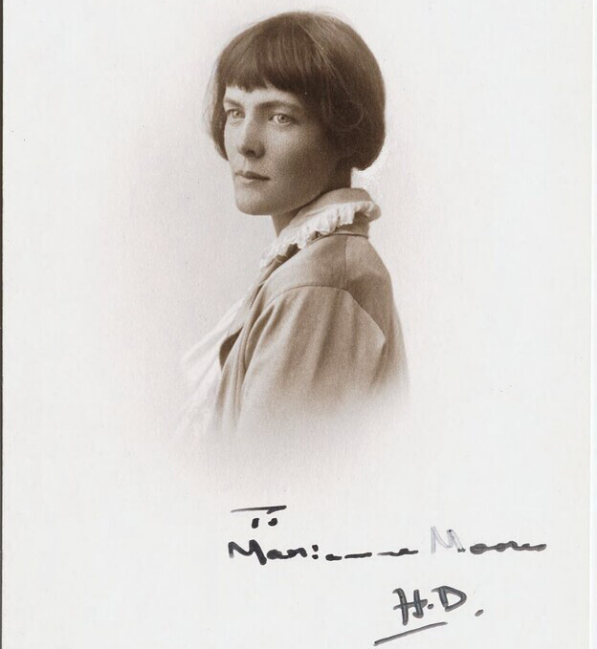
“Helen” (1924)
imagist technique
color allusion
Stanza form=?
contrast of emotions—why this view?
relation of gods to humans
what is “Helen”?

