Slide 1
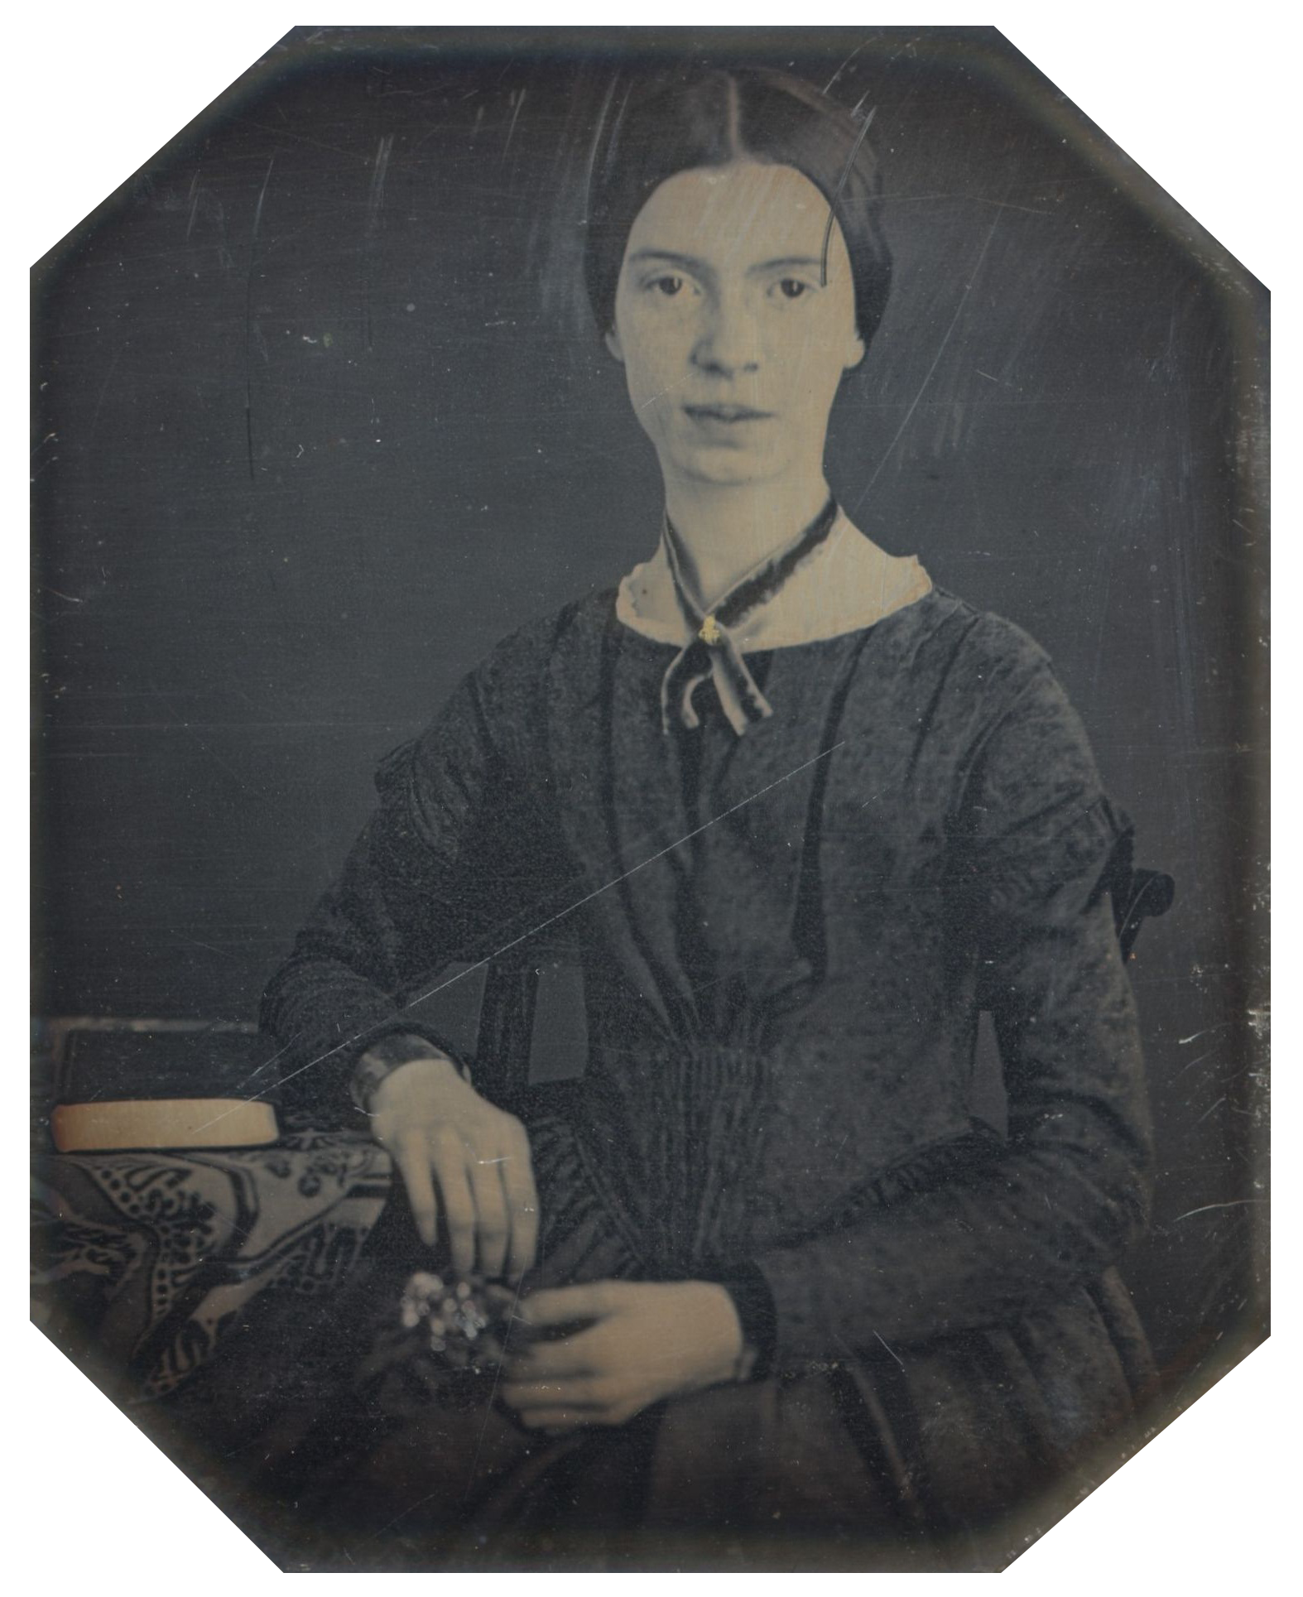
Emily Dickinson (1830-1886)

Slide 2
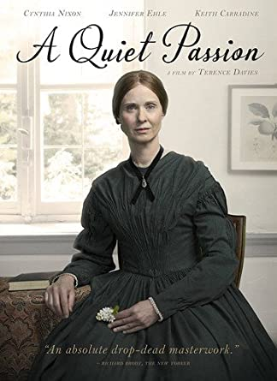
The Ultimate Coronavirus Survivor!
Spent all her life in Amherst, Massachussets (“Homestead”), except for one-year college stint at Mt. Holyoke Female Seminary in 1847
strict religious upbringing by protective, stern father
voracious reader and learner, greatly influenced by Transcendentalism
became a recluse, always dressed in white, refusing to meet people
plagued by health problems (eyesight), death of beloved family members (including young nephew)
Her awareness of her great talent was thwarted by critics/editors, who did not understand her odd poetry (unusual use of dashes, iambic “slant” rhymes, meter taken from popular hymns, musicality, concentration, odd metaphors); only a dozen poems published in her lifetime, and those edited beyond recognition.
Many poems scribbled informally on scraps of (used) papers, backs of envelopes, etc; many stitched by hand in tiny booklets; many she burned due to disappointment, others she ordered burned after her death.

Slide 3
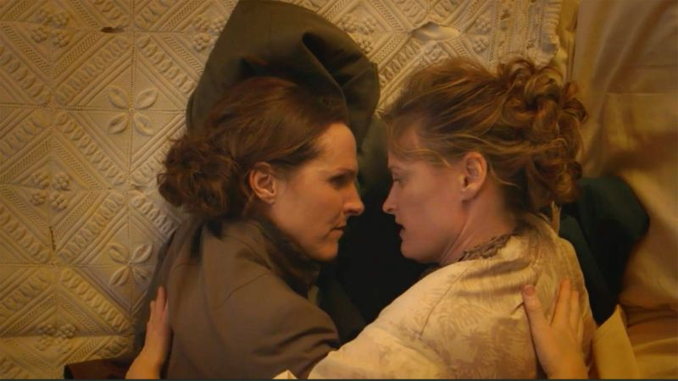
From “The Myth” to Celebrity
Intense relationships with friends, family-members, admired icons and possible lovers (“Master” poems) carried long-distance through prolific letter-writing and poem-gifts; presumed to have carried passionate sexual affairs with members of both sexes
Emily’s sister Lavinia did not comply all the way with the poet’s wishes to have her work burned: surviving poems were edited and published posthumously by Lavinia and neighbor Mabel Loomis Todd made Emily an instant and lasting success
Despite hundreds of surviving poems and letters, her life remains a mystery (Harvard snood and white dress).
Wild Nights with Emily (2019)

Slide 4
Poem 49: “I never lost…”
“Irreverent” view of God/Father (possibly because of her own idea of fathers)
autobiographical reference to deaths of two loved ones (cousin Sophia Holland, or teacher Leonard Humphrey and her father’s apprentice, Benjamin Newton)
biblical motifs: the beggar Lazarus, Job, Jacob wrestling with the Angel
Format: dashes, stanza division re: tone, theme, vocabulary (all her poems, in iambic tetrameter, can be sung to one tune!)

Slide 5
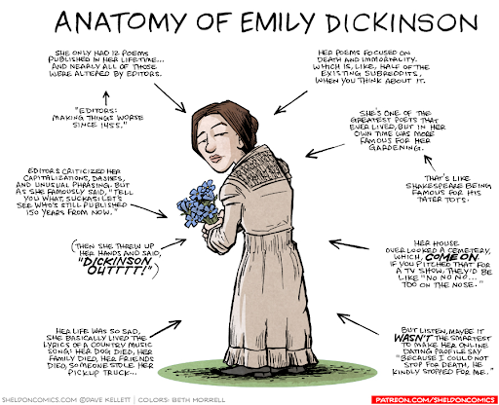

Slide 6

185: “Faith is a fine invention”
Religion VS science as a more dependable faith
Contrast between “faith” and “see”
Double meaning of “fine invention”: irony, sarcasm

Slide 7
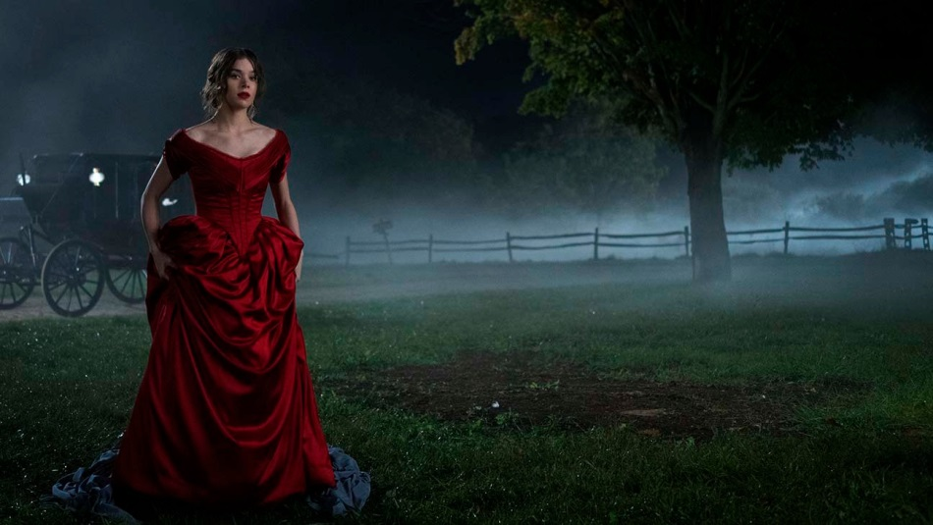
249: “Wild Nights”
Love affair as sailing
Positioning: poet as ship, lover as calm “port”; port stanza “moored” in between sailing/rowing ones
Alliteration, repetition, rhythm as joining metaphor to reality (sea waves, love rhythms)
The gender of images: port, rowing, sea, “in” suggesting…?

Slide 8
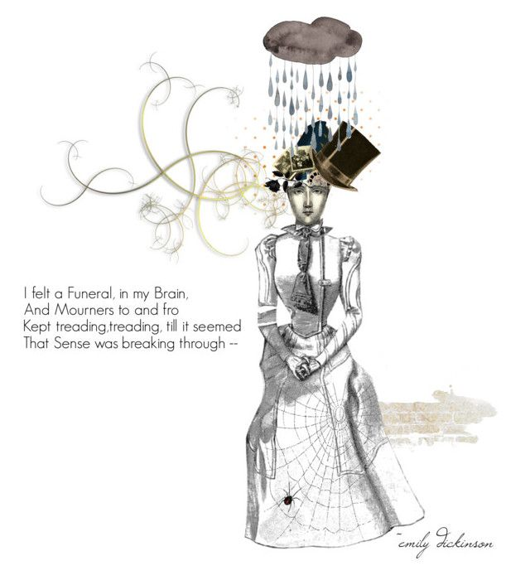
280: “I felt a funeral in my brain”
Funeral as a metaphor for?
A “sound” poem→ effect?
Last line: double meaning of “finished knowing”

Slide 9
324: “Some keep the Sabbath”
Sabbath church as foil to transcendentalist home experience of theosis—experience of Emerson’s “Over-Soul” and “defiant pantheism”
Immediacy VS mediated contact with God
Individual human agency (Romantic) of choosing how to worship and constructing worship space out of imagination and will VS religious submission to fate, God, nature
https://twitter.com/ferrisjabr/status/1365744836268023809?fbclid=IwAR2CjMtd7tXJvHrgOsxyOw775vr6IoW3CD3BT1cHyGjmBE-FlpPwkONLaSo

Slide 10
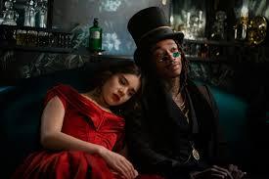
712: “Because I could not stop for Death”
Alternative view of Death as “kindly” gentleman, leisurely ride
Death related to immortality, eternity
Journey stages
Eternity as a matter of perspective, speaker hasn’t felt its passage

