Slide 1
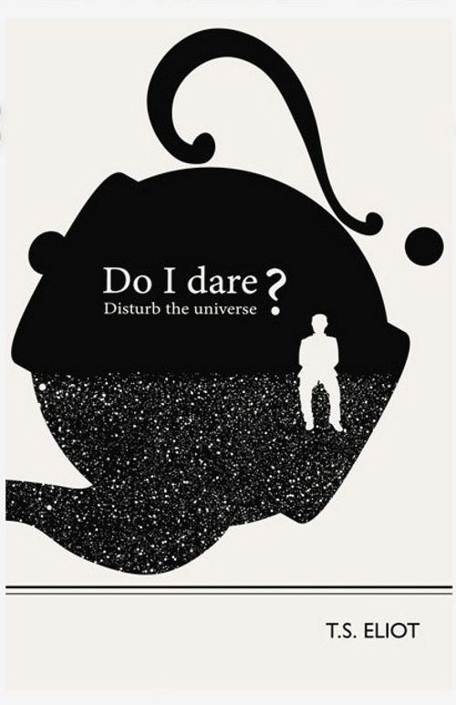
T.S. ELIOT
The Lost Generation, Part II

Slide 2
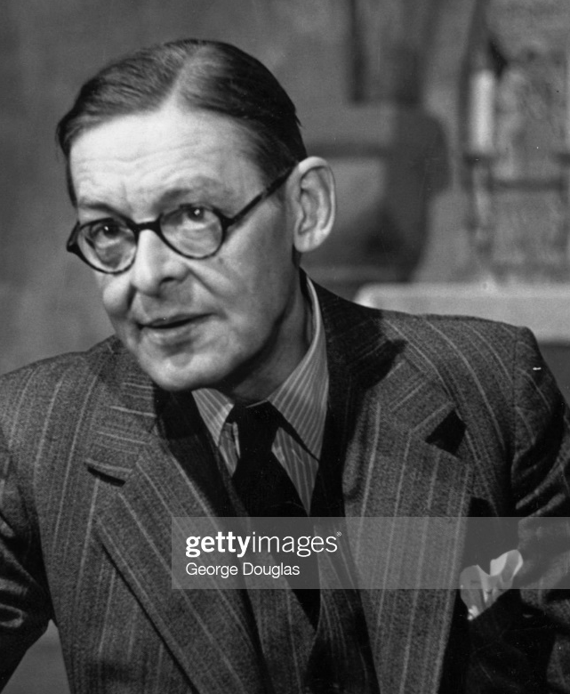
T.S. Eliot (1888-1965)
Health problems since childhood (“premature decrepitude”), aggravated by heavy smoking and alcohol abuse
Emotionally tormented by:
A. unsuccessful marriage to socialite Vivienne Haigh-Wood:
“To her, the marriage brought no happiness. To me, it brought the state of mind out of which came The Waste Land."
(Haigh-Wood eventually hospitalized for mental illness; TSE content at 68 with 2nd marriage to his secretary)
B. literary direction a “betrayal” of active male family tradition (3 U.S. Presidents)
Exceptional studies (classical letters and languages—Greek, Latin, Sanskrit; philosophy; French); taught himself Italian to read Dante in the original
Early turn to literature and college teaching--> banker→Faber and Faber publishing director
Expatriation (and religious conversion to High Anglicanism) as a way to discover personal happiness
Modernity VS Dante’s age, “Golden” ages of Pericles and Elizabeth, Christianity

Slide 3
Critical views
“Poetry is...an escape from emotion” (New Criticism):
crystallization of emotions into “feelings”
“objective correlative” (key to controlled interpretation)
“mythical method” (mythical blueprint to order meaning)
Poetry elusiveness:
“So here I am, ... having had twenty years— Twenty years largely wasted... Trying to use words, and every attempt Is a wholly new start, and a different kind of failure....
...And so each venture Is a new beginning, a raid on the inarticulate With shabby equipment always deteriorating. (East Coker, 172-180)
Small poetical production (also plays, essays), but gems of craftsmanship and art
1948 Nobel Prize in Literature

Slide 4
“The Love Song of J. Alfred Prufrock” (1915)
The allusion game:
A. epigram from Dante’s Inferno
B. Michaelangelo refrain
C. “There will be time” (allusion to Andrew Marvell’s “To His Coy Mistress” and to Ecclesiastes)
D. John the Baptist and Lazarus
E. Hamlet
Description of environment (outside/inside/imagined sea)→tone
What is the “overwhelming question”? Why can’t he ask it?
What is Prufrock’s problem?
Title irony
Read the comic-book adaptation at:
https://julianpeterscomics.com/page-1-the-love-song-of-j-alfred-prufrock-by-t-s-eliot/

