Slide 1
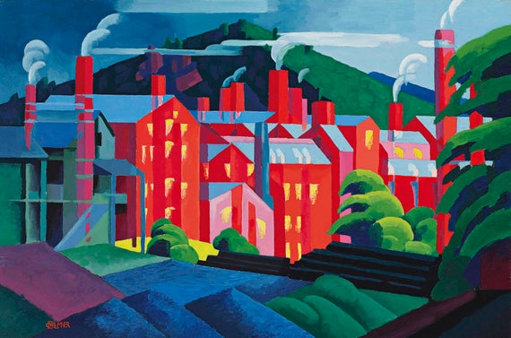
The 20th Century and Modernism

Slide 2
Modernism
Trauma of wars (especially World Wars) leads to: a. embrace, b. denial/escape, c. understanding and redress
A. love of “make it new” (Ezra Pound, 1934) and worship of machine, youth, war (Tommaso Marinetti’s “Manifesto of Futurism”: “A locomotive is more beautiful than the Mona Lisa”)→fascism, Low Modernism
B. classic culture, oriental influence, elaborate craftsmanship and erudition VS fragmentation, degradation→ High Modernism
C. exploration of the unconscious (automatic writing, surrealism, language experiments) and socialism/innovation against establishment values: poetry for the masses (minorities, the proletariat), symbolism, avant-garde, agrarian/regional themes

Slide 3
“The Lost Generation” vs “Home” poets
American expatriates (Ezra Pound, Amy Lowell, T.S. Eliot) incept modernism in Europe
The Prohibition (1920-33) in “The Roaring Twenties” (extravagant mafia capitalism)
New York Dada (1915-1923) and the Harlem Renaissance (1918-1929)
The “Agrarians”/ “Home Poets”: praise of quiet rural America and its regional differences
The Great Depression (1929-1939) ends first phase of U.S. modernism, but feeds its future

Slide 4
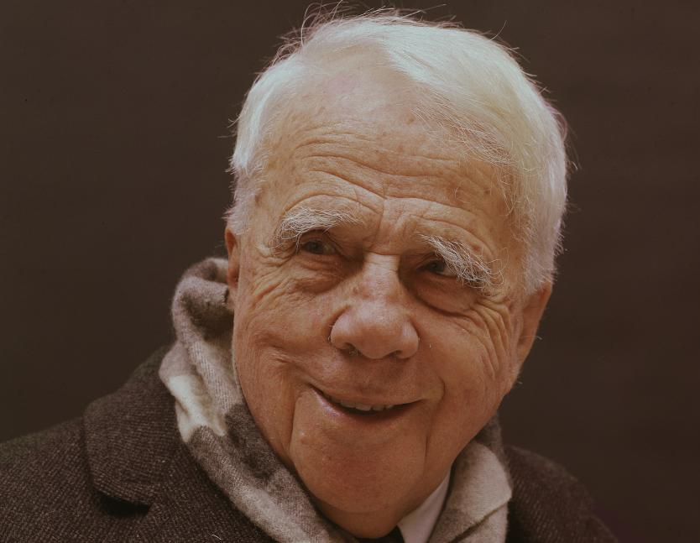
Robert Frost (1874-1963)
Regionalism (New England rural), symbolism, modernist themes and diction but traditional forms
Moved to England briefly to find fame, came back at 40 with it; read poet for JFK’s inauguration, enjoyed favored poet status and household-brand name, 4 Pulitzers; lifelong battle against depression
From epigrams (“Fire and Ice”) to short emblematic poems (“Stopping by the Woods on a Snowy Evening,” “The Road Less Travelled”) to long dramatic poems (“Death of a Hired Man”) with natural/ist themes
Poetry as “a momentary stay against confusion”

Slide 5
“The Road Not Taken”
Two roads diverged in a yellow wood, And sorry I could not travel both And be one traveler, long I stood And looked down one as far as I could To where it bent in the undergrowth;
Then took the other, as just as fair, And having perhaps the better claim, Because it was grassy and wanted wear; Though as for that the passing there Had worn them really about the same,
And both that morning equally lay In leaves no step had trodden black. Oh, I kept the first for another day!
Yet knowing how way leads on to way, I doubted if I should ever come back.
I shall be telling this with a sigh Somewhere ages and ages hence: Two roads diverged in a wood, and I— I took the one less traveled by, And that has made all the difference.
From The Poetry of Robert Frost, edited by Edward Connery Lathem. Copyright 1923, © 1969 by Henry Holt and Company, Inc., renewed 1951, by Robert Frost. Reprinted with the permission of Henry Holt and Company, LLC.

Slide 6
“Stopping by the Woods on a Snowy Evening”
Whose woods these are I think I know. His house is in the village though; He will not see me stopping here To watch his woods fill up with snow.
My little horse must think it queer To stop without a farmhouse near Between the woods and frozen lake The darkest evening of the year.
He gives his harness bells a shake To ask if there is some mistake. The only other sound’s the sweep Of easy wind and downy flake.
The woods are lovely, dark and deep, But I have promises to keep, And miles to go before I sleep, And miles to go before I sleep.
From The Poetry of Robert Frost, edited by Edward Connery Lathem. Copyright 1923, © 1969 by Henry Holt and Company, Inc., renewed 1951, by Robert Frost. Reprinted with the permission of Henry Holt and Company, LLC.

Slide 7
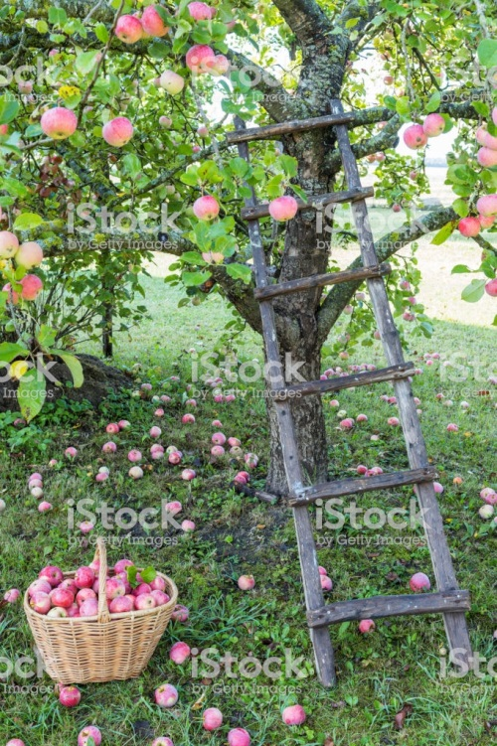
“After Apple Picking”
Symbols: various apple(s)
Winter season
Apple-picking activity
Final “sleep” as “woodchuck” or as human? What’s the difference?

Slide 8
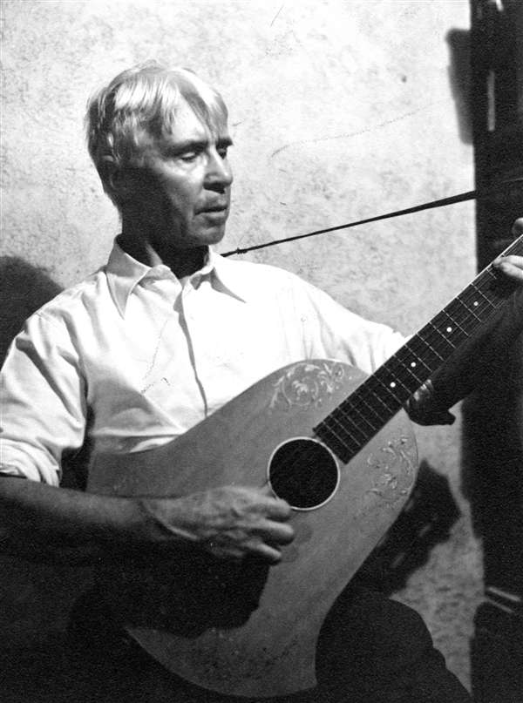
Carl Sandburg (1878-1967)
Started life on a series of working-class manual jobs; then Chicago journalist
Beloved author and poet-urban folk singer (guitar recitals); 3 Pulitzers
Affinity for workers, African-Americans

Slide 9
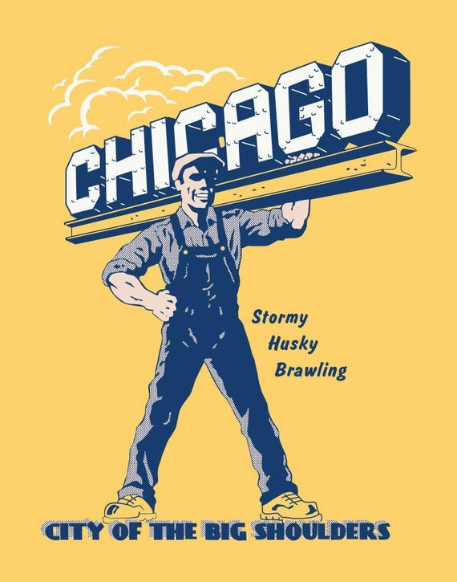
“Chicago”
Apostrophe (ode)
Tone, epithets selected
Why this focus on workers?
Why repetitious (cyclical)
ending?

