Slide 2
Mon 11 Nov. Wed 20 Nov.
Schedule, Fall 2022-2023
ΠΜΣ/ ΔΠΜΣ
MA, specialization ‘ Translation Studies and Interpreting’
MA ‘Translation: Greek, English, Russian’
 | Mon | Tue | Wed | Thu | Fri
9.00-12.00 | κα Κόρδα | κ. Ιντζίδης | 803 κα Σιδηροπούλου Research | κα Χατζηδάκη
 |  |  | Methodology in Translation Studies
12.00-3.00 | ΔΠΜΣ |  | ΠΜΣ κα Μπορίσοβα

Slide 3
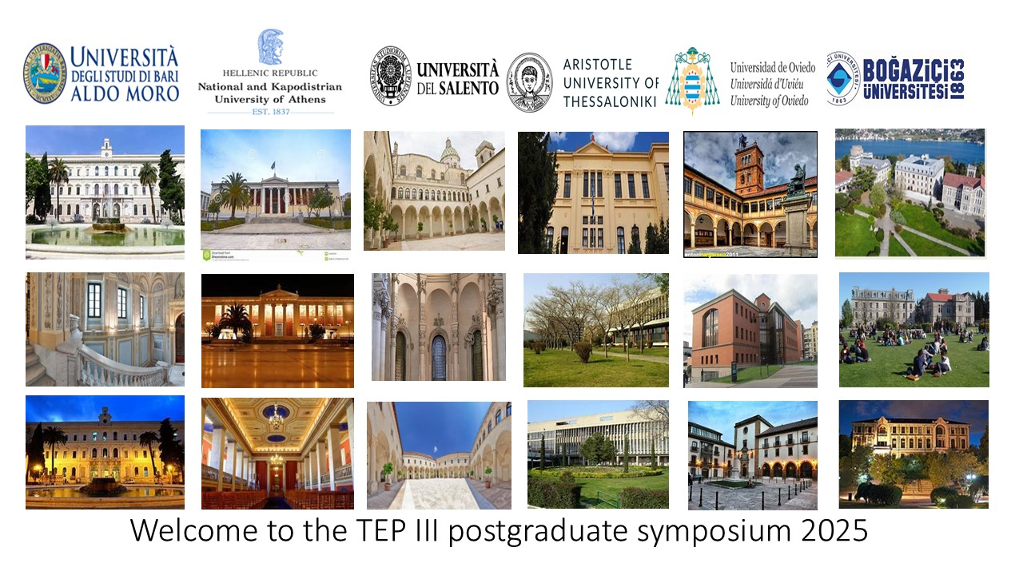

Slide 4
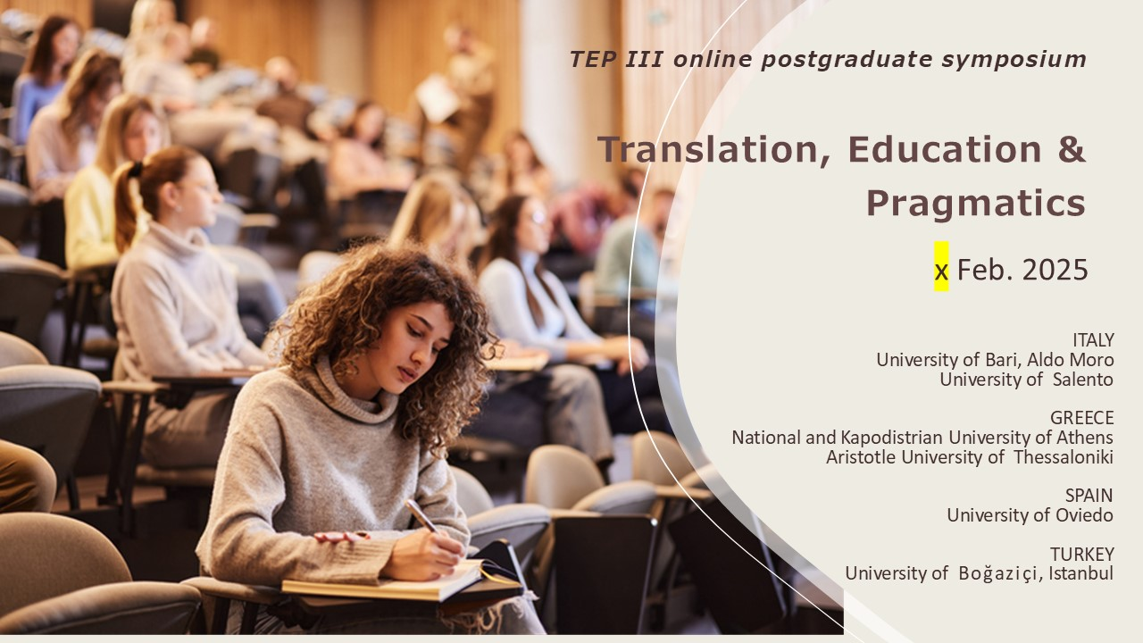

Slide 5
experimental pragmatics
Attempts to test pragmatic theories using experimental psychological methods have given birth to the promising field of experimental pragmatics
whilst psycholinguists have tended to evaluate their insights into linguistic phenomena on the basis of experimental evidence, pragmaticists have traditionally opted to rely mainly on their own intuitions about how an artificial or naturally occurring utterance would be/is presumably interpreted
Leppihalme’s investigation of the responses of Finnish readers to allusions in texts translated from British EN

Slide 6
utterance(s) trigger implicature(s)
Implicature in film can be defined as any assumption intended by the filmmakers which is implicitly and non-conventionally communicated in the film dialogue.
The utterance(s) that trigger the implicature(s) are intended by the filmmakers to evoke a specific context: background knowledge will be triggered in the form of implicated premises while the information readily conveyed via the film’s image and sound will be selected as immediate contextual premises

Slide 7
methodology
The proposed methodology for the investigation of implicatures in subtitled film consists of three stages: multimodal transcription, pragmatic analysis and experimental testing of implicature comprehension by actual source and target viewers (Desilla, 2009/2012)

Slide 8
stages of methodological design
(a) operationalising utterance comprehension, which is inextricably linked with the formulation of research questions, and
(b) measuring utterance comprehension.
Comprehension of implicatures in Bridget Jones’s Diary (2001) and Bridget Jones: The Edge of Reason (2004) by British and Greek viewers

Slide 9
research questions driving the experimental study
To what extent can the source-audience (SA) and target audience (TA) understand the implicatures that the filmmakers intended to communicate? Does the intuitive pragmatic analysis represent a realistic account of implicature comprehension by the SA and TA?
To what extent is the TA’s comprehension of implicatures similar to that of the SL viewers?
What is the contribution of non-verbal semiotic resources to implicature comprehension by the two audiences?

Slide 10
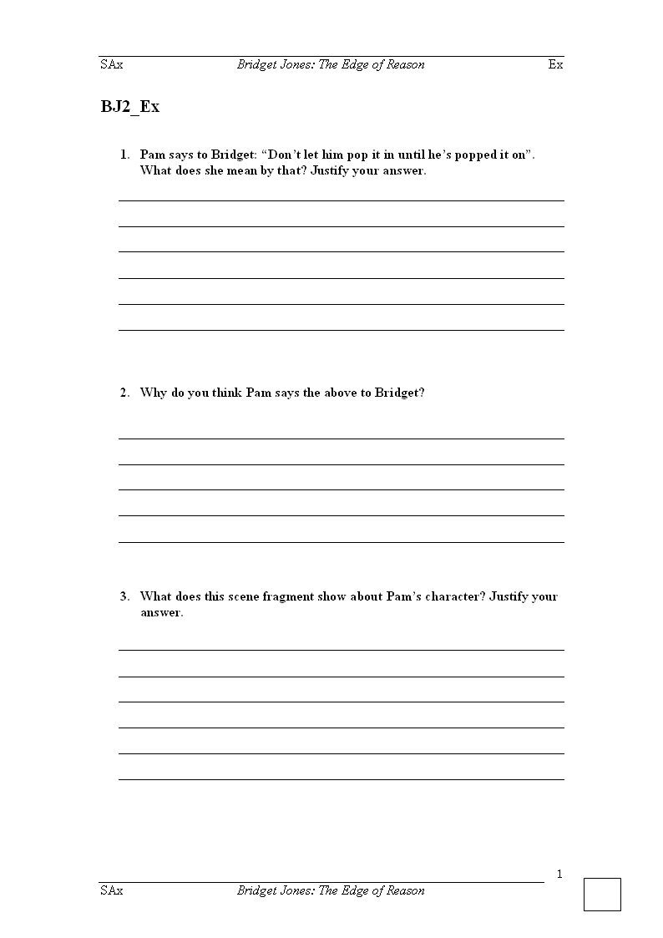
  Measuring the variable

Slide 11
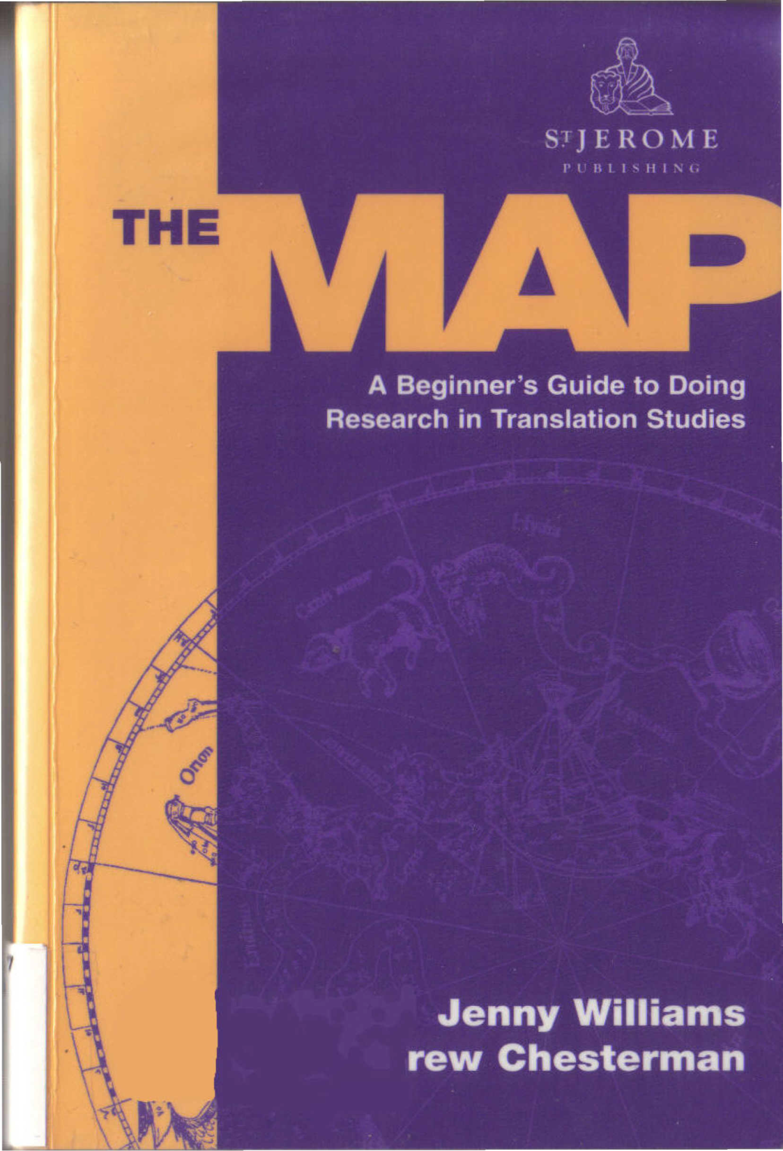
I. Areas in Translation Research
2. From the Initial Idea to the Plan
3. Theoretical Models of Translation
4. Kinds of Research
5. Questions, Claims, Hypotheses
6. Relations between Variables
7. Selecting and Analyzing Data
8. Writing Your Research Report
9. Presenting Your Research Orally
10. Assessing Your Research

Slide 12
Conceptual and empirical research
Conceptual research/Hermeneutics: (for humanistic disciplines) the science of interpretation
It clarifies concepts, re/interpret ideas, relates concepts into larger systems
(e.g. what do you see translation as? Making a cake? doing a jigsaw puzzle? performing a piece of music?)
*
Empirical research/Positivism (focus on data and hard science)
It seeks evidence which dis/confirms hypotheses

Slide 13
Η προφήτισσα Κασσάνδρα ως πολιτισμική μεταφράστρια:
‘Κι όμως, αλίμονο, ελληνικά ξέρω καλά’
Βασισμένη στο έργο θεωρητικών του πολιτισμού και της πολιτισμικής μετάφρασης, η μελέτη αυτή επικεντρώνεται σε μία πτυχή της τραγωδίας του Αισχύλου Αγαμέμνων—πρώτου μέρους της τριλογίας της Ορέστειας—που αφορά στο πρόσωπο της καταραμένης προφήτισσας Κασσάνδρας, αιχμάλωτης του Αγαμέμνονα. Δεδομένου ότι κάθε προφητεία αποτελεί ουσιαστικά μία αναγκαστικά ατελή μετάφραση, από το άτομο που έχει το διαμεσολαβητικό (άρα μεταφρα­στικό) χάρισμα, της σκοτεινής θείας βούλησης σε λόγο υποτιθέμενα κατανοητό από τους ανθρώπους, έτσι και ο λόγος της Κασσάνδρας στον Αγαμέμνονα εξελίσσεται σε μία συγκεκριμένη ατραπό που είναι ταυτόχρονα διαπολιτισμική, διαγλωσσική και διακειμενική. Από τον αρχικό ακατάληπτο λόγο του προφητικού σπασμού, την ποιητική μα «ξένη» προς τον χορό των Αργείων γλώσσα, η προφήτισσα περνά στην μαντική πρόβλεψη με λόγο στρωτό μεν μορφολογικά, σκοτεινού νοήματος δε, εφόσον μιλά για τα μελλούμενα που προς το παρόν είναι αδιανόητα για τους Αργείους. Η μετάφραση ολοκληρώνεται με την Κασσάνδρα να αφομοιώνεται η ίδια μόνιμα στο νέο της χώρο μέσω του σφαγιασμού της. Μόνο τότε γίνεται η προφητεία /μετάφρασή της τέλεια αντιληπτή απ’ το Χορό, όταν δηλαδή η μεταφράστρια εξαϋλωθεί στη λειτουργία μίας τέλειας (μεταφυσικής), άρα διαφανούς ως προς τον δίαυλό της, επικοινωνίας, πραγματώνοντας την ίδια την προφητεία της στο ακέραιο και αρχίζοντας να επηρεάζει πολιτισμικά πια το νέο της περιβάλλον.

Slide 14
Characteristics of Empirical Research
Empirical science has two major objectives: to describe particular phenomena in the world of our experience and to establish general principles by means of which they can be explained and predicted. The explanatory and predictive principles of a scientific discipline are stated in its hypothetical generalizations and its theories; they characterize general patterns or regularities to which the individual phenomena conform and by virtue of which their occurrence can be systematically anticipated (Toury 1995:9)

Slide 15
Features of empirical research:
Particular/general
Scholars in translation studies ARE interested in describing particular instances of phenomena, but they also generalize, abstract away from the particular in order to understand the larger picture (e.g. features shared by all translators_universals)
Describing/ explaining
Relating a phenomenon to a more general principle, analyze it down to its parts, what is the significance of the phenomenon. All this explanatory knowledge increases understanding
Predicting
In the natural sciences, if we know the causes of sth we can predict when it will occur. Predictions can be deterministic (100% certain) and probabilistic (<100%)

Slide 16
Subtypes of empirical research naturalistic vs. experimental
Naturalistic
Investigating a phenomenon in real life without interfering with the process (e.g., investigate the working habits of professional translators, how they revise their work…). The observer might also gather material through questionnaires or interviews. Observation may also be done by video or a programme (Translog)
Triangulation: a third source of evidence
(e.g. translations, keynote data, protocols)

Slide 17
Subtypes of empirical research naturalistic vs. experimental
Experimental
The researcher deliberately interferes with the natural order of things to isolate a particular feature and eliminate other non-relevant features… e.g. observing how professional and trainee translators revise their work: you give them the same translation task and the same deadline and you see how they operate…
e.g. Giles describes an experiment on the assessment of fidelity in consecutive interpreting…(Target 7(1), 1995)
e.g. using protocols under experimental conditions to see how they use reference works…(to minimize artificiality, ask them to work in pairs?)

Slide 18
Qualitative vs. quantitative research
Qualitative research: conclusions about what is possible, what can happen (not what is probable, universal)
(more subjective)
Quantitative research: conclusions about the generality of a phenomenon, by measuring, counting things or comparing statistically, in corpus-based studies
(more objective)

Slide 19
Examples of empirical research methods
Case studies
(for unique instances of translation practice, explorative, descriptive or explanatory) e.g. why a particular play did not appeal to the local audience in its Finnish version? (Leppihalme 2000: the translation was to blame!)
Corpus studies
Building very large archives of textual data (parallel or comparable)
As a resource for translators and for pedagogical reasons, terminological research
Survey studies
How widespread a phenomenon is/ through questionnaires and interviews
Historical and archival studies
Analysis of existing records and information, through bibliographies or historical records.

Slide 20
Applied Research
To recommend some good use of particular research results or conceptual analysis, e.g. in meeting some social need (translation policies in multilingual communities/development of electronic translation tools/dictionaries/ computer programmes for analyzing corpora).
It is prescriptive, but based on descriptive evidence.

Slide 21
Course: Research methodology in translation studies
Unit 5: Questions, claims, hypothesis
Prof. Emerita M. Sidiropoulou
MA in TRANSLATION STUDIES AND INTERPRETING
MA in TRANSLATION: GREEK, ENGLISH, RUSSIAN

Slide 22
Asking good questions is one of the secrets of research
(for conceptual research)
How can x best be defined?
(for descriptive research)
What is this translation like compared to the ST?
How are these translators different from non-translated texts
How has the translator dealt with proper names?
What are the frequencies of relative and main clauses in these translations and in the comparable non-translated texts?
(for explanatory research, causes and effects)
Why was this novel translated and not that one?
How did the general public react to this new Bible translation?
Why are there so many more relative clauses in these translations?

Slide 23
Arriving at potential answers & making reasonable claims by logical analysis
Can I make any generalizations about the differences between retranslations?
(later translations are closer to the ST)
Do my results suggest that the retranslation hypothesis needs to be modified? (claim about a hypothesis)
Do my results relate to research in other areas of translation studies? (universal features of translation)

Slide 24
Four kinds of Hypotheses
A hypothesis may simply arise from intuition
Interpretive Hypothesis
Something can be usefully described as, or seen as, or interpreted as something else. (How can we interpret the social role of a translator? Cronin 2000: translators are travellers, nomads…)
Descriptive Hypothesis
An empirical claim about generality: translations tend to be more explicit, longer and more conventional than STs, technical translators in a country tend to be paid more than literary translators…
Explanatory Hypothesis
After selecting evidence, you might be able to propose an explanatory hypothesis about why a translator may be using a lot of footnotes/ why the client did not like a translation they commissioned.
Predictive Hypothesis
Conditions or factors x may influence phenomenon y. E.g., if a translator preserves metaphors, the critics may like the result. In literary translation, we should preserve metaphors…

Slide 25
Hypothesis testing distinguishes scientific work from other ways of searching for knowledge
Operationalizing
Because hypotheses are often rather abstract, we have to reduce them to concrete terms to be tested: e.g. by ‘closer to the original’ I mean x number of structural shifts per 100 words. Ensuring reliability
Degrees of testability
An empirical hypothesis should be falsifiable (all ravens are black).
Hypotheses, formulated as tendencies, are weaker but should be testable.
If a hypothesis cannot be tested its consequences may be testable.

Slide 26
Hypotheses tested on four criteria
Added value; it brings new understanding, it is genuinely interesting
Comparative value; in what respect is it better than other hypotheses?
Internal value: Is it logical? Elegant? Plausible?
Data; does it accurately represent the empirical evidence?

Slide 27
Science does not proceed by piling up truths but by developing better and better hypotheses
An empirical test may support a hypothesis or corroborate it.
A research project may start with two opposing hypothesis (e.g. generalization/specification) to check which is supported
(In Translation studies, the results of a single test are seldom conclusive).
Hypothesis testing pertains to the scope of a claim. Tests may narrow the scope of a claim [the retranslation hypothesis works only for fiction (?)]
If a hypothesis is not supported, this may be an interesting result in itself, which may raise new questions

Slide 28
What type of hypothesis does this paper support?
Brecht in dark times: Translations of his works under the Greek junta (1967–1974) Dimitris Asimakoulas, University of Manchester
This paper will place Brecht’s published works within the socio-political context of the Greek junta (1967–1974). After preventive censorship was lifted in 1969, a massive import of Brecht’s works occurred. Brecht was immediately incorporated in the recently established tradition of serious books addressing important social issues, bringing the reader closer to modern thought and kindling the desire for democracy. Two of the most influential publishers of the time published Brecht’s works and actively subscribed to this trend of defiance against the regime in the publishing industry. The publishers’ activity as well as the content and paratextual elements of Brecht’s works launched constituted instantiations of the discursive motif of dark times introduced by Brecht himself to describe oppression and distortion of truth.

Slide 29
Politeness Theory and Relational Work
Miriam A. Locher / Richard J. Watts
Published Online: JPR 2005-07-27
In this paper we briefly revisit politeness research influenced by Brown and Levinson's (1987) politeness theory. We argue that this research tradition does not deal with politeness but with the mitigation of face-threatening acts (FTAs) in general. In our understanding, politeness cannot just be equated with FTA-mitigation because politeness is a discursive concept. This means that what is polite (or impolite) should not be predicted by analysts. Instead, researchers should focus on the discursive struggle in which interactants engage. This reduces politeness to a much smaller part of facework than was assumed until the present, and it allows for interpretations that consider behavior to be merely appropriate and neither polite nor impolite. We propose that relational work, the “work” individuals invest in negotiating relationships with others, which includes impolite as well as polite or merely appropriate behavior, is a useful concept to help investigate the discursive struggle over politeness. We demonstrate this in close readings of five examples from naturally occurring interactions. Keywords: politeness; impoliteness; face; relational work; facework

Slide 30
Politeness and in-directness across cultures: A comparison of English, German, Polish and Russian requests
Eva Ogiermann Published Online: 2009-07-15 JPR
This paper provides insights into cross-cultural variation in speech act realization by analyzing English, German, Polish and Russian requests. It aims to show that the relationship between indirectness and politeness is interpreted differently across cultures. Hence, the analysis focuses on the difference between direct requests, which have been said to play a central role in Polish and Russian, and conventionally indirect requests, which are the most frequent request type in English and German. It further shows that the examined languages exhibit culture-specific preferences for syntactic and lexical downgraders modifying the illocutionary force of the request and, thus, reducing the threat to the hearer's face.
The requests analyzed in this study have been elicited by means of a discourse completion task and constitute responses to a scenario frequently used in previous request studies, so that the results can be compared with those established for other languages. The strong agreement among languages on the use of conventional indirectness in this scenario allows for testing the restricted applicability of interrogative constructions claimed for the two Slavic languages.

Slide 31
Impoliteness and Entertainment in the Television Quiz Show:
The Weakest Link
Jonathan Culpeper Published Online: 2005-07-27 JPR
Building on Culpeper (1996) and Culpeper et al. (2003), I first propose a new definition of impoliteness and general revisions to my model of impoliteness, both derived from data analyses. Given that my particular data in this paper, The Weakest Link, is a television entertainment quiz show, I will briefly account for why impoliteness might be entertaining. As a backdrop to my micro-analyses of interactions, I discuss the nature of “exploitative” chat and game shows, and I examine the structure of The Weakest Link and how it maximizes the potential for face-damage. In my analyses, I show the formulaic and creative nature of parts of the discourse, and also how analyzing prosody is key to understanding the impoliteness. I pay special attention to “off-record impoliteness”, sarcasm and mimicry, and I integrate into my model Spencer-Oatey's (2002) revisions of Brown and Levinson's (1987) concepts of negative and positive face. Finally, referring to Levinson's (1992) “activity types”, I consider whether the context of the quiz show “neutralizes” the “impoliteness”. I argue that the salience of “impolite” signals engulf the context, with the result that targets often take offense in contexts where they theoretically should not. Keywords: impoliteness; mimicry; politeness; prosody; quiz shows; sarcasm

Slide 32
Gender and impoliteness
Sara Mills Published Online: 2005-07-27
This article analyzes the complex relationship between gender and impoliteness. Rather than assuming that gender and impoliteness are concrete entities which can be traced in conversation, I argue that gender and impoliteness are elements which are worked out within the course of interaction. They are elements which are closely inter-related as stereotypically feminine gender identity is largely constructed around notions of “nice”, supportive, co-operative behaviour, either affirming or resisting those stereotypes of femininity. Challenging the notion that women as a whole are “nicer” than men in interaction, since much current research seems to highlight women’s interactional competitiveness, I argue that nevertheless supportiveness may play a role in other interactants’ judgments of women’s linguistic behaviour and may result in assertiveness being categorized as impoliteness.
Keywords: Gender; impoliteness; politeness; assertiveness; co-operativeness; nice

Slide 33
Identity and impoliteness: The expert in the talent show Idol
Pilar Garcés-Conejos Blitvich / Patricia Bou-Franch/ Nuria Lorenzo-Dus Published Online: 2013-01-18
Premised on the belief that both identity construction and im/politeness assessments relate to norms associated with genre practices, the aim of this paper is to examine the interconnections between identity co-construction and impoliteness in a media genre: the talent show. This aim is innovative in so far as im/politeness has traditionally been related to the notion of face, rather than identity. Our study draws upon a corpus of 160 interactional sequences from the UK and US versions of the talent show Idol. All sequences in the data include music expert Simon Cowell, who has been singled out as playing the role of the malicious judge by both journalists and scholars. However, to our knowledge, no previous study has undertaken a micro-analysis of the linguistic resources deployed by Simon Cowell to construct his expert identity or has examined the role that impoliteness may play therein. This is what we set out to do in this paper. To that end, our analytic framework combines socio-constructivist approaches to identity construction (Anton and Peterson 2003; Joseph 2004; Bucholtz and Hall 2005; De Fina et al. 2006) with a recently revised, discursive approach to im/politeness, i.e., the genre approach (Garcés- Conejos Blitvich 2010, this issue).
Keywords: Identity; impoliteness; talent show; genre; expert; reality television

Slide 34
A study into politeness strategies and politeness markers in Jordanian print advertisements as persuasive tools
Sadam Issa Published Online: 2017-02-02
This study seeks to investigate the socio-pragmatic and persuasive functions of politeness in Jordanian print advertisements. Specifically, the study is concerned with the linguistic politeness strategies the Jordanian ads deploy in order to persuade the potential Jordanian customers of their products. Brown and Levinson’s (1987) seminal work as well as Watts’ (2003) and Spencer-Oatey’s (2005) research on politeness provide the framework for this study. My study is based on examining linguistic politeness as linked to social relationships (Christie 2005), in that “‘ways of putting things’ ... are part of the very stuff that social relationships are made of” (Brown and Levinson 1987: 55). It is believed that the success of the ads hinges on their politeness and persuasion strategies that appeal to the socio-economic and cultural specificities of Jordanian society. To this end, 200 Jordanian ads were collected from Al-Ghad, Al-Rai, and Ad-Dustour, the major Jordanian newspapers. The ads’ messages were analyzed to highlight their politeness strategy category and subcategory and their frequencies were computed. This study was conducted on the assumption that the ads would use more positive politeness strategies to establish rapport with the customers in the hope of winning the approval of their products. Keywords: Politeness; politeness strategies; persuasion; Jordanian print advertisements

Slide 35
Children’s early awareness of the effect of interpersonal status on politeness
Yupin Chen Published Online: 2017-02-02
This study discusses two Mandarin-speaking children’s linguistic politeness through longitudinally observing their uses of request forms with regard to different interactional situations where their interpersonal status may vary accordingly. It seems that the children demonstrate a systematic correspondence between request forms and directness to adhere to politeness at an early age. Although they apparently prefer to utilize comparatively more direct request forms most of the time, a closer investigation reveals a division of labor: they appear to use simple imperatives when their interpersonal status is either superior or equal to their parents and use declaratives with the lexeme WANT when their interpersonal status is inferior. It is therefore suggested that politeness may be mutually negotiated between interlocutors and that children should get socialized with politeness through interaction with adults or other children within various social or interpersonal relationships.

Slide 36
Off-record politeness in Sophocles: The patterned dialogues of female characters
Marco Catrambone Published Online: 2016-06-15
This paper tests the applicability of Brown and Levinson’s concept of off-record politeness on a specific sub-set of patterned dialogues in Sophocles’ extant tragedies, i.e., those involving the participation of female speakers. Brown and Levinson’s framework still provides the most suitable model for empirical analysis, but with refinements concerning the interrelation between emic and etic politeness, the notion of face, the extension of analysis to longer stretches of conversation, and the absolute ranking of the super-strategies. The survey suggests that a strict connection between the use of off record and the mitigation of FTAs can be established quite straightforwardly and that the hearer’s reactions to off record can help to identify the valid instances of the phenomenon. Moreover, it is argued that (a) female speakers frequently resort to off record, most notably in cross-sex interactions with men invested with high power; (b) few restricted categories of male speakers, i.e., strangers and lower-status characters, do use off-record politeness towards women; (c) off record in same-sex interactions among female characters is limited to when the imposition is of extraordinary seriousness.

Slide 37
The stranger on the threshold. Telemachus welcomes Athena in Odyssey 1.102–143: a case study of polite interaction in ancient Greek culture Francesco Mari Published Online: 2016-06-15
Homeric epics are rich in paradigmatic scenes, where it is not inappropriate to look for examples of Greek polite social behaviour. This paper proposes an analytical framework to study ancient Greek politeness, and applies it to a famous scene of the Odyssey: the arrival of the goddess Athena, disguised as the old stranger Mentes, at the door of the royal palace of Ithaca, where she is welcomed by Ulysses’ son Telemachus. The stranger’s welcome in Homer is a very formal ritual following a well ordered pattern, which is made by several steps that require a high level of cooperation between the householder and his guest. My interpretation of Telemachus’ behaviour toward Athena-Mentes is based on the analytical categories developed by Erving Goffman to understand the everyday behaviour code. I take into consideration two main variables: the distribution of authority that characterizes the social situation of Ulysses’ palace and its social density, defined as the degree to which people are in each other’s presence and hence under each other’s surveillance. A close analysis of these variables within the social situation is helpful in defining its members’ social expectations towards each other, and, thus, highlighting which behavioural norms are enforced by the social situation itself.

Slide 38
Polite like an Egyptian? Case Studies of Politeness in the Late Ramesside Letters Kim Ridealgh Published Online: 2016-06-15
The Late Ramesside Letters, a corpus of over 70 personal communications written in Late Egyptian, form one of the most complete letter collections from ancient Egypt (c. 1099–1069 BCE). A key feature of ancient Egyptian letter writing is the adherence to the social positions of, and relationships between, the interlocutors, allowing scholars to reconstruct the hierarchical network of individuals directly and indirectly included in the corpus. From this understanding, how can modern scholars discern what was considered to be ‘polite’ communicative behaviour within these relationships and how can developments in historical politeness help us do this? This article will explore three case studies surrounding different aspects of politeness research: first-order politeness, facework, and discernment politeness in order to explore the phenomenon of ‘politeness’ in Late Egyptian and reflect on the suitability of current politeness frameworks for the analysis of the Late Ramesside Letters.

Slide 39
Conceptualizing conversational humour as (im)politeness: The case of film talk Marta Dynel Published Online: 2016-02-02
This paper addresses the methodology and theory of research on conversational humour in the context of (im)politeness theory, focusing on the production and reception ends (the speaker’s intention and the hearer’s evaluation respectively). In the light of a critical overview of the relevant scholarship from both humour and impoliteness studies, several notions are elucidated, such as mock (im)politeness or banter. Generally, conversational humour forms may give rise to face-saving and rapport, thereby subscribing to (solidarity) politeness; and/or face-threat and conflict indicative of impoliteness. Moreover, impoliteness can be viewed as a source of humour in its own right, especially in media entertainment discourse. Additionally, one utterance may invite diverging evaluations on the part of the various participants, depending on their interactional statuses: the butt/target or the receiver of humour, which is most pronounced in media discourse. This discussion on the interdependence between humour and (im)politeness is conducted with reference to film talk and is illustrated with humorous extracts taken from the American series entitled “House”.

Slide 40
The face of others: Triadic and dyadic interactions in Korea and the United States
Hunter Hatfield / Jee-Won Hahn Published Online: 2014-07-02
The concept of group face has been used to explain facework that relates to members of in-groups. Hahn and Hatfield (2011) looked at situations in which a family member of a Speaker commits a possible offense towards a Hearer. They tested the prediction that collectivist Koreans would apologize for the family member at a greater rate than individualist Americans who would be focused upon individual face not group face. This prediction was not confirmed as the chance of an apology for the two groups was not significantly different among the university students participating. Interpreting speaker responses in such triadic interactions, however, was difficult because there was no comparison point to classic dyadic interactions. Without this comparison the facework performed could be unrelated to group face. The current paper creates this comparison point by adapting the methods of Hahn and Hatfield for dyadic interaction. A Discourse Completion Task was given to 80 speakers. There was no significant difference in apology rates between the two countries in either the triadic or dyadic studies, plus a complex interaction of each factor with Gender. The results argue for the significance of face management of individuals and groups not in immediate interaction, which has implications for the distinction of face and identity.

Slide 41
Rethinking Discernment (the ability to judge well.)
Dániel Z. Kádár/ Sara Mills Published Online: 2013-06-28
This article engages with the notions of discernment and volition, developed by Ide (1989), in order to consider how the concept which these phenomena describe could be reintroduced into second-wave critical analysis of politeness and impoliteness. It is our contention that these terms have been used in a way which polarizes cultures, so that various East Asian cultures are characterized as ‘discernment cultures’ whilst Western cultures are seen as ‘volitional’. We argue that this polarization is problematic as it does not capture politeness behaviour beyond certain stereotypes, and as such it fails to address the complexities with which a cross-cultural examination of politeness needs to cope. Nevertheless, we believe that the cross-cultural phenomenon which Ide attempted to capture should not be completely ignored. Thus, we reconceptualize the notions of discernment and volition, by focusing on discernment, and we integrate this concept into a framework (Kádár 2013) based on convention and ritual, hence providing a way of using the term discernment in cross-cultural (and intercultural) analysis.

Slide 42
From Politeness1 to Politeness2: Tracking norms of im/politeness across time and space Marina Terkourafi
Increasing attention to the distinction between first- and second-order im/politeness has led to considerable soul-searching among theorists regarding which of the two should form the basis of a theory of im/politeness. In this article, I take an alternative path: I build on norms of Politeness1, as attested in influential texts laying out Politeness1 norms in different parts of the world from antiquity to this day, to extract from them the core elements of a theory of Politeness2. By affording us with some glimpses into the diachronic intertwining of Politeness1 and Politeness2, this analysis helps explain why it has been so difficult to keep these two notions apart in previous research. At the same time, it suggests some possible ways forward. Specifically, this survey reveals two overarching themes regarding the role of politeness (and, by implication, impoliteness) in these cultures. The first concerns the social regulatory role of Politeness1 norms, while the second concerns the relationship of Politeness1 norms with an underlying morality. I propose that these two elements should be placed at the heart of an empirically grounded theory of Politeness2

Slide 43
When is an email really offensive?: Argumentativity and variability in evaluations of impoliteness
Michael Haugh Published Online: 2010-03-15
The analysis in this paper centres on an email exchange between a lecturer and a student at the University of Auckland which resulted in the dismissal of that lecturer. This dismissal gave rise to significant controversy, both off- and online, as to whether the email itself was simply “intemperate” and “angry”, or more seriously “offensive” and “racist”. Through a close analysis of the interpretations of the emails by the lecturer and student, as well as online evaluations made on blogs and discussion boards, it becomes apparent that the inherent discursivity of evaluations of impoliteness arises not only from different perceptions of norms, but also from the ways in which commentators position themselves vis-à-vis these evaluations. It also emerges that the relative level of discursive dispute is mediated by the technological and situational characteristics of the CMC medium in which these evaluations occurred. It is concluded that research into various forums of online interaction provides a unique window into the inherent variability and argumentativity of perceptions of offensive behaviour, as a public record of discursive disputes surrounding particular alleged violations of norms of appropriateness can be (re)scrutinized in such forums.

Slide 44
Virtual community and politeness: The use of female markers of identity and solidarity in a transvestites' website
Gaëlle Planchenault Published Online: 2010-03-15
Displaying a positive face when joining an online community, i. e., demonstrating the will that one's face wants be desirable to fellow interlocutors can be a key to success for integration. A new member will often have to comply with the appropriate behaviour (a set of specific rules and codes adopted by the community of practice that he or she is joining) if s/he wants to be included and not rejected. And acceptance is particularly important for a marginal population such as transvestites. The data that I am working with in this article is drawn from “texts of introduction” written by members of a virtual community of transvestites for a French-speaking website. The goal of the website is clearly to establish an international community for its members. I use these introductory texts to address linguistic ideology and representations, especially regarding gender. Expectations about feminine talk and politeness, such as cooperation and avoidance of rude language (Holmes, Women, men and politeness, Longman, 1995), which can be related to the notion of verbal hygiene that Cameron (Applied Linguistics 15: 382–398, 1994: 383) defines as “ways of using language [which] are functionally, aesthetically, or morally preferable to others”, will be focused on in particular. Furthermore, I will show how, through this writing exercise, members participate in building a sense of community.

Slide 45
Politeness and leadership discourse in New Zealand and Hong Kong: A cross-cultural case study of workplace talk
Stephanie Schnurr / Angela Chan Published Online: 2009-07-15
[…]Drawing on naturally-occurring data recorded in business meetings in New Zealand and Hong Kong, and using Locher and Watts' (Journal of Politeness Research 1: 9–33, 2005) framework for analyzing relational work, this paper explores how leaders from two white-collar organizations achieve their various workplace objectives while simultaneously adhering to culture-specific politeness norms and expectations. The analysis focuses on just one of the discursive strategies which these leaders employ when performing relational work: humour. This strategy constitutes a versatile and multi-functional tool which assists leaders in achieving their various leadership objectives. It is particularly useful for building rapport with subordinates and mitigating the impact of negatively affective speech acts. The analysis explores how the leaders' use of humour is consistent with culturally specific politeness norms negotiated in the leaders' community of practice; and how by drawing on it the leaders also meet cultural expectations concerning the enactment of effective leadership.

Slide 46
Invitations and politeness in Greek: The age variable
Spyridoula Bella Published Online: 2009-07-15
This paper investigates invitations and invitation refusals in Greek and their rela- tionship to politeness within Brown and Levinson's (Politeness: Some Universals in Language Usage, Cambridge University Press, 1987) framework. On the basis of data drawn from role plays corroborated with informants' verbal reports, it is argued that age is a determining factor for both the format of the speech event of inviting/refu-sing and the politeness strategies preferred for its realization. It is shown that the younger age group conceptualize invitations as face-enhancing acts for the addre- ssee, thus, they insist more and prefer positive politeness strate- gies. By contrast, the older age group conceptualize invitations as addressee face-threatening acts, so they hardly ever insist and appear to favour negativepoliteness strategies. This latter obse- rvation seems to challenge earlier findings regarding the positive politeness orienta- tion of Greek society. However, a closer look at the data reveals that the negative poli- teness strategies employed are intermingled with positive politeness ones or they function as such in the specific context. These findings bring to the fore a number of issues relating to Brown and Levinson's theory, including the difficulty of drawing a clear-cut distinction between positive and negative politeness strategies and the cau- tion that should be exercised when attributing type of politeness to decontextualized utterances. The findings are further used to offer suggestions for EFL teaching.

Slide 47


