Slide 1
Lecture 6: The Great Depression
Κωνσταντίνος Ρεπαπής
Επίκουρος καθηγητής ΕΚΠΑ

Slide 2
Recap
1620 Tulipmania- a crisis of private credit that was transferable.
1720 Mississippi crisis- a crisis emanating from an overextension of paper credit.
1825 Banking crisis- a crisis emanating from the relation between the market, the banking sector and the central bank.
1873 Railroad Panic- another bubble in stocks that created a global financial crisis and a prolonged recession.
As the economy became more complex crises had many dimensions- financial, real, production etc.
Today we will discuss what became the signature crisis of the 20th century. The Great Depression. This crisis had a fundamental effect on political, social and economic conditions across the world and influenced hugely economics as a field of study.

Slide 3
The Great Depression
The economic crisis that began in 1929 soon engulfed virtually every manufacturing country and all food and raw materials producers.
  The countries involved in 1931 accounted for 55.6% of world GDP, That included all industrialised countries at the time.
In 1931, Keynes observed that the world was then:
“in the middle of the greatest economic catastrophe . . . of the modern world . . . there is a possibility that when this crisis is looked back upon by the economic historian of the future it will be seen to mark one of the major turning points” (Keynes, 1931)

Slide 4
The 1920s
The US became the vital engine for sustained recovery from the effects of WWI.
Following a rapid recovery from the post-war slump of 1920–1, Americans enjoyed a great consumer boom, which was heavily dependent upon the automobile and the building sectors.
High levels of investment, significant productivity advances, stable prices, full employment, tranquil labour relations, high wages, and high company profits combined to create the perfect conditions for a stock-market boom.
The US was linked to the rest of the world through international trade as the world’s leading exporter and second, behind the UK, as an importer.

Slide 5
The majority of the world’s economies were linked to each other by the gold standard, which had been suspended during WWI, but its restoration was considered a priority by virtually all the major economic powers.
  To policy-makers the gold standard represented a state of normality for international monetary relations.
The UK in 1925, returned to gold at the 1913 exchange rate after a deflationary squeeze had made this possible.
  This meant that the UK returned to the gold standard at an appreciated rate.
  Sterling was overvalued and Britain’s export industries were disadvantaged.
During the 1920s, UK unemployment was double the pre-1913 level and also higher than in all the other major economic powers.
  On average, in the 1920s, almost 10% of the UK insured workforce was unemployed.

Slide 6
Gold standard: Monetary situation
By 1929, US and France had accumulated nearly 60% of the world’s gold stock and their central banks sterilized much of their gold so that it did not inflate the money supply.
  In other words, both countries kept a high proportion of the world’s gold stock in their vaults and withdrawn from circulation.
As a result, other countries were forced to reduce the money supply in order to compensate for a shortage of reserves.
Gold shortages compelled UK policy-makers to impose relatively high interest rates in order to attract foreign funds to increase the country’s inadequate bullion reserves.
  Domestic investors suffered as the real cost of credit rose.

Slide 7
The crisis
In January 1928 the Federal Reserve ended several years of easy credit and embarked on a tight money policy. The Fed began a sale of government securities and gradually raised the discount rate from 3.5 to 5 %.
  The monetary authorities aimed gently to deflate the bubble on Wall Street by making bank borrowing for speculation progressively more expensive.
The new higher rates made more funds from non-bank sources available to the ever-rising stock market, and speculation actually increased.
  The interest rate increase acted more like a price leader than redirected resources to other non-stock market uses.
Many corporations used their balances to fund broker’s loans, and investors who normally looked overseas found loans to Wall Street a more attractive option.

Slide 8
Dow Jones Industrial Average
Date | Change | % Change | Close
October 28, 1929 | −38.33 | −12.82 | 260.64
October 29, 1929 | −30.57 | −11.73 | 230.07
On March 25, 1929, after the Federal Reserve warned of excessive speculation
The market had been on a nine-year run that saw the Dow Jones Industrial Average increase in value tenfold, peaking at 381.17 on September 3, 1929.
October 24, Black Thursday, the market lost 11% of its value at the opening.
October 28, Black Monday, the slide continued with a record loss of 38.33 points, or 13%
October 29, Black Tuesday, about 16 million shares traded as the panic selling reached its peak.
  Some stocks actually had no buyers at any price that day.
  The massive volume of stocks traded that day made the ticker continue to run until about 7:45 p.m.
  The market had lost over $30 billion in the space of two days, including $14 billion on October 29 alone
After a one-day recovery on October 30, when the Dow 12 %, to close at 258.47, the market continued to fall.
  On November 13, 1929, the Dow closed at 198.60.

Slide 9
After the stock-market collapse the Fed embarked on vigorous open-market operations and reduced interest rates.
  But broad money (M4) contracted substantially.
In late 1929 the market seemed to stabilize close to the level it had reached in early 1928. For several months it appeared that the US economy was recovering after a dramatic financial contraction.
However this was not the case in the real economy the contraction was unprecedented.

Slide 10
The Great Depression
UK and the USA
 | Real GDP | GDP deflator | Unemployment (%) | Stock market prices
UK
1929 | 100.0 | 100.0 | 8.0 | 100.0
1930 | 99.9 | 99.6 | 12.3 | 80.5
1931 | 94.4 | 97.2 | 16.4 | 62.8
1932 | 95.1 | 93.7 | 17.0 | 60.2
1933 | 96.0 | 92.5 | 15.4 | 74.3
1934 | 102.8 | 91.7 | 12.9 | 90.3
1935 | 106.6 | 92.6 | 12.0 | 100.0
1936 | 109.9 | 93.1 | 10.2 | 115.9
1937 | 114.7 | 96.6 | 8.5 | 108.0
1938 | 118.2 | 99.3 | 10.1 | 88.5
USA
1929 | 100.0 | 100.0 | 2.9 | 100.0
1930 | 91.4 | 96.4 | 8.9 | 69.4
1931 | 85.6 | 86.3 | 15.6 | 35.8
1932 | 74.4 | 76.2 | 22.9 | 30.8
1933 | 73.4 | 74.2 | 20.9 | 46.2
1934 | 81.3 | 78.4 | 16.2 | 45.8
1935 | 88.6 | 79.9 | 14.4 | 63.1
1936 | 100.0 | 80.7 | 10.0 | 79.8
1937 | 105.3 | 84.1 | 9.2 | 50.5
1938 | 101.6 | 81.7 | 12.5 | 61.7
Sources: UK: Real GDP: Feinstein (1972); GDP deflator: Feinstein (1972); Unemployment: Boyer and Hatton (2002); Stock market prices: Mitchell (1988). USA : Carter et al. (2006).

Slide 11
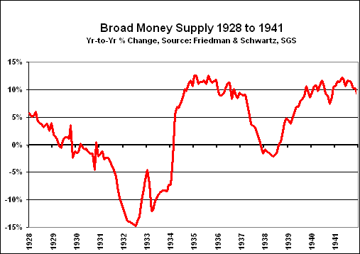
Money supply contraction
The money supply severely contracted as a result of bank failure, reduced inter-bank (bank to bank) lending, and deposit withdrawal.

Slide 12
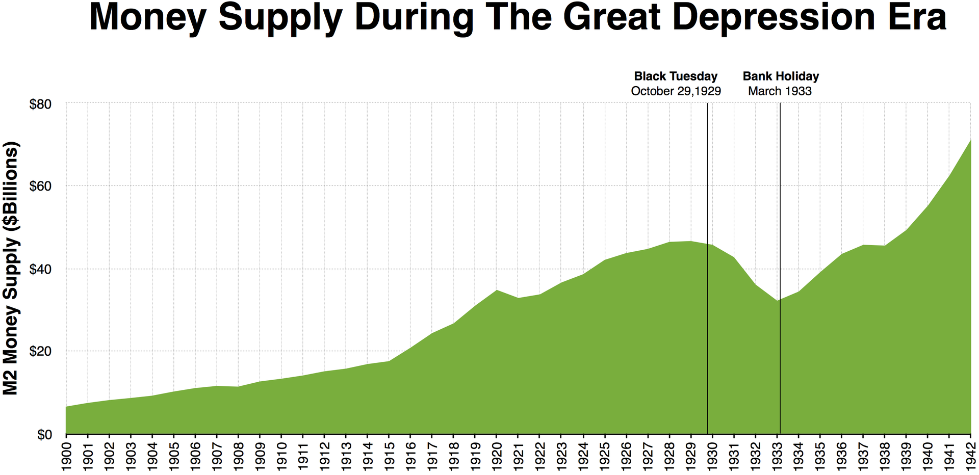
Money supply (M2)
The money supply contracted reaching its lowest level in March 1933, which was the year of the highest unemployment.
The money supply did not reach 1929 levels until the start of WWII.

Slide 13
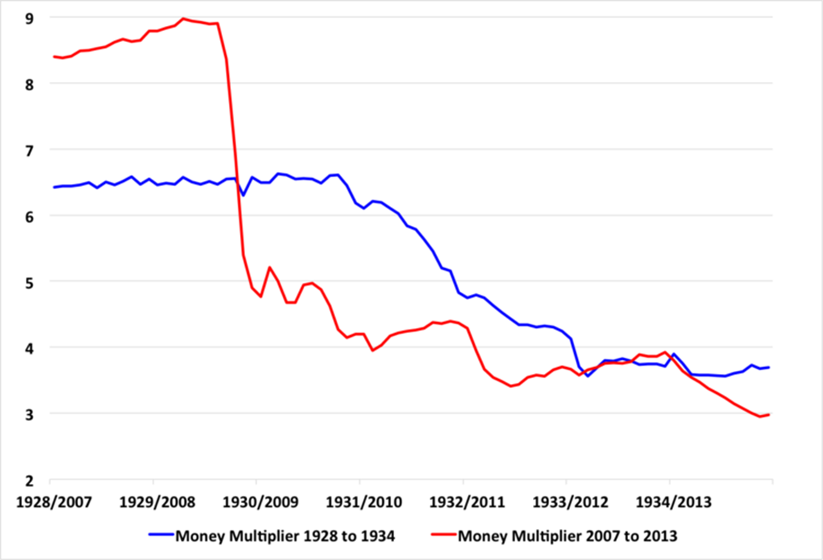
The money multiplier
Variables:
R The cash held in bank reserves
C The cash held by the public
H The number of hard currency
D The size of bank deposits
x reserve ratio
b cash ratio
M=D+C This is total money supply
𝑀=[(1+𝑏)/(𝑏+𝑥)]𝐻
The money multiplier collapsed during the great depression and during the recent financial crisis.

Slide 14
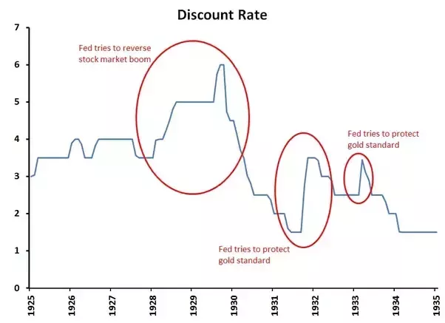
Federal reserve policy actions
The Fed. Reduced aggressively the discount rate to lend to banks, but it was still attached to gold standard.
As prices where declining the real interest rate was above the nominal interest rate.
So although the central bank was reducing the rate, the real interest rate in the economy was increasing.
When faced with a policy choice, the Fed always opted to follow the gold standard rule.
As a result, during late 1931, and also during the winter of 1932–3, the Fed raised interest rates to protect the dollar from external speculation in order to halt gold losses external drain.
This further reduced the money supply.

Slide 15
Real economy- industrial sector
From August 1929 to March 1933 we had the following:
  Output fell by 52%
  Wholesale prices fell by 38%
  Real income fell by 35%
Aggregate Demand collapsed:
  Gross private domestic investment, measured in constant prices, had reached $16.2 billion in 1929. In 1933 it was only $0.3 billion.
  In 1926, gross expenditure on new private residential construction was $4,920 million. in 1933 the figure had fallen to $290 million.
  Consumer expenditure at constant prices fell from $79.0 billion in 1929 to $64.6 billion in 1933.
Production of durable goods decreased substantially.
  In 1929, 4.5 million passenger vehicle where produced. In 1932, 1.1 million cars were produced by a workforce that had been halved.
Unemployment: The number of wage earners in manufacturing fell by 40 %.
  Those remaining worked fewer hours and experienced pay cuts.
  The producers of non-durable goods, (such as food) faced more modest declines in output and employment.

Slide 16
Real economy- agricultural sector
The most dramatic price falls were in agriculture and a fall of 65% in farm income was unsustainable for farmers, especially those in debt.
Unlike manufacturers, individual farms did not reduce output in response to low prices. Their reaction was to produce more in a desperate attempt to sustain income.
The result was the accumulation of stocks in foodstuffs which further depressed prices.
As banks and other financial institutions foreclosed on farm mortgages, distress auctions caused such turmoil that some states were obliged to suspend them.
Farmers unable to pay their debts put pressure on undercapitalized local banks.
As bank failures spread, banks increased their cash holdings by called in loans and curtailing lending.
Rural families were forced to reduce their purchases of manufactured goods, adding to urban unemployment.
At the other end unemployed manufacturing workers could not afford to buy food even at reduced prices.

Slide 17
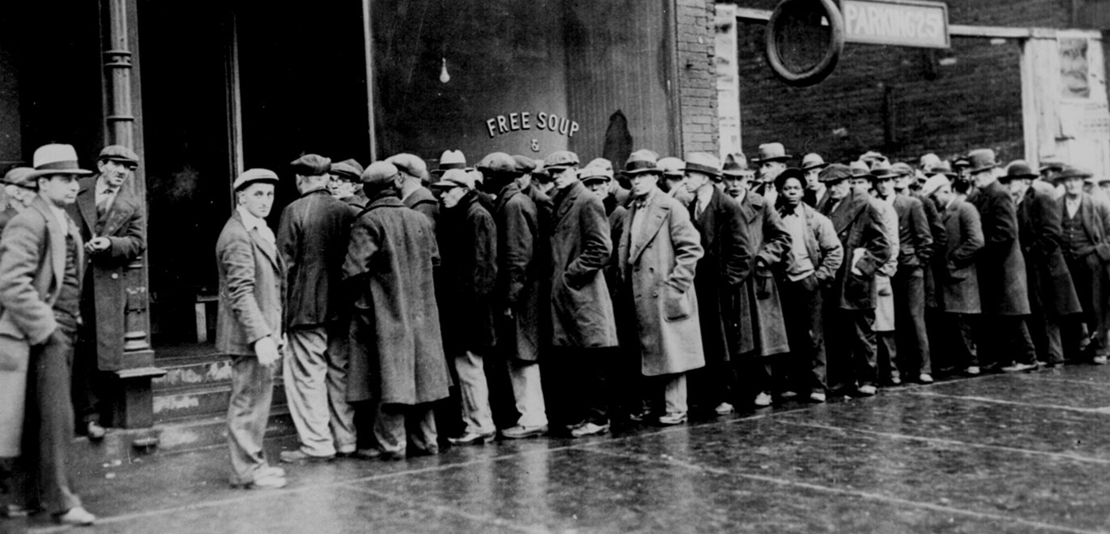
Unemployment
The percentage of the US civilian labour force without work rose from 2.9 in 1929 to 22.9 in 1932.
The US had no national system of unemployment benefits.
Those most affected included the young, the old, and ethnic minorities, whose unemployment rates were relatively high.

Slide 18
International transmission of the crisis
The key element in the transmission of the Great Depression was the gold standard.
  God standard created asymmetries: States accumulating gold were not forced to inflate their currencies, but when gold losses occurred governments and central banks were expected to take measures that cause deflation.
  Between 1927 and 1932 France experienced a surge of gold accumulation which saw its share of world gold reserves increase from 7 to 27 %.
  On 21 September 1931, Britain was forced to leave the gold standard, the first major country to do so, and devalue sterling. Sterling fell by 25% against the dollar.
  Start of 1931, 47 countries were members of the gold-standard. By the end of 1932 the only significant members were: Belgium, France, Netherlands, Poland, Switzerland, and the US .
  In 1933, the US decided to leave the gold standard and devalue the dollar.
  In 1936 France, too, abandoned gold.
Trade restrictions increased dramatically during the 1930s but even when there was some relaxation it was by bilateral agreements.

Slide 19
Global unemployment
Mass unemployment was a worldwide phenomenon during the depression.
Unemployment in the UK during the 1930s was fairly similar to that of the 1920s.
The US had enjoyed low unemployment during the 1920s. It increased substantially in the 1930s.
Sweden, Denmark and Norway, endured double-digit unemployment in both the 1920s and the 1930s.
In Germany, the deflationary policies pursued even after the gold standard had been abandoned led to an unemployment total of 6 million in 1933, roughly double that of the UK.

Slide 20
Perspectives
Last week we discussed:
  J.A. Hobson, who was one of the main advocates of under consumption as a cause of prolonged depression.
  M. Friedman who focused on money supply restrictions as the main reason for the fall in prices and depression.
This week we will add another two perspectives:
  F.A. Hayek and cycles due to mal-production. The idea that what drives the cycle is wrong signals between sectors of the economy usually as the result of central bank manipulation.
  I. Fisher who introduced the debt-deflation theory of depressions.

Slide 21
F.A. Hayek
F.A. Hayek wrote in 1931 Prices and Production, which became the standard work in Austrian Business Cycle Theory.
It combines a general equilibrium understanding of the economy, with cyclical phenomena arising from misalignments in relative prices.
The defining feature of Hayek’s cycle is that there is mal-production, i.e. mis-coordination in production between the different sectors of the economy.
  This assumes that while there is still scarcity in the application of resources in the system. A boom is not a period of reduced scarcity.
  Therefore we do not have an overall lack of demand or overall increase in supply, but, instead the signals (prices) that coordinate the system of production and consumption are mis-directing resources to some sectors over others.

Slide 22
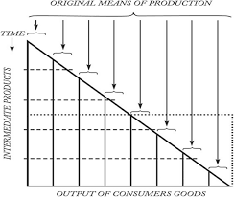
Austrian Capital Theory
Eugen von Böhm-Bawerk
  Positive Theorie des Kapitals (Universitätsverlag Wagner, 1889) (translated by William Smart as Positive Theory of Capital (1892)
Original means of production + intermediate products=Output of consumer goods
Linear (vs. circular) view of production.
Main characteristic of production is the time the various factors enter the productive process.
Time disaggregation vs sectoral disaggregation.

Slide 23
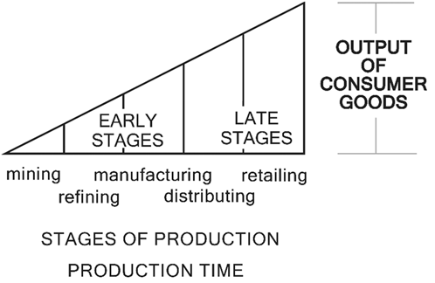
The average period of production
The whole point of the Austrian cycle theory is that the change in the interest rate influences asymmetrically production across the different stages of production- when we disaggregate them with relation to their proximity to the final complex consumer good.

Slide 24
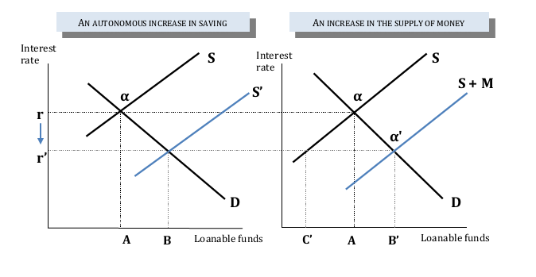
The Austrian Business Cycle
The Austrian Business cycle distinguishes between a voluntary increase in saving, and a forced saving (i.e. an increase due to monetary reasons).

Slide 25
The diagrams above depict two distinct scenarios.
In both cases we start from an equilibrium position which has interest rate (r), and a volume of loanable funds (A).
At point (a), the amount of saving people are willing to supply at this interest rate equals firms’ demand for funds for investment projects.
  I.e. the long run equilibrium position.
On the left diagram we have an autonomous increase in saving, where people decide to voluntarily save more of their income.
On the right we have an increase in the supply of money in the economy, where the central bank, or the commercial banks, decide to increase credit to the producers/entrepreneurs, while none of the underlying real factors of the economy have changed.
  This means that people have not decided to save more than before. Instead this gap between what people intend to save and the volume of investment is filled by the credit expansion.

Slide 26
An increase in voluntary savings
Savings are always funnelled to increased opportunities for investment.
Therefore, when people decide to save a greater part of their income, it necessarily follows that we have a shift of the supply curve.
  This is because we have a change in the amount people intend to save for every level of the interest rate.
The new intersection of the curves shows that the outcome of this autonomous increase is to permanently lower the real interest rate and permanently increase the volume of investment plans materialising.
Today's increase in saving leads to a more prosperous future, as lower interest rates allow producers to reorganise production in such a way that it will yield more consumption goods in the future.
This new production process is more ‘sophisticated’ or to put it in standard terminology more ‘roundabout’. It was the lower interest rates that made setting up this new process economically viable, and made economic growth possible.
  This is what the Austrians call an increase in the ‘roundaboutness’ of capital. I.e. the creation of more stages of intermediate capital goods that can deliver better and a bigger volume of consumption goods in the future. For them, capitalist progress takes place through this channel.

Slide 27
An increase in credit in the economy
We consider the second case. The shift in the supply schedule is because of increased credit supplied by the commercial banks or by the central bank.
Hayek noted that when commercial banks or the central bank, abuse their role as intermediaries between the public that saves and the entrepreneurs that invest this saving, what follows is a trade cycle.
When the central bank increases the supply of credit in the economy, the new short period equilibrium position is at B'.
  This is not a stable equilibrium.
  Soon enough, prices start to rise, and some of the investment plans are in arrears, banks start to realise that they do not have the stream of savings to finance this increased activity in the investment sector.
  The credit expansion that depressed the interest rate also decreased the wish of the individuals to save. Therefore, we are still on the old supply schedule and, at the new interest rate (r’), individuals would wish to reduce the amount they save to point C’.
As the economy adjusts to these new conditions it becomes increasingly apparent that the level of saving that individuals wish to hold (C’) does not correspond to the level of investment in this economy (B’).

Slide 28
The crisis stage
During the crisis stage of the cycle, and as the economy reorganises itself, we observe the common phenomena of increased unemployment, decreased production, and wage deflation.
  There is loss of investment as projects that seemed profitable in the boom stage of the cycle are now abandoned.
The reason why we have both unemployment and unused capital is because there is a misalignment between what the market wants in consumer and producer goods, and what its existing capital structure can deliver.
Thus, according to Hayek, physical capital may appear underutilised, but the reason for this phenomenon is that its economic valuation has decreased, as it was built to deliver a specific array of goods.
  I.e. what it can produce is no longer in demand, hence its economic value has diminished, and workers remain unemployed as the old production processes shut down and the new ones are yet to be fully functional.

Slide 29
Hayek and the Austrians- conclusions
Monetary factors (banking credit expansions) create crises through misalignment in the market price mechanism.
This usually (but not necessarily) happens because of government manipulation, e.g. central banks keeping the interest rate too low.
  The Austrians are in favour of abolishing the privilege of central banks as a result.
The overall effect of overt credit expansions is misdirection of real resources (rather than general overproduction), that leads to the creation of production bottlenecks, sectoral misalignment between actual and perceived needs.
  The result is a market crash as these contradictions are not sustainable in the long run.

Slide 30
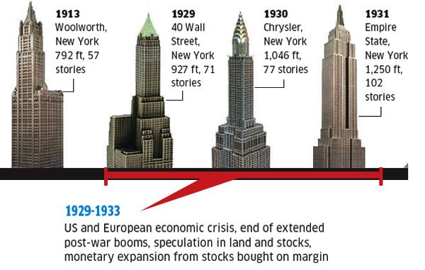
The Empire State Building
While plans for the Empire State Building were being finalized, an intense competition in New York for the title of "world's tallest building" was underway.
Construction began on 1/10/1929 and it opened on 1/5/1931.
Much of its office space was vacant from its opening. In the first year, only 23% of the available space was rented.
It started becoming profitable in the 1950s.
The construction of three record-breaking buildings coincided with the onset of the Great Depression.
  40 Wall Street, which on completion in 1929 reached 927 feet, followed by the 1,046-foot-tall Chrysler building in 1930, and the Empire State building in 1931, which towered over the others at 1,250 feet.

Slide 31
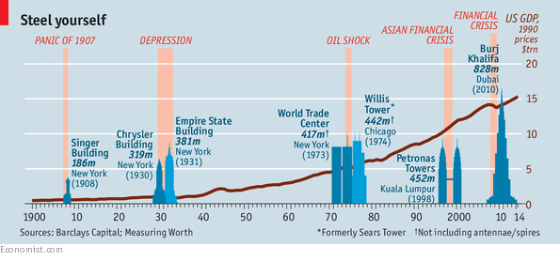
Skyscraper index
Some economists (especially Austrians) argue that skyscrapers is an indication of a bubble- a combination of high asset prices with a lot of easy credit.
  What is true is that a lot of the skyscrapers that became famous later where not profitable to start with…

Slide 32
Irving Fisher: Debt deflation theory
Fisher, Irving (1933), "The Debt-Deflation Theory of Great Depressions", Econometrica, 1 (4) 337-57
Methodology: How to think about crises:
  The way to see and analyse crises that Fisher uses is still the basis for neoclassical and later mainstream schools of thought.
Economic theory includes a study both of (a) such imaginary, ideal equilibrium and (b) disequilibrium.
  The former is economic statics; the latter, economic dynamics. Cycle theory is one part of economic dis-equilibrium.
He argues there are two ways to study dis-equilibrium:
  We can investigate an actual historical case of great dis-equilibrium. This is part of Economic History.
  We may take as our unit for study any constituent tendency, such as, say, deflation, and discover its general laws, relations to, and combinations with, other tendencies. This is part of Economic Theory.

Slide 33
Methodology continued
From a theoretical perspective a cycle, conceived as a historical event, is ‘non-existent’.
  I.e. its never the outcome of only one tendency but a complicated outcome of many tendencies that may happen or be causally linked to work together.
The innumerable tendencies making mostly for economic dis-equilibrium may roughly be classified under three groups:
  Growth or trend tendencies, which are steady;
  Haphazard disturbances, which are unsteady;
  Cyclical tendencies, which are unsteady but steadily repeated.
    Its cyclical tendencies which are the bigger problem
Two kinds of cyclical tendencies:
  One is "forced“, meaning due to natural forces or cultural factors/religious calendar. These are part of institutional, social or natural conditions.
  The second is the "free" cycle, which is self-generating, operating analogously to a pendulum or wave motion. These are unanticipated events.

Slide 34
“Free” cycles and Equilibrium
“Under such assumptions, and taking account of "economic friction”, which is always present, it follows that, unless some outside force intervenes, any "free "oscillations about equilibrium must tend progressively to grow smaller and smaller, just as a rocking chair set in motion tends to stop. That is, …, ordinary "free“ cycles tend to cease, giving way to equilibrium.” (Fisher, 1933, 339)
Therefore, tendencies that create free cycles are temporary departures from the equilibrium position.
If the system was not shocked anew equilibrium would be re-established.

Slide 35
Equilibrium vs. out of equilibrium
“Theoretically there may be, in fact, at most times there must be, over– or under–production, over– or under–consumption, over– or under–spending, over– or under–saving, over– or under–investment, and over or under every thing else. It is as absurd to assume that, for any long period of time, the variables in the economic organization, or any part of them, will "stay put,“ in perfect equilibrium, as to assume that the Atlantic Ocean can ever be without a wave.” (Fisher, 1933, 339)
Thus the economy is never in equilibrium because it is very complex and this means it experiences a variety of shocks from many sectors.
All these contribute to create small and large fluctuations on the economy .

Slide 36
Over-production vs. Mal-production
“There may even be a general over-production and in either of two senses:
there may be, in general, at a particular point of time, over-large inventories or stocks on hand, or
there may be, in general, during a particular period of time, an over-rapid flow of production.
The classical notion that over-production can only be relative as between different products is erroneous. Aside from the abundance or scarcity of particular products, relative to each other, production as a whole is relative to human desires and aversions, and can as a whole overshoot or undershoot the equilibrium mark.”(Fisher, 1933, 340)
Therefore Fisher agreed that there can be an under-consumption or overproduction cycle, like Hobson argued, and not only a mal-adjustment one, as Hayek emphasised.

Slide 37
Main actor- debt valuations
“In particular, as explanations of the so-called business cycle, or cycles, when these are really serious, I doubt the adequacy of over-production, under-consumption, over-capacity, price-dislocation, mal-adjustment between agricultural and industrial prices, over-confidence, over-investment, over-saving, over-spending, and the discrepancy between saving and investment.” (Fisher, 1933, 340)
“The big bad actors are debt disturbances and price – level disturbances.” (Fisher, 1933, 341)
  So Fisher’s view can be seen against both over-production and mul-production real theories, i.e. Hobson and Hayek’s theoretical schemes, which have a real production element as part of their theory.
  Fisher focuses almost entirely on credit elements, and in this way has a credit cycle theory.

Slide 38
THE ROLES OF DEBT AND DEFLATION
“No exhaustive list; can be given of the secondary variables affected by the two primary ones, debt and deflation; but they include especially seven, making in all at least nine variables, as follows:
debts, circulating media, their velocity of circulation, price levels, net worths, profits, trade, business confidence, interest rates.
The chief inter-relations between the nine chief factors may be derived deductively, assuming, to start with, that general economic equilibrium is disturbed by only the one factor of over-indebtedness, and, in particular, assuming that there is no other influence ,whether accidental or designed, tending to affect the price level.” (Fisher, 1933, 341)

Slide 39
The stages
Assuming, accordingly, that, at some point in time, a state of over-indebtedness exists, this will tend to lead to liquidation, through the alarm either of debtors or creditors or both. Then we may deduce the following chain of consequences in nine links:
Debt liquidation leads to distress selling and to
Contraction of deposit currency, as bank loans are paid off, and to a slowing down of velocity of circulation. This contraction of deposits and of their velocity, precipitated by distress selling, causes
A fall in the level of prices, …. Assuming, as above stated, that this fall of prices is not interfered with by reflation or otherwise, there must be
A still greater fall in the net worths of business, precipitating bankruptcies and
A like fall in profits, which in a "capitalistic," that is, a private-profit society, leads the concerns which are running at a loss to make
A reduction in output, in trade and in employment of labor. These losses, bankruptcies and unemployment, lead to
pessimism and loss of confidence, which in turn lead to
Hoarding and slowing down still more the velocity of circulation.
The above eight changes cause
Complicated disturbances in the rates of interest, in particular, a fall in the nominal, or money, rates and a rise in the real, or commodity, rates of interest.

Slide 40
Fisher’s theory, concluding thoughts
Fisher combines psychological and monetary factors to build an understanding based on the debt structure and its impact in the economy.
  Interestingly the psychology of individuals during this crisis is different to that of equilibrium analysis- or at least different effects take prominence.
Valuation of debt, and therefore balance sheet effects (we will discuss these more next week) are at the centre of crises.
Price deflation exacerbates the problems of debt deflation, creating a downward spiral.
  “When over-indebtedness stands alone, that is, does not lead to a fall of prices, in other words, when its tendency to do so is counter-acted by inflationary forces (whether by accident or design), the resulting "cycle“ will be far milder and far more regular.”
  “Then we have the great paradox which, I submit, is the chief secret of most, if not all, great depressions:
  The more the debtors pay, the more they owe.”
Thus, Fishes concluded, not all cycles of this kind tend again towards equilibrium- some have destabilising dynamics.

