Slide 1
Οικονομική Θεωρία και Πραγματικότητα.
Κωνσταντίνος Ρεπαπής
Επίκουρος Καθηγητής στην Πολιτική Οικονομία
ΕΚΠΑ

Slide 2
Social Sciences
What are the social sciences?
This question has two parts: ‘social’ and ‘science’
The ‘social’ part: it involves the study of phenomena pertaining to societies
  But what do we mean by a society?

Slide 3
English word ‘society’ stems from the Latin word ‘socius’ (friendship or companionship)
Society - not just a group of individuals, but those who are connected or related
  This connection need not necessarily be in terms family or friendship
  May refer to more abstract entities: for instance, a nation, a culture...
  Societies can be classified in many ways - how they are organized and their associated complexity

Slide 4
Task of the Social Sciences
Society in social sciences: relates to the nature, rationale and consequences of these different human social relationships
The task of the social sciences is to study human beings and their social relationships develop a body of knowledge to understand the actions of human beings as members of a society study human beings at different levels:
  individuals (motivations, feelings, behaviour)
  groups (family, race, nations, political parties)
  institutional arrangements that govern them (government, markets, economies)

Slide 5
Scope in the form of questions
Why do human beings behave the way they do? how do they make decisions in the face of uncertainty?
Why is there a remarkable degree of coherence and co-ordination among millions of individuals and their seemingly separate decisions about what to buy and sell?
Does religious faith influence productivity of individuals and success of a society?
Why do we have so many new innovations bursting out in the last 400 years?

Slide 6
Why is there so much inequality among nations and why is there so much poverty? What should we do about it?
Why and how do seemingly small events spontaneously spark off huge revolutions?
Why do we cooperate in a society?
Why aren’t people selfish sometimes?
Why are arranged marriages more common in some traditional cultures than others? Why do we have cities? what is the reason for their existence?

Slide 7
Scientific questions……
These questions are relevant, but are they scientific?
What do we understand by science or scientific?
Should we call it social studies, instead?
What qualifies as being scientific?
  We turn to philosophy of science and social science
  Philosophy of (social) science: investigates the aims and methods of the (social) sciences
  Deals with ontological (what is) epistemological/methodological (what/how can we know) and normative (what ought to be)

Slide 8
The necessity and possibility of bringing to social affairs the methods and techniques of the physical sciences was widely discussed among French scientists and academicians of the 1780s. No one is more representative of this attitude than the marquis de Condorcet. At once a mathematician and historian of the sciences, an economist and social reformer, Condorcet was perpetual secretary of the Academie des Sciences during one of the most fertile and vigorous stages of its existence – a period in which the Academy showed itself interested in the application of the methods of the sciences to a variety of human affairs. (Baker, 1964, p. 212)

Slide 9
French revolution and Marquis de Condorcet
Condorcet believed that the sciences of the man would enjoy as much success as the natural sciences
Crucial: social sciences adopt the methods of the natural
sciences
  What are these methods?
  Are the methods to be taken seriously?

Slide 10
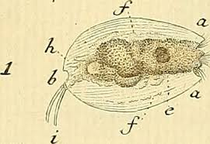
Animalcula and other minims of existence!

Slide 11
Emerging from three revolutions
what we commonly understand as science :
  data, quantification, measurement, prediction, mathematisation, experimentation and testing hypotheses
  depersonalised nature and explaining it by devising postulates and explanations (law-like processes)
scientific revolution - increasing inclination towards studying nature in the above mode.
Industrial revolution - emergence of modern capitalism and complex forms of social organization.
Social revolution in France and desire to look for a science of the society needs to be understood.

Slide 12
How do we reason and know about truth?
Deduction (παραγωγικός συλλογισμός)
Induction (επαγωγικός λογισμός)
Deduction
  Start with a premise
  apply valid deductive logic
  arrive at a conclusion.
An example:
  1 Snakes are reptiles
  2 Reptiles are cold-blooded
  3 Therefore, snakes are cold-blooded
In deduction if the premises/assumptions are true, then the conclusions that are must be or guaranteed to be true.
Induction: Start from a specific and attempt to generalize.
If the premise is valid, then the conclusion holds with a probability moving from specific to the general

Slide 13
Positivism
Rise of empiricism in science: all relevant knowledge is knowable through experience
Positivism - rejects all metaphysical entities as potential sources of knowledge
Logical positivism - Vienna circle in the 1920s
  scientific knowledge is the only kind of factual knowledge
  for knowledge to be meaningful, it should be verifiable through empirical observation
Empirically unobservable entities are rejected

Slide 14
Social Sciences
positivist backdrop - social sciences were born, articulated and developed
Application of empirical/inductive and mathematical deductive methods
Verification vs. falsification
How does science progress:
Hypothetico-deductive method - collect data, formulate hypothesis (conjecture), deduce testable predictions if the hypothesis were true, empirically test to see whether or not we reject the hypothesis

Slide 15
Social Facts
Are there objective ‘facts’ that exist in social sciences (like gravity)?
Émile Durkheim
there are social facts that are distinct and external to the individual!
They are created or determined by the collective forces in a society.
They may not always be observable, they ought to be studied using empirical methods
  religious beliefs, customs, norms in a society or a work place

Slide 16
Social Facts
When I fulfil my obligations as brother, husband, or citizen, when I execute my contracts, I perform duties which are defined, externally to myself and my acts, in law and in custom. Even if they conform to my own sentiments and I feel their reality subjectively, such reality is still objective, for I did not create them; I merely inherited them through my education. - (Durkheim, 1895)
Durkheim and the study of suicide
stable patterns concerning suicide rates that differ across countries or communities
an example of social facts according to Durkheim

Slide 17
Durkheim
Durkheim believed that it was important to study non-material social facts (as opposed to material ones like economy, contracts, institutions etc.) or social currents and a good example of this approach is his pioneering quantitative study of suicides.
Even though psychology plays an important role in determining why a certain individual may have a tendency to commit suicide, stable patterns concerning suicide rates that differ across countries or communities are of a different category and are an example of social facts according to Durkheim.

Slide 18
The suicide-rate is therefore a factual order, unified and definite, as is shown by both its permanence and its variability. For this permanence would be inexplicable if it were not the result of a group of distinct characteristics, solidary with one another, and simultaneously effective in spite of different attendant circumstances; and this variability proves the concrete and individual quality of these same characteristics, since they vary with the individual character of society itself. In short, these statistical data express the suicidal tendency with which each society is collectively afflicted. (Durkheim,1897)

Slide 19
Natural vs. Social Sciences
What are some differences?
Social facts are rarely invariant (unlike gravity on earth) – hard to come up with general laws
Exact predictability of future events is difficult (financial crisis vs. solar eclipse )
Possibility of feedback effects altering human behaviour (election predictions/expectations)
The extent of measurability of causes is difficult or even impossible (utility)
Possibility of experimentation is severely limited in social sciences
Human beings are far more complex, adaptive entities by their ability to change behaviour at will (when compared to atoms for instance).

Slide 20
Ενότητες
Schumpeter – Economics as an analytical field with abstract laws
Rocher/Schmoller – Economics as a descriptive field of social reality
Stark – Sociology of Knowledge Approach
An example- Mercantilism in the 17th century and today
Concluding thoughts
  The ontological basis of Political Economy

Slide 21
Joseph Schumpeter – Economics an engine of analytical progress
Schumpeter- History of Economic Analysis, 1954 (published posthumously).
  Schumpeter emphasized that this was a history of economic analysis and not a history of economic thought.
  He distinguishes between scientific economic analysis and economic thought.
“BY HISTORY of Economic Analysis I mean the history of the intellectual efforts that men have made in order to understand economic phenomena or, which comes to the same thing, the history of the analytic or scientific aspects of economic thought.”
  Writers of the past can be assessed from a modern perspective on how much they advanced the science of economics.

Slide 22
Schumpeter - continued
“The state of any science at any given time implies its past history and cannot be satisfactorily conveyed without making this implicit history explicit.”
  We learn about both the futility and the fertility of controversies; about detours, wasted efforts, and blind alleys; about spells of arrested growth, about our dependence on chance, about how not to do things, about leeways to make up for.
Although it is possible nevertheless…to speak for every epoch of established professional opinion on scientific topics and although this opinion has often stood the test of being proof against strong differences in political views, we cannot speak with as much confidence about it as can physicists or mathematicians.
Definitions of science:
  a science is any kind of knowledge that has been the object of conscious efforts to improve it.
  a science is any field of knowledge that has developed specialized techniques of fact-finding and of interpretation or inference (analysis).
  a science is any field of knowledge in which there are people, so-called research workers or scientists or scholars, who engage in the task of improving upon the existing stock of facts and methods and who, in the process of doing so, acquire a command of both that differentiates them from the ‘layman’ and eventually also from the mere ‘practitioner.’
  (1) science is refined common sense; (2) science is tooled knowledge.

Slide 23
German Historical School
Wilhelm Roscher (1817-1894).
  Roscher was against the idea of universal theoretical systems
    ‘historical-physiological’ method as opposed to ‘philosophic or idealistic method’ (1842: 1854-vol I, 43-56)
      Idealistic method- deductive and based on abstract principles. Classical economics was a case in point.
  “the object of political economy is not to point out the best possible state of things, …, but to describe in its continuous process of development the state of things as actually evolved”
    “what is” vs “what ought to be”
    Economic behavior and thus economic "laws" were contingent upon their historical, social and institutional context.
      Stages of development and with it legal and social systems. Evolutionary social viewpoint.
      Historical relativism.
  To derive any economic "laws", the method must be inevitably cross-disciplinary: one must look at economic life with the eye of a historian and sociologist, as well as an economist.
  Rocher was not again the theoretical (not methodological) apparatus of the classical school. He thought the theories where organically linked with the social reality of the 19th century.
    He did extensive work on mercantilism, and especially the story of cameralism in Germany.

Slide 24
The Younger School - Gustav Schmoller.
Gustav Schmoller
  “The older historical political economy has repeatedly desired to turn too quickly to account the lessons of universal history; we are now aware that laborious inquiries into the details of economic history can alone supply the right basis for the study of history in its economic and joint aspect” (326)
Methodenstreit (struggle of method) –abstract theorizing against historical descriptive analysis.
  “detailed historical study to free political economy from false abstractions”.
  Economics, is inherently a normative discipline and thus should be engaged in forging tools for use by policymakers.
  History exists only to provide illustrations for the particular problem at hand. Even historical laws are suspect.
  Interdisciplinary approach of social and economic history is the best of what can be done.

Slide 25
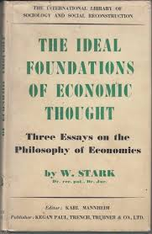
Werner Stark (1909-1985)
Werner Stark was a sociologist, economic historian and historian of economic thought.
He escapes German occupation of Prague and spends the period from 1939 to 1944 in Cambridge
His stay in Cambridge was supported by J.M. Keynes.
Keynes held Stark’s scholarship in high esteem:
“He is, I should say, one of the half dozen most learned people going on his own subject, namely the history and valuation of economic thought”
The Ideal Foundations of Economic Thought (1943)
The History of Economics and Its Relation to Social Development (1944)
History and Historians of Political Economy (posthumous 1994)

Slide 26
Sociology of Knowledge Approach
“Sociology of knowledge is primarily directed towards the study of the precise ways that human experience, through the mediation of knowledge, takes on a conscious and communicable shape”.
“Every society must take up some concrete vantage-point from which to survey the broad –the unbounded- acres of that which is, and every society will therefore have its own particular picture of reality because it sees reality, and must see it, in one particular perspective.”

Slide 27
Social Knowledge and Ideology
A core argument of the sociology of knowledge approach is that social existence and its relations is the very starting point of forming knowledge and societal understanding.
  The individual and their interests cannot be viewed as a coherent pre-social entity.
  “Before other ‘interests’ can claim satisfaction, one basic ‘interest’ must be satisfied –namely, the necessity to live in an understandable universe; without it, no concrete thought is possible at all, not even selfish thought”.
  “Therefore, sociology of knowledge, as a study, must logically precede, and be kept apart from, the doctrine of, and the hunt for ideologies”.

Slide 28
Sociology of Knowledge and HET
“There are, in the last analysis, two ways of looking upon the history of economic thought: the one is to regard it as a steady progression from error to truth, or at least from dim and partial vision to clear and comprehensible perception; the other is to interpret every single theory put forward in the past as a faithful expression and reflection of contemporary conditions, and thus to understand it in its historical causation and meaning. It is obvious that between these two antagonistic conceptions, no compromise is possible.” (Stark, 1944, I)

Slide 29
A third way of doing HEI
He distinguishes three approaches on how historians of economic thought write about past theory and its relation to social reality.
Critical. Sees ideas outside their social and historical context, and proceeding independently of them, as abstract economic theory improves and refines over time.
Descriptive. It exhausts itself in a description of the theories that existed and their social context.
Explanatory. Combines the judgement implicit on the first approach with the effort to understand the social and economic context of the second approach.
“Should the historian of political economy … abstain … from all criticism?
  Yes, in so far as this criticism tends to subject the past to the same standards as the present.
  No, in so far as the past has been fully understood in its independent life so that the basis for a just judgment is secured…..”

Slide 30
Μερκαντιλισμός – Ιστορία και το σήμερα
One recurrent question in this literature is the discussion whether mercantilism was simply a politically motivated ideology supported by vested interests, or a distinct viewpoint of the economy that contributed to the development of later economic thought.
  Adam Smith in The Wealth of Nations created an unsympathetic view of the mercantilist writers, as confused thinkers whose main aim was political power and influence to further their own interests.
  This starts a tradition that sees seeing mercantilism as a partisan, politically oriented pressure group that lacks true insight on the economy at large.

Slide 31
Adam Smith Wealth of Nations
[These policy arguments] were addressed by merchants to parliaments and to the councils of princes, to nobles and to country gentlemen, by those who were supposed to understand trade to those who were conscious to themselves that they knew nothing about the matter. That foreign trade enriched the country, experience demonstrated to the nobles and country gentlemen as well as to the merchants; but how, and in what matter, none of them well knew. The merchants knew perfectly in what manner it enriched themselves. It was their business to know it. But to know in what manner it enriched the country was no part of their business. This subject never came into their consideration but when they had occasion to apply to their country for some change in the laws relating to foreign trade. It then became necessary to say something about the beneficial effects of foreign trade; and the manner in which those effects were obstructed by the laws as they then stood. To the judges who were to decide the business it appeared a most satisfactory account of the matter, when they were told that foreign trade brought money into the country, but that the laws in question hindered it from bringing so much as it otherwise would do. Those arguments therefore produced the wished-for effect. (Smith [1776] 1999, vol. II, p. 10)

Slide 32
This narrative reverses Stark’s order of how we arrive at an understanding of social reality. It starts with interests and these interests then form the basis of tentative social knowledge, which can be twisted and partisan as it constructed from a narrow ideological position.
  This position assumes that if there is an element of truth in mercantilist thought, it is an almost unintended consequence of their theorising.
Stark disagrees with this understanding of mercantilism:
“Thus, where others, grossly misunderstand mercantilism, speak of its errors, Roscher grasped its historical meaning: to be the guide of national economy toward modern capitalism”

Slide 33
Mercantilist world view
First, as Schmoller (1896) noted, mercantilism has an interest in nation-state building, as a new social and economic entity that transformed social reality from its medieval social centre, the village and the countryside and its social relations, to a system that had an unprecedented level of centralised organization
They generally held to a viewpoint of a natural hierarchical relation in consumption and production in society , as well as a particular ethical stance concerning the different parts of society and their obligations and duties. In this they were pre-modern.
This transitional viewpoint does not presuppose an inherent new social balance either within or between states.

Slide 34
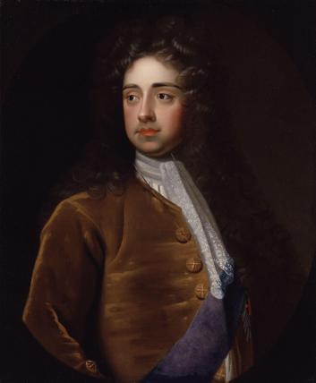
Charles Davenant
(1656–1714)
“Numbers of men, Industry, Advantagious situation, Good ports, skill in Maritime affaires, with a good Annuall Income from the Earth, are true and lasting Riches to a Country; But to put a Value upon all this, and to give life and motion to the whole, there must be a quick stock running among the people, and always where that stock increases, the Nation growes strong and powerfull; and where it visibly decayes, that decay is generally attended w/i/th publick Ruin”

Slide 35
Enter Keynes
Keynes writes to Stark: (6/1/1945)
“My criticism would be, perhaps, that you push rather too far the idea that each age is right and that we are tackling new situations rather than providing a better analysis. It may be that the form which error takes is often pragmatically true. But the very fact that we can look back, as your book does, itself shows the progress of our science, - that our analysis has become more universal, so that we can intelligibly comprehend in is past as well as present situations.”

Slide 36
Mercantilists vs. The Classics
“Mercantilists’ thought never supposed that there was a self-adjusting tendency by which the rate of interest would be established at the appropriate level” (Keynes, 1936, 341).
  No natural tendency of the economic system to balance itself.
“The mercantilists perceived the existence of the problem without being able to push their analysis to the point of solving it. But the classical school ignored the problem, as a consequence of introducing into their premises conditions which involved its non-existence; with the result of creating a cleavage between the conclusions of economic theory and those of common sense.”
Keynes found in the mercantilists a social vision that was akin to his own. Then from this base he intended to extend their framework by adding theoretical clarity and updating it in a variety of ways that would suit his modern needs.

Slide 37
Schumpeter on the mercantilists
Comparative study of these men and their measures also brings out interesting differences and, above all, the fact that precisely the greatest of them cannot be said to have followed any consistent system of principles at all.
  One aspect of this will be mentioned presently in our text. We must confine ourselves to a brief comment upon Colbert, who has been and still is considered by many historians as the typical representative of that imaginary entity, the ‘mercantilist system’—so much so that Colbertism is often used, especially in Italian, as a synonym of mercantilism.
  Jean Baptiste Colbert (1619–83), of bourgeois origin, was a civil servant who rose to be minister of finance (this, although various other offices were added from time to time, is the best way in which to describe his main function, which must, however, be understood to cover the affairs of industry, commerce, and agriculture as well) in the first period of Louis XIV’s reign. He was an honest, able, and energetic administrator who knew how to raise money, intimidate creditors, improve administrative and accounting methods, stimulate industry, build palaces and harbors, develop the navy, and so on, though he was distinctly unlucky in the execution of his larger plans, e.g. colonial enterprise, the history of which shows that the wastes of public planning may easily surpass anything that, on the score of wastefulness, can be charged to private enterprise. There is no reason to extol his achievement, especially to see in him the oversized champion of some great principle, as did some of his admirers.
This indicates that the administrators had no understanding of the political economy they where in at all. They did things without any plan whatsoever.

Slide 38

Μερκαντιλισμός –Στις μέρες μας
Donald Trump & Tariffs and neomercantilist policies
US trade position has changed since the 1960s
So has china’s. Trade surplus at historic highs

Slide 39

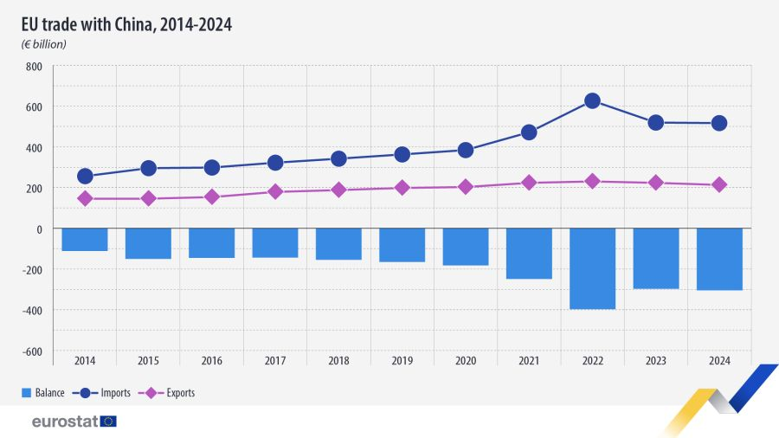
EU and US vs China

Slide 40
Free trade and modern realities
‘Developed’ world opinion on free trade is shifting.
  US has imposed global tariffs. President Macron and other European leaders are considering tariffs on Chinese goods.
    The era of free trade advocacy from the developed west may be coming to an end.
  Many modern economists are still dogmatically against tariffs because they are detrimental to global trade and decrease overall welfare.
    But they do not acknowledge that free trade is also not distributing gains from trade equally globally necessarily.
    When the balance was favoring the western countries these distributional concerns where minor compared to what was seen as benefits for free trade to all.
  A return to other historical periods shows us that the belief in free trade did not exist when national economies where being formed and global dominance was far from certain.
    It developed analytically during the 19th century, at a period when European global dominance was at its peak.
    And even then, distributional gains where considered explicitly.

Slide 41
Conclusions
Past theory can be seen as a deep library of alternative visions of the social order that the modern theorist can try to access through study of their context, language and discourse, and in this way attempt to see if the vision has something of value for today’s social reality.
Its an attempt to access another universe of perspectives and it allows a different kind of pluralism that is delineated by history, its literature and our ability to conceptually and practically access it.
It also gives the history of economic thought a place in modern theorising that is both unique and vital, as it keeps the theorist returning to the very nature of their deep-seated viewpoint of society.

