Slide 1
David Ricardo’s Theory of
Comparative Advantage

Slide 2
Classical theory of comparative advantage
Ricardian theory of international trade challenged the mercantilism dogma of accumulating gold or silver by promoting industry specialization and exports.
Ricardo introduced "comparative advantage“:
Nations should concentrate resources only in industries where they have the greatest efficiency of production relative to their own alternative uses of resources.
He argued that international trade is always beneficial, even if one country is more competitive in every area of production.
He opposed protectionism for national economies.

Slide 3
Classical theory of comparative advantage
1500-1750 the mercantilist dogma dominated.
Absolute advantage (A. Smith 1723-1790)
Relative (or comparative) advantage (D. Ricardo 1772-1823)
Assumptions of the Ricardo theory of comparative advantage:
Two countries, two goods, one factor of production, (labor).
Free trade, no transaction costs, or transportation costs.
Constant opportunity cost.
Free mobility of labour within a country.
No mobility of labour from country to country.

Slide 4
Production possibility frontier(or transformation curve) is a straight line.
“Before” trade, both countries produce both goods.
“After” trade, each country specializes in the production which has the comparative advantage.
Comparative advantage: lower opportunity cost, or lower relative cost of production, or lower relative price.
Gains from trade: specialization, greater production internationally, greater consumption for all (welfare increases)
Next: Ricardo’s example with the 4 magic numbers (P. Samuelson)

Slide 5
Ricardo’s example: labour cost of production (hours needed to produce one unit of production)
countries | 1 unit of cloth | 1 unit of wine
England | 100 | 120
Portugal | 90 | 80

Slide 6
Ricardo’s example: labour cost of production (hours needed to produce one unit of production)
countries | 1 unit of cloth (price of cloth) | 1 unit of wine (price of wine)
England | 100 | 120
Portugal | 90 | 80
Labour theory of value: the amount of labour needed to produce one unit of a commodity, determines its value.
Portugal has the “absolute” advantage in producing both goods.

Slide 7
Ricardo’s example: labour cost of production (hours needed to produce one unit of production)
countries | 1 unit of cloth (price of cloth) | 1 unit of wine (price of wine) | Relative price of cloth
England | 100 | 120 | 0,83
Portugal | 90 | 80 | 1,125

Slide 8
Ricardo’s example: labour cost of production (hours needed to produce one unit of production)
countries | 1 unit of cloth (price of cloth) | 1 unit of wine (price of wine) | Relative price of cloth | Relative price of wine
England | 100 | 120 | 0,83 | 1,2
Portugal | 90 | 80 | 1,125 | 0,88

Slide 9
Ricardo’s example: labour cost of production (hours needed to produce one unit of production)
countries | 1 unit of cloth | 1 unit of wine | Relative price of cloth with respect to wine | Relative price of wine with respect to cloth | Relative labour cost of the production of cloth with respect to wine | Relative productivity of wine with respect to cloth (opportunity cost of wine with respect to cloth)
England | 100 | 120 | 0,83 | 1,2 | 0,83 | 1,2
Portugal | 90 | 80 | 1,125 | 0,88 | 1,125 | 0,88

Slide 10
Comparative advantage
Each country
specializes in the sector producing at a lower relative labour cost.(comparative advantage)
exports the good of the comparative advantage and imports the other good.
England specializes in the production of cloth.
Portugal specializes in the production of wine.

Slide 11
Gains from Trade
Both countries gain if the relative international price of cloth with respect to wine is between the two relative prices in a state of autarky for the two countries:
0,83<(Pc/Pw)^{int}<1,125
And for the relative price of wine
0,88<(Pw/Pc)^{int}<1,2
More production is available for the world through specialization in production.

Slide 12
Diagrammatical exposition
Before trade: Production Possibility Curves (or transformation curves)
England
Portugal
 | Cloth | Wine | L
England | 100 | 120 | 1000
Portugal | 90 | 80 | 1000
How much of each product can each country produce?

Slide 13
Before trade: Production Possibility curves or transformation curves
England
Portugal
Wine
Wine
12,5
8,3
10
Cloth
11,1
cloth
 | Cloth | Wine | L
England | 100 | 120 | 1000
Portugal | 90 | 80 | 1000
L=1000

Slide 14
Before trade: Production=Consumption
England
Portugal
Wine
Wine
12,5
8,3
Ε΄
Ε
Slope 0,83
slope: 1,125
10
Cloth
11,1
Cloth
 | ύφασμα | κρασί
Αγγλία | 100 | 120
Πορτογαλία | 90 | 80
 | Cloth | Wine | L
England | 100 | 120 | 1000
Portugal | 90 | 80 | 1000

Slide 15
After trade: production? Consumption?
England
Portugal
Wine
Wine
12,5
Production
Ζ
8,3
Ε΄
Ζ΄
Ε
Slope: 0,83
Slope: 1,125
Production
10
Cloth
11,1
cloth

Slide 16
General case: labour cost of production
Countries | 1 unit of cloth | 1 unit of wine
Ι | α_{LC} | α_{LW}
ΙΙ | α*_{LC} | α*_{LW}

Slide 17
labour cost of production
Countries | 1 unit of cloth | 1 unit of wine | Opportunity cost of the production of cloth with respect to wine
Ι | α_{LC} | α_{LW} | α_{LC} / α_{LW}
ΙΙ | α*_{LC} | α*_{LW} | α*_{LC} / α*_{LW}

Slide 18
labour cost of production
Countries | 1 unit of cloth | 1 unit of wine | Opportunity cost of the production of cloth with respect to wine | Relative price of cloth with respect to wine (or relative labour cost )
Ι | α_{LC} | α_{LW} | α_{LC} / α_{LW} | α_{LC} / α_{LW}
ΙΙ | α*_{LC} | α*_{LW} | α*_{LC} / α*_{LW} | α*_{LC} / α*_{LW}

Slide 19
if (α_{LC} / α_{LW}) < (α*_{LC} / α*_{LW} )
then
Country, I, has the comparative advantage in the production of cloth.
country ΙΙ has the comparative advantage in the production of wine. ⇒
Country Ι exports cloth, imports wine.
⇒ Country IΙ exports wine, imports cloth.

Slide 20
Labour theory of value
Ρc/Ρw = α_{Lc}/α_{Lw}
The relative cost of production in terms of hours needed to produce good C, relative to the production of W, determines the relative price of the good C with respect to W.
This holds for the case of a closed economy (no international trade)

Slide 21
Equation (Ρc/Ρw = α_{Lc}/α_{Lw}) holds for the case of a closed economy
For the case of two countries:
Suppose that (before international trade) it is true that:
(α_{Lc} / α_{Lw}) < (α*_{Lc} / α*_{Lw} ) ⇒
⇒( Ρc / Ρw) < ( Ρ*c / Ρ*w )
⇒Country, I, exports cloth and imports wine.
And country, II exports wine and imports cloth.

Slide 22
When free trade begins between the two countries:
(Ρc/Ρw) < (Ρc/Ρw )^{i} < ( Ρ*c /Ρ*w ) (7)
The relative international price of cloth, (Ρc/Ρw )^{i}
is the same in both countries and
is between the two relative prices that correspond to a state of autarky.

Slide 23
It is also true that
(α_{Lc} /α_{Lw})< (Ρc/Ρw )^{i}< (α*_{Lc} /α*_{Lw})
hence, after international trade has started the labor theory of value does not hold.

Slide 24
What determines which good will be exported?
Conditions that have to do with production:
The relative productivity of labour, that is the relative labor cost, determines the structure of trade.
Country I, which has a relatively greater productivity of labour in the production of cloth, will export cloth and import wine.

Slide 25
Example: labour cost of production
 | 1 unit of (Τ) | 1 Unit of (V) | Relative price of T with respect to V | Hours of labour that each country possesses
Spain | 2 | 1 | 2 | 100
India | 5 | 10 | 1/2 | 1000

Slide 26
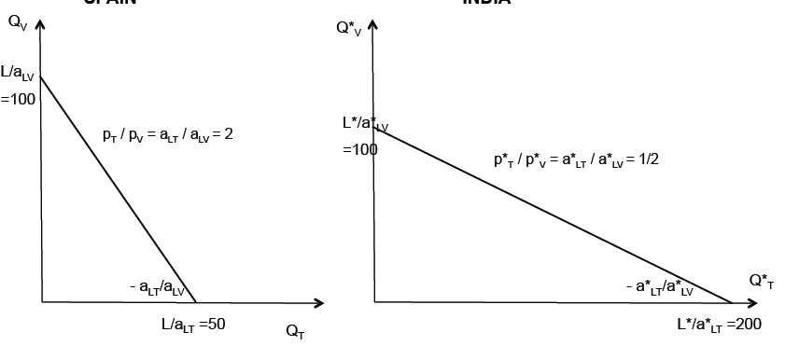
Spain
India

Slide 27
Example: labour cost of production
 | 1 unit of (Τ) | 1 Unit of (V) | Relative price of T with respect to V | Relative price of V with respect to T | Opportunity cost of T with respect to V | Relative productivity of labour in V with respect to T
Spain | 2 | 1 | 2 | 1/2 | 2 | 2
India | 5 | 10 | 1/2 | 2 | 1/2 | 1/2

Slide 28
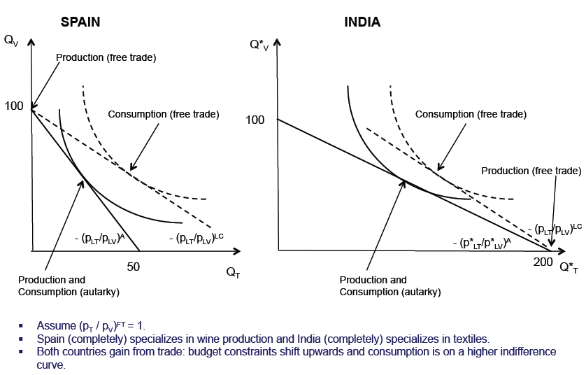
Spain
India
Production and consumption before trade
Production and consumption before trade
Each country specializes in the production of the sector with the comparative advantage

Slide 29
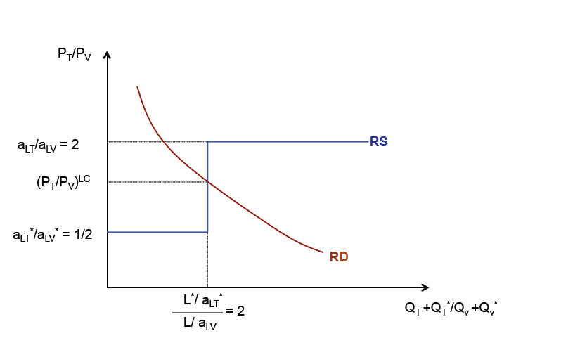
Relative production and demand

Slide 30
Another way to determine the sector of comparative advantage:
We compare the cost of production between the two products for the two countries.
ω: wage rate
α_{LC}∙ω: cost of production of one unit of cloth in country I.
α _{LW}∙ω:cost of production of one unit of wine in country II.
Suppose
α*_{LW} ∙ ω* ≤ α _{LW} ∙ ω ⇒ (α*_{LW}/ α_{LW})≤ ω/ω*
α_{LC}∙ ω ≤ α*_{LC}∙ ω* ⇒ ω/ω*≤(α*_{LC}/ α_{LC}) ⇒
(α*_{LW}/ α_{LW})≤ ω/ω*≤(α*_{LC}/ α_{LC})
Country II has a lower cost of production in the wine sector.
Country I has a lower cost of production in the cloth sector.

Slide 31
Comparative advantage restated
The sector of the comparative advantage has the lower relative cost of production.
and
the lower relative cost of production is due to
either the lower wage, or the higher productivity of labour.

Slide 32
Many goods, two countries(Ι, ΙΙ)
commodities: 1,2,……,n.
Which is the sector (s) of the comparative advantage?
Question: which products will be exported (imported)?
I make a sequence of relative productivity of goods from lower to greater...
Then, I compare with the relative wage.

Slide 33
For example:
If
α*_{L1}/ α_{L1}< α*_{L2}/ α_{L2}<….< α*_{Ln}/ α_{Ln}
and:
α*_{L1}/ α_{L1}< α*_{L2}/ α_{L2} < ω /ω* < α*_{L3}/ α_{L3} ….< <α*_{Ln}/ α_{Ln}
Then we can infer that
country II specializes and exports goods 1 and 2.
country, I, specializes and exports goods 3,….n.

Slide 34
Each country produces and exports the goods, in the production of which, the relative labour cost is lower than the relative wage of the other country.
Consequently, each country produces and exports the goods that are produced at a lower cost.
a lower cost : is either due to lower labour cost or to lower wage.

