Slide 1
A collection of Εarth Observation Tools

Slide 2
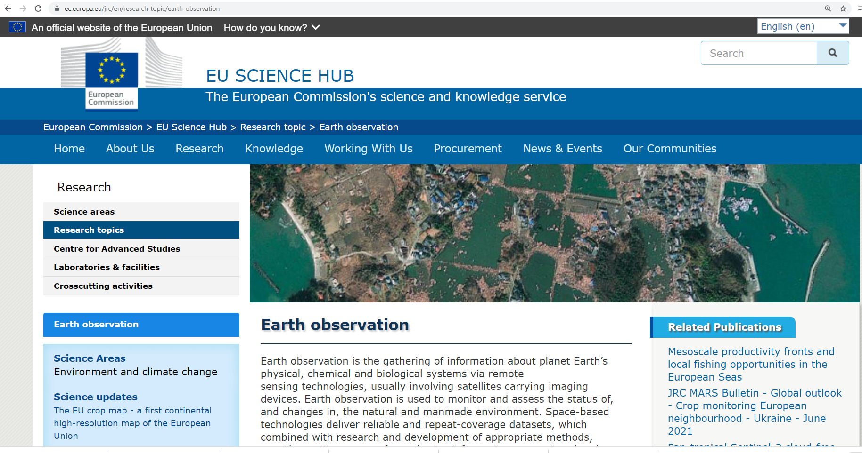

Slide 3
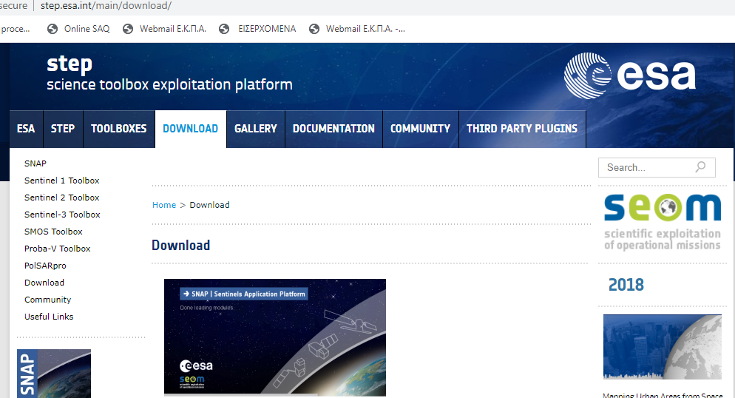

Slide 4
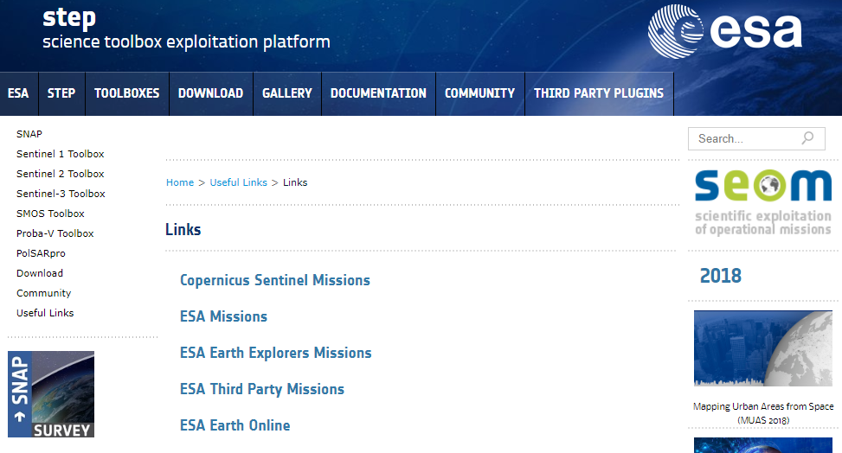

Slide 5
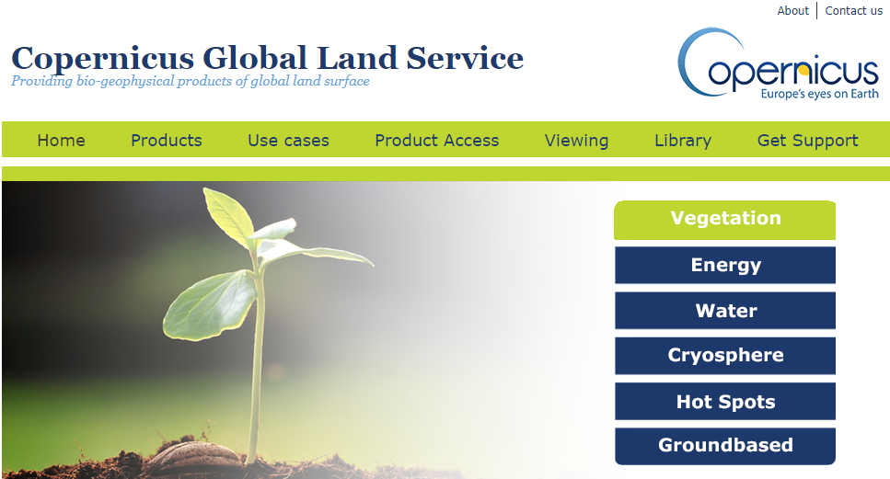
https://land.copernicus.eu/global/

Slide 6
https://land.copernicus.eu/local/urban-atlas/view
https://land.copernicus.eu/local/urban-atlas/street-tree-layer-stl
https://cds.climate.copernicus.eu/cdsapp#!/dataset/satellite-fire-burned-area?tab=overview (250 m)

Slide 7
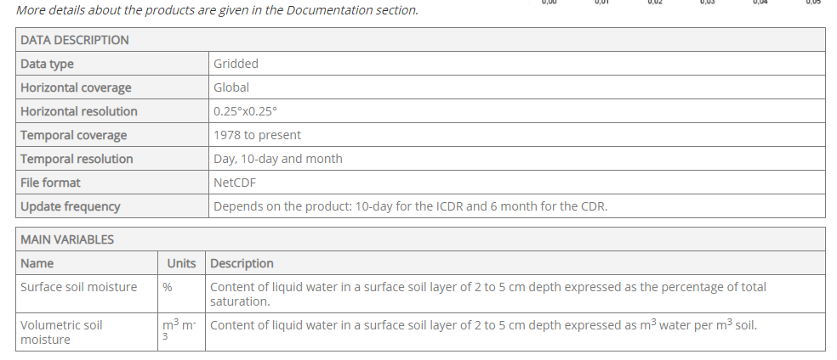
https://cds.climate.copernicus.eu/cdsapp#!/dataset/satellite-soil-moisture?tab=overview

Slide 8
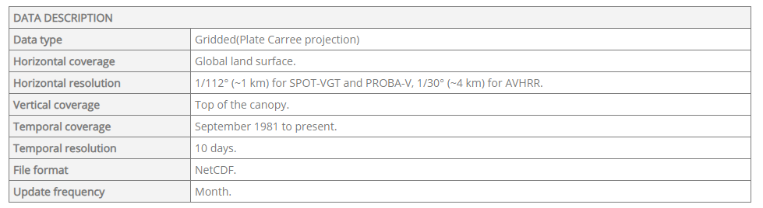
https://cds.climate.copernicus.eu/cdsapp#!/dataset/satellite-albedo?tab=overview

Slide 9
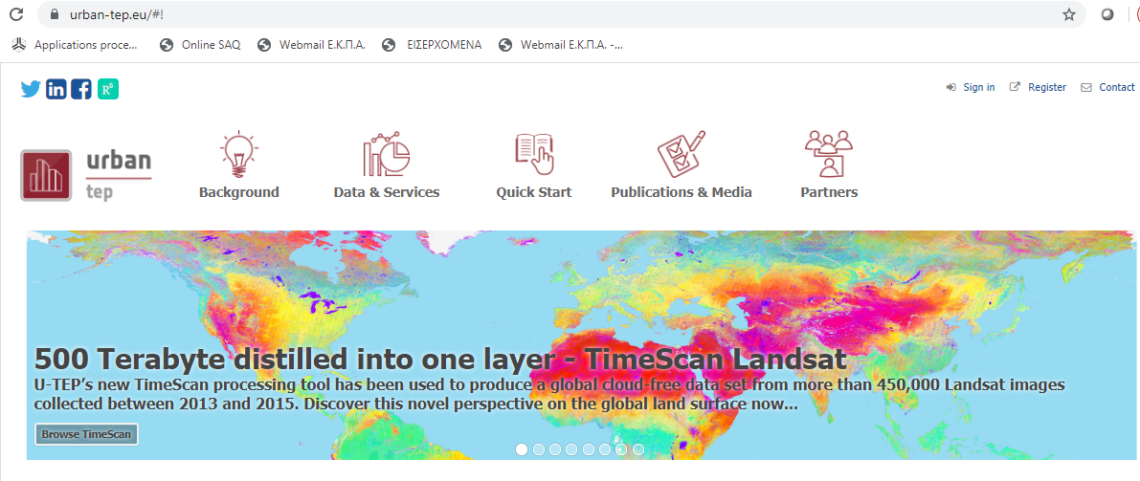

Slide 10
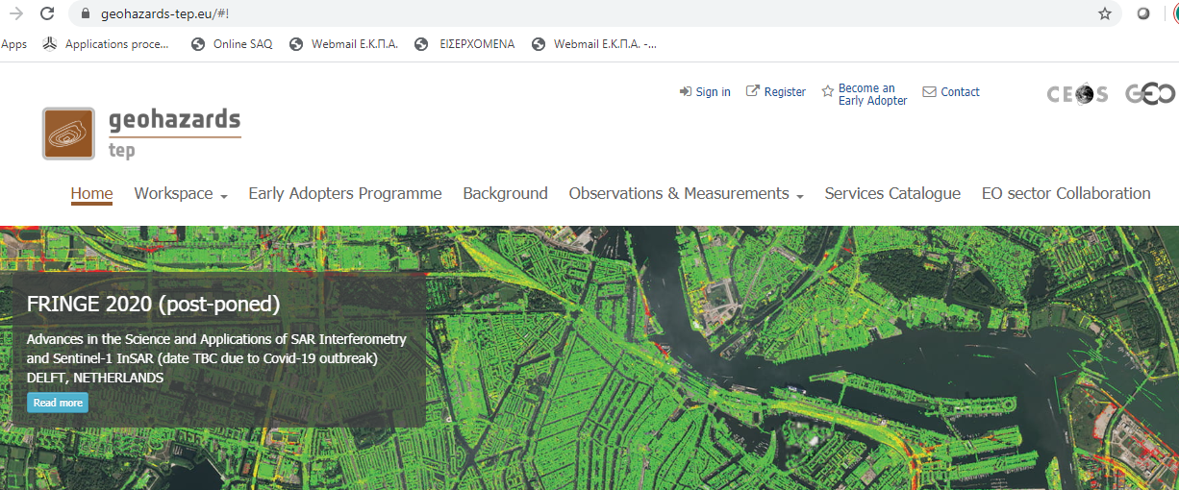

Slide 11
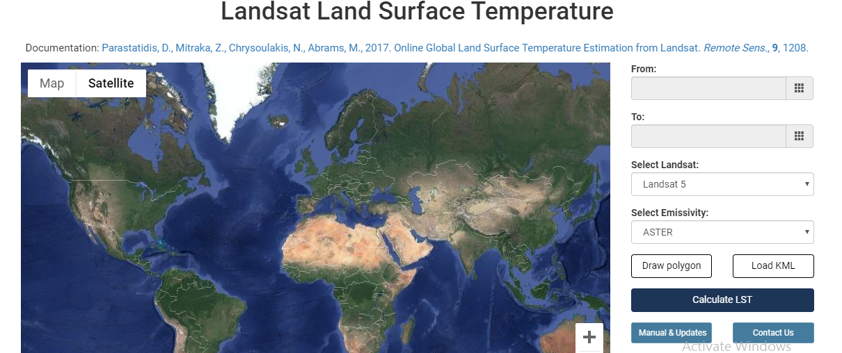
http://rslab.gr/downloads_LandsatLST.html

