Slide 1

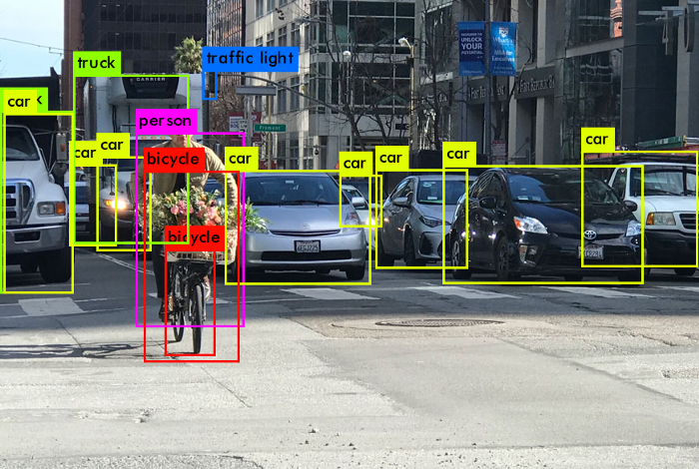
Project Title: AI-Enabled Drone Swarm network and information management Subtitle: Object Detection, DRONE2DRONE Information Exchange and Collaborative AWARENESS

Slide 2
Training an AI Model for Object Detection with YOLOv5

Slide 3
introduction
Content:
Overview of Object Detection
Introduction to YOLO (You Only Look Once)
Why YOLOv5? Speed and accuracy
Hands-on learning objectives

Slide 4
What You Need to Get Started
Basic understanding of Python and deep learning
Installed software: Python, pip, Git
Libraries: PyTorch, OpenCV, Matplotlib, Pandas, NumPy
GPU recommended (optional but speeds up training)

Slide 5
setting Up the Environment - Installing YOLOv5
Open a terminal and run:
git clone https://github.com/ultralytics/yolov5.git
cd yolov5
pip install -r requirements.txt
This command clones the YOLOv5 repository from GitHub, navigates into the directory, and installs the required dependencies specified in requirements.txt.
Verify installation:
python detect.py --weights yolov5s.pt --img 640 --conf 0.25 --source data/images/
This command runs object detection using a pre-trained YOLOv5 model (yolov5s.pt), with an image size of 640 pixels and a confidence threshold of 25%.

Slide 6
Preparing the Dataset
Use an existing dataset (COCO, Pascal VOC) or collect images
Label images using tools like LabelImg or Roboflow
Organize dataset into:
images/train/, images/val/, images/test/
labels/train/, labels/val/, labels/test/
The data.yaml file specifies paths for training and validation data, the number of classes (nc), and the class names.
Create a data.yaml file:
train: ./data/images/train
val: ./data/images/val
nc: 1 # number of classes
names: ['object’]
The data.yaml file specifies paths for training and validation data, the number of classes (nc), and the class names.

Slide 7
Training the Model- Running YOLOv5 Training
Run the training command:
python train.py --img 640 --batch 16 --epochs 50 --data data.yaml --weights yolov5s.pt --device 0
This command trains YOLOv5 using images of 640 pixels, a batch size of 16, for 50 epochs, with the dataset configuration from data.yaml and pre-trained weights yolov5s.pt. --device 0 ensures GPU usage if available
Monitor progress in runs/train/exp/
Adjust hyperparameters for better accuracy

Slide 8
Evaluating Model Performance-Analyzing Results
Check runs/train/exp/ for metrics like mAP (mean Average Precision)
Use TensorBoard for visual analysis:
tensorboard --logdir runs/train
This command starts TensorBoard, which helps visualize training metrics such as loss and accuracy over time.
Test on new images using:
python detect.py --weights runs/train/exp/weights/best.pt --img 640 --conf 0.25 --source data/images/test/
This command tests the trained model (best.pt) on new images with a confidence threshold of 25%.

Slide 9
Fine-tuning and Optimization - Improving the Model
Increase dataset size
Use data augmentation
Tune learning rate, batch size, number of epochs
Try different YOLO versions (YOLOv5m, YOLOv5l, etc.)

Slide 10
Deploying the Model Using Your Trained Model
Convert to ONNX or TensorRT for efficiency
Deploy using Flask/FastAPI for web applications
Implement on edge devices like Raspberry Pi or Jetson Nano

Slide 11
Models for training
Objects
MODELS
WASTE
CARS
PERSONS
BOATS
AIRPLANES
DRONES
TREES
BUILDINGS
SELECT OBJECT
CREATE DATASET
TRAIN ON YOLO
RETRAIN : TARGET ACCURACY 70%
https://youtu.be/vXYMJFBLzfc

