Slide 1
BIOLOGY
Knowledge
Terminology
Biology
Development
Function
Structure
Biology
Biology Lecture E. Anastasiadou Bioinformatics – Biomedical Data Science 2021-2022

Slide 2
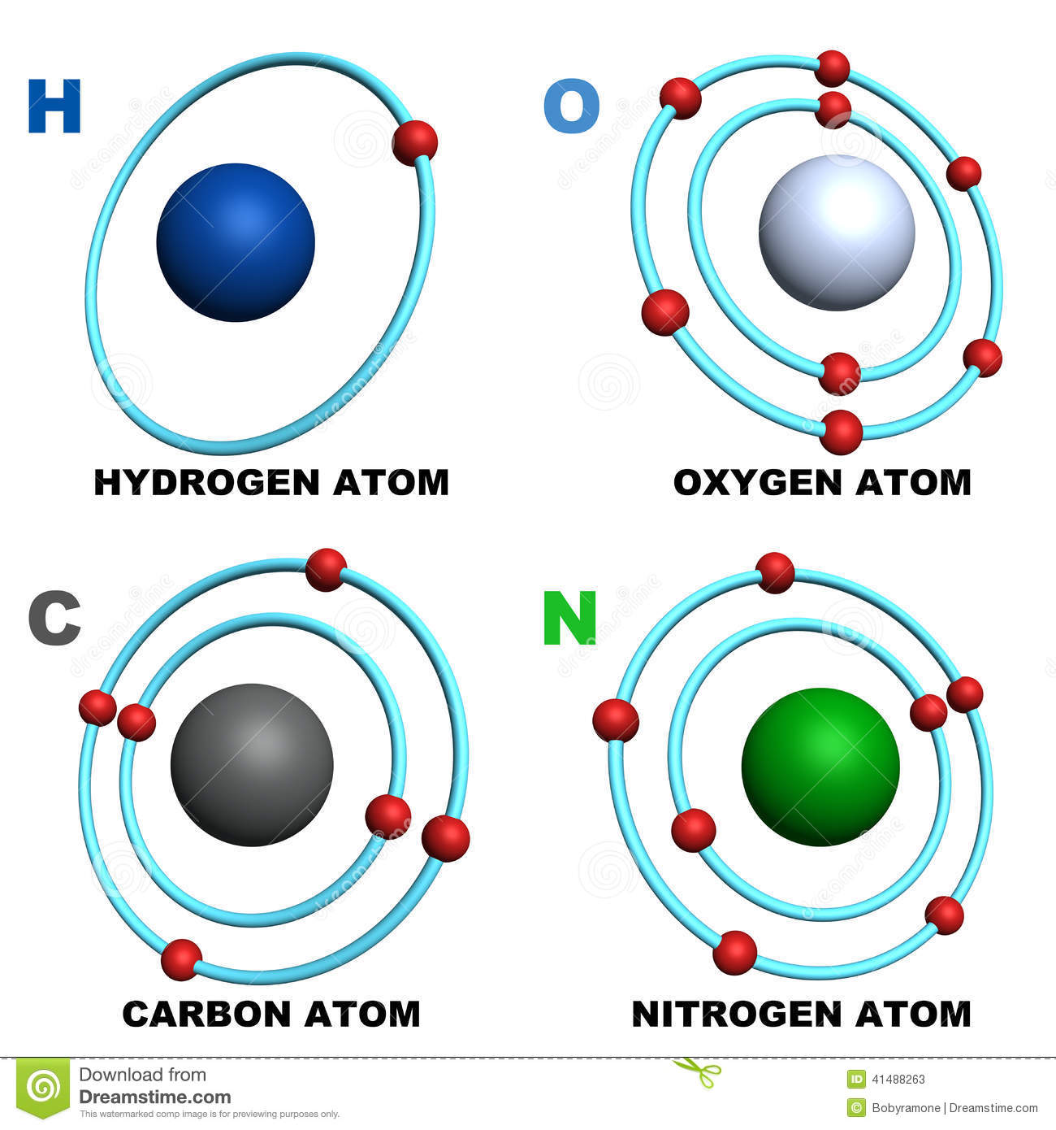
biomolecules
A biomolecule is any chemical molecule that is a structural or functional component of organisms and which is produced by them through metabolism.
Four are the chemical elements that take a significant part in the synthesis of biomolecules: carbon, hydrogen, oxygen and nitrogen.
They synthesize the two essential components of the cells / organisms, the nucleic acids (DNA and RNA) and the proteins.
Biology Lecture E. Anastasiadou Bioinformatics – Biomedical Data Science 2021-2022

Slide 3
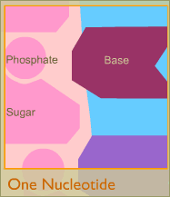
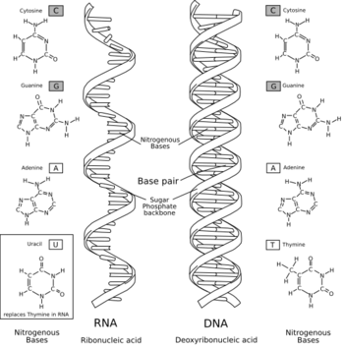
nucleic acid
The nucleic acid consists of nucleotides.
DNA is formed from deoxyribonucleotides while
RNA from ribonucleotides.
Biology Lecture E. Anastasiadou Bioinformatics – Biomedical Data Science 2021-2022

Slide 4
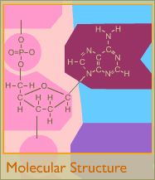
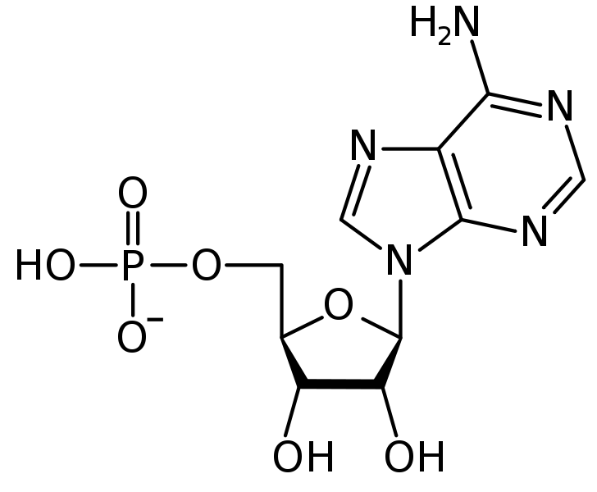
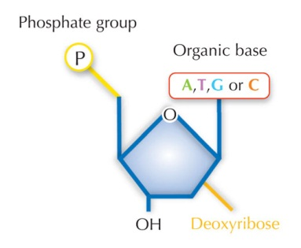
DNA STRUCTURE
Biology Lecture E. Anastasiadou Bioinformatics – Biomedical Data Science 2021-2022

Slide 5
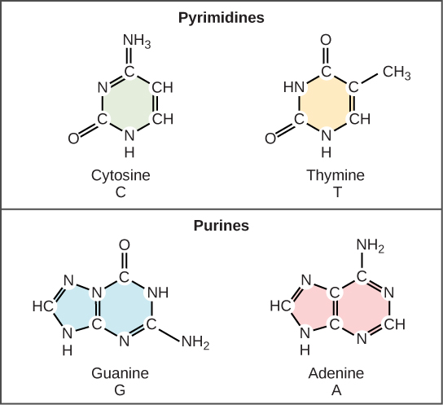
NITROGENOUS BASE
A (adenine), T (thymine),
C (cytosine), G (guanine)
The bases are combined in a specific order and store the genetic information of each organism:
Each DNA molecule can be considered as a string with an alphabet.
Biology Lecture E. Anastasiadou Bioinformatics – Biomedical Data Science 2021-2022

Slide 6
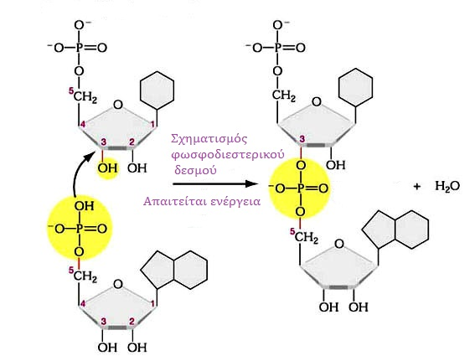
3’-5’ sugar-phosphate bond
3’-5’ sugar-phosphate (phosphodiester) bond is a covalent bond between the 3’ carbon atom of the pentose of the first nucleotide and the phosphate group attached to the 5’ carbon atom of the pentose of the next nucleotide.
Multiple nucleotide association with
covalent bonds forms
the polynucleotide chain.
The phospho-groups and the sugars
are located in the outer side of the
molecule (DNA) και compose
the skeleton.
It is hydrophilic due to the negative
load of the phosphate groups.
Inside: bases (hydrophobic)
Hence the DNA is a polar molecule (hydrophilic skeleton & hydrophobic interior).
Biology Lecture E. Anastasiadou Bioinformatics – Biomedical Data Science 2021-2022

Slide 7
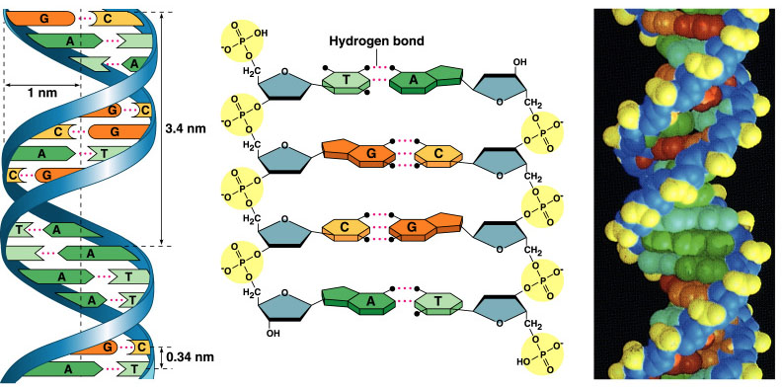
THE DOUBLE HELIX OF DNA & NITROGENOUS BASES
Biology Lecture E. Anastasiadou Bioinformatics – Biomedical Data Science 2021-2022

Slide 8
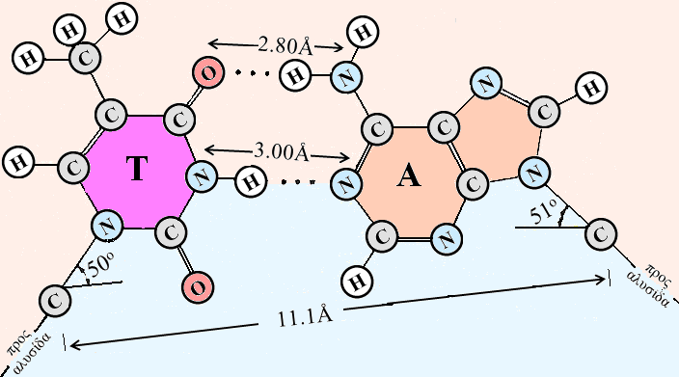
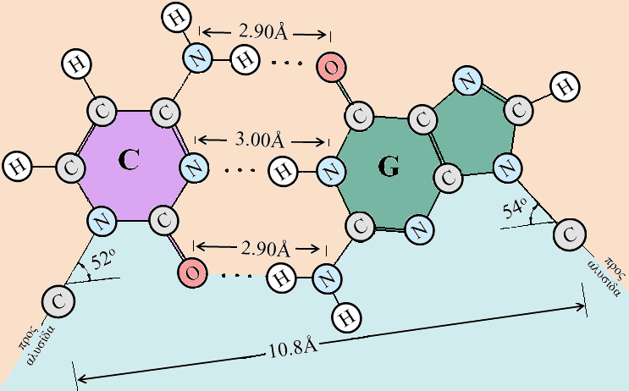
complementarity – hydrogen bonds
Hydrogen bonds stabilize the structure of DNA by joining the two DNA chains.
Chain complementarity suggests that the sequence of one also determines that of the other, important property for the preservation and transmission of genetic information through the synthesis of identical DNA molecules.
Therefore, the number of As = number of Ts & number of Cs = number of Gs
Guanine (G) binds to cytosine (C) with three hydrogen bonds
Thymine (T) binds to adenine (A) with two hydrogen bonds
Biology Lecture E. Anastasiadou Bioinformatics – Biomedical Data Science 2021-2022

Slide 9
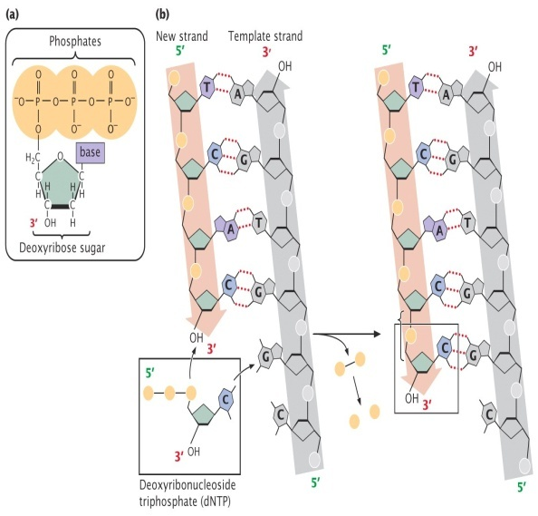
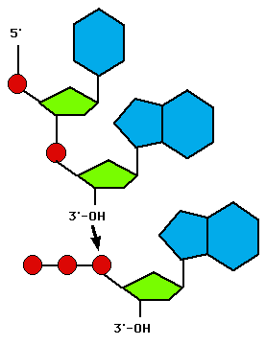
STRUCTURE OF THE DNA DOUBLE HELIX
Biology Lecture E. Anastasiadou Bioinformatics – Biomedical Data Science 2021-2022

Slide 10
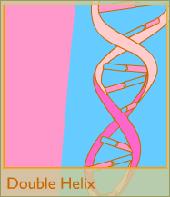
The model of the double helix of DNA
The DNA consists of 2 polynucleotide chains forming a clockwise double helix.
Stable hydrophilic (negative charge) helix backbone of recurring of phosphogroup-deoxyribose molecules joined by phosphodiester bond to the exterior of the molecule and hydrophobic bases to the interior of the helix.
Supplementary rule (A-T, C-G): Hydrogen bonds stabilize the structure of DNA.
Chain complementarity states that the sequence of one determines that of the other, property important for the preservation and transmission of genetic information by complementary chain synthesis by using each of the original strands to form 2 identical DNA molecules.
Direction of each chain is 5’-3’ but they are antiparallel with each other (3’ end of one opposite of the 5’ end of the other).
Biology Lecture E. Anastasiadou Bioinformatics – Biomedical Data Science 2021-2022

Slide 11
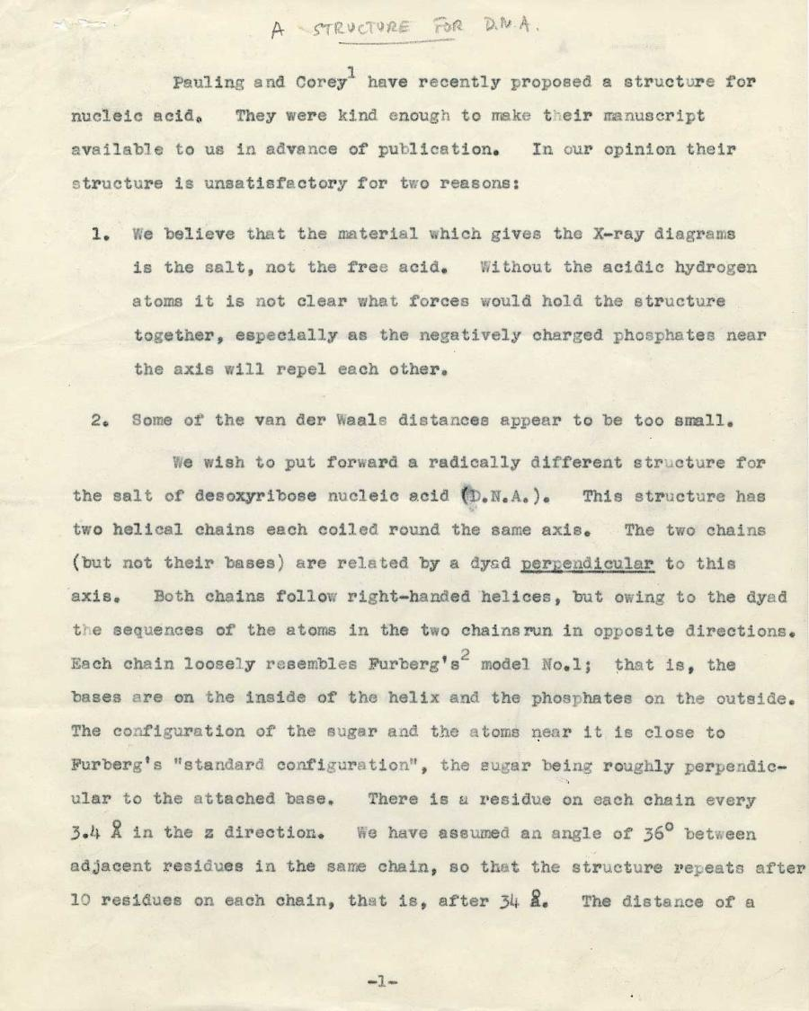
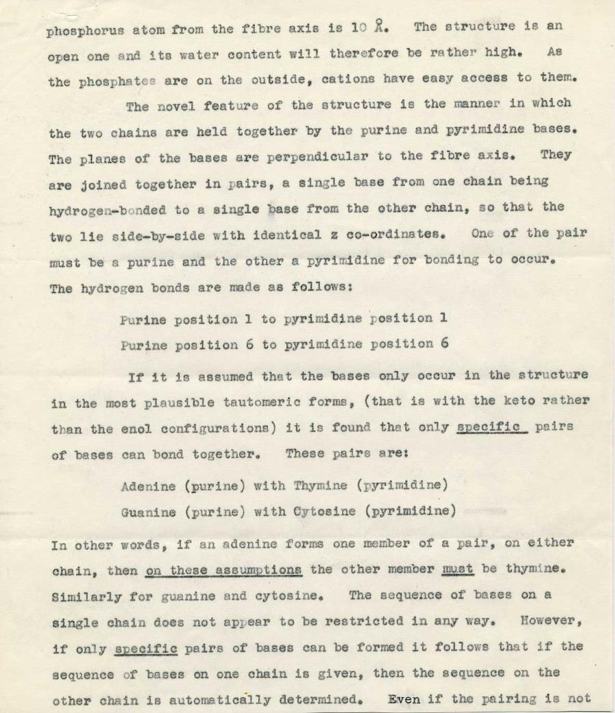
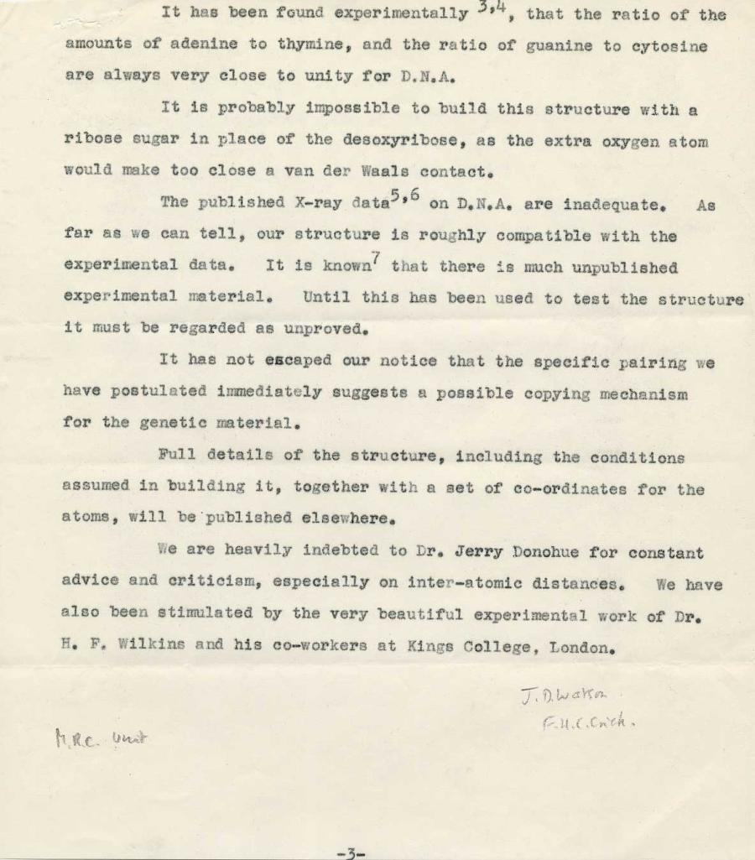
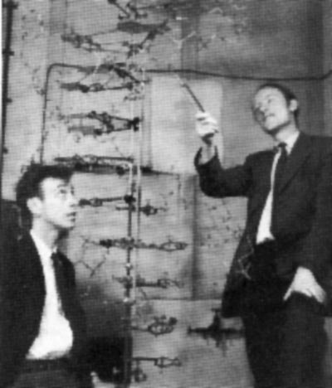
A Structure for DNA
(typescript)
Watson & Crick [Nature 1953]
Watson was 23 at the time!!!
Biology Lecture E. Anastasiadou Bioinformatics – Biomedical Data Science 2021-2022

Slide 12
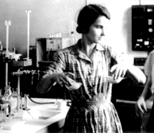
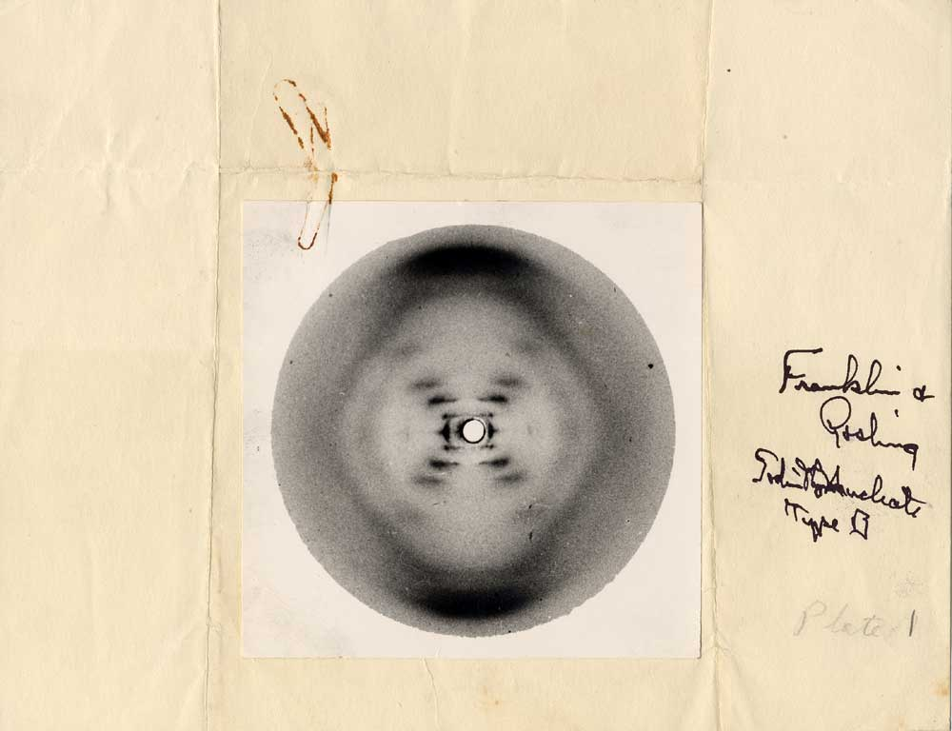
Rosalind Franklin took an exceptional X-ray photograph of a DNA molecule, which provided Watson+Crick with the key to the double-helix puzzle.
Sodium deoxyribose nucleate from calf thymus
Structure B, Photo 51, (May 2, 1952)
by Rosalind E. Franklin and R.G. Gosling
Biology Lecture E. Anastasiadou Bioinformatics – Biomedical Data Science 2021-2022

Slide 13
https://www.youtube.com/watch?v=o_-6JXLYS-k
https://www.youtube.com/watch?v=C1CRrtkWwu0
https://www.youtube.com/watch?v=yDkSWd_ZbbE
Biology Lecture E. Anastasiadou Bioinformatics – Biomedical Data Science 2021-2022

Slide 14
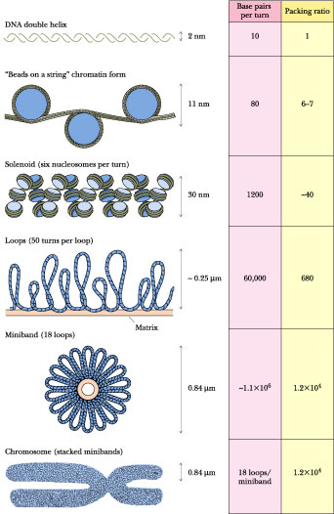
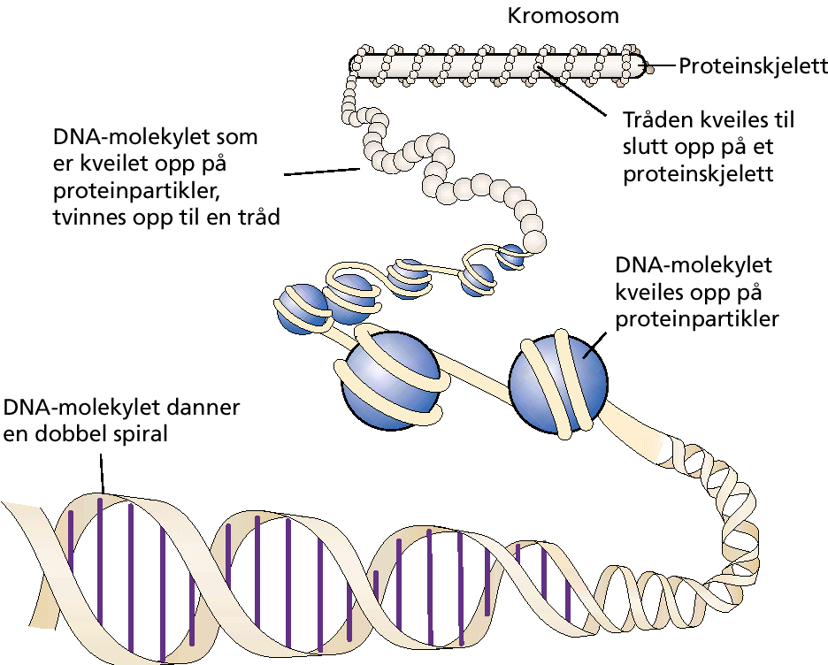
DNA ORGANIZATION
DNA in a human cell is 2 m long but can supercoil rises up to 10 μm.
Their number and length are characteristic of each type of organism.
Biology Lecture E. Anastasiadou Bioinformatics – Biomedical Data Science 2021-2022

Slide 15
nucleosome
~ 200 base pairs per nucleosome
Biology Lecture E. Anastasiadou Bioinformatics – Biomedical Data Science 2021-2022

Slide 16
STRUCTURE OF NUCLEOSOME
It is packaged with the assist of proteins to form chromatin fibrils that resemble beads. Each bead is called a nucleosome and is the basic unit for the organization of chromatin. It is made up of 146 base-length DNA that coild (2 turns) 8 molecules (octamer) of proteins called histones.
Biology Lecture E. Anastasiadou Bioinformatics – Biomedical Data Science 2021-2022

Slide 17
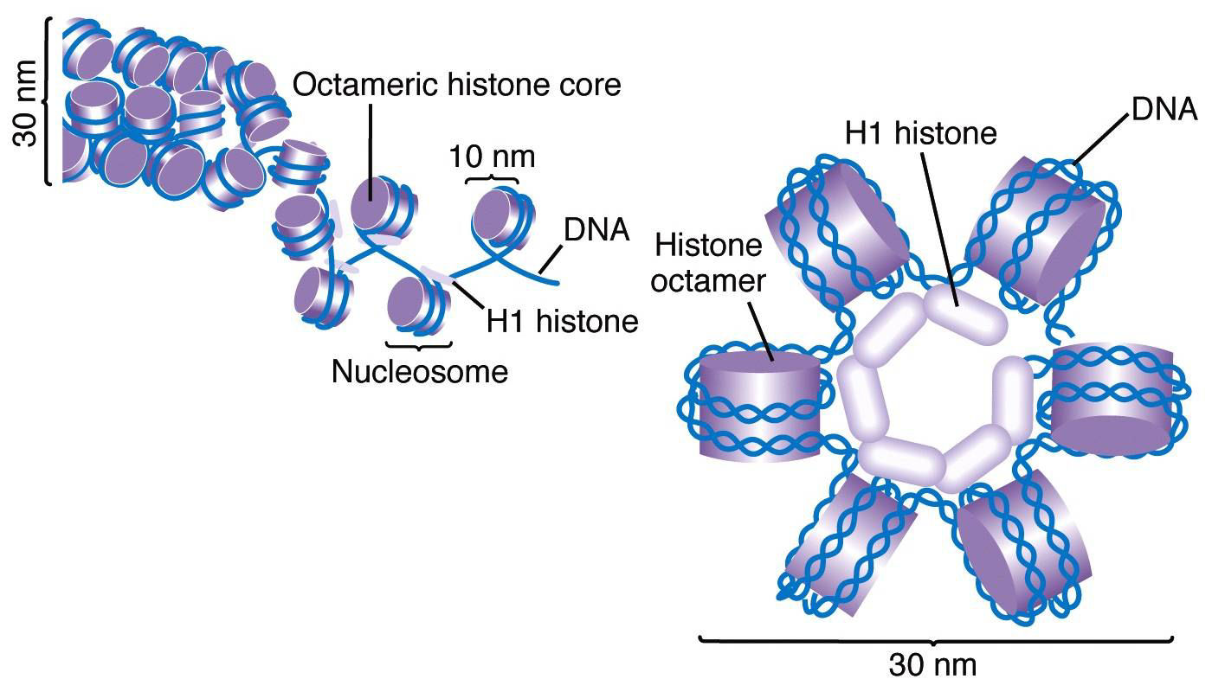
HISTONE PROTEIN Organization
Histones are the major structural proteins of chromosomes.
The DNA molecule is wrapped twice around a Histone Octamer
to make a nucleosome.
Six nucleosomes are assembled into a solenoid in association with H1 histones.
Biology Lecture E. Anastasiadou Bioinformatics – Biomedical Data Science 2021-2022

Slide 18
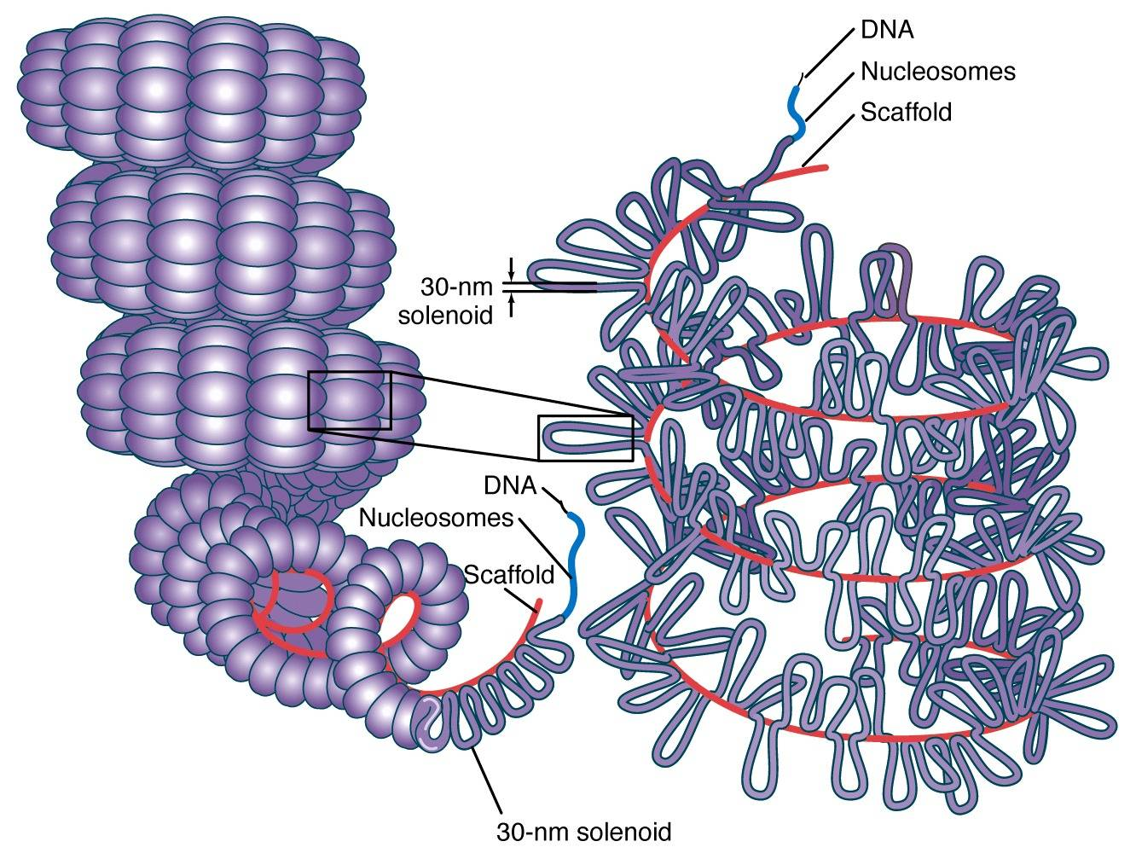
CHROMATIN STRUCTURE & ORGANISATION
The solenoids are coiled onto a scaffold, which is futher coiled to make the chromosomal matrix.
Depending on the stage of the cell cycle, there is a different degree of coiling, low during interphase with formation of chromatin fibrils.
Biology Lecture E. Anastasiadou Bioinformatics – Biomedical Data Science 2021-2022

Slide 19
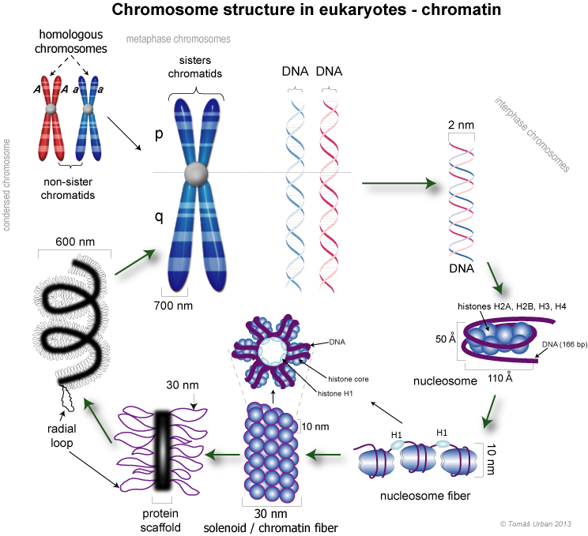
Biology Lecture E. Anastasiadou Bioinformatics – Biomedical Data Science 2021-2022

Slide 20
https://www.youtube.com/watch?v=gbSIBhFwQ4s
Biology Lecture E. Anastasiadou Bioinformatics – Biomedical Data Science 2021-2022

Slide 21
ORGANISATION OF CHROMATIN
Packaging is achieved with proteins to form chromatin fibrils that resemble beads. Each bead is called a nucleosome and is the basic unit for the organization of chromatin. It is consisted of 146 base-length DNA that coils around (2 turns) 8 molecules (octamer) of proteins called histones.
Depending on the cell cycle stage, there is a different degree of coiling, low during Interphase forming chromatin fibrils that are not visible in the optical microscope. When replication is completed, each fibril is doubled forming the sister chromatids which are linked by the centromere.
In the cell division, the sister chromatids obtain a maximum degree of coiling, so metaphasic chromosomes are visible in the optical microscope. At the end of the cell division, 2 new cells are generated, genetically identical to each other and the original, each containing 1 of the 2 sister chromatids from each chromosome.
Biology Lecture E. Anastasiadou Bioinformatics – Biomedical Data Science 2021-2022

Slide 22
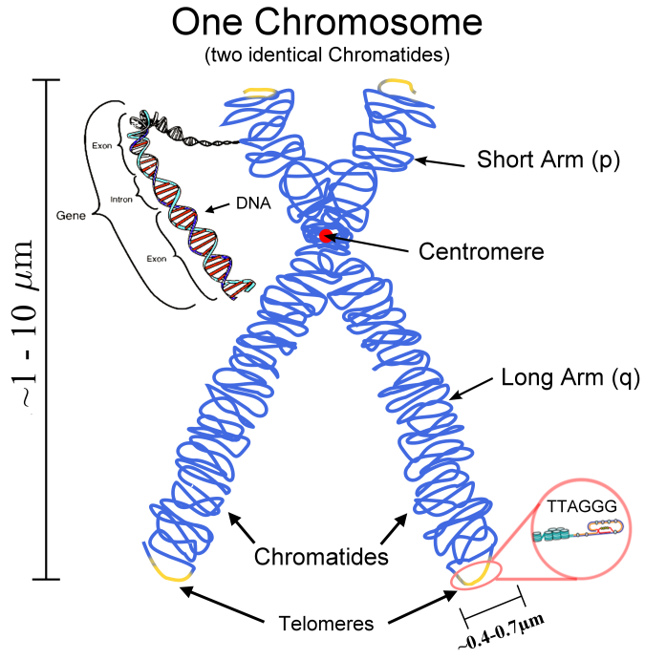
METAPHASIC CHROMOSOME
CHO
HELA
HELA
85.000 bases per loop
Biology Lecture E. Anastasiadou Bioinformatics – Biomedical Data Science 2021-2022

Slide 23
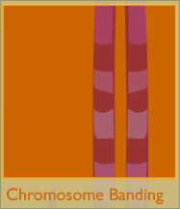
When stained, chromosomes show bands of light and dark areas. The dark bands indicate areas where the structure of the chromosome is dense. Each of the 23 chromosome types has a unique banding pattern. (A chromosome pair has identical banding.) In fact, scientists can identify a chromosome based solely on its banding pattern.
Biology Lecture E. Anastasiadou Bioinformatics – Biomedical Data Science 2021-2022

Slide 24
https://www.youtube.com/watch?v=IePMXxQ-KWY
Biology Lecture E. Anastasiadou Bioinformatics – Biomedical Data Science 2021-2022

Slide 25
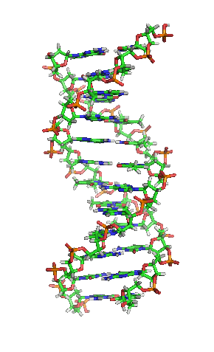
DNA CHARACTERISTICS
Functions
Quantity
Structure
Double-helix model :
2 antiparallel strands,
5΄ 3΄ orientation each
Polarity of a molecule
3-5 phosphodiester bond
Complementarity
Biology Lecture E. Anastasiadou Bioinformatics – Biomedical Data Science 2021-2022

Slide 26
QUANTITY OF DNA
The amount of DNA in each organism is stable regardless of the environment. The amount of DNA is the same in all cells of an organism (spleen, liver, etc.).
Gametes (haploid) of the higher organisms contain half the amount of DNA than somatic cells (diploids).
The amount of DNA is proportional to the complexity of the organism. The higher in evolution, the more DNA contains each cell.
Each organism has a different base ratio
Biology Lecture E. Anastasiadou Bioinformatics – Biomedical Data Science 2021-2022

Slide 27
THE FUNCTIONS OF THE GENETIC MATERIAL
The genetic material controls the cell's functions:
Storage of genetic information. DNA (RNA in RNA-viruses) contains information about the characteristics of the organism and is organized into units, the genes.
Conservation and transfer of cell-to-cell and organism-to-organism genetic information: Duplication.
Expression of genetic information by protein synthesis.
Biology Lecture E. Anastasiadou Bioinformatics – Biomedical Data Science 2021-2022

Slide 28
DNA REPLICATION
Biology Lecture E. Anastasiadou Bioinformatics – Biomedical Data Science 2021-2022

Slide 29
DNA REPLICATION
The replication of DNA evolves as follows:
Hydrogen bonds are broken between complementary bases.
The double-stranded helix unfolds as the bonds break.
The clones are copied simultaneously thanks to the DNA polymerase III enzyme according to the principle of complementarity.
Thus, depending on the base containing each nucleotide of the parent strand, a new nucleotide is aligned against it. The new nucleotides are linked by covalent bonds. Gradually the two parent strands are completely separated as new ones are formed.
Every new strand is complementary to the parent, which is used as blueprint.
In prokaryotics, replication begins at one point, while in eukaryotes at many and so has a higher rate of replication.
Biology Lecture E. Anastasiadou Bioinformatics – Biomedical Data Science 2021-2022

Slide 30
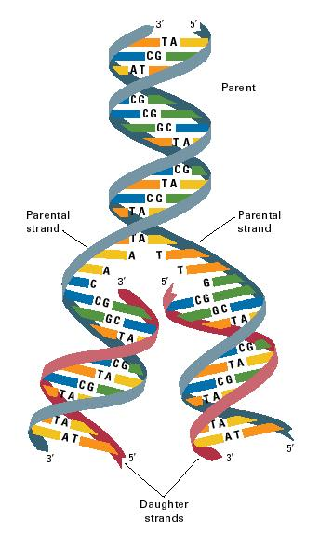
DNA REPLICATION
This way of DNA replication is called semi-conservative, because each new daughter molecule consists of an old (parental) strand and a new (daughter) strand.
Biology Lecture E. Anastasiadou Bioinformatics – Biomedical Data Science 2021-2022

Slide 31
DNA REPLICATION
5 '- 3' replication occurs in both prokaryotic as well as eukaryotic organisms
Biology Lecture E. Anastasiadou Bioinformatics – Biomedical Data Science 2021-2022

Slide 32
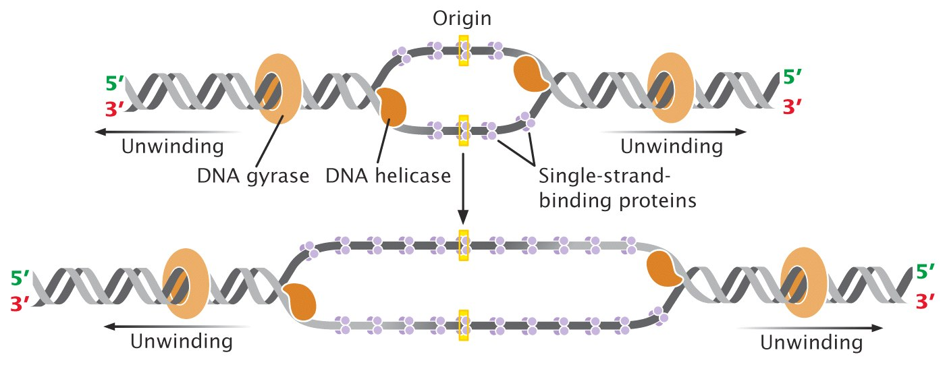
DNA REPLICATION
Replication Bubble Forms
Directionality
Helper proteins
Helper proteins
Biology Lecture E. Anastasiadou Bioinformatics – Biomedical Data Science 2021-2022

Slide 33
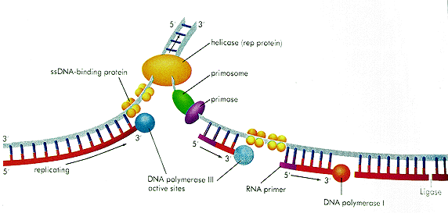
DNA REPLICATION
Leading strand
Helicase
ssDNA binding protein
primosome
primase
E. coli DNA replication
Lagging strand
replicating
DNA polymerase III
Active sites
RNA primer
Ligase
DNA polymerase I
Biology Lecture E. Anastasiadou Bioinformatics – Biomedical Data Science 2021-2022

Slide 34
Biology Lecture E. Anastasiadou Bioinformatics – Biomedical Data Science 2021-2022

Slide 35
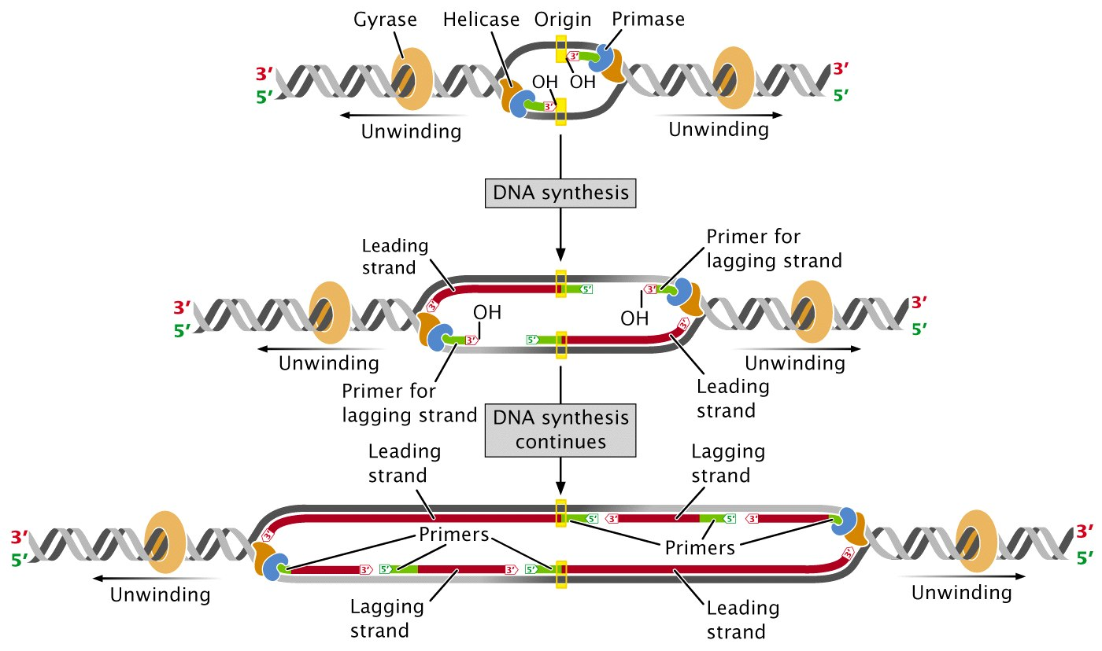
Step 3: Primase
Step 4. Elongation
Okazaki Fragments
Biology Lecture E. Anastasiadou Bioinformatics – Biomedical Data Science 2021-2022

Slide 36
Biology Lecture E. Anastasiadou Bioinformatics – Biomedical Data Science 2021-2022

Slide 37
DNA REPLICATION
Unwind DNA helix with DNA Helicase.
A single strand binding (SSB) protein complex is formed and stabilizes single strand DNA.
RNA primer formation by RNA Primase.
Initiation of synthesis of leading strand by DNA polymerase III.
Initiation of synthesis of the lagging strand by DNA polymerase III.
Construction of Okazaki fragments.
Elongation of the leading strand.
Replace ribonucleotides with deoxyribonucleotides by DNA polymerase I.
Linking the modified Okazaki fragments with Ligase.
Completion of the synthesis of the leading and lagging strands.
Biology Lecture E. Anastasiadou Bioinformatics – Biomedical Data Science 2021-2022

Slide 38
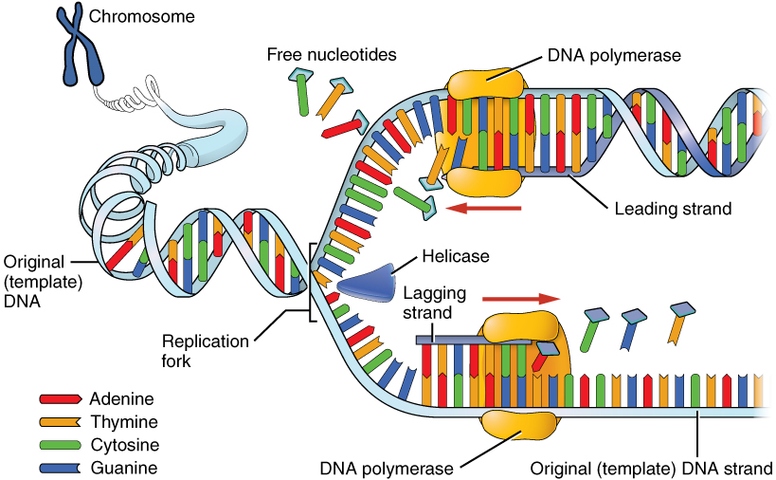
Biology Lecture E. Anastasiadou Bioinformatics – Biomedical Data Science 2021-2022

Slide 39
MULTIPLE POSITIONS OF ORIGIN OF DNA REPLICATION
A bubble appears along the DNA. The arrows indicate the direction of DNA replication at the two ends of the bubble (replication bubble).
Biology Lecture E. Anastasiadou Bioinformatics – Biomedical Data Science 2021-2022

Slide 40
Animation:
https://www.youtube.com/watch?v=TNKWgcFPHqw
https://www.youtube.com/watch?v=TEQMeP9GG6M
http://www.youtube.com/watch?v=-mtLXpgjHL0&feature=related
Biology Lecture E. Anastasiadou Bioinformatics – Biomedical Data Science 2021-2022

Slide 42
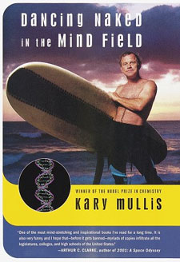
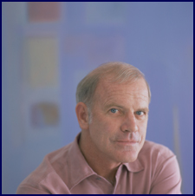
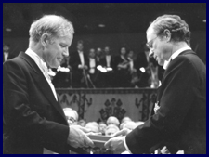
Polymerase Chain Reaction - PCR
Probably the most popular and widely used technique in studies and applications in all areas of biological sciences.
Unusual Origin of PCR Mullis KB, 1990
Scientific American
1966, Thomas Brock discovers thermostable bacteria, Thermus aquaticus, in the hot springs of the Yellowstone National Park.
1983, Kary Mullis captures the concept of PCR (Nobel Prize 1993)
1985, scientists from Cetus Corp. isolate thermostable polymerase (Taq).
1993 Nobel Prize in Chemistry
Biology Lecture E. Anastasiadou Bioinformatics – Biomedical Data Science 2021-2022

Slide 43
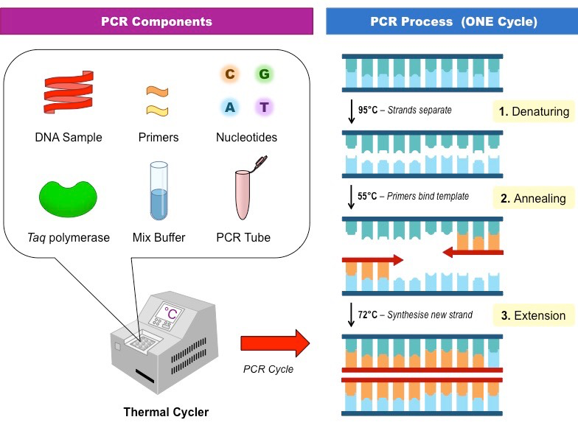
PCR
Stages:
DNA double strand separation.
Primer annealing to complementary DNA strand.
Synthesis of new DNA clones
by DNA-polymerase and dNTPs.
Goal: Amplification of DNA molecules through replication
Biology Lecture E. Anastasiadou Bioinformatics – Biomedical Data Science 2021-2022

Slide 44
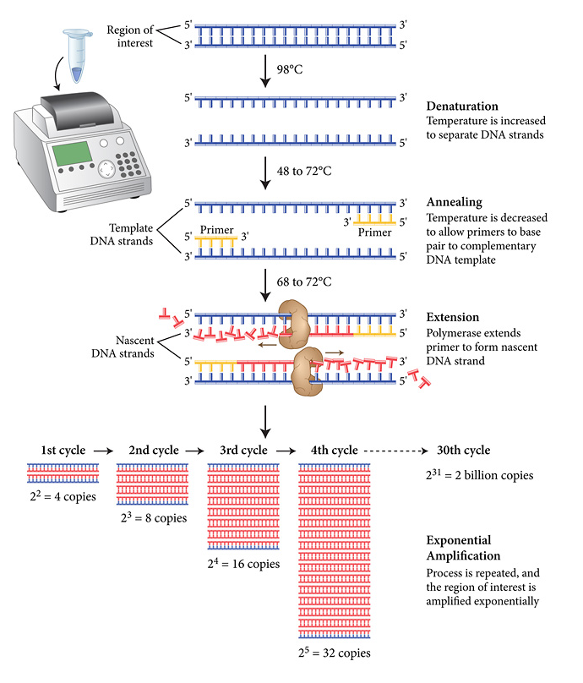
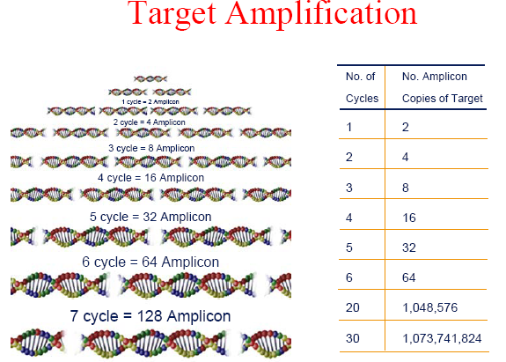
PCR
simple
sensitive
specific
reliable
quick
dynamic
Biology Lecture E. Anastasiadou Bioinformatics – Biomedical Data Science 2021-2022

Slide 45
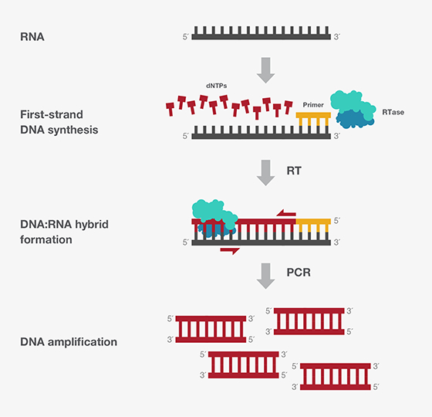
Reverse Transcriptase PCR - RT-PCR
Uses
RNA as template and
DNA polymerase enzyme for
RNA-directed ds cDNA synthesis
Biology Lecture E. Anastasiadou Bioinformatics – Biomedical Data Science 2021-2022

Slide 46
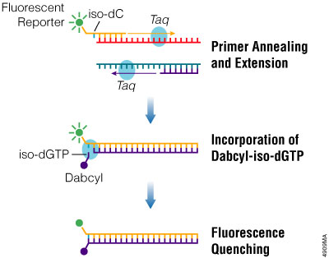
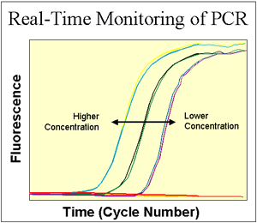
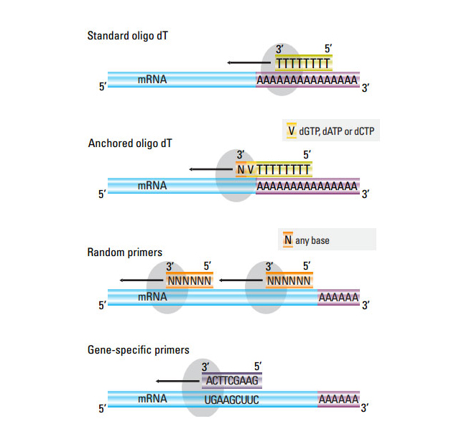
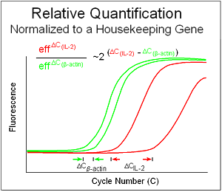
REAL TIME PCR
Biology Lecture E. Anastasiadou Bioinformatics – Biomedical Data Science 2021-2022

Slide 47
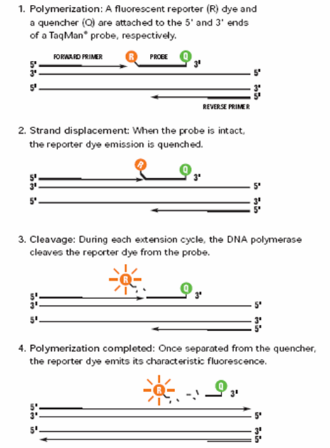
REAL TIME PCR
Biology Lecture E. Anastasiadou Bioinformatics – Biomedical Data Science 2021-2022

Slide 48
Biology Lecture E. Anastasiadou Bioinformatics – Biomedical Data Science 2021-2022

Slide 49
Biology Lecture E. Anastasiadou Bioinformatics – Biomedical Data Science 2021-2022

Slide 50
Biology Lecture E. Anastasiadou Bioinformatics – Biomedical Data Science 2021-2022

Slide 51
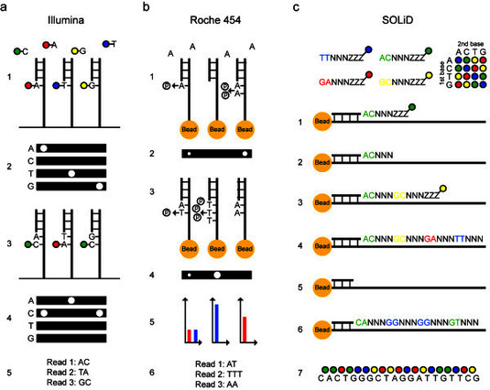
Biology Lecture E. Anastasiadou Bioinformatics – Biomedical Data Science 2021-2022

Slide 52
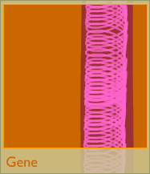
Genes determine the characteristics (brown or blue eyes, long or short fingers, etc.). Genes also control everything from how cells grow to how they interact with each other. A gene can range from 100 base pairs of DNA to several millions.
GENES
Biology Lecture E. Anastasiadou Bioinformatics – Biomedical Data Science 2021-2022

Slide 53
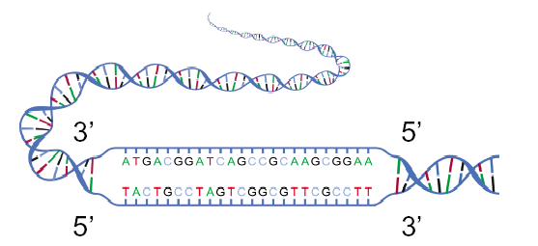
GENES
Genes are the basic units of heredity.
A gene encodes a protein by storing the necessary information for its construction and is the nucleotide sequence of a portion of the DNA, which is a model for the synthesis of an RNA.
The human genome consists of about ~ 25,000 genes.
Biology Lecture E. Anastasiadou Bioinformatics – Biomedical Data Science 2021-2022

Slide 54
GENE ORGANIZATION
The largest known gene (2.4 million bases in length) is associated with Duchenne muscular dystrophy.
Biology Lecture E. Anastasiadou Bioinformatics – Biomedical Data Science 2021-2022

Slide 55
GENOME
The total genetic material of a cell consists the genome of the cell (we usually imply the nuclear genetic material).
Each cell includes the entire genome of an organism.
Cells with 1 copy of genome (prokaryotes, gametes of eukaryotic organisms) are called haploids. Cells with 2 copies of genes (upper eukaryotic organisms) are called diploids. The human genome consists of 46 chromosomes.
To describe the length or sequence of nucleic acid, we use the term DNA sequence, meaning the nucleotide sequence (e.g., DNA: 10000 base pairs, RNA: 5000 bases).
Biology Lecture E. Anastasiadou Bioinformatics – Biomedical Data Science 2021-2022

Slide 56
HUMAN GENOME PROJECT
15 year project sequence 3.2 billion bases
started in 1990
required 4 years to determine the first billion basis
4 months for the second billion bases and in January 2003, 1.5 billion basis
In 1993: $ 10 per base
In April 2003: 10 cents per base
Biology Lecture E. Anastasiadou Bioinformatics – Biomedical Data Science 2021-2022

Slide 57
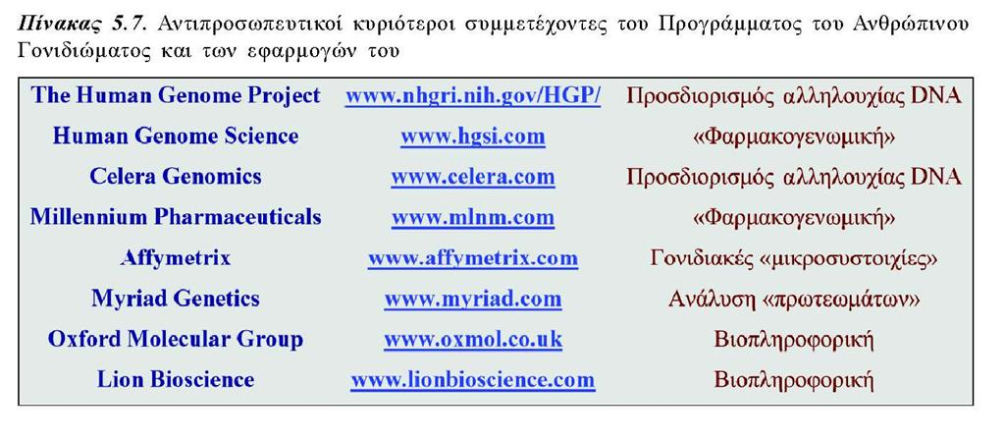
Biology Lecture E. Anastasiadou Bioinformatics – Biomedical Data Science 2021-2022

Slide 58
1997: E. coli Genome Sequenced 1998: M. Tuberculosis Bacterium Sequenced 1998: Genome of Roundworm C. elegans Sequenced 1999: Chromosome 22
2000: Free Access to Genomic Information 2000: Chromosome 21 2000: Drosophila and Arabidopsis genomes sequenced 2001: First Draft of the Human Genome Sequence Released
2002: Mouse Genome Sequenced 2002: Rice Genome Sequenced 2003: Human Genome Project Completed 2003: ENCODE Program Begins
2004: Rat and Chicken Genomes Sequenced 2004: Refined Analysis of Complete Human Genome Sequence 2005: Chimpanzee Genomes Sequenced 2005: Trypanosomatid Genomes Sequenced 2005: Dog Genomes Sequenced 2006: The Cancer Genome Atlas (TCGA) Project Started 2006: Second Non-human Primate Genome is Sequenced
Biology Lecture E. Anastasiadou Bioinformatics – Biomedical Data Science 2021-2022

Slide 59
THE FUTURE
Data from –omic approaches are increasing.
Need for:
Acquisition
Storage
Access
Analysis
Biology Lecture E. Anastasiadou Bioinformatics – Biomedical Data Science 2021-2022

Slide 60
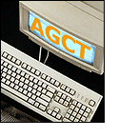
THE FUTURE
Collection and distribution of data.
Creation and operation of databases.
Software development for large-scale analysis.
Developing tools to compare and interpret the data.
Dissemination of information to the scientific community.
Dissemination of information to the general public.
Technology development.
Large-scale data manipulation faster and cheaper.
Biology Lecture E. Anastasiadou Bioinformatics – Biomedical Data Science 2021-2022

