Slide 1
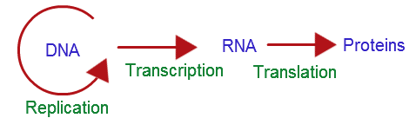
The Central Dogma
Biology Lecture E. Anastasiadou Bioinformatics – Biomedical Data Science 2022-2023

Slide 2
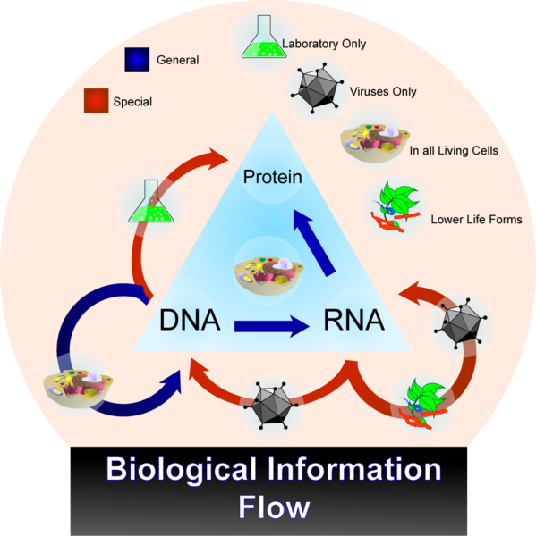
The Central Dogma Of Molecular Biology
The DNA replicates and produces two daughter molecules identical to the original.
DNA is transcribed and produces RNA.
RNA is translated and produces proteins.
exception: some viruses that have as genetic material RNA they make DNA from. This process is called reverse transcription.
Biology Lecture E. Anastasiadou Bioinformatics – Biomedical Data Science 2022-2023

Slide 3
The Central Dogma Of Molecular Biology
Biology Lecture E. Anastasiadou Bioinformatics – Biomedical Data Science 2022-2023

Slide 4
TRANSCRIPTION
Biology Lecture E. Anastasiadou Bioinformatics – Biomedical Data Science 2022-2023

Slide 5
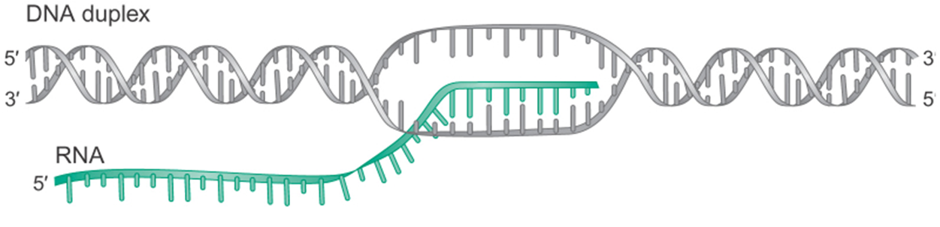
TRANSCRIPTION
Transcription is the process during which the genetic information stored and written in the language of the DNA is transcribed in the language of the RNA.
It is based on the principle of complementarity of the bases, but instead of thymine, the uracil nitrogen base is used.
Biology Lecture E. Anastasiadou Bioinformatics – Biomedical Data Science 2022-2023

Slide 6

BASIC UNIT OF TRANSCRIPTION
terminator
Promoter
Transcription start site
RNA coding region
Terminator
Let’s look closely at the process of transcription.
Biology Lecture E. Anastasiadou Bioinformatics – Biomedical Data Science 2022-2023

Slide 7
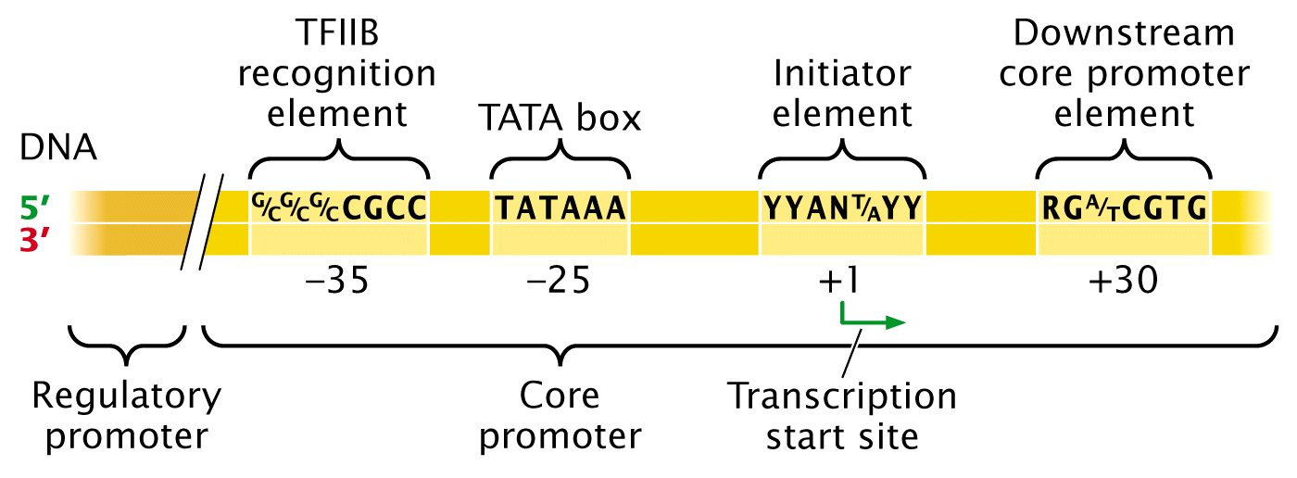
RNA POLYMERASE ΙΙ PROMOTER
Defines the starting point and the rate of transcription
Biology Lecture E. Anastasiadou Bioinformatics – Biomedical Data Science 2022-2023

Slide 8
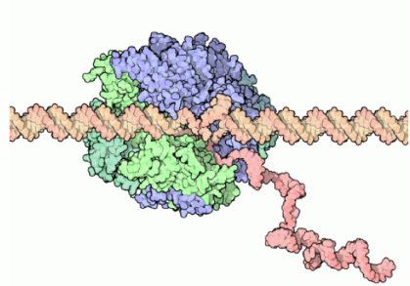
eukaryotic RNA POLYMERASES
Eukaryotic RNA polymerases cannot find or bind to a promoter by themselves. They require the binding of assembly factors and a positional factor to locate the promoter and to orient the polymerase correctly.
There may be as many as 14 subunits in an eukaryotic RNA polymerase; the total molecular weight is typically 500-700 kD.
3 distinct RNA polymerases in a eukaryotic cell nucleus define the three major classes of eukaryotic transcription unit:
Class I genes or transcriptional units: transcribed by RNA polymerase I (13 subunits) in the nucleolus. Example: rRNA transcription units.
Class II genes or transcription Units: transcribed by RNA polymerase II (12 subunits) that can transcribe RNA from nicked dsDNA templates or from ssDNA templates. However, by itself, it cannot initiate transcription at a promoter. In this respect, it resembles the core form of bacterial RNA polymerase. Example: mRNA.
Class III genes or transcription Units: are principally small RNA molecules transcribed by the largest and most active polymerase, RNA polymerase III (17 subunits). The best studied examples are the 5S rRNA gene and tRNA genes.
polymerase | location | type of RNA transcribed
I | Nucleus/nucleolus | Large rRNA
II | nucleus | pre-mRNA, some snRNAs, some snoRNAs
III | nucleus | small RNA such as tRNA and 5S rRNA, and snRNAs
Biology Lecture E. Anastasiadou Bioinformatics – Biomedical Data Science 2022-2023

Slide 9
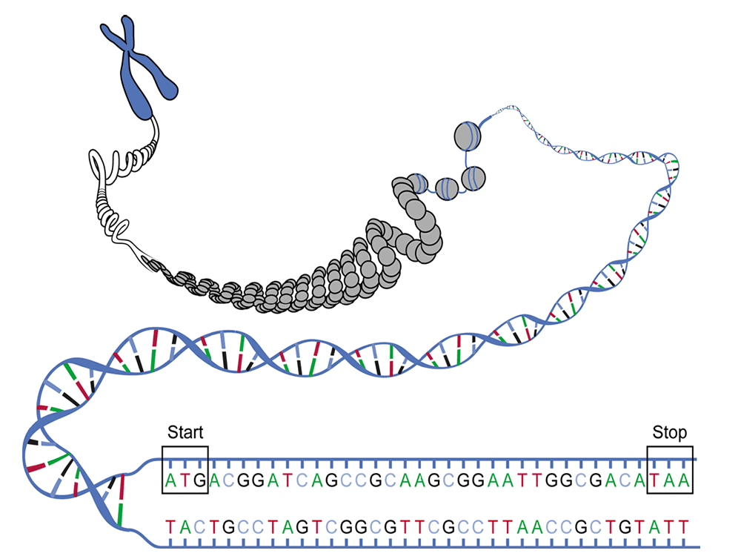
ORIGIN OF TRANSCRIPTION
Localization of genes is theoretically easy as DNA sequences, encoding for proteins, start with the ATG bases and end with one or more termination codons (TAA, TAG or TGA). But finding genes is not always easy.
It is easier to identify genes in bacterial DNA than in eukaryotic. In bacteria, the genes are positioned like beads in a row. Each gene consists of a single ORF. The condition in eukaryotic organisms is complicated by the split nature of the genes as most eukaryotic genes consist of alternating exons and introns.
Biology Lecture E. Anastasiadou Bioinformatics – Biomedical Data Science 2022-2023

Slide 10
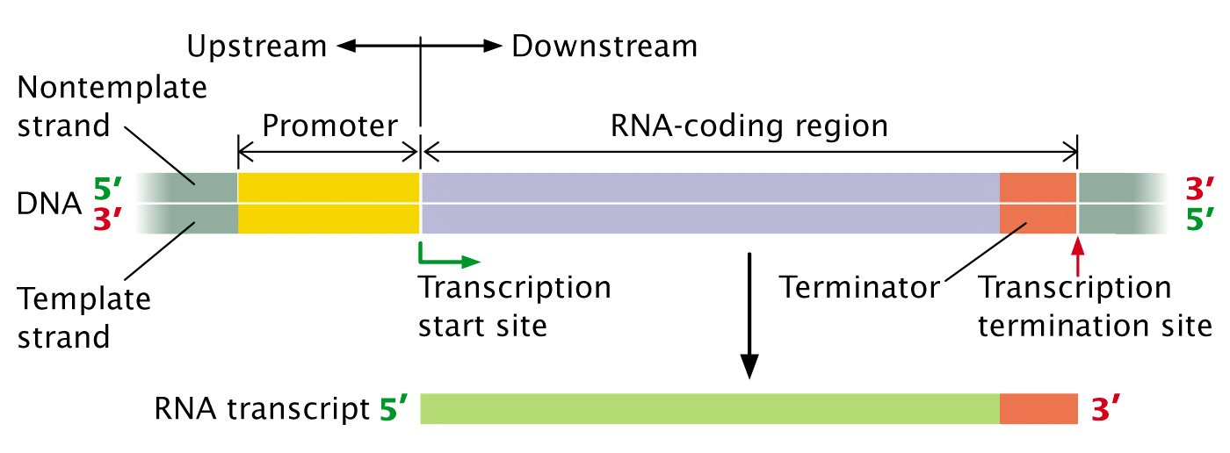
CODING & NON CODING STRAND OF DNA
In transcription, one DNA strand, the non-coding strand, is used as a blueprint for the RNA synthesis. As the transcription proceeds in the 5 → 3 direction, it is based on the complementarity of the DNA bases of the DNA template clone with the 3 '→ 5' direction. The clone not used as a template is called coding strand and its sequence reflects that of the RNA produced.
Biology Lecture E. Anastasiadou Bioinformatics – Biomedical Data Science 2022-2023

Slide 11
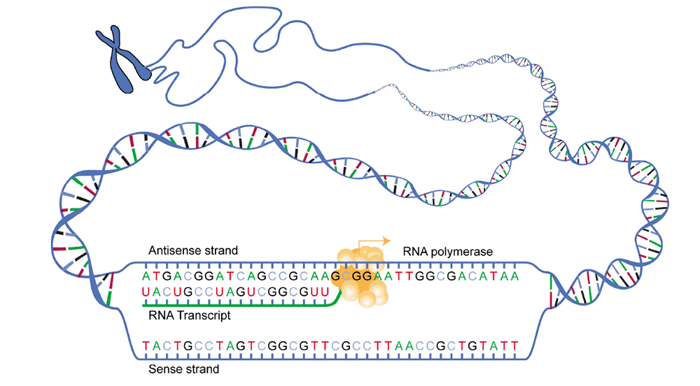
The DNA clone encoding the protein is called sense because its sequence reads the same as that of the messenger RNA. The other strand is the antisense and serves as a matrix for RNA polymerase during transcription.
Biology Lecture E. Anastasiadou Bioinformatics – Biomedical Data Science 2022-2023

Slide 12
http://www.youtube.com/watch?v=WsofH466lqk
https://www.youtube.com/watch?v=zNbycmLouog
Biology Lecture E. Anastasiadou Bioinformatics – Biomedical Data Science 2022-2023

Slide 13
TRANSCRIPTION
DNA genetic material is found in the nucleus, while the ribosomes in which the protein synthesis occurs, are found outside of it, so genetic information has to be reached there. The DNA does not move out of the nucleus for the following reasons:
- The nuclear membrane is impervious to DNA.
- Often the cell produces multiple molecules of a protein and therefore it would be impossible for the same DNA molecule to be present at different ribosomes simultaneously.
Transmission problems of genetic information are solved with an intermediate molecule, mRNA or messenger RNA.
The mRNA is produced in the nucleus via the DNA transcription process and transfers information from the nucleus to the cytoplasm.
Biology Lecture E. Anastasiadou Bioinformatics – Biomedical Data Science 2022-2023

Slide 14
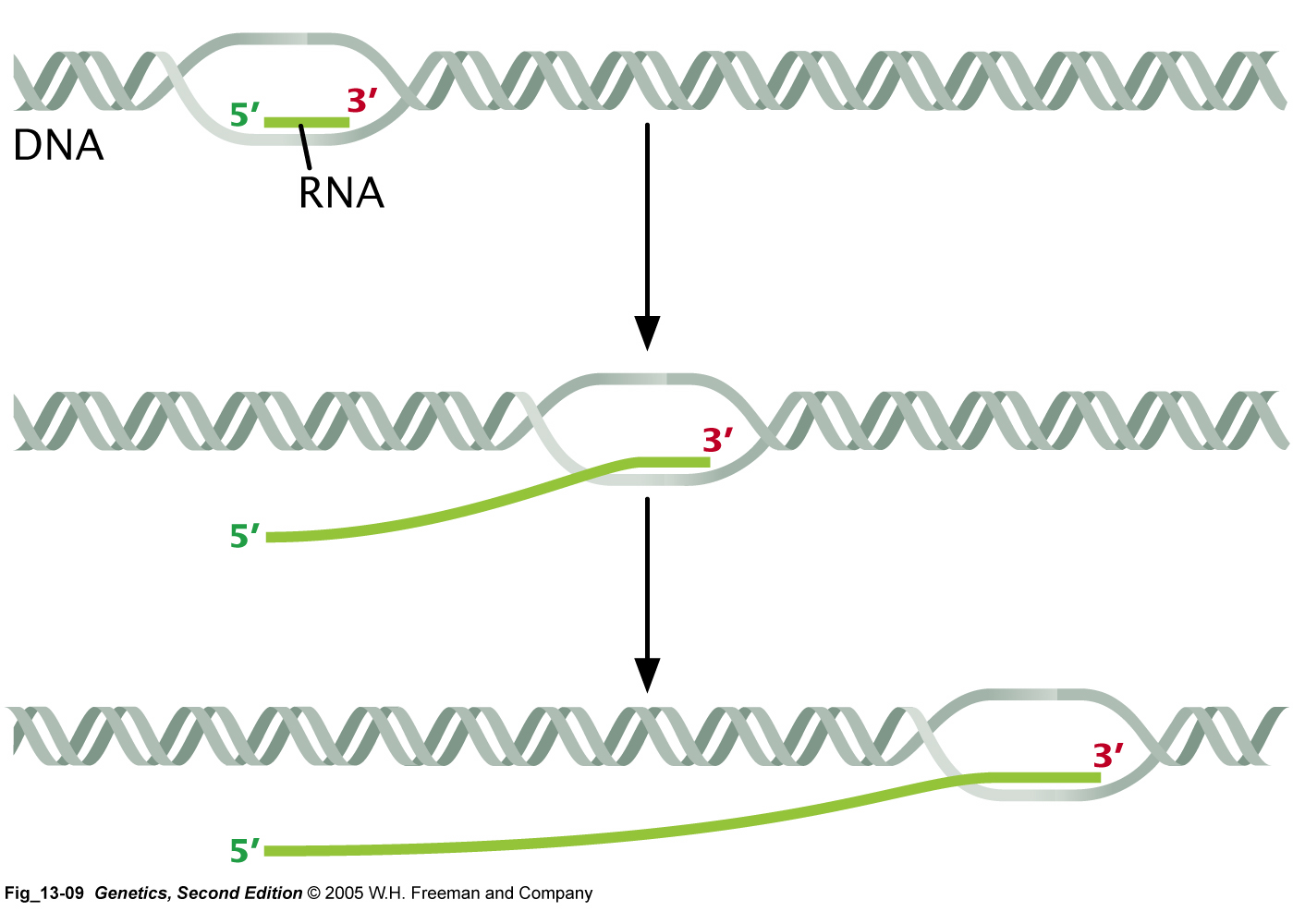
TRANSCRIPTION STAGES
Initiation
Elongation
Termination
Biology Lecture E. Anastasiadou Bioinformatics – Biomedical Data Science 2022-2023

Slide 15
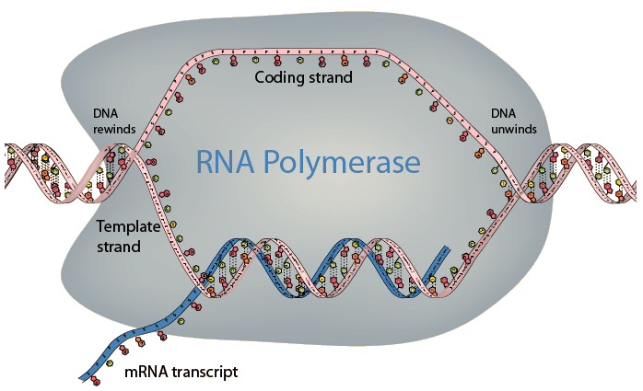
TRANSCRIPTION
RNA transcription from DNA evolves as follows:
The hydrogen bonds between the complementary bases break in the part of the DNA strand that has the requested genetic information and the double helix opens.
Due to the complementarity towards each deoxyribonucleotide of one strand of DNA, a complementary ribonucleotide is aligned. The RNA-polymerase enzyme sequentially connects the ribonucleotides by covalent bonding, thereby forming a single-stranded RNA molecule.
Biology Lecture E. Anastasiadou Bioinformatics – Biomedical Data Science 2022-2023

Slide 16
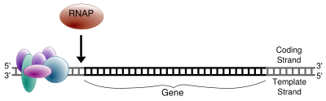
INITIATION
Transcription begins with the binding of RNA polymerase to the promoter. In prokaryotes, the RNA polymerase is a central enzyme consisting of five subunits. At the start of the procedure, the enzyme binds to a sigma factor (number 70) that helps find the appropriate -35 and -10 bases downstream of the promoter.
The onset of transcription is much more complex in eukaryotes. The main difference is that the eukaryotic polymerases do not directly recognize the promoter sequences. In contrast to replication, transcription does not require a primer to initiate its RNA polymerase activity. The DNA unfolds and produces a small open complex and synthesis begins only on the clone-matrix.
RNAP = RNA polymerase
Biology Lecture E. Anastasiadou Bioinformatics – Biomedical Data Science 2022-2023

Slide 17

ELONGATION
In contrast to DNA replication, transcription of the mRNA may involve multiple RNA polymerases on a single DNA matrix, so that many mRNA molecules can be produced from a single copy of a gene. This step also includes a proofreading mechanism that can replace errors in RNA.
Biology Lecture E. Anastasiadou Bioinformatics – Biomedical Data Science 2022-2023

Slide 18
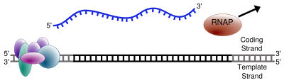
TERMINATION
Bacteria use two different strategies for terminating transcription:
In "Rho-independent termination," transcription stops when the newly synthesized RNA molecule forms a hairpin loop, followed by Us, causing the detachment from the template (DNA).
In the "Rho-dependent" termination pattern, a protein called "Rho" destabilizes the interaction between the template and the RNA, thus releasing the newly synthesized mRNA from the elongation complex.
Ending transcription in eukaryotes is less understandable. It involves "cleavage" of the new transcript and addition of As at the 3’ end, regardless of the DNA sequence that is used as template, during a process called polyadenylation.
Biology Lecture E. Anastasiadou Bioinformatics – Biomedical Data Science 2022-2023

Slide 19
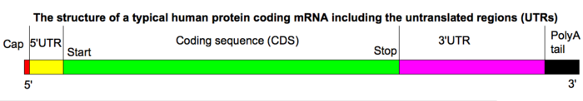
POST-TRANSCRIPTIONAL MODIFICATIONS
5’ cap addition
3' poly(A) tail addition
Splicing
Let’s look closely at the process of transcription.
Biology Lecture E. Anastasiadou Bioinformatics – Biomedical Data Science 2022-2023

Slide 20
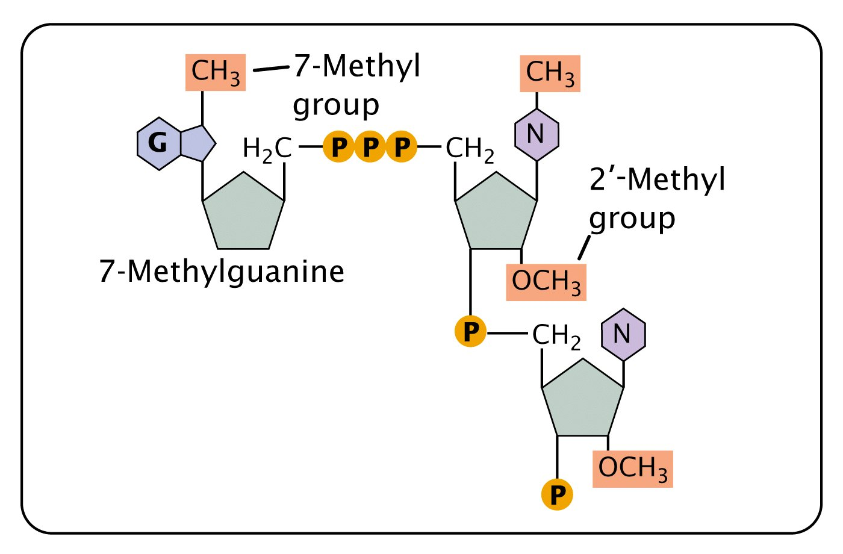
5' cap
The 5’ cap is a modified guanine nucleotide added at the 5' end of the pre-mRNA using a 5', 5-triphosphate bond. This modification is critical for the identification and proper binding of mRNA to the ribosome as well as 5’ exonuclease protection. It can also be important for other essential processes such as splicing and transport.
Biology Lecture E. Anastasiadou Bioinformatics – Biomedical Data Science 2022-2023

Slide 21
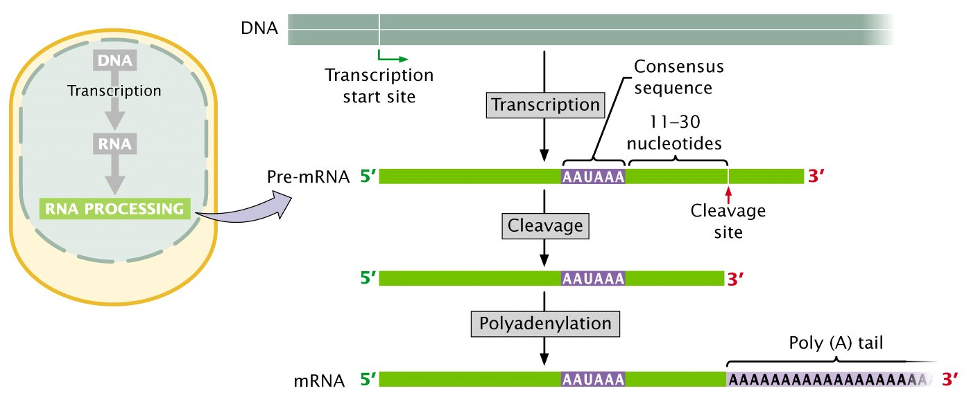
3' poly(A) tail
The 3’ poly (A) "tail" is a long adenine nucleotide sequence (often several hundreds) added to the 3' end of pre-mRNA via the action of an enzyme, the polyadenylate polymerase. In higher eukaryotes, the poly (A) tail is added to transcripts containing a particular sequence, the AAUAAA. The significance of the AAUAAA signal is evidenced by a mutation in the human alpha 2-globin gene, which alters the original AATAAA sequence in AATAAG, leading to hemoglobin dysfunctions.
Biology Lecture E. Anastasiadou Bioinformatics – Biomedical Data Science 2022-2023

Slide 22
https://www.youtube.com/watch?v=DoSRu15VtdM
Biology Lecture E. Anastasiadou Bioinformatics – Biomedical Data Science 2022-2023

Slide 23
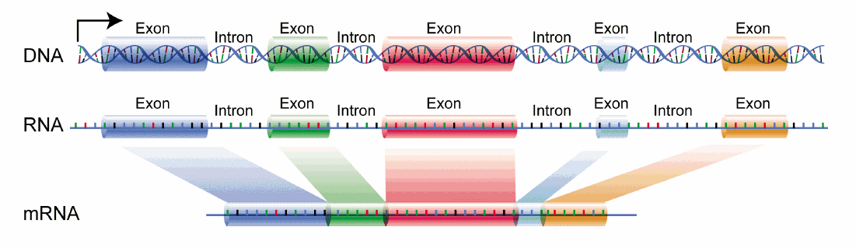
RNA splicing
Most eukaryotic genes consist of alternating exons and introns. Each exon encodes a protein segment. Introns do not encode amino acids but contain regulatory sequences and internal termination codons.
Biology Lecture E. Anastasiadou Bioinformatics – Biomedical Data Science 2022-2023

Slide 24
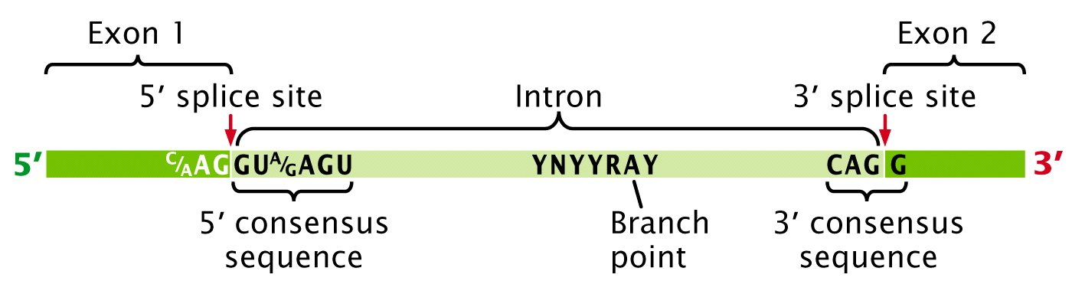
Splicing: 3 components are required
Note some important aspects of the 5’ and 3’ ends
5’ phosphodiester of G
2’ OH of A
Biology Lecture E. Anastasiadou Bioinformatics – Biomedical Data Science 2022-2023

Slide 25
https://www.youtube.com/watch?v=AVABXkK5Q_o
https://www.youtube.com/watch?v=OfeYFF85u-U
Biology Lecture E. Anastasiadou Bioinformatics – Biomedical Data Science 2022-2023

Slide 26
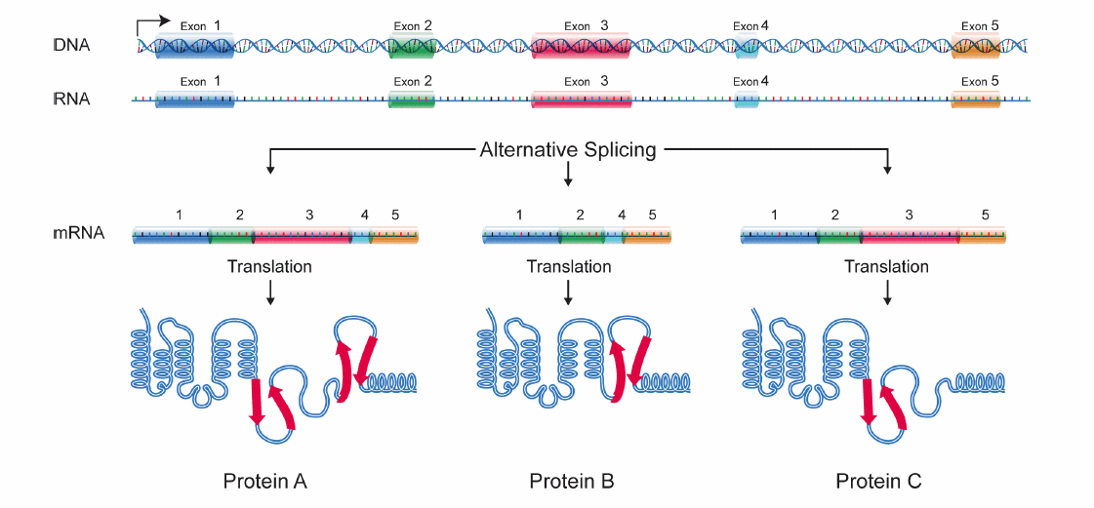
One of the surprises of the Human Genome Program was the relatively small number of genes found, ~ 25,000. One could ask, "How can something as complex as humans have only 25% more genes than the small warm C. elegans? Part of the answer seems to be interpreted with alternative splicing. Alternative splicing refers to the process by which a given gene with alternative splices predominates more than one type of mRNA molecule.
Biology Lecture E. Anastasiadou Bioinformatics – Biomedical Data Science 2022-2023

Slide 27
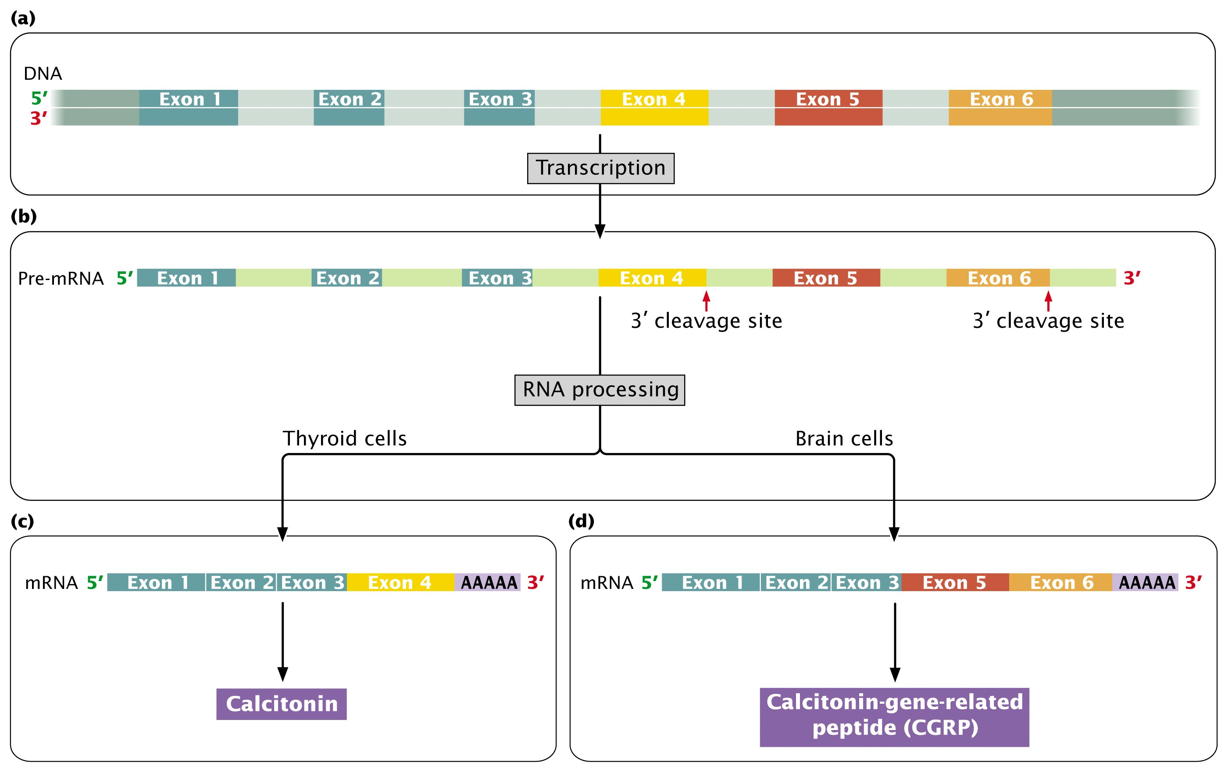
Biology Lecture E. Anastasiadou Bioinformatics – Biomedical Data Science 2022-2023

Slide 28
http://www.youtube.com/watch?v=OEWOZS_JTgk&feature=related
Biology Lecture E. Anastasiadou Bioinformatics – Biomedical Data Science 2022-2023

Slide 30
GENETIC CODE
Biology Lecture E. Anastasiadou Bioinformatics – Biomedical Data Science 2022-2023

Slide 31
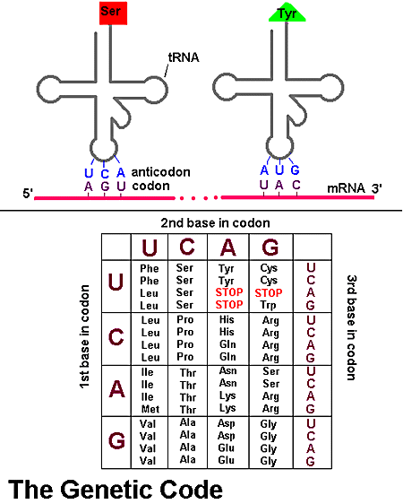
GENETIC CODE
Genetic code is called the total of correlation of codons to specific amino acids during translation.
Codon is called any successive triad of nucleotides encoding an amino acid.
Biology Lecture E. Anastasiadou Bioinformatics – Biomedical Data Science 2022-2023

Slide 32
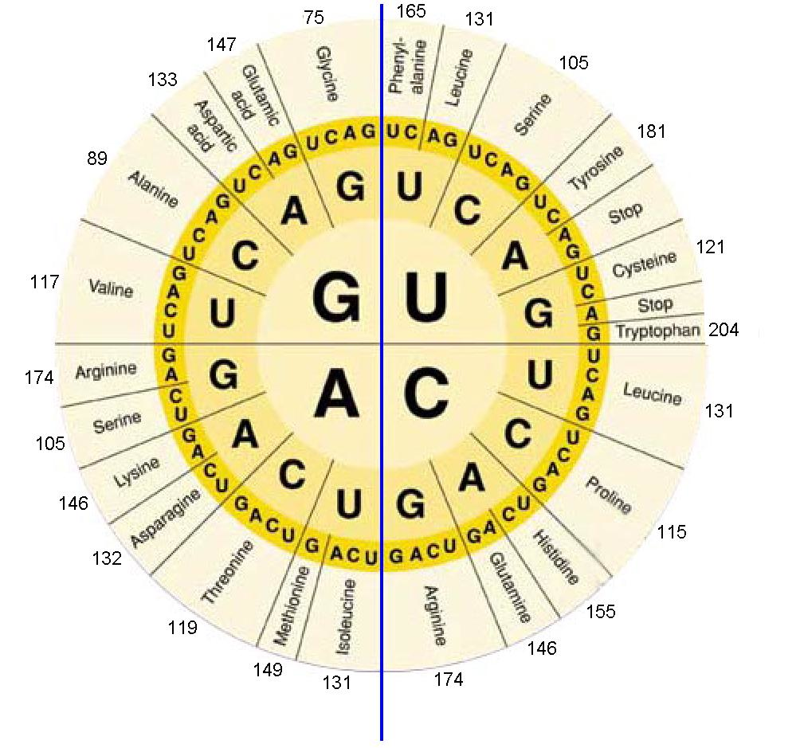
GENETIC CODE
Between deoxyribonucleotides and ribonucleotides, the correlation is one to one.
But the correlation between bases of ribonucleotides and amino acids is more complex. It is not one to one because more than four different amino acids are required.
Neither two to two because the different duplex of bases would be 4²=16 and thus 16 amino acids at the most would be coded.
A triple of bases corresponds to an amino acid. The different triads are 4³=64, so they are sufficient to cover all amino acids.
Biology Lecture E. Anastasiadou Bioinformatics – Biomedical Data Science 2022-2023

Slide 33
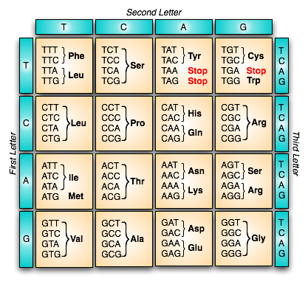
GENETIC CODE
A gene starts with a codon for the amino acid methionine (ATG), the start codon, and ends with one of the 3 termination codons (TAA, TAG, TGA). The codons between the start and stop signals encode for the various amino acids of the gene product.
Biology Lecture E. Anastasiadou Bioinformatics – Biomedical Data Science 2022-2023

Slide 34
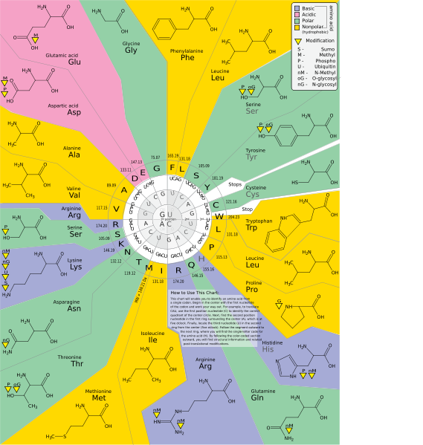
GENETIC CODE
Biology Lecture E. Anastasiadou Bioinformatics – Biomedical Data Science 2022-2023

Slide 35
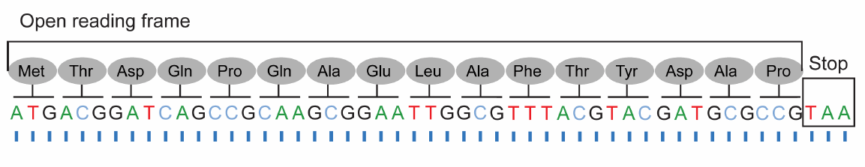
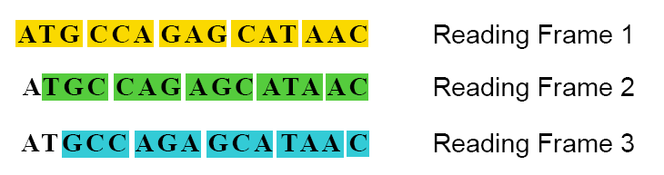
OPEN READING FRAME
When examining an unknown DNA sequence, an indication that it may be part of a gene is the presence of an Open Reading Frame or ORF.
An ORF is any part of the DNA that when transcribed into RNA does not contain a stop codon.
A computer program can be used to test an unknown DNA sequence for ORFs. It transcribes each chain of DNA into complementary RNA and translates into amino acids in all three different reading frames, performing six different translations for each given double-stranded DNA sequence.
Biology Lecture E. Anastasiadou Bioinformatics – Biomedical Data Science 2022-2023

Slide 36
GENETIC CODE
The genetic code has the following characteristics:
It is ternary, that is, a nucleotide triad encodes an amino acid.
One (AUG) encodes for initiation of translation and for the amino acid methionine.
Three (UAG, UAA, UGA) encode for the end of the translation.
It is degenerative, that is, each amino acid (except two) is encoded by more than one codon, the so-called synonyms.
It is not overlapping. Translation starting from defined points in the mRNA (AUG) proceeds by one codon at each step. Thus, each nucleotide acts as a member of only one triad.
It is universal. Any codon has the same meaning in all organisms. This is a strong argument in favor of the common origin of species.
Biology Lecture E. Anastasiadou Bioinformatics – Biomedical Data Science 2022-2023

Slide 37
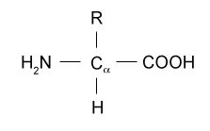
AMINO ACIDS
It is a molecule containing amino and carboxyl groups.
In biochemistry, the term "amino acid" refers to alpha-amino acids with the general formula H₂NCHRCOOH, wherein R is an organic group.
In α-amino acids, the amino and carboxyl groups bind to the same carbon atom, which is called α-carbon.
The α-amino acids differ in the side chain (group R) attached to the α-carbon. It can vary in size from just one hydrogen atom in glycine, a methyl group in alanine, to a large heterocyclic group in tryptophan.
Biology Lecture E. Anastasiadou Bioinformatics – Biomedical Data Science 2022-2023

Slide 38
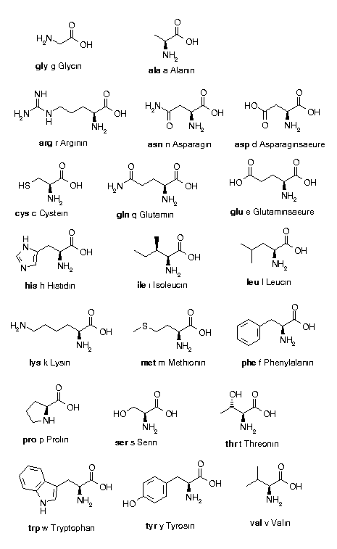
α-AMINO ACIDS
Alanine ala A CH3-CH(NH2)-COOH
Arginine arg R HN=C(NH2)-NH-(CH2)3-CH(NH2)-COOH
Asparagine asn N H2N-CO-CH2-CH(NH2)-COOH
Aspartic acid asp D HOOC-CH2-CH(NH2)-COOH
Cysteine cys C HS-CH2-CH(NH2)-COOH
Glutamine gln Q H2N-CO-(CH2)2-CH(NH2)-COOH Glutamic acid glu E HOOC-(CH2)2-CH(NH2)-COOH Glycine gly G NH2-CH2-COOH
Histidine his H NH-CH=N-CH=C-CH2-CH(NH2)-COOH
Isoleucine ile I CH3-CH2-CH(CH3)-CH(NH2)-COOH Leucine leu L (CH3)2-CH-CH2-CH(NH2)-COOH
Lysine lys K H2N-(CH2)4-CH(NH2)-COOH
Methionine met M CH3-S-(CH2)2-CH(NH2)-COOH Phenylalanine phe F Ph-CH2-CH(NH2)-COOH
Proline pro P NH-(CH2)3-CH-COOH
Serine ser S HO-CH2-CH(NH2)-COOH
Threonine thr T CH3-CH(OH)-CH(NH2)-COOH
Tryptophan trp W Ph-NH-CH=C-CH2-CH(NH2)-COOH
Tyrosine tyr Y HO-p-Ph-CH2-CH(NH2)-COOH
Valine val V (CH3)2-CH-CH(NH2)-COOH
Biology Lecture E. Anastasiadou Bioinformatics – Biomedical Data Science 2022-2023

Slide 39
PROTEINS
Large organic compound consisting of amino acids arranged in a linear chain.
They are linked by peptide bonds between the carboxyl- and amino-groups of adjacent amino acids.
The sequence of amino acids in a protein is determined by the gene and decoded by the genetic code.
Although the genetic code is defined by 20 amino acids, it is often subject to chemical alterations, post-translational modifications: either to make a protein functional in the cell, or as part of the regulation mechanisms.
Proteins can also work together to achieve a certain function, and often interact to form stable complexes.
Biology Lecture E. Anastasiadou Bioinformatics – Biomedical Data Science 2022-2023

Slide 40
proteins
https://www.youtube.com/watch?v=wvTv8TqWC48
https://www.youtube.com/watch?v=wvTv8TqWC48&t=4s
enzymes
https://www.youtube.com/watch?v=yk14dOOvwMk
Biology Lecture E. Anastasiadou Bioinformatics – Biomedical Data Science 2022-2023

Slide 41
TRANSLATION
Biology Lecture E. Anastasiadou Bioinformatics – Biomedical Data Science 2022-2023

Slide 42
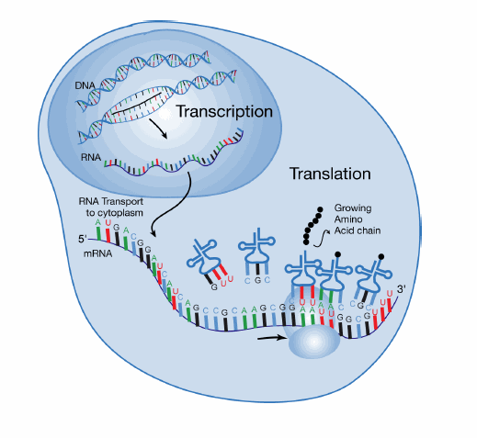
TRANSLATION
Translation is the third and final phase in the expression of the genetic information during which the protein molecule is synthesized in the ribosomes.
The sequence of the nucleotides of an mRNA determines the amino acid sequence of a polypeptide chain.
The protein synthesis develops in three stages:
Initiation
Elongation
Termination
Biology Lecture E. Anastasiadou Bioinformatics – Biomedical Data Science 2022-2023

Slide 43
TRANSLATION
The factors involved in protein synthesis are:
mRNA, encodes and stores the information.
Ribosomes, are the organelles where protein synthesis occurs.
Amino acids, are the structural blocks of the proteins.
Enzymes, protein molecules assisting the procedure.
ATP, for power supply.
tRNA, for the transport of amino acids.
Biology Lecture E. Anastasiadou Bioinformatics – Biomedical Data Science 2022-2023

Slide 44
TRANSLATION
Messenger Ribonucleic Acid (mRNA) is an RNA molecule encoding a chemical "blueprint" for a protein.
The short life of a mRNA molecule begins with transcription and eventually ends with degradation. During its lifetime, a mRNA molecule will be processed and transported prior to translation. Eukaryotic mRNA molecules often require extensive processing and transport, whereas prokaryotic molecules, do not.
Biology Lecture E. Anastasiadou Bioinformatics – Biomedical Data Science 2022-2023

Slide 45
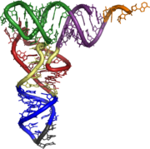
TRANSFER RNA (tRNA)
Small RNA chain (73-93 nucleotides) carrying a specific amino acid to a newly synthesized polypeptide chain, at the ribosomal position of the protein synthesis, during translation.
It has a 3’ end for covalent attachment of amino acids catalyzed by an aminoacyl-tRNA synthase.
It also contains a three-base region called the anticodon corresponding each time to the three bases of the codon in the mRNA.
Each tRNA molecule can be linked to only one type of amino acid, but because the genetic code contains multiple codons that define the same amino acid, tRNA molecules carrying different anticodons may also carry the same amino acid.
Biology Lecture E. Anastasiadou Bioinformatics – Biomedical Data Science 2022-2023

Slide 46
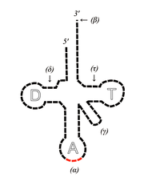
TRANSFER RNA (tRNA)
The acceptor stem is a 7- to 9-base pair (bp) stem made by the base pairing of the 5'-terminal nucleotide with the 3'-terminal nucleotide (which contains the CCA 3'-terminal group used to attach the amino acid).
The CCA tail is cytosine-cytosine-adenine sequence at the 3’ end of the tRNA molecule. The amino acid loaded onto the tRNA by aminoacyl-tRNA synthetases to form aminoacyl-tRNA, is covalently bonded to the 3'-hydroxyl group on the CCA tail. This sequence is important for the recognition of the tRNA by enzymes critical in translation.
In most prokaryotic and eukaryotic tRNAs, the CCA sequence is added during processing and therefore does not appear in the tRNA gene.
The D arm is a 4 to 6bp stem ending in a loop that often contains dihydrouracil.
The anticodon arm is a 5bp stem whose loop contains the anticodon.
The T arm is a 4 to 5bp stem containing the sequence TΨC where Ψ is pseudouridine, a modified uridine.
Modified bases, especially by methylation, occur in several positions throughout the tRNA. The first anticodon base is sometimes modified to inosine (derived from adenine) pseudouridine or lysidine (derived from cytosine).
Biology Lecture E. Anastasiadou Bioinformatics – Biomedical Data Science 2022-2023

Slide 47
https://www.youtube.com/watch?v=T54Akbu0ONU
Biology Lecture E. Anastasiadou Bioinformatics – Biomedical Data Science 2022-2023

Slide 48
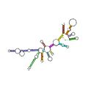
RIBOSOMAL RNA (rRNA)
RNA synthesized in the nucleus by RNA polymerase I and is the central component of the ribosome, the protein-making machinery of all living cells.
The function of rRNA is to provide a mechanism for the decoding of mRNA to amino acids and to interact with tRNAs during translation by providing peptidyl transferase activity.
Small subunit ribosomal RNA
Biology Lecture E. Anastasiadou Bioinformatics – Biomedical Data Science 2022-2023

Slide 49
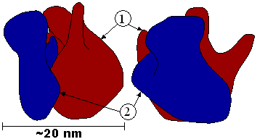
RIBOSOME
It consists of two subunits, small and large.
Between the small and large subunits, a groove is formed where the mRNA coding for the message to be translated is bound.
An mRNA can be translated simultaneously from multiple ribosomes.
Type | Size | Large subunit | Small subunit
prokaryotic | 70S | 50S (5S, 23S) | 30S (16S)
eukaryotic | 80S | 60S (5S, 5.8S, 28S) | 40S (18S)
Biology Lecture E. Anastasiadou Bioinformatics – Biomedical Data Science 2022-2023

Slide 50
http://telstar.ote.cmu.edu/Hughes/HughesArchive/tutorial/polypeptide/tutorial.swf
Biology Lecture E. Anastasiadou Bioinformatics – Biomedical Data Science 2022-2023

Slide 51
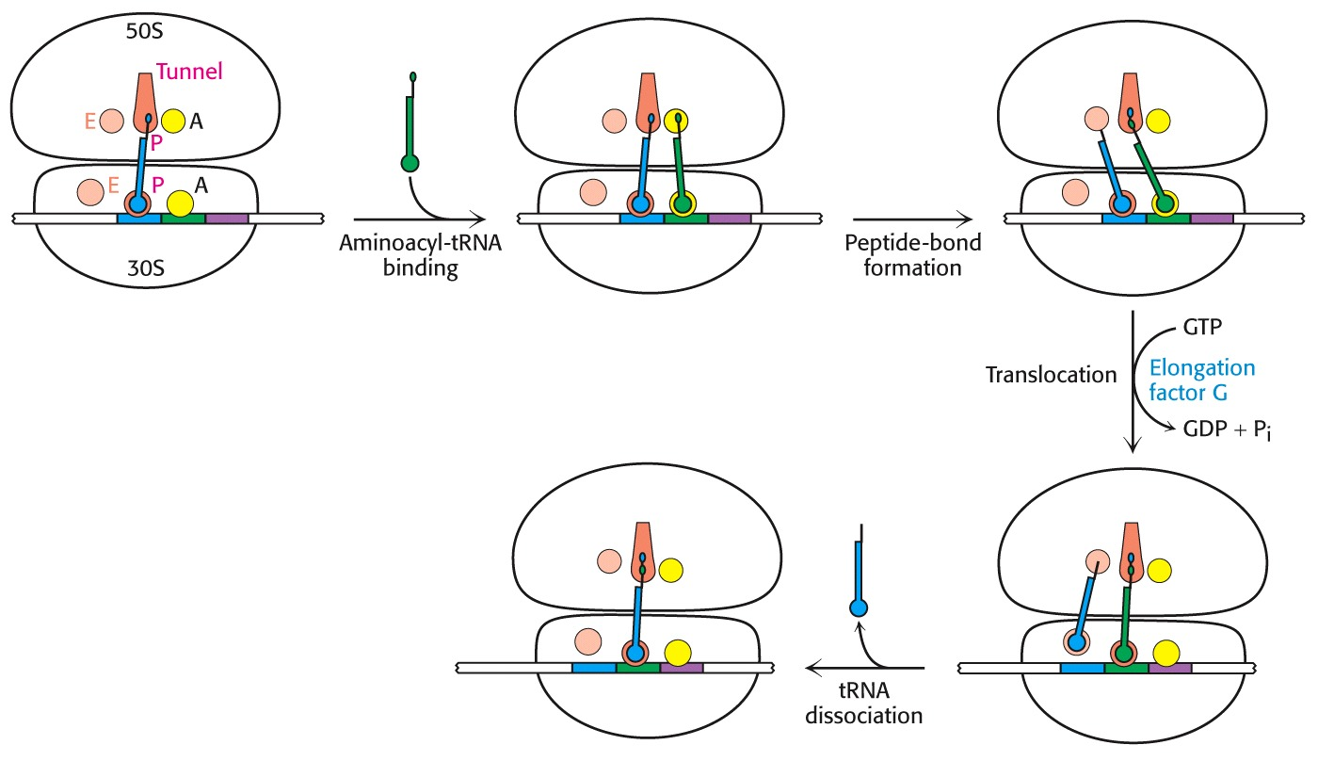
TRANSLATION
Start: mRNA binds to a specific site of the ribosome. Protein synthesis begins after the ribosome localizes the start codon (AUG). Then the tRNA binds to an anticodon complementary to AUG, carrying the amino acid methionine.
Biology Lecture E. Anastasiadou Bioinformatics – Biomedical Data Science 2022-2023

Slide 52
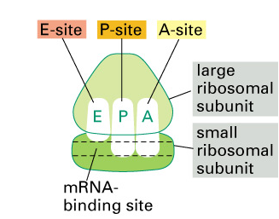
RIBOSOME
The ribosome has 3 binding sites called A, P, and E.
An aminoacyl-tRNA (a tRNA carrying an amino acid) binds to position A. The NH2-group of the amino acid of aminoacyl-tRNA interacts with the carboxyl group of the peptidyl-tRNA (located at position P), which contains the last amino acid of the growing strand.
The tRNA that carried the last amino acid moves to position E, and the aminoacyl-tRNA becomes peptidyl-tRNA.
A new tRNA is squeezed at the P site and the ribosome catalyzes the formation of a peptide bond between the 2 amino acids attached to the tRNAs.
Biology Lecture E. Anastasiadou Bioinformatics – Biomedical Data Science 2022-2023

Slide 53
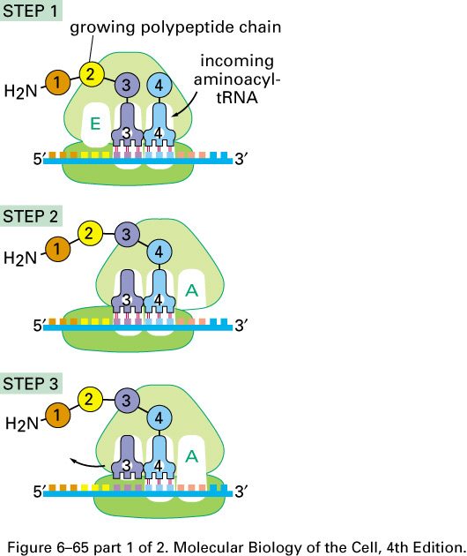
TRANSLATION
Elongation: The first tRNA is followed by a second one with an anticodon complementary to the second codon. Its amino acid develops a peptide bond with methionine. The first tRNA is detouched from the methionine and moved towards the cytoplasm while the ribosome is shifted to the third codon whereby the position of first codon becomes occupied by the second that carries the dipeptide.
Biology Lecture E. Anastasiadou Bioinformatics – Biomedical Data Science 2022-2023

Slide 54
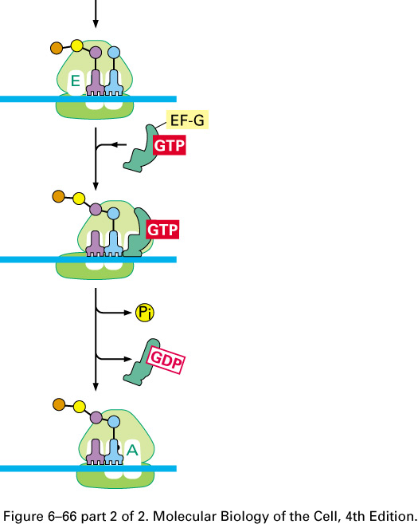
TRANSLATION
The Elongation Factor EF-G or EF-2 leads to the ribosome shift along the mRNA.
In combination with the hydrolysis of GTP by EF-1 and EF-2, it promotes protein synthesis.
Biology Lecture E. Anastasiadou Bioinformatics – Biomedical Data Science 2022-2023

Slide 55
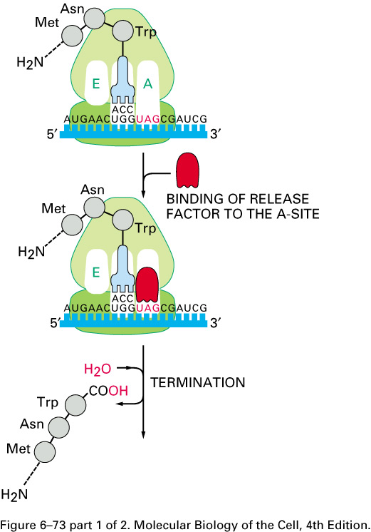
TRANSLATION
Termination: the ribosome localizes a stop codon and stops the protein synthesis.
The release factor enters the A position and causes hydrolysis of the peptidyl-tRNA bond leading to protein release.
The polypeptide chain is released from the ribosome
Biology Lecture E. Anastasiadou Bioinformatics – Biomedical Data Science 2022-2023

Slide 56
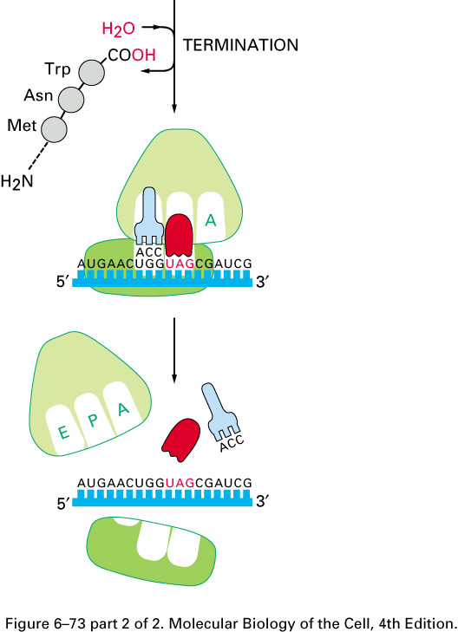
TRANSLATION
The release of the protein causes the ribosome to break down into its components, in its subunits.
Biology Lecture E. Anastasiadou Bioinformatics – Biomedical Data Science 2022-2023

Slide 57
http://www.youtube.com/watch?v=5bLEDd-PSTQ&feature=related
https://www.youtube.com/watch?v=TfYf_rPWUdY
Biology Lecture E. Anastasiadou Bioinformatics – Biomedical Data Science 2022-2023

Slide 58
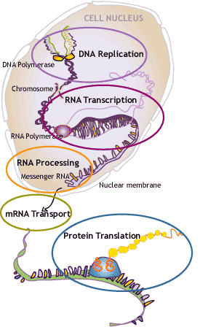
https://www.youtube.com/watch?v=gG7uCskUOrA
Biology Lecture E. Anastasiadou Bioinformatics – Biomedical Data Science 2022-2023

Slide 60
CELL CYCLE
Biology Lecture E. Anastasiadou Bioinformatics – Biomedical Data Science 2022-2023

Slide 61
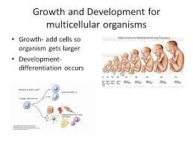
CELL CYCLE
Why do cells divide?
Growth (add cells so organism gets larger in size)
Development (differentiation of the cells)
Repair
Make gametes
Biology Lectur E. Anastasiadou Bioinformatics – Biomedical Data Science 2021-2022

Slide 62
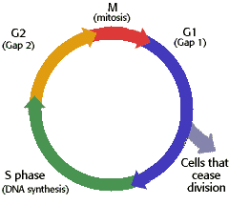
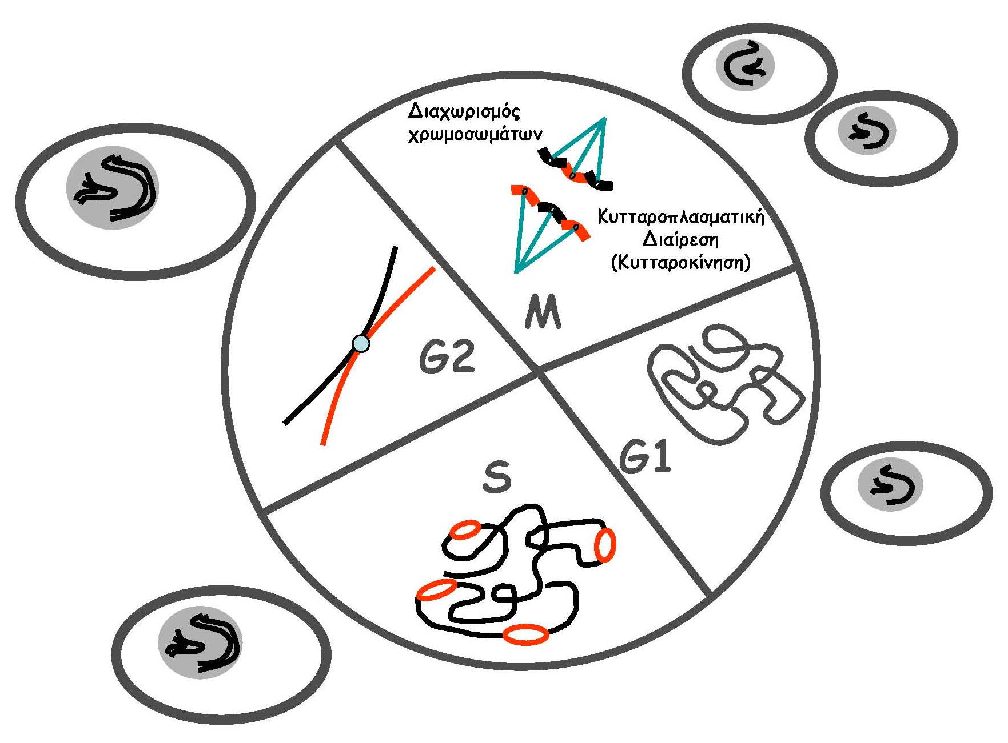
CELL CYCLE
PHASES OF THE CELL CYCLE
G1: Gap1
Cell grows – Duplication of organelles (including centriols) and cytoplasmic components.
Preparation of chromosomes for replication.
S: DNA synthesis (DNA replication)
DNA synthesis
G2: Gap2
Preparing for mitosis – Production of required enzymes and RNA.
M: Mitosis
Nuclear/chromosomal separation
and cytoplasmic division/cytokinesis
Chromosomes must be copied before mitosis so that new cells receive the same chromosomes found in the parental cells.
Biology Lecture E. Anastasiadou Bioinformatics – Biomedical Data Science 2022-2023

Slide 63
https://www.youtube.com/watch?v=JfSgbbjz2rE
https://www.youtube.com/watch?v=1hJDclmVkrg
Biology Lecture E. Anastasiadou Bioinformatics – Biomedical Data Science 2022-2023

Slide 64
ΜΙTOSIS
Biology Lecture E. Anastasiadou Bioinformatics – Biomedical Data Science 2022-2023

Slide 65

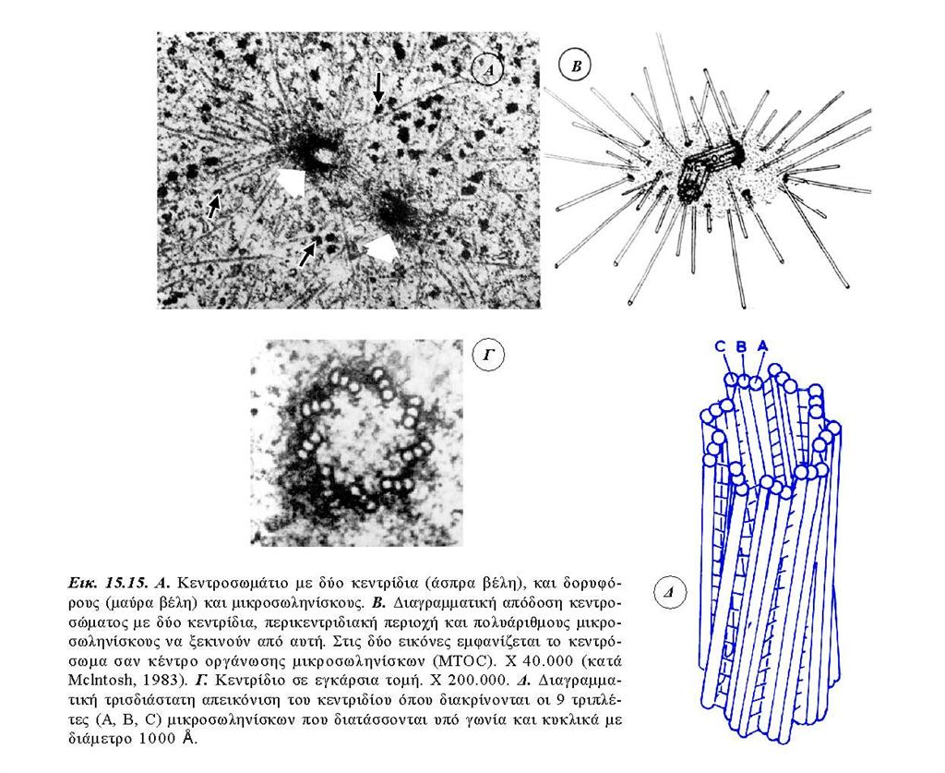
INTERPHASE (G1 / S / G2)
The cell administers the metabolic activity and the preparation for mitosis (the next four phases resulting in nuclear division).
Chromosomes are not clearly distinguishable in the nucleus, although a dark spot called nucleolus may be visible.
Nucleolus is a specific part in the nucleus that contains the machinery necessary to assemble the cell's ribosomal RNAs. Ribosomal RNAs then are transported through the nuclear pores into the cytoplasm where they become part of the ribosomes.
The cell may contain a pair of centriols, the microtubule organizing centers.
Biology Lecture E. Anastasiadou Bioinformatics – Biomedical Data Science 2022-2023

Slide 66
INTERPHASE (G1 / S / G2)
A centriole is a cylindrical organelle composed mainly of a protein called tubulin.
Centrioles are typically made up of nine sets of short microtubule triplets, arranged in a cylinder.
A bound pair of centrioles, surrounded by a highly ordered mass of dense material, called the pericentriolar material (PCM), makes up a structure called a centrosome. Additional proteins include centrin, cenexin and tektin.
Centrioles are involved in
- the organization of the mitotic spindle during cell division
and in the completion of cytokinesis
- organizing microtubules in the cytoplasm
- determining the position of the nucleus and playing a crucial role in the spatial arrangement of the cell
- determining the flagella or cilia
Biology Lecture E. Anastasiadou Bioinformatics – Biomedical Data Science 2022-2023

Slide 67

MITOSIS - PROPHASE
Chromatin in the nucleus begins to condense and becomes visible in the microscope as chromosomes.
The nucleolus disappears.
Centriols begin to move towards the opposite sites of the cell and microtubule fibers extend from the centromers. Some cross the cell to form the mitotic spindle.
Biology Lecture E. Anastasiadou Bioinformatics – Biomedical Data Science 2022-2023

Slide 68
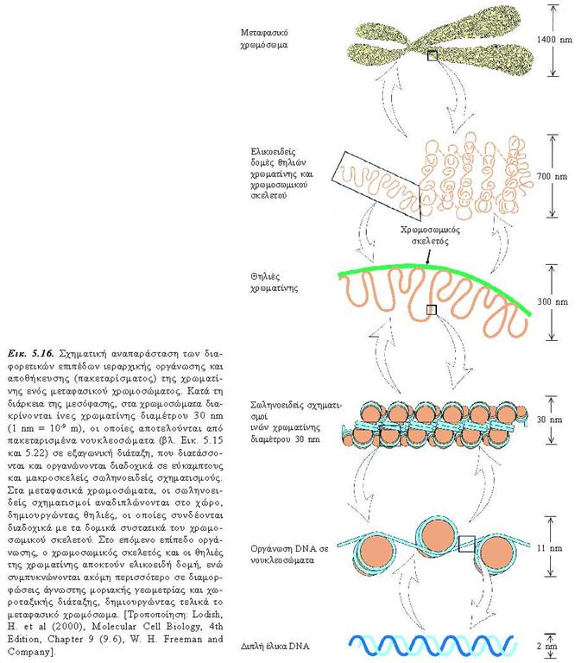
CHROMOSE
CHROMOSE
DNA SEQUENCE
CENTROMERE
SISTER CHROMATIDS
Biology Lecture E. Anastasiadou Bioinformatics – Biomedical Data Science 2022-2023

Slide 69

PROMETAPHASE
The nuclear membrane dissolves, signaling the onset of metaphase.
Proteins bind to centromers by creating kinetochore.
Microtubules bind to the chromosomes and the chromosomes begin to move.
Biology Lecture E. Anastasiadou Bioinformatics – Biomedical Data Science 2022-2023

Slide 70

METAPHASE
Spindle fibers align the chromosomes along the equator of the cell.
This organization helps to ensure that in the next phase, when the chromosomes are separated, each new nucleus will receive a copy of each chromosome.
Biology Lecture E. Anastasiadou Bioinformatics – Biomedical Data Science 2022-2023

Slide 71

ANAPHASE
Pairs of chromosomes are separated in the kinetochore and move towards the opposite sides of the cell.
Movement results from a combination of motion along the microtubules of the spindle and through the natural interaction of polar microtubules.
Biology Lecture E. Anastasiadou Bioinformatics – Biomedical Data Science 2022-2023

Slide 72

TELOPHASE
Chromatids end up at the opposite poles of the cell.
New membranes are formed around the nucleus of the separated cells.
The chromosomes are dissolved and are no longer visible under the photonic microscope.
The microtubules of the spindle dissolve.
Cytokinesis (cell separation) can begin at this stage.
Biology Lecture E. Anastasiadou Bioinformatics – Biomedical Data Science 2022-2023

Slide 73
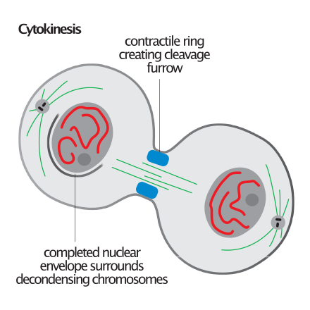

CYTOKINESIS
Cytokinesis is the stage of the cell division during which the cytoplasm of a single eukaryotic cell divides into two daughter cells.
Biology Lecture E. Anastasiadou Bioinformatics – Biomedical Data Science 2022-2023

Slide 74
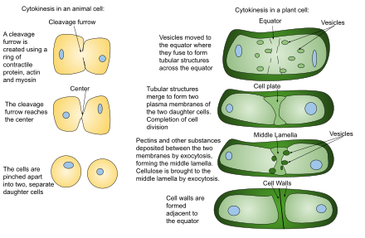
CYTOKINESIS
In animal cells, cytokinesis occurs when a fibrous ring is generated around the center of the cell, pushing the cell to create two daughter cells.
Initiation
Contraction
Membrane insertion
Completion/Abcission
In plant cells, the rigid wall requires the synthesis of a plaque between the two daughter cells.
Biology Lecture E. Anastasiadou Bioinformatics – Biomedical Data Science 2022-2023

Slide 75
MITOSIS
Prophase
Prometaphase
Metaphase
Anaphase
Telophase
Cytokinesis
Biology Lecture E. Anastasiadou Bioinformatics – Biomedical Data Science 2022-2023

Slide 76
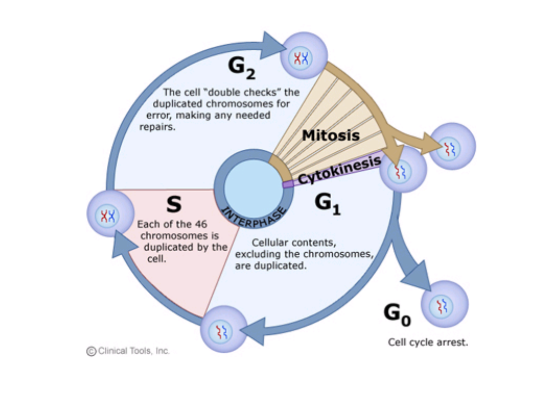
CELL CYCLE DURATION
5 hours
1 hour
10 hours
8 hours
Biology Lecture E. Anastasiadou Bioinformatics – Biomedical Data Science 2022-2023

Slide 77
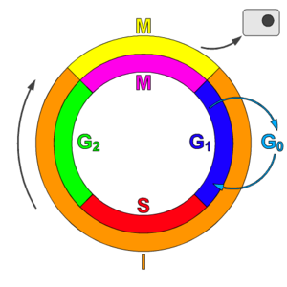
G0 Phase
Often a cell will leave the cell cycle temporarily or permanently. It exits the circle at G1 and enters a phase defined as G0 (G zero).
A G0 cell is in a "quiescent" state, but this concerns only the cell cycle. Many cells in G0 are all but calm. They are busy carrying out their duties in the organism.
Cells in G0 can be finally differentiated: they never return to the cell cycle, but they perform various functions in the organism until they die.
Other cells in G0 may re-enter the cell cycle. Most lymphocytes in human blood are at G0. However, with appropriate stimulation, e.g. with a suitable antigen, can stimulate, return to the cell cycle (in G1), and proceed to new rounds of alternating S phases and mitosis.
G0 represents not only the absence of a signal for mitosis but an active suppression of the genes required for mitosis. Cancer cells can not enter G0 and repeat the cell cycle indefinitely.
Biology Lecture E. Anastasiadou Bioinformatics – Biomedical Data Science 2022-2023

Slide 78
https://www.youtube.com/watch?v=C6hn3sA0ip0
http://www.youtube.com/watch?v=lf9rcqifx34&feature=related
http://www.youtube.com/watch?v=2WwIKdyBN_s&feature=related
http://www.youtube.com/watch?v=s1ylUTbXyWU&feature=player_embedded#
https://www.youtube.com/watch?v=8uzHTKdv_Sw&t=1s
Biology Lecture E. Anastasiadou Bioinformatics – Biomedical Data Science 2022-2023

Slide 79
MEIOSIS
Biology Lecture E. Anastasiadou Bioinformatics – Biomedical Data Science 2022-2023

Slide 80
MEIOSIS
Meiosis I is like Mitosis.
Meiosis II is similar to mitosis.
However, there is no S phase.
The chromatids of each chromosome are no longer identical due to recombination.
During Meiosis II the chromatids are separated.
Two daughter cells are produced each with 23 chromosomes (haploids), and each chromosome has only one chromatids.
Biology Lecture E. Anastasiadou Bioinformatics – Biomedical Data Science 2022-2023

Slide 81
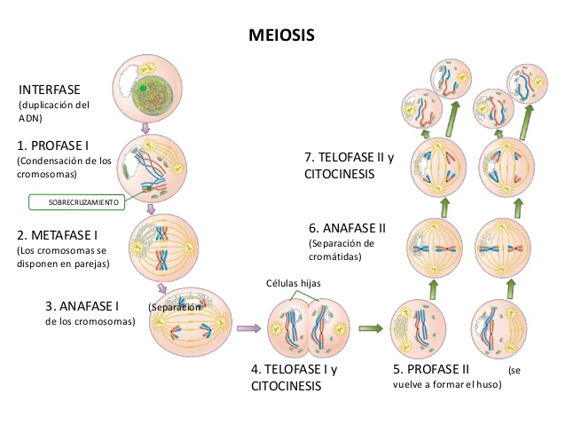
Biology Lecture E. Anastasiadou Bioinformatics – Biomedical Data Science 2022-2023

Slide 82
Animation:
http://www.biology.arizona.edu/CELL_BIO/tutorials/meiosis/page3.html
http://www.youtube.com/watch?v=MqaJqLL49a0&feature=related
http://www.youtube.com/watch?v=D1_-mQS_FZ0&feature=related
Biology Lecture E. Anastasiadou Bioinformatics – Biomedical Data Science 2022-2023

Slide 83
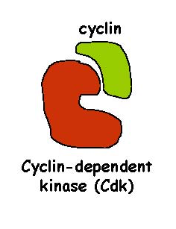

CELL CYCLE
CELL CYCLE REGULATION
The proteins that regulate the mechanism of action of the cell cycle are:
Cyclins: main switches for cell cycle control
Cdks: Cyclin-dependent protein kinases
add phosphate groups to a protein (a cyclin)
CKIs: Inhibitors of CDKs
Biology Lecture E. Anastasiadou Bioinformatics – Biomedical Data Science 2022-2023

Slide 84


CELL CYCLE REGULATION
Cyclins
cyclin of G1 phase (cyclin D)
cyclins of S/G2 phases (cyclins E and A)
mitotic cyclin (cyclins B)
Their levels in the cell increase and decrease according to the stages of the cell cycle.
Cyclin-dependent protein kinases (CDKs)
CDK of G1 phase (Cdk4)
CDK of S phase (Cdk2)
CDK of G2 and M phases (Cdk1)
Their levels in the cell remain relatively stable. However, they must bind to the appropriate cyclin (the levels of which vary) to be activated. They add phosphate groups to a variety of protein substrates that control cell cycle processes.
Biology Lecture E. Anastasiadou Bioinformatics – Biomedical Data Science 2022-2023

Slide 85

ACTIVATION & DEACTIVATION OF CDKs
CDKs are 34-40 kDa proteins with protein kinase activity. For their activation they bind with the appropriate cyclin. Active cyclin-dependent protein kinases are heterodimers, where kinase provides the site of catalytic activity while cyclin is responsible for the activation of the molecule and for its specific action. The catalytic center of CDKs contains a domain of ​​300 amino acids, where a high degree of homology is observed between the different members of the kinase family. Within this region there is a conserved 16 amino acid sequence that participates in cyclin binding and assists in the specific cyclin-CDK interaction.
In mammals, there are at least seven different catalytic subunits, CDK1-CDK7.
Biology Lecture E. Anastasiadou Bioinformatics – Biomedical Data Science 2022-2023

Slide 86

ACTIVATION & DEACTIVATION OF CDKs
CDKs may appear in both active and inactive formats. The transition between the two forms is regulated in several ways. Specific phosphorylation and dephosphorylation are critical in controlling the CDK activity. CDKs have specific phosphorylation sites, that may exhibit an activating or inhibitory effect.
Phosphorylation of Thr160 of CDK1, Thr161 of CDK2 or Thr172 of CDK4, leads to kinase activation. Phosphorylation of Thr14 and Tyr15 results in inactivation. For activation and inactivation to occur the interaction of the CDK to its corresponding cyclin is required.
Biology Lecture E. Anastasiadou Bioinformatics – Biomedical Data Science 2022-2023

Slide 87

CDK INHIBITOR PROTEINS (CKI)
CKIs are important elements
with an inhibitory effect on the cell cycle that
depends on the ratio of CKIs / cyclin concentration.
Biology Lecture E. Anastasiadou Bioinformatics – Biomedical Data Science 2022-2023

Slide 88

CDK INHIBITOR PROTEINS (CKI)
The p21CIP1 inhibitor has a dual inhibitory effect. It connects the CDK2 complex with cyclins A, D and E and leads to their deactivation and has a binding domain for the complementary Proliferating Cell Nuclear Antigen (PCNA) protein, which is important for DNA synthesis and the binding of polymerase to DNA. Binding of the inhibitor prevents replication of DNA from polymerase, in vitro.
The concentration of p21CIP1 is regulated at its transcription level by the p53 tumor suppressor protein, which promotes p21CIP1 transcription by binding to its promoter. Activation of p53 occurs mainly during DNA destruction. The main purpose of the regulation is to repair the damage or promote apoptosis.
Biology Lecture E. Anastasiadou Bioinformatics – Biomedical Data Science 2022-2023

Slide 89
CDK INHIBITOR PROTEINS (CKI)
The p27KIP1 inhibitor is regulated at the post-translational level and is observed in its inactive form in proliferating cells. It can be activated by TGFβ, increased cAMP concentration and cell communication.
The p16ink4a inhibitor has a tumor-suppressive role as its gene is mutated in many cancer cell lines. There is evidence that the pRb protein has a regulatory role in the transcription of p16ink4a.
Transcriptional regulation of p15ink4a inhibitor has been observed through TGFβ cytokine. The binding of TGFβ to its receptor produces a signal that triggers the transcription of the p15 gene, which may lead to disruption of the cell cycle.
Biology Lecture E. Anastasiadou Bioinformatics – Biomedical Data Science 2022-2023

Slide 90

Reception: A cell detects a signaling molecule from the outside of the cell. A signal is detected when the chemical signal (also known as a ligand) binds to a receptor protein on the surface of the cell or inside the cell.
Transduction: When the signaling molecule binds the receptor it changes the receptor protein in some way. This change initiates the process of transduction. Signal transduction is usually a pathway of several steps. Each relay molecule in the signal transduction pathway changes the next molecule in the pathway.
Response: Finally, the signal triggers a specific cellular response.
Biology Lecture E. Anastasiadou Bioinformatics – Biomedical Data Science 2022-2023

Slide 91
CELL CYCLE REGULATION
The correct course of the cell cycle is ensured through:
regulated changes in the activity of CDKs (by phosphorylation at Thr161 or dephosphorylation at Thr14 & Thr15)
binding to CDK-inhibitors (CKIs) and
ubiquitin-dependent proteolysis of CDKs or CKIs
These processes are intertwined and mutually interdependent.
Biology Lecture E. Anastasiadou Bioinformatics – Biomedical Data Science 2022-2023

Slide 92

CELL CYCLE REGULATION THROUGH UBIQUITIN-DEPENDENT PROTEOLYSIS
Choosing a protein for ubiquitin-dependent proteolysis is via the E3 enzymes of the ubiquitin pathway, which catalyze the binding of ubiquitin to the target protein.
The specificity of ubiquitin-protein binding is determined by the nature of the E3 enzymes, which are composed of several subunits. The composition of this complex varies and can be modified/adapted as required.
It leads to simultaneous and complete deactivation of cell cycle multifunctional proteins, such as cyclins.
Specialized reorganization of subunits of hetero-oligomeric protein complexes, e.g., targeted proteolysis of a CDI.
All the substrates of the cell cycle regulatory enzymes can be inactivated by proteolysis.
􀂃
Biology Lecture E. Anastasiadou Bioinformatics – Biomedical Data Science 2022-2023

Slide 93
UBIQUITINATION COMPLEXES
Two types of E2/E3 complexes are of particular importance for the control CDK activity and therefore the cell cycle:
the SCF (Skp1/cullin/F-box protein), a key player for the G1/S transition (end of G1, S, G2) and
- the APC (anaphase-promoting complex), also called the cyclosome, is a crucial regulator of mitosis (M and beginning of G1). The APC/C: triggers the events that allow the sister chromatids to separate; degrades the mitotic cyclin B.
https://www.youtube.com/watch?v=jbc1QCu9hFg
https://www.youtube.com/watch?v=eZVDmyCbq8s
Biology Lecture E. Anastasiadou Bioinformatics – Biomedical Data Science 2022-2023

Slide 94

CELL CYCLE REGULATION
MPF: maturation promoting factor
Triggers progression through the cell cycle
P53: blocks cell cycle if DNA is damaged
may lead to apoptosis (cell death)
P27: blocks entry into S phase
by binding to cyclin and cdk
https://www.youtube.com/watch?v=Jmqd9Qj_PTA
https://www.youtube.com/watch?v=nEMMKzYQf9A
https://www.youtube.com/watch?v=AHU_7TU7hvw
Biology Lecture E. Anastasiadou Bioinformatics – Biomedical Data Science 2022-2023

Slide 95

p53-DNA damage response pathway
p53 is activated after DNA damage, resulting in either of two cellular responses: induction of the CDK inhibitor p21, which leads to a G1-phase cell cycle arrest, allowing time to repair DNA damage before cellular division and
programmed cell death (apoptosis), whereby the damaged cell undergoes suicide.
In tumors with mutations of p53, DNA damage is not adequately repaired, leading to the accumulation of mutations and genetic rearrangements. Two cellular genes regulate p53 activation: MDM2 and p19-ARF.
Biology Lecture E. Anastasiadou Bioinformatics – Biomedical Data Science 2022-2023

Slide 96
p53-DNA damage response pathway
https://www.youtube.com/watch?v=2RG9caushI0
https://www.youtube.com/watch?v=2yI_SoOWFMU
https://www.youtube.com/watch?v=nd_SMrd1oag
In tumors with mutations of p53, DNA damage is not adequately repaired, leading to the accumulation of mutations and genetic rearrangements. Two cellular genes regulate p53 activation: MDM2 and p19-ARF.
Biology Lecture E. Anastasiadou Bioinformatics – Biomedical Data Science 2022-2023

Slide 97
STEPS OF THE CELL CYCLE
Rising level of G1-cyclins bind to their Cdks and signal the cell to prepare the chromosomes for replication.
Rising level of S-phase promoting factor (SPF) — which includes cyclin A bound to Cdk2 — enters the nucleus and prepares the cell to duplicate its DNA (and its centrosomes).
As DNA replication continues, cyclin E is destroyed, and the level of mitotic cyclins begins to rise (in G₂).
M-phase promoting factor (the complex of mitotic cyclins with the M-phase Cdk) initiates assembly of the mitotic spindle,
breakdown of the nuclear envelope and condensation of the chromosomes. These events take the cell to metaphase of mitosis.
The M-phase promoting factor activates the anaphase-promoting complex (APC/C) which allows the sister chromatids to separate (metaphase) and move to the poles (anaphase), completing mitosis.
  Degradation of cyclin B by attaching to the protein ubiquitin which targets it for destruction by proteasomes.
  Synthesis of G1 cyclin for the next turn of the cycle.
  Degradation of geminin, a protein that keeps the freshly-synthesized DNA in S phase from being re-replicated before mitosis.
Biology Lecture E. Anastasiadou Bioinformatics – Biomedical Data Science 2022-2023

Slide 98

CELL CYCLE OVERVIEW
https://www.youtube.com/watch?v=nEMMKzYQf9A
Biology Lecture E. Anastasiadou Bioinformatics – Biomedical Data Science 2022-2023
Notes:
The cell cycle is an ordered set of events by which cells undertake growth and division into two daughter cells. In
eukaryotes, the cell cycle is described by five phases: G0, G1, S, G2, and M. In G0 phase, cells have entered a
quiescent state or are not dividing. During G1 period, the cells grow and accumulate nutrients for the subsequent S
phase, where DNA replication occurs. The gap between S and M phases is termed G2 period, during which the cells
continue to grow and prepare for mitosis that occurs in M phase. All these processes are elaborately controlled to
ensure proper cell development and renewal. The key molecules that program cell cycle are cyclins and cyclindependent
kinases (CDKs), whereas inhibitors that prevent improper cell division are two families of genes, the Cip /
Kip family and the INK4 family. Notably, these inhibitor genes are also termed tumor suppressor genes as they are
instrumental in the prevention of tumor formation.

Slide 99

Biology Lecture E. Anastasiadou Bioinformatics – Biomedical Data Science 2022-2023

Slide 100
Kinetochore and Mitosis
https://www.youtube.com/watch?v=IvJrDsRuWxQ
Biology Lecture E. Anastasiadou Bioinformatics – Biomedical Data Science 2022-2023

