Slide 1
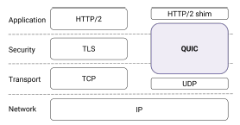
Quick UDP Internet Connections
QUIC, a new transport designed to improve performance for HTTPS. QUIC replaces most of the traditional HTTPS stack: HTTP/2, TLS, and TCP. QUIC is a user-space transport with UDP as a substrate.
The use of UDP allows QUIC packets to traverse middleboxes.
QUIC is an encrypted transport: packets are authenticated and encrypted, preventing modification and limiting ossification of the protocol by middleboxes.
QUIC uses a cryptographic handshake that minimizes handshake latency for most connections by using known server credentials on repeat connections and by removing redundant handshake-overhead at multiple layers in the network stack.
QUIC eliminates head-of-line blocking delays by using a lightweight data-structuring abstraction, streams, which are multiplexed within a single connection so that loss of a single packet blocks only streams with data in that packet.

Slide 2
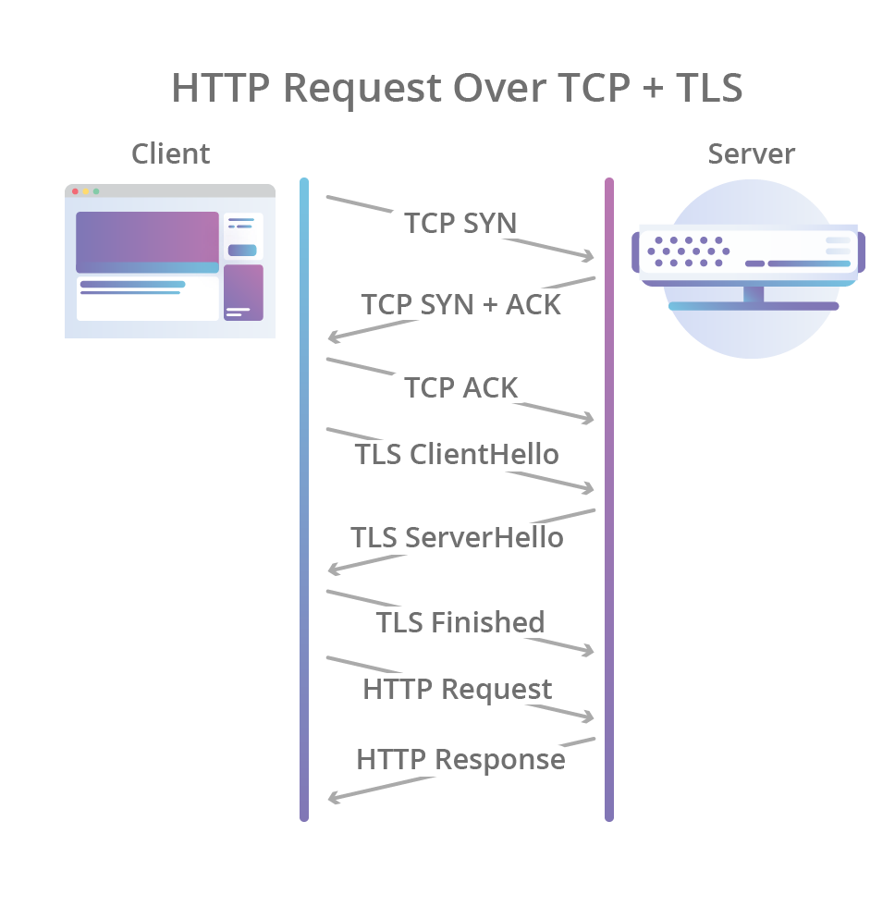
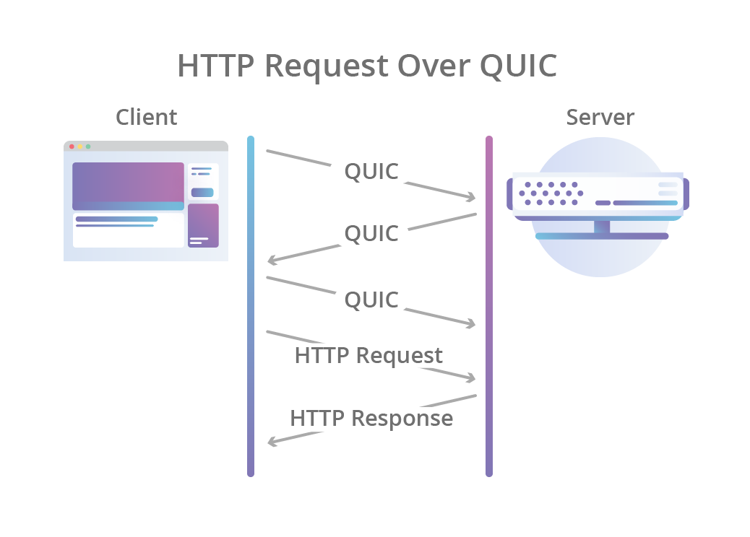

Slide 3
QUIC DESIGN AND IMPLEMENTATION
QUIC is designed to meet several goals, including deployability, security, and reduction in handshake and head-of-line blocking delays.
The QUIC protocol combines its cryptographic and transport handshakes to minimize setup RTTs.
It multiplexes multiple requests/responses over a single connection by providing each with its own stream, so that no response can be blocked by another.
It encrypts and authenticates packets to avoid tampering by middleboxes and to limit ossification of the protocol.
It improves loss recovery by using unique packet numbers to avoid retransmission ambiguity and by using explicit signaling in ACKs for accurate RTT measurements.
It allows connections to migrate across IP address changes by using a Connection ID to identify connections instead of the IP/port 5-tuple.
It provides flow control to limit the amount of data buffered at a slow receiver and ensures that a single stream does not consume all the receiver’s buffer by using per-stream flow control limits.

Slide 4
Protocol ossification
Protocol ossification happens when intermediate network devices (middleboxes) are built to only recognize very specific formats of network traffic.
The "Wire Image" Trap: Middleboxes learn to expect an exact pattern of bits for a protocol (like TCP). If endpoints (like a browser or server) try to introduce new features—such as novel TCP options or encrypted headers—the middlebox may misinterpret the new data as broken or malicious, and drop the connection.
Version Intolerance: Endpoints and applications are sometimes programmed to reject any traffic that doesn't perfectly match older protocol version numbers (e.g., assuming TLS 1.2 is the highest version possible, and breaking when TLS 1.3 arrives).

Slide 5
Infrastructure Ossification
Infrastructure ossification refers to the extreme difficulty of upgrading physical and core network hardware.
Because the internet relies on a massive, decentralized, and interdependent web of hardware operated by thousands of different companies, getting everyone to deploy new network-layer architectures is logistically and financially staggering.
Consequently, developers are often forced to "shoehorn" new ideas into older, outdated packet formats rather than building them from scratch.

Slide 6
Connection Establishment
QUIC relies on a combined cryptographic and transport handshake for setting up a secure transport connection.
On a successful handshake, a client caches information about the origin.
On subsequent connections to the same origin, the client can establish an encrypted connection with no additional round trips and data can be sent immediately following the client handshake packet without waiting for a reply from the server.
QUIC provides a dedicated reliable stream for performing the cryptographic handshake.
QUIC’s cryptographic handshake facilitates a zero roundtrip time (0-RTT) connection setup.
Initial handshake: Initially, the client has no information about the server and so, before a handshake can be attempted, the client sends an inchoate client hello (CHLO) message to the server to elicit a reject (REJ) message.
The REJ message contains: (i) a server config that includes the server’s long-term Diffie-Hellman public value, (ii) a certificate chain authenticating the server, (iii) a signature of the server config using the private key from the leaf certificate of the chain, and (v) a source-address token: an authenticated-encryption block that contains the client’s publicly visible IP address (as seen at the server) and a timestamp by the server. The client sends this token back to the server in later handshakes, demonstrating ownership of its IP address. Once the client has received a server config, it authenticates the config by verifying the certificate chain and signature. It then sends a complete CHLO, containing the client’s ephemeral Diffie-Hellman public value.
Final (and repeat) handshake: All keys for a connection are established using Diffie-Hellman. After sending a complete CHLO, the client is in possession of initial keys for the connection since it can calculate the shared value from the server’s long-term Diffie-Hellman public value and its own ephemeral Diffie-Hellman private key. At this point, the client is free to start sending application data to the server. Indeed, if it wishes to achieve 0-RTT latency for data, then it must start sending data encrypted with its initial keys before waiting for the server’s reply.
If the handshake is successful, the server returns a server hello (SHLO) message. This message is encrypted using the initial keys, and contains the server’s ephemeral Diffie-Hellman public value. With the peer’s ephemeral public value in hand, both sides can calculate the final or forward-secure keys for the connection. Upon sending an SHLO message, the server immediately switches to sending packets encrypted with the forward-secure keys. Upon receiving the SHLO message, the client switches to sending packets encrypted with the forward-secure keys.
QUIC’s cryptography provides two levels of secrecy: initial client data is encrypted using initial keys, and subsequent client data and all server data are encrypted using forward-secure keys. The initial keys provide protection analogous to TLS session resumption with session tickets. The forward-secure keys are ephemeral and provide even greater protection.
The client caches the server config and source-address token, and on a repeat connection to the same origin, uses them to start the connection with a complete CHLO. Τhe client can now send initial-key-encrypted data to the server, without having to wait for a response from the server.
Eventually, the source address token or the server config may expire, or the server may change certificates, resulting in handshake failure, even if the client sends a complete CHLO. In this case, the server replies with a REJ message, just as if the server had received an inchoate CHLO and the handshake proceeds from there.

Slide 7
Stream Muxing
Applications commonly multiplex units of data within TCP’s single byte stream abstraction. To avoid head-of-line blocking due to TCP’s sequential delivery, QUIC supports multiple streams within a connection, ensuring that a lost UDP packet only impacts those streams whose data was carried in that packet. Subsequent data received on other streams can continue to be reassembled and delivered to the application.
QUIC streams are a lightweight abstraction that provide a reliable bidirectional byte stream. Streams can be used for framing application messages of arbitrary size—up to 264 bytes can be transferred on a single stream—but they are lightweight enough that when sending series of small messages a new stream can reasonably be used for each one.
Streams are identified by stream IDs, which are statically allocated as odd IDs for client-initiated streams and even IDs for server-initiated streams to avoid collisions. Stream creation is implicit when sending the first bytes on an as-yet unused stream, and stream closing is indicated to the peer by setting a "FIN" bit on the last stream frame.
If either the sender or the receiver determines that the data on a stream is no longer needed, then the stream can be canceled without having to tear down the entire QUIC connection.
Though streams are reliable abstractions, QUIC does not retransmit data for a stream that has been canceled.
A QUIC packet is composed of a common header followed by one or more frames. QUIC stream multiplexing is implemented by encapsulating stream data in one or more stream frames, and a single QUIC packet can carry stream frames from multiple streams.
The rate at which a QUIC endpoint can send data will always be limited. An endpoint must decide how to divide available bandwidth between multiple streams.

Slide 8
QUIC streams

Slide 9
Connection migration
Connection migration is a mechanism used in mobile telephony. QUIC allows for a client to switch from the cellular network to a close-by Wi-Fi network and vice versa no matter the fact that the IP address changes.
TCP on the other hand will drop the connection if the host device changes its IP address. Either TCP or the supported application will force connection re-establishment leading to great latencies introduced and a waste of bandwidth by resending data.
QUIC mitigates this by using the CID (Connection Identifier) which is a number assigned to the 4-tuple of source and destination IP addresses and ports
Since using a CID raises privacy issues, the CID can actually be changed to avoid tracking. The CID is encrypted with the payload and in case it changes, original and subsequent CID are kept by the operator.

Slide 10
QUIC packet structure
Red : authenticated yet unencrypted public Header
Green : encrypted body.

Slide 11
Loss recovery
Each QUIC packet carries a new packet number, including those carrying retransmitted data.
This design obviates the need for a separate mechanism to distinguish the ACK of a retransmission from that of an original transmission, thus avoiding TCP’s retransmission ambiguity problem.
Stream offsets in stream frames are used for delivery ordering.
The packet number represents an explicit time-ordering, which enables simpler and more accurate loss detection than in TCP.
QUIC acknowledgments explicitly encode the delay between the receipt of a packet and its acknowledgment being sent. Together with monotonically-increasing packet numbers, this allows for precise network round-trip time (RTT) estimation, which aids in loss detection.

Slide 12
Flow Control
When an application reads data slowly from QUIC’s receive buffers, flow control limits the buffer size that the receiver must maintain.
A slowly draining stream can consume the entire connection’s receive buffer, blocking the sender from sending data on other streams. QUIC ameliorates this potential head-of-line blocking among streams by limiting the buffer that a single stream can consume.
QUIC thus employs connection-level flow control, which limits the aggregate buffer that a sender can consume at the receiver across all streams, and stream-level flow control, which limits the buffer that a sender can consume on any given stream.
Similar to HTTP/2, QUIC employs credit-based flow-control.
A QUIC receiver advertises the absolute byte offset within each stream up to which the receiver is willing to receive data. As data is sent, received, and delivered on a particular stream, the receiver periodically sends window update frames that increase the advertised offset limit for that stream, allowing the peer to send more data on that stream.
Connection-level flow control works in the same way as stream-level flow control, but the bytes delivered

