Slide 1
Apache HTTP Server
Lecture notes by Theodoros Anagnostopoulos

Slide 2
Apache HTTP Server
Apache http server project
http://httpd.apache.org/
http://httpd.apache.org/docs/2.2/platform/windows.html
Apache foundation started to support the web server project, but now extends to a multitude of other projects

Slide 3
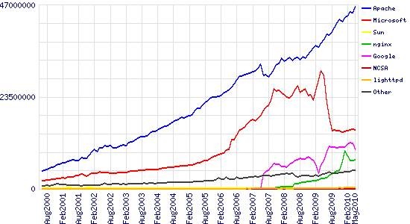
Stats of Web Server types

Slide 4
What the Busiest 1M Websites use

Slide 5
The Number One HTTP Server On The Internet
The Apache HTTP Server Project is an effort to develop and maintain an open-source HTTP server for modern operating systems including UNIX and Windows NT. The goal of this project is to provide a secure, efficient and extensible server that provides HTTP services in sync with the current HTTP standards.
Apache httpd has been the most popular web server on the Internet since April 1996, and celebrated its 17th birthday as a project this February.
The Apache HTTP Server ("httpd") is a project of The Apache Software Foundation

Slide 6
Apache httpd 2.4.9 Released 2014-03-17
The Apache Software Foundation and the Apache HTTP Server Project are pleased to announce the release of version 2.4.9 of the Apache HTTP Server ("Apache"). This version of Apache is our latest GA release of the new generation 2.4.x branch of Apache HTTPD and represents fifteen years of innovation by the project, and is recommended over all previous releases. This version of Apache is principally a security and bug fix release.
This version of httpd is a major release of the 2.4 stable branch, and represents the best available version of Apache HTTP Server. New features include Loadable MPMs, major improvements to OCSP support, mod_lua, Dynamic Reverse Proxy configuration, Improved Authentication/Authorization, FastCGI Proxy, New Expression Parser, and a Small Object Caching API.

Slide 7
Using Apache HTTP Server on Microsoft Windows
This document explains how to install, configure and run Apache 2.2 under Microsoft Windows. If you have questions after reviewing the documentation (and any event and error logs), you should consult the peer-supported users' mailing list.
This document assumes that you are installing a binary distribution of Apache. If you want to compile Apache yourself (possibly to help with development or tracking down bugs), see Compiling Apache for Microsoft Windows.

Slide 8
Operating System Requirements
The primary Windows platform for running Apache 2.2 is Windows 2000 or later. The binary installer only works with the x86 family of processors, such as Intel and AMD processors. Always obtain and install the current service pack to avoid operating system bugs.
Running Apache on Windows 9x is ignored by the developers, and is strongly discouraged. On Windows NT 4.0, installing Service Pack 6 is required. Apache HTTP Server versions later than 2.2 will not run on any operating system earlier than Windows 2000.

Slide 9
Downloading Apache for Windows
The Apache HTTP Server Project itself does not provide binary releases of software, only source code. Individual committers may provide binary packages as a convenience, but it is not a release deliverable.
If you cannot compile the Apache HTTP Server yourself, you can obtain a binary package from numerous binary distributions available on the Internet.
Popular options for deploying Apache httpd, and, optionally, PHP and MySQL, on Microsoft Windows, include:
ApacheHaus
Apache Lounge
BitNami WAMP Stack
WampServer
XAMPP

Slide 10
Installing Apache for Windows
You need Microsoft Installer 2.0 or above for the installation to work. For Windows NT 4.0 and 2000 refer to Microsoft's article KB 292539. Windows XP and later do not require this update. The Windows 98/ME installer engine appears to no longer be available from Microsoft, and these instructions no longer detail such prerequisites.
Note that you cannot install two versions of Apache 2.2 on the same computer with the binary installer. You can, however, install a version of the 1.3 series and a version of the 2.2 series on the same computer without problems. If you need to have two different 2.2 versions on the same computer, you have to compile and install Apache from the source.

Slide 11
Installing Apache for Windows
Run the Apache .msi file you downloaded above. The installation will ask you for these things:
Network Domain. Enter the DNS domain in which your server is or will be registered in. For example, if your server's full DNS name is server.mydomain.net, you would type mydomain.net here.
Server Name. Your server's full DNS name. From the example above, you would type server.mydomain.net here.

Slide 12
Installing Apache for Windows
Administrator's Email Address. Enter the server administrator's or webmaster's email address here. This address will be displayed along with error messages to the client by default.
For whom to install Apache Select for All Users, on Port 80, as a Service - Recommended if you'd like your new Apache to listen at port 80 for incoming traffic. It will run as a service (that is, Apache will run even if no one is logged in on the server at the moment) Select only for the Current User, on Port 8080, when started Manually if you'd like to install Apache for your personal experimenting or if you already have another WWW server running on port 80.

Slide 13
Installing Apache for Windows
The installation type. Select Typical for everything except the source code and libraries for module development. With Custom you can specify what to install. A full install will require about 13 megabytes of free disk space. This does not include the size of your web site(s).
Where to install. The default path is C:\Program Files\Apache Software Foundation under which a directory called Apache2.2 will be created by default.

Slide 14
Installing Apache for Windows
During the installation, Apache will configure the files in the conf subdirectory to reflect the chosen installation directory. However, if any of the configuration files in this directory already exist, they will not be overwritten. Instead, the new copy of the corresponding file will be left with the extension .default. So, for example, if conf\httpd.conf already exists, it will be renamed as conf\httpd.conf.default. After the installation you should manually check to see what new settings are in the .default file, and if necessary, update your existing configuration file.
Also, if you already have a file called htdocs\index.html, it will not be overwritten (and no index.html.default will be installed either). This means it should be safe to install Apache over an existing installation, although you would have to stop the existing running server before doing the installation, and then start the new one after the installation is finished.
After installing Apache, you must edit the configuration files in the conf subdirectory as required. These files will be configured during the installation so that Apache is ready to be run from the directory it was installed into, with the documents server from the subdirectory htdocs. There are lots of other options which you should set before you really start using Apache. However, to get started quickly, the files should work as installed.

Slide 15
Advanced Installation Topics
One feature of the installer, "Build Headers and Libraries", can be ignored by most users, but should be installed if compiling third party modules. The "APR Iconv Code Pages" can similarly be omitted by most users, unless using mod_charset_lite or a third party module which relies on APR internationalization features.
There are requests to ship a .zip file from time to time. There is no point in the ASF consuming additional storage, mirroring and bandwidth for this purpose, because the .msi installer allows the installation artifacts to all be unpacked using the msiexec /a network installation option. Using this command against any .msi will result in an exploded tree of all of the individual files and components.

Slide 16
Advanced Installation Topics
The installation options above can be customized by users familiar with msiexec.exe options and silent installation. The actual installer sources are available in the httpd/httpd/win32-msi/ tree of the httpd project subversion respository. For reference, some of the more common variables which may be modified are;
AgreeToLicense (toggle to "Yes")
ALLUSERS (choose between Null and "1")
ApplicationUsers (toggle to "OnlyCurrentUser")
EXISTING_APACHE_SERVICE_PATH
INSTALLDIR (default "ProgramFilesFolder\Apache Software Foundation\Apache2.2\").

Slide 17
Advanced Installation Topics
INSTALLLEVEL (default "100", refer to list below)
RESOLVED_WINSOCK2 (toggle to "1")
SERVERADMIN
SERVERDOMAIN
SERVERNAME
SERVERPORT (default "80")
SERVERSSLPORT (default "443")
SERVICEINTERNALNAME (default "Apache2.2", no spaces!)
SERVICENAME (default "Apache2.2", include spaces)
SetupType (default "Typical")

Slide 18
Advanced Installation Topics
The installation level of various features, which may be individually toggled, include;
Apache (1, base Apache HTTP Server 2.2 feature)
ApacheDocs (11, Apache Documentation)
ApacheMonitoring (41, Apache Service Taskbar Icon)
ApacheRuntime (1, Apache Runtime)
BuildFiles (101, Build Headers and Libraries)
Iconv (21, APR Iconv Code Pages)
OpensslBin (31, OpenSSL Runtime)
SslBin (41, Ssl Binaries)

Slide 19
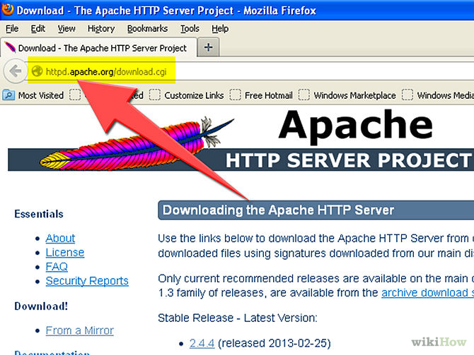
Example Apache for Windows

Slide 20
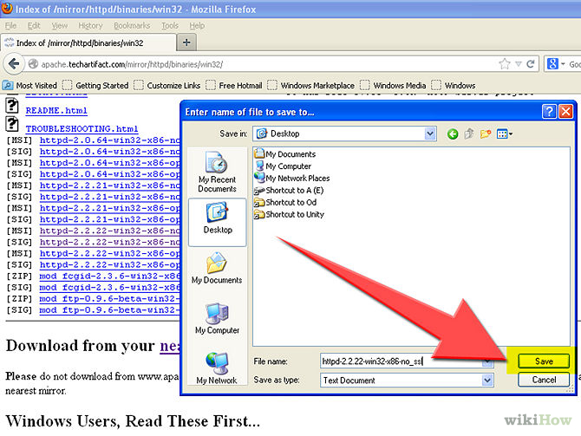
Example Apache for Windows

Slide 21
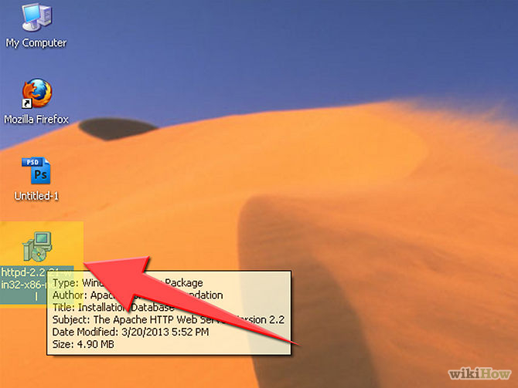
Example Apache for Windows

Slide 22
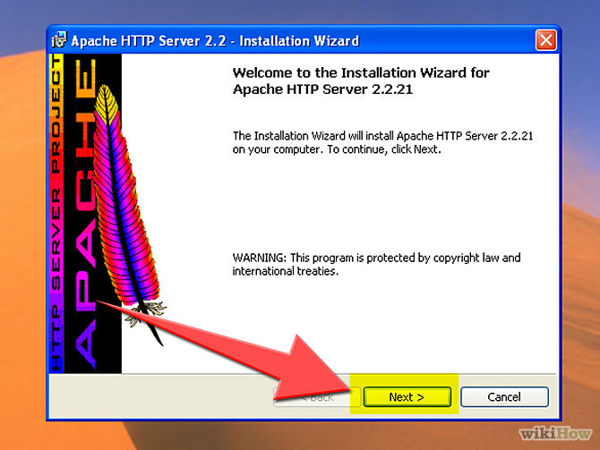
Example Apache for Windows

Slide 23
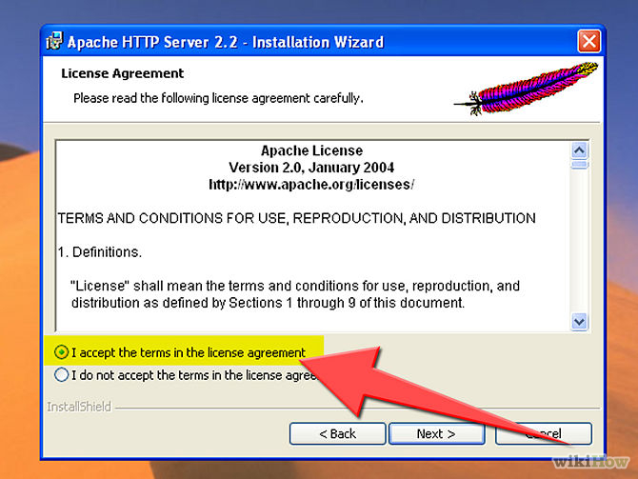
Example Apache for Windows

Slide 24
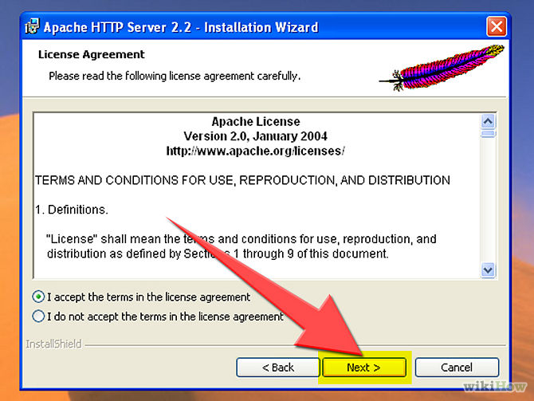
Example Apache for Windows

Slide 25
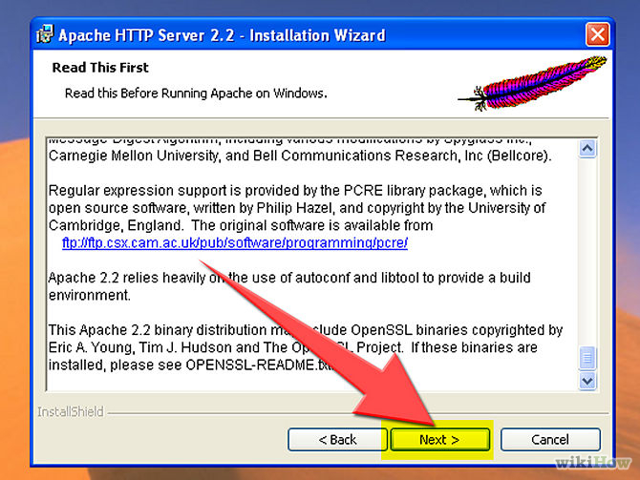
Example Apache for Windows

Slide 26
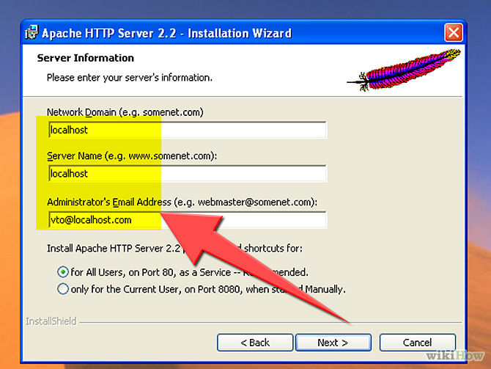
Example Apache for Windows

Slide 27
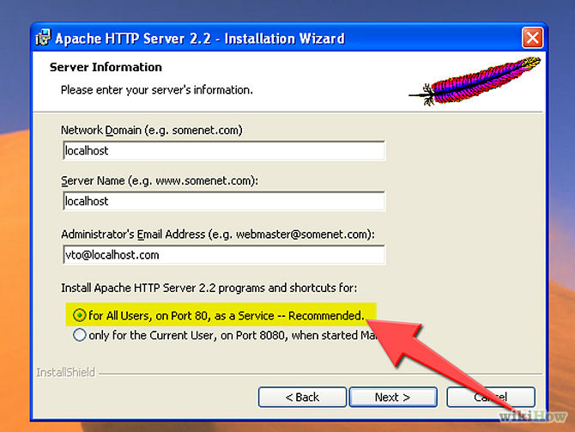
Example Apache for Windows

Slide 28
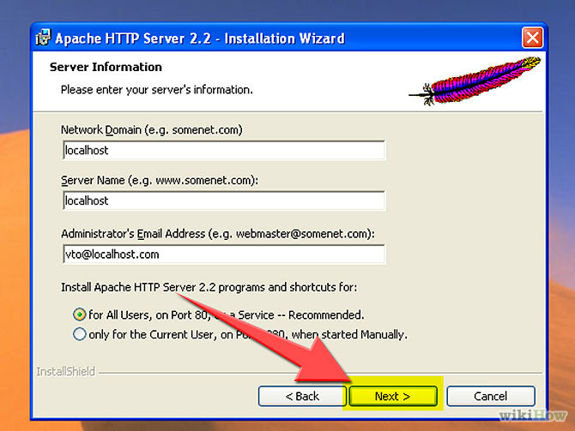
Example Apache for Windows

Slide 29
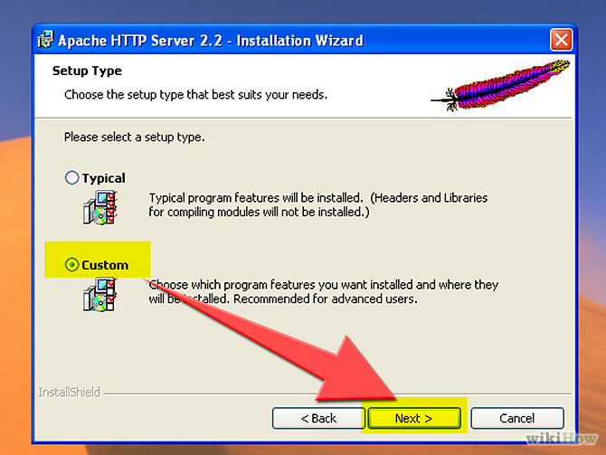
Example Apache for Windows

Slide 30
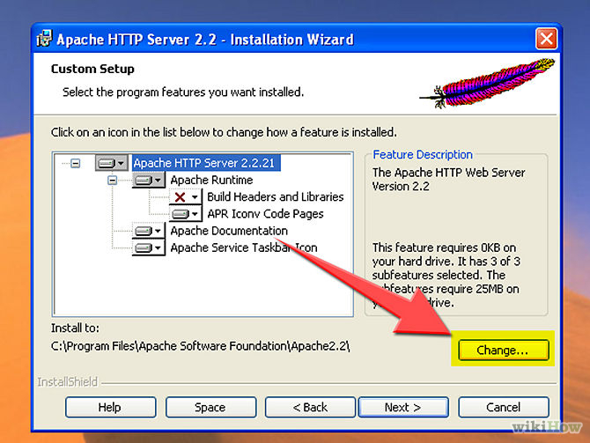
Example Apache for Windows

Slide 31
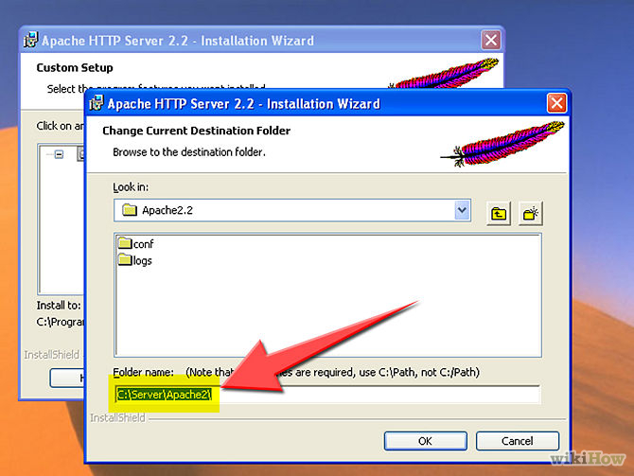
Example Apache for Windows

Slide 32
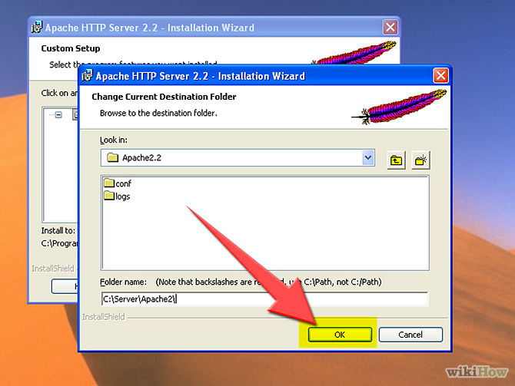
Example Apache for Windows

Slide 33
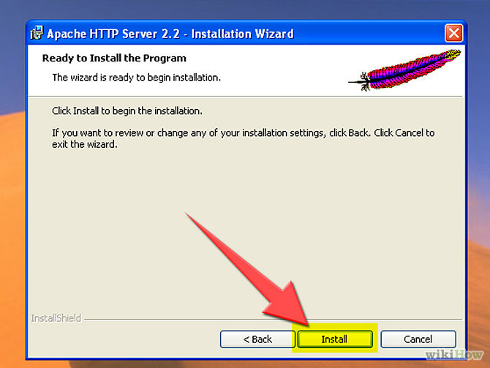
Example Apache for Windows

Slide 34
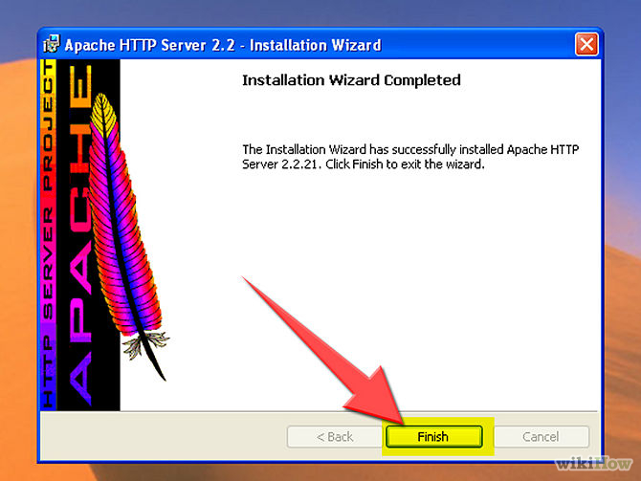
Example Apache for Windows

Slide 35
Example Apache for Windows YouTube Video
How to install, Configure, and Verify an Apache Web Server:
http://www.youtube.com/watch?v=oeZpY6JY4iI

Slide 36
Questions?
Feel free to ask whatever you want…

