Slide 1

20% over 65 years old
30.4% in risk of pour nutrition
21.6% with chewing difficulties
PROBLEM

Slide 2


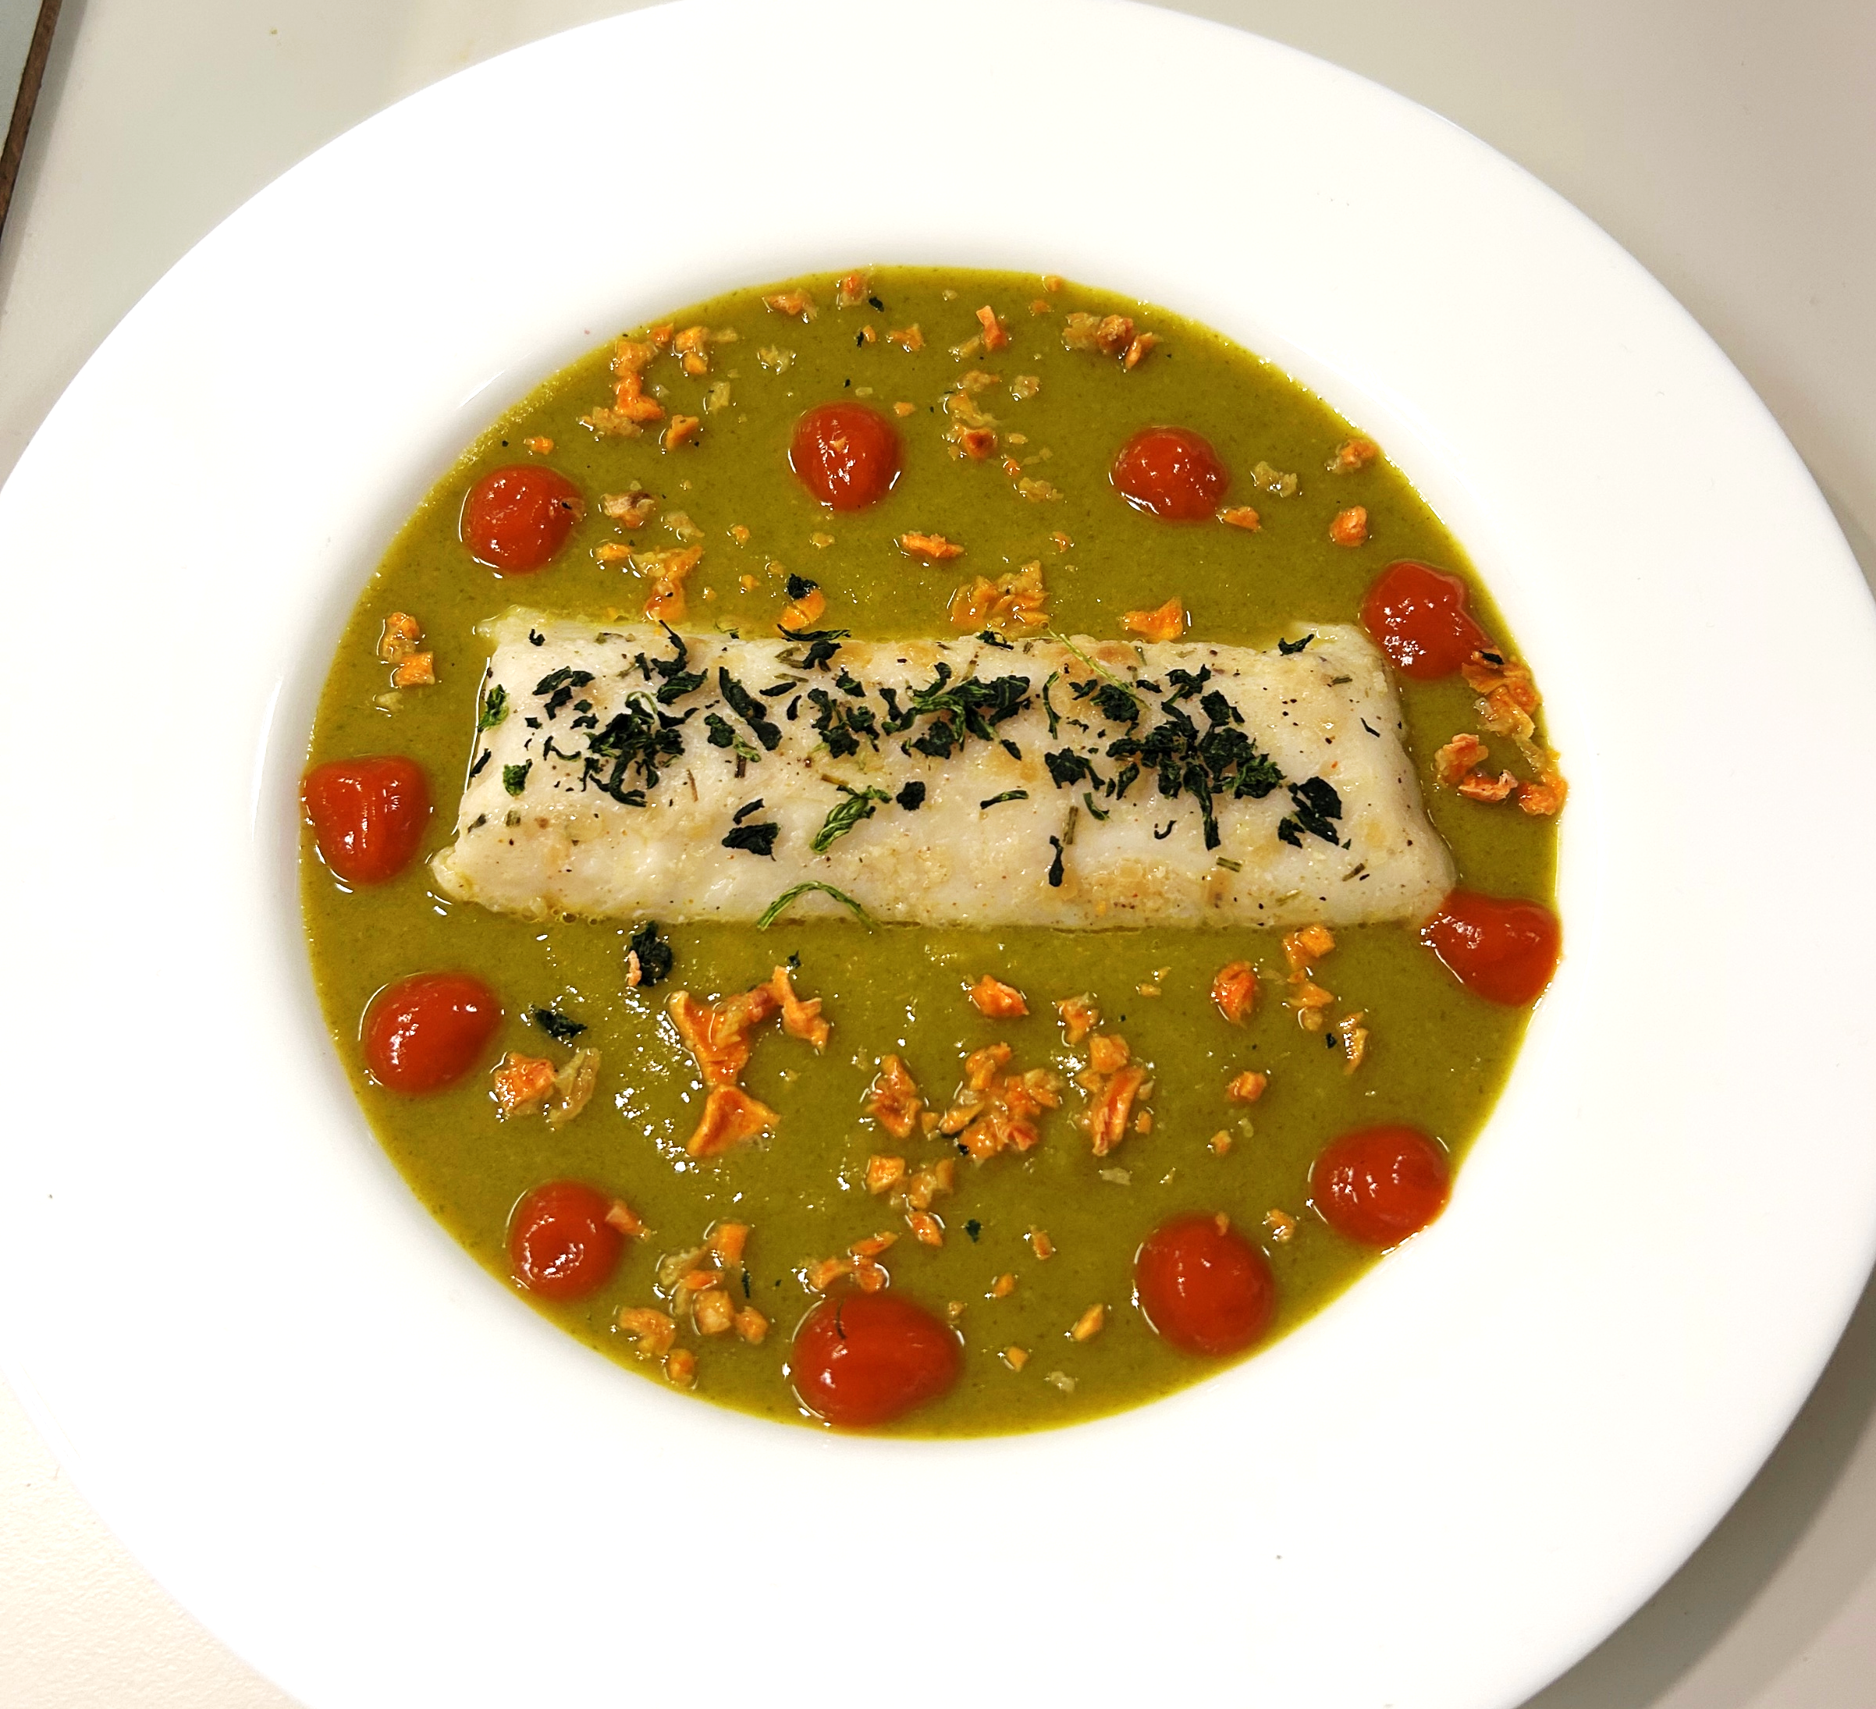
SOUPreme FISH
A SoUPreme WAY TO EAT
Adrián Matas gil, Catarina maia, EIRINI FOTI, LUAN MARVAO, PEDRO NAVARRO

Slide 3

Pepita Martinez
78 years old
Basic level studies
Recent widow

Slide 4

Grandmother
Wants to cook for the family

Slide 5
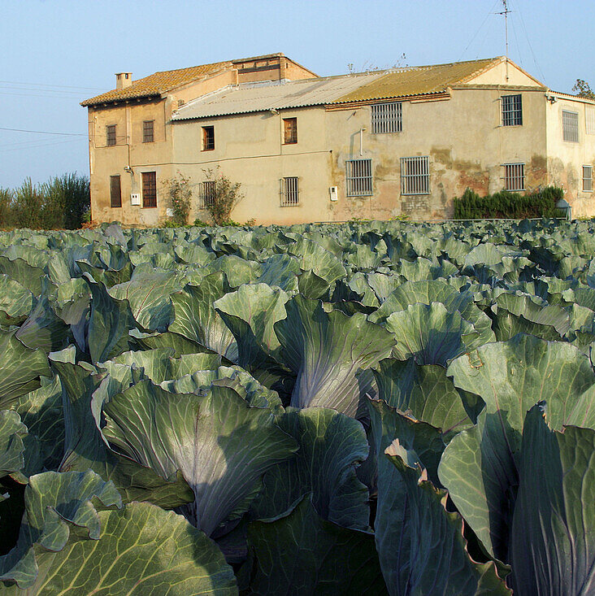
Lives alone
Alboraya
Difficulties to cook and chew
Family visits on weekends
Support from neighbors

Slide 6
Cares about her nutrition
Looks for natural alternatives
Wants to be healthier/happier
Wants to be more independent

Slide 7
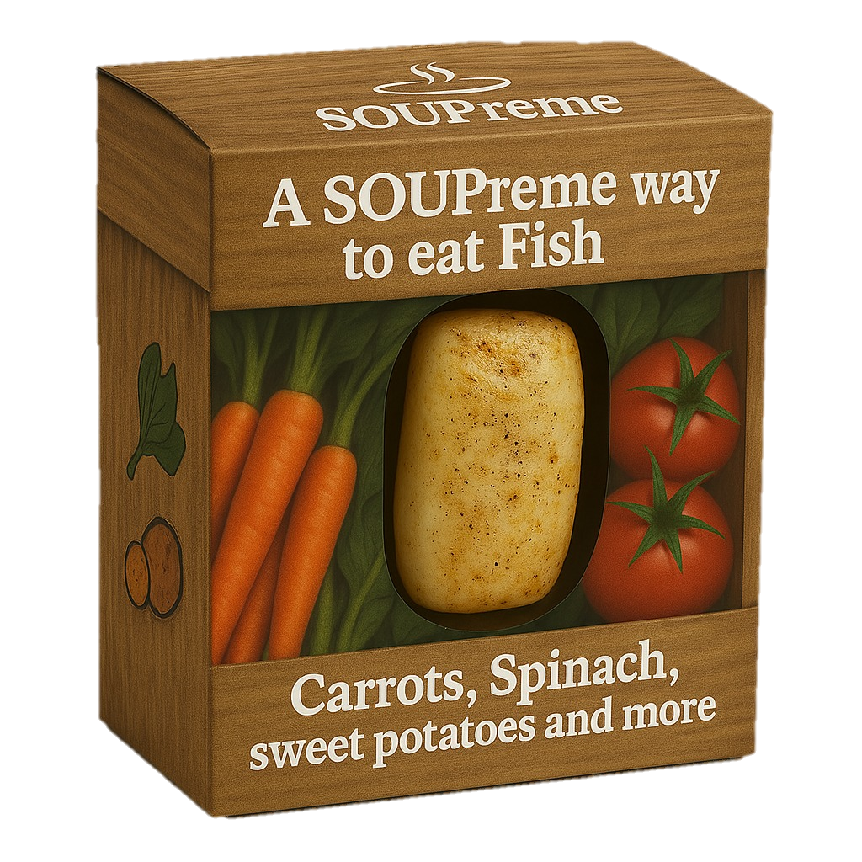
SOLUTION

Slide 8

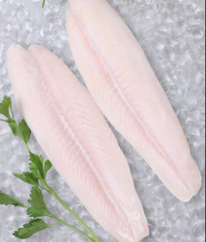
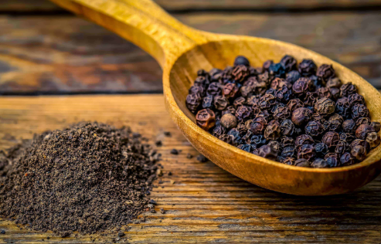

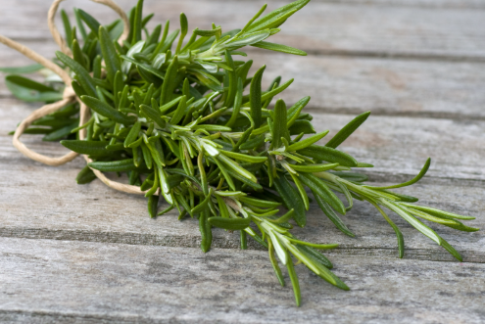
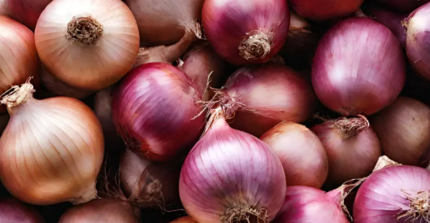




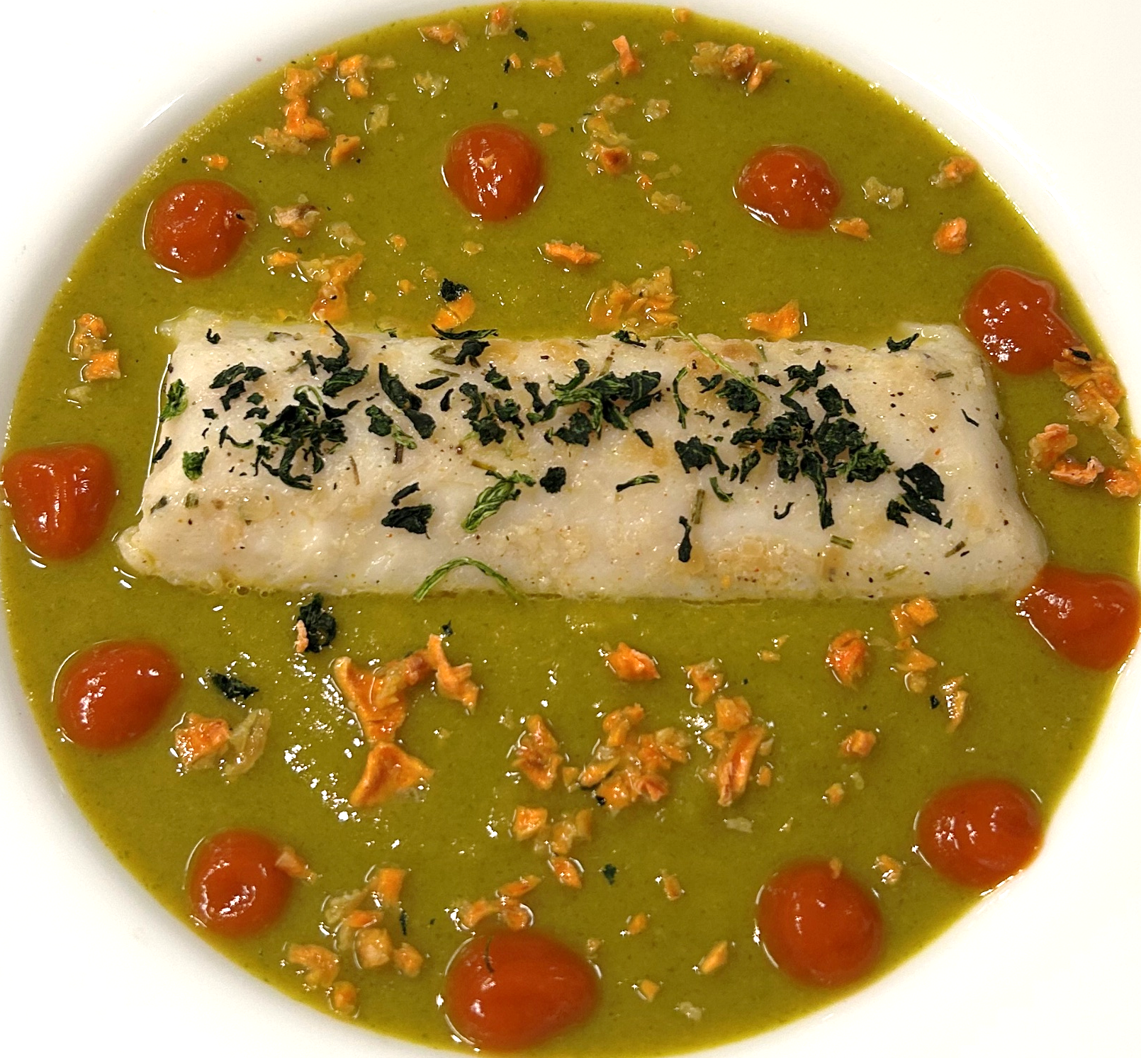
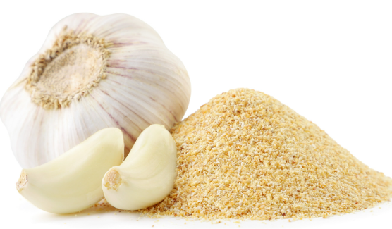
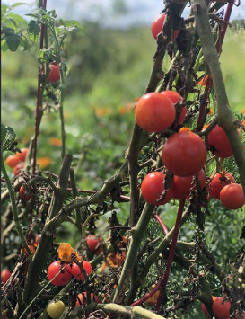
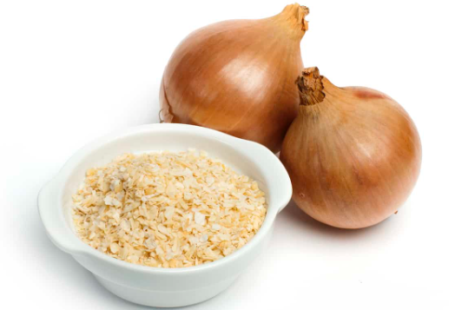
INGREDIENTS

Slide 9



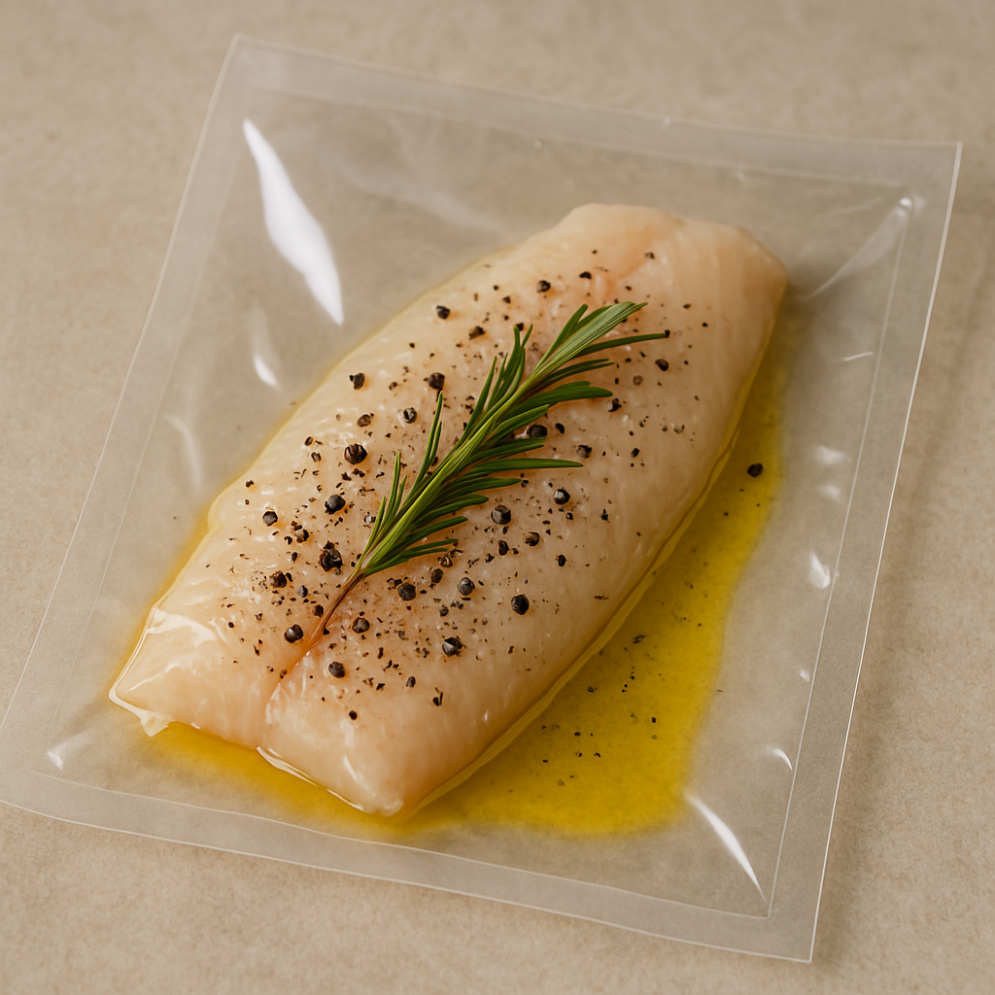





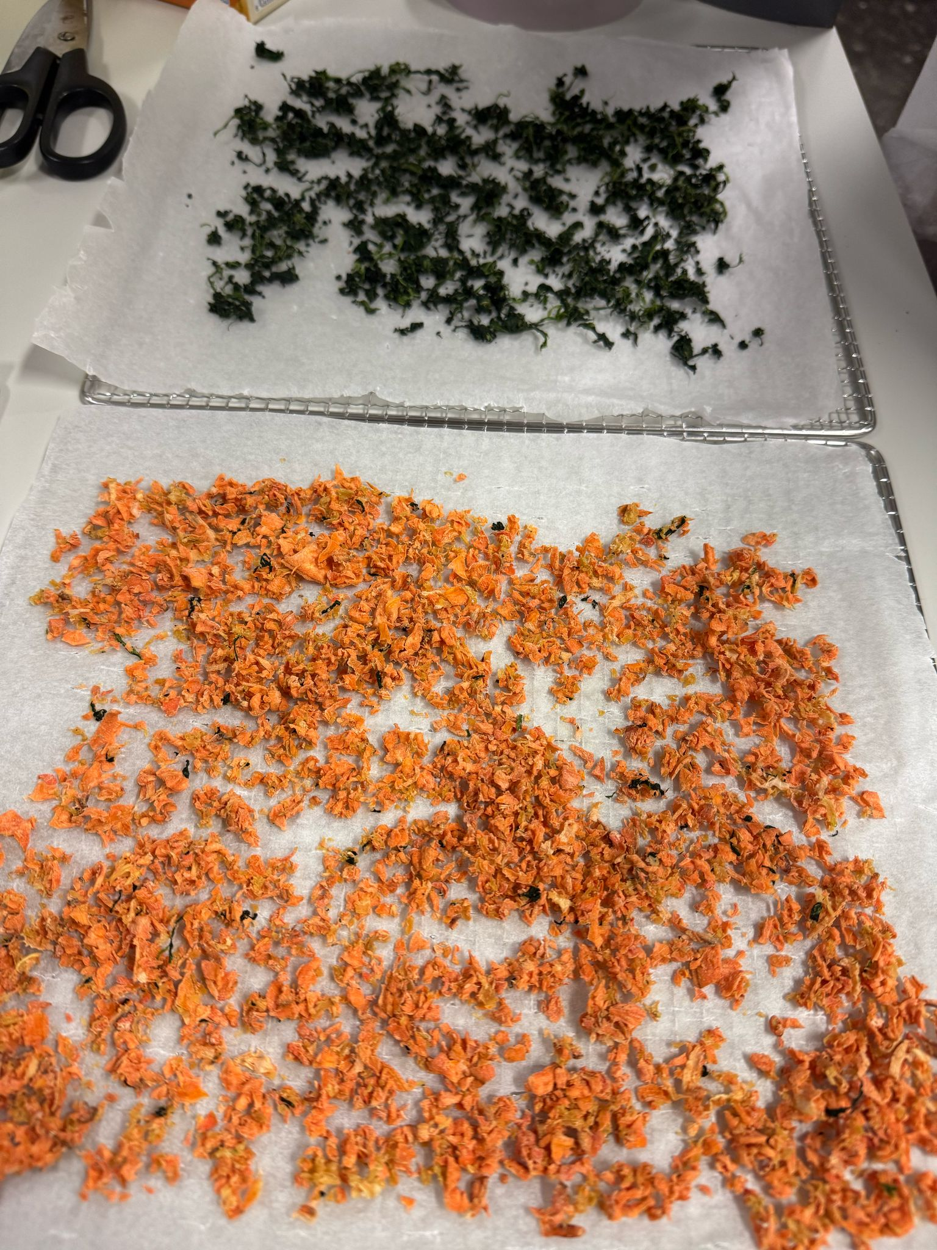
PROCESS DIAGRAM
Fish preparation
Put all ingredients in a bag
(200g Hake, 2g salt,1g Rosemary, 0.1g black pepper, 13.5g olive oil)
Vacuum marinating and sealing 6 min
Sous-vide cooking at 65ºC for 20 min
Fast cooling at -25ºC for 30 min and keeps at 4ºC
Soup preparation
Boil vegetables 100ºC 15min
(270g sweet potato, 180g spinach, 100g onions, 100g cauliflower, 10g olive oil, 9g Carrots, 3g garlic, 1.5g salt)
Air-drying 24h at 50ºC
Grind vegetables 5 min and vacuum sealed 50g of powder

Slide 10

PROCESS DIAGRAM
Tomato sauce preparation
Boil ingredients 100ºC 20min
(200g tomato, 10g olive oil, 1.5g salt)
Fast cooling at -25ºC for 30 min
Vacuum sealing 6min

Slide 11
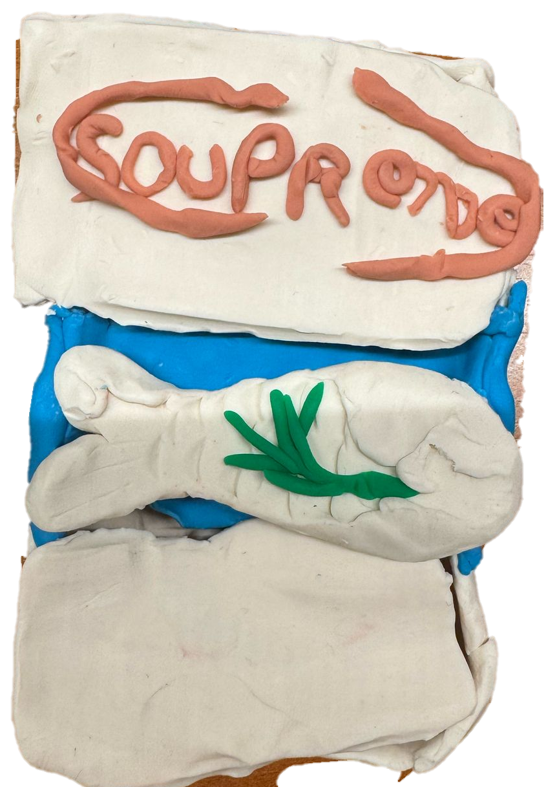

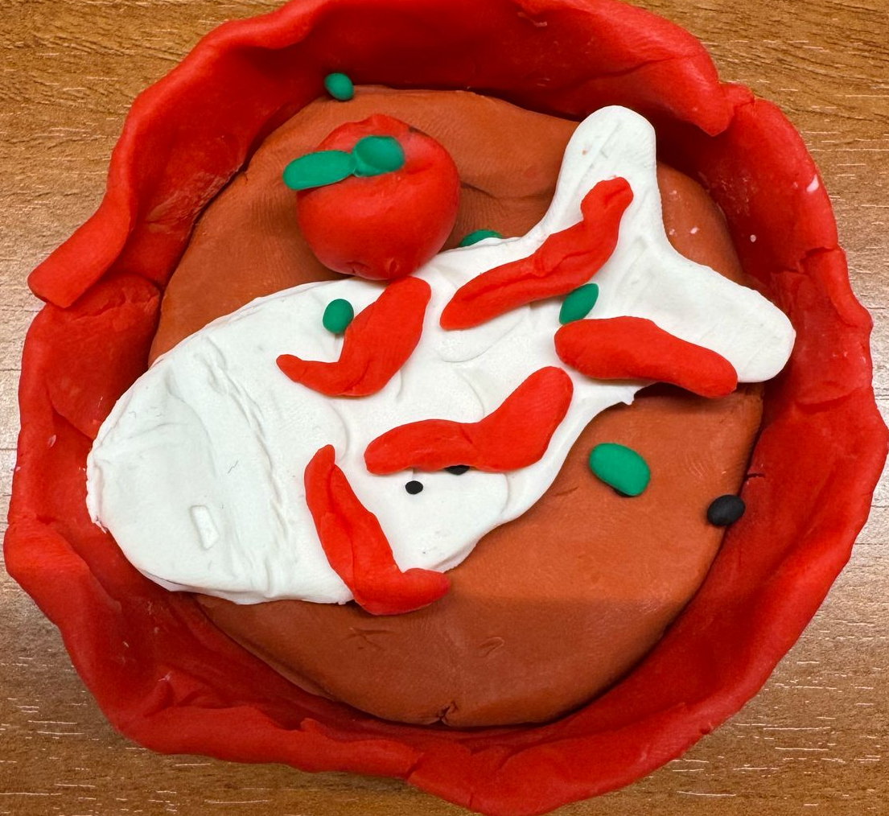
Box
PACKAGING PROTOTYPE - PLAYDOUGH
Box
Prepared Dish
Front Side
Inside content
Bowl with soup and fish on top with tomato sauce and dried vegetables topping

Slide 12
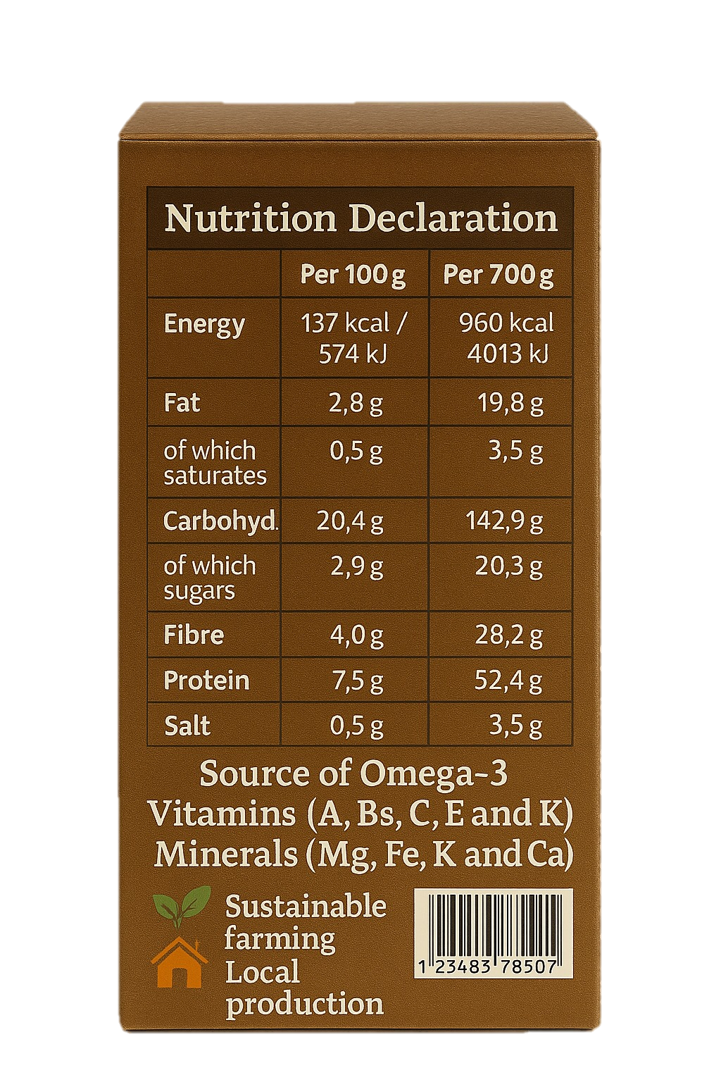
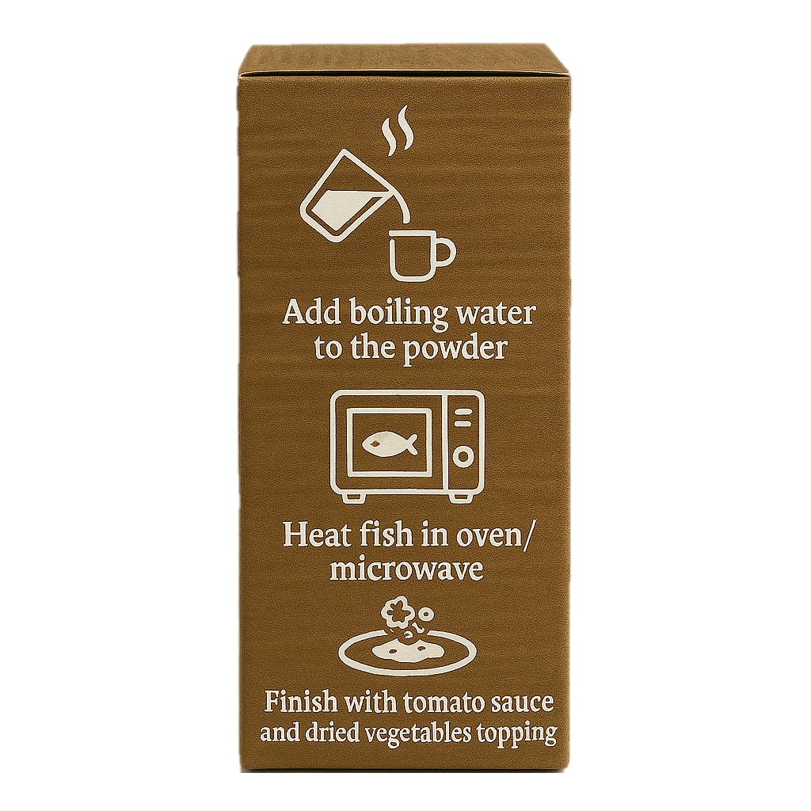
Box
PACKAGING – FINAL VERSION
Box
Box
Front Side
Right side – Preparation Instructions
Backside – Nutritional Declaration

Slide 13
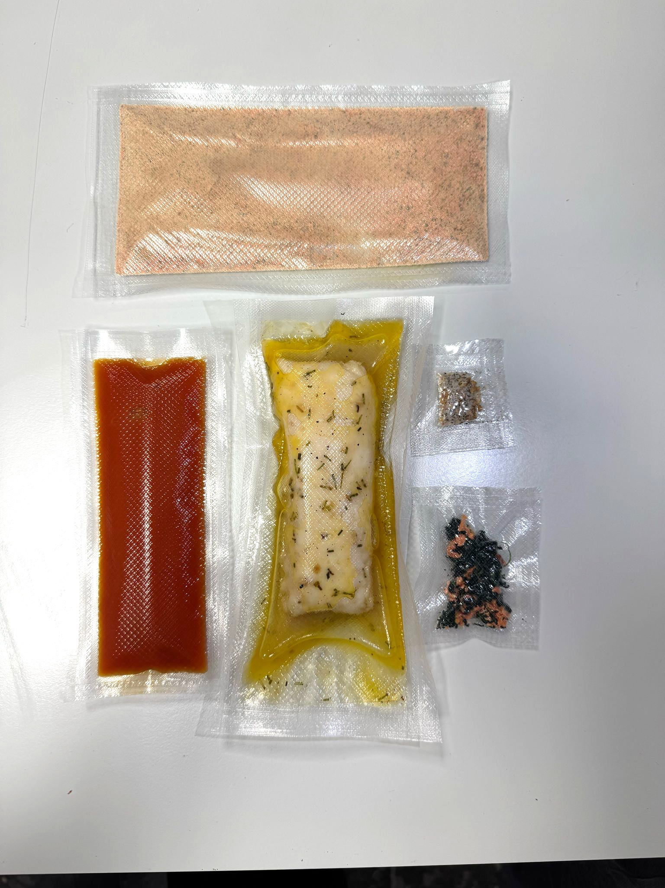
PACKAGING – FINAL VERSION
Fish
Crispy vegetables
Tomato sauce
Soup
Seasoning

Slide 14

4.8€ per package

Slide 15
About the future …
Registering a company
New flavours
Internationalisation
Family pack
Advertising

Slide 16
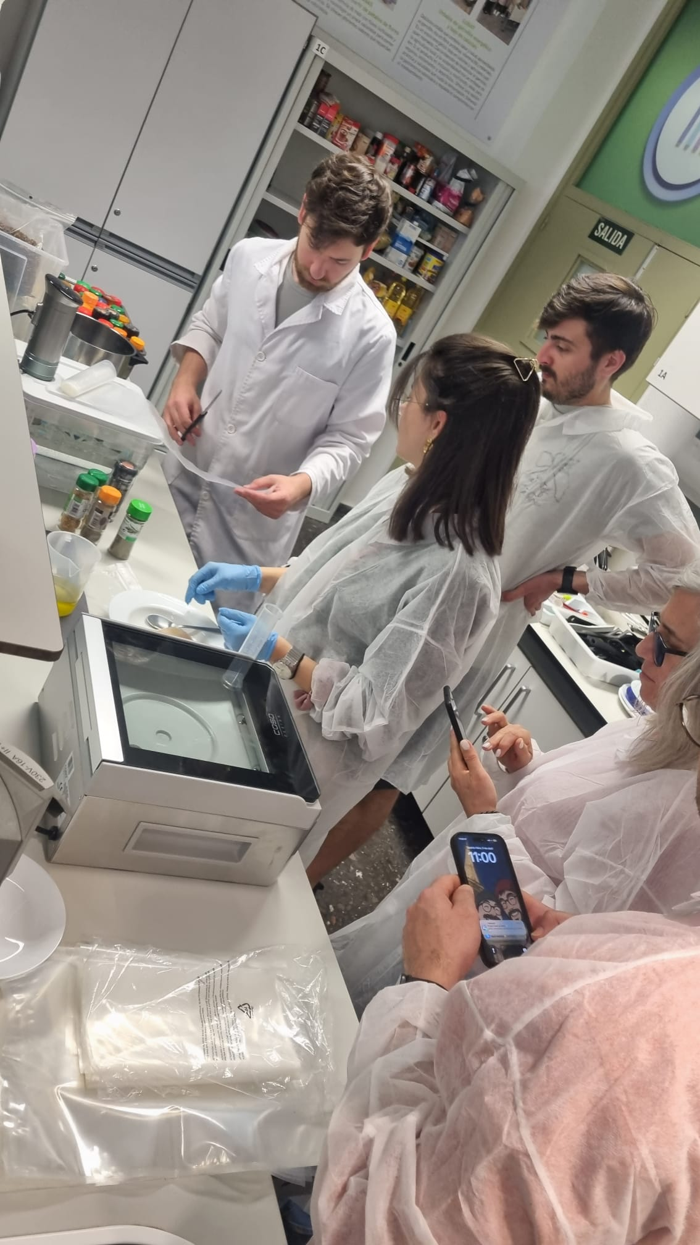
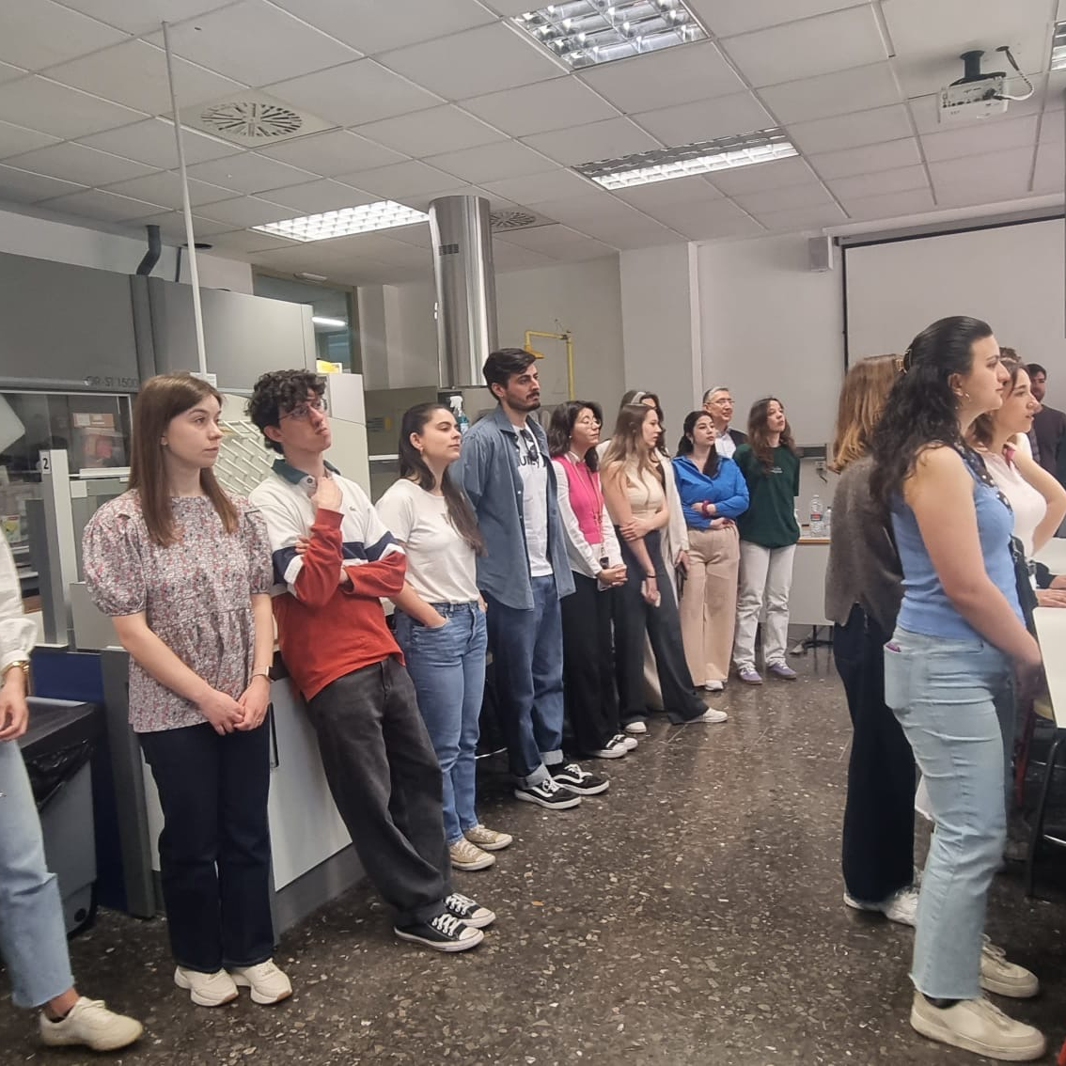
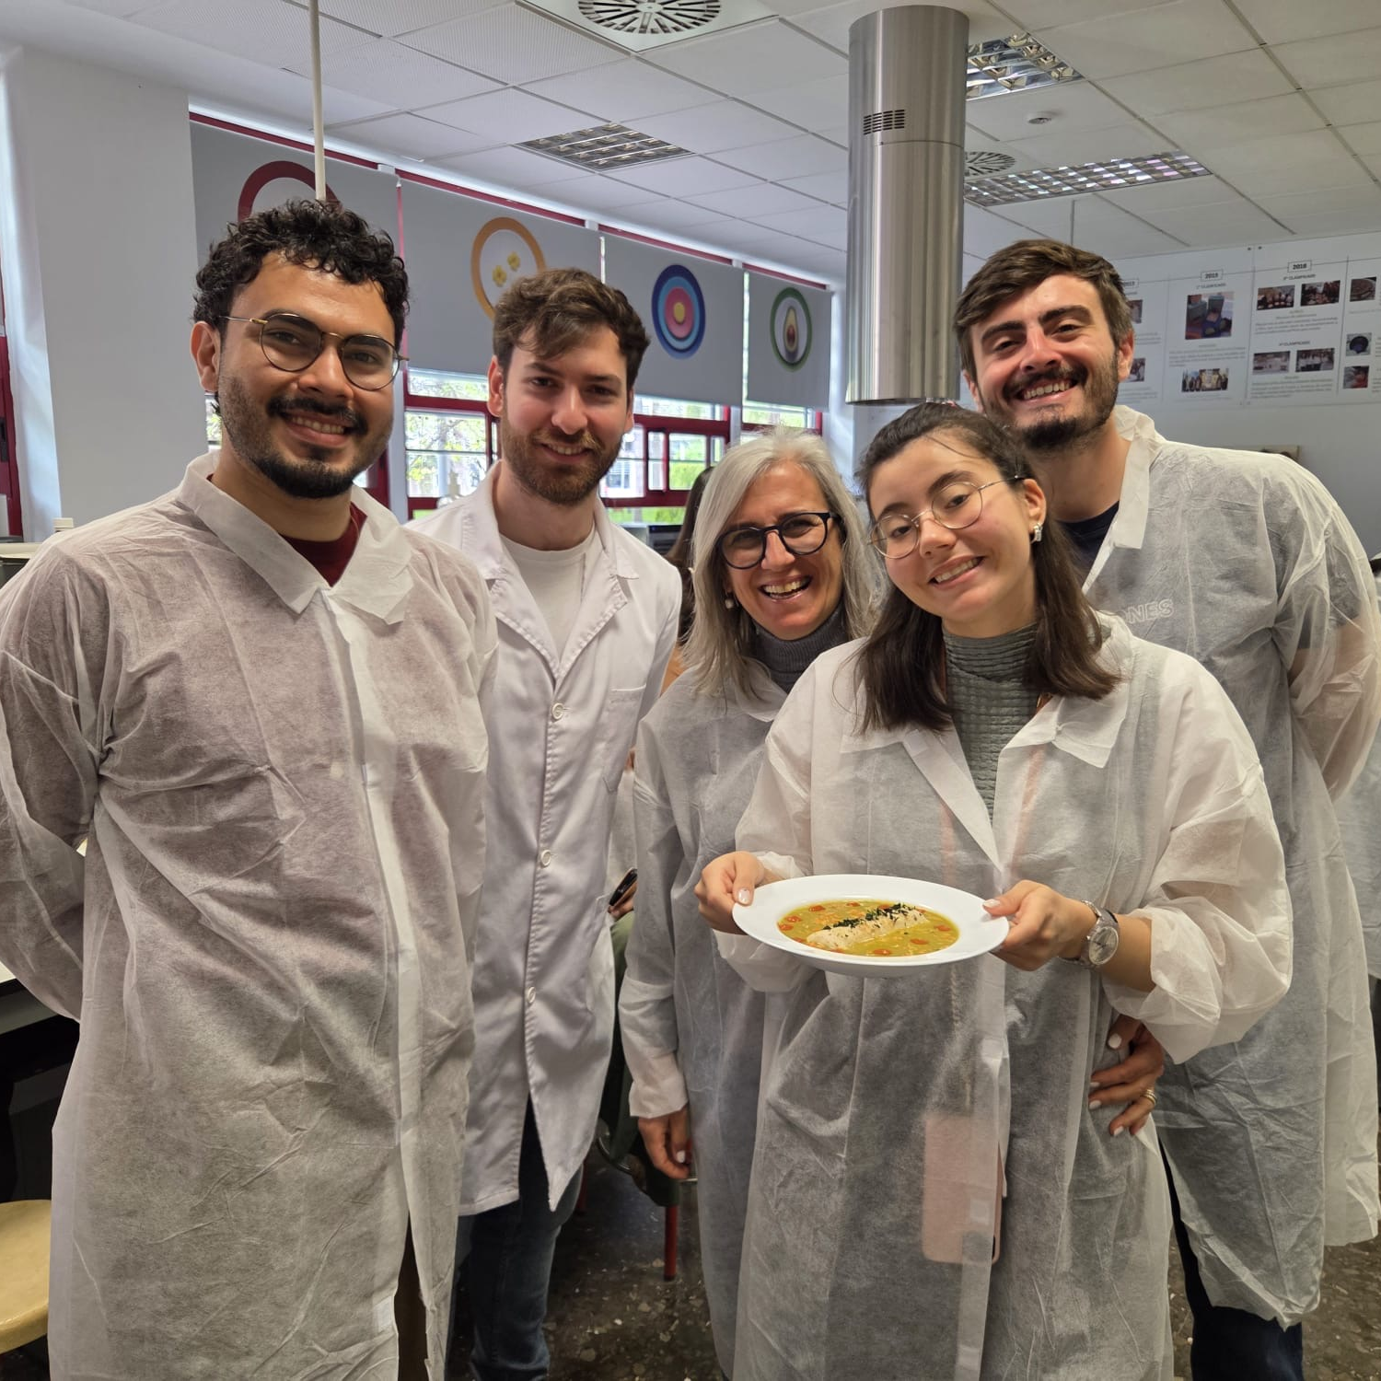
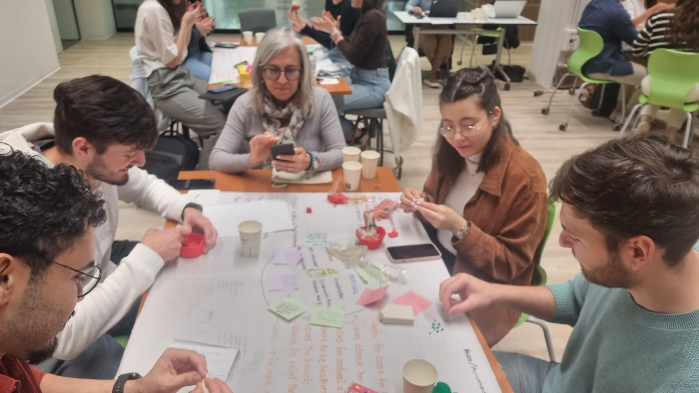
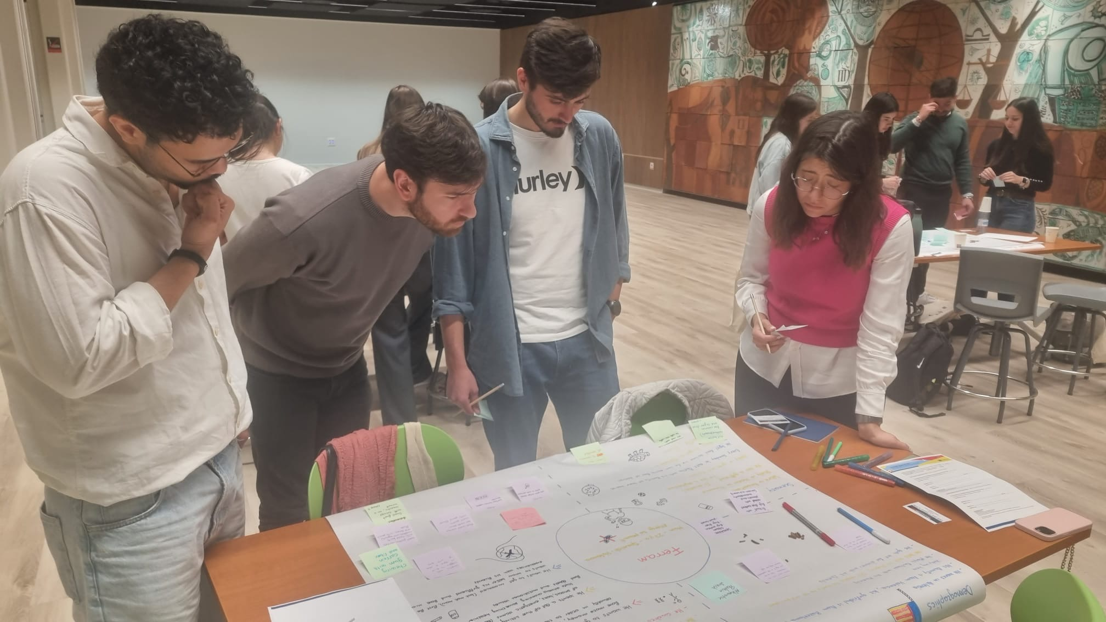
Buon appetito
Καλή όρεξη
Bon appétit
Bom apetite
Buen provecho
Bon profit

Slide 17
ABSTRACT
SOUPreme fish meal is a convenient and nutritionally balanced dehydrated soup product combined with a portion of pre-cooked hake fish, designed to provide a complete and wholesome meal with minimal preparation. Developed to meet the needs of individuals seeking a easy and yet nourishing food option, the product offers a unique blend of dehydrated vegetables, including sweet potato, spinach, cauliflower, onion flakes, carrots, and tomato sauce, enriched with aromatic herbs and spices such as garlic, rosemary, and black pepper. The pre-cooked hake fillet, seasoned and ready to heat, complements the soup base by delivering high-quality protein and essential omega-3 fatty acids. The final meal, when rehydrated with water and paired with the reheated fish, delivers approximately 960 kcal, 49 g of protein, and a rich spectrum of micronutrients. It is particularly notable for its high content of vitamins A, B6, C, E and K, as well as minerals such as magnesium, iron, potassium, and calcium. The soup also contributes significantly to daily fiber intake, with over 28 g of fiber, supporting digestive health.With no added sugars and low in saturated fats, soupreme fish meal is ideal for health-conscious consumers, combining culinary simplicity with functional nutrition. Its innovative format – dehydrated vegetables with a separately packed pre-cooked fish – ensures long shelf life, easy storage, and rapid preparation by simply adding hot water to the soup and reheating the fish in the oven or microwave.

