Slide 1
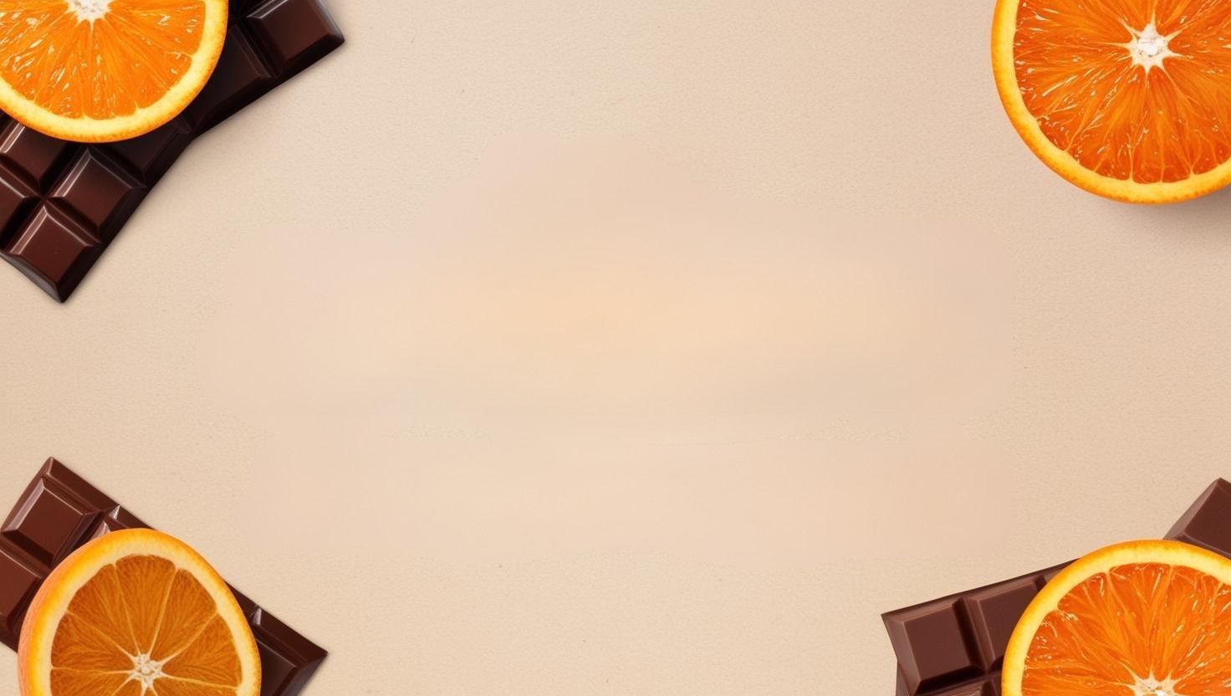
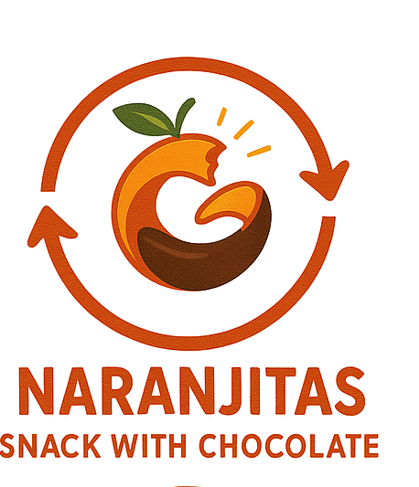
NARANJITAS
Energy balls
GROUP 3 | Bruna, Lara, Lina, Maxime, Rebeca

Slide 2

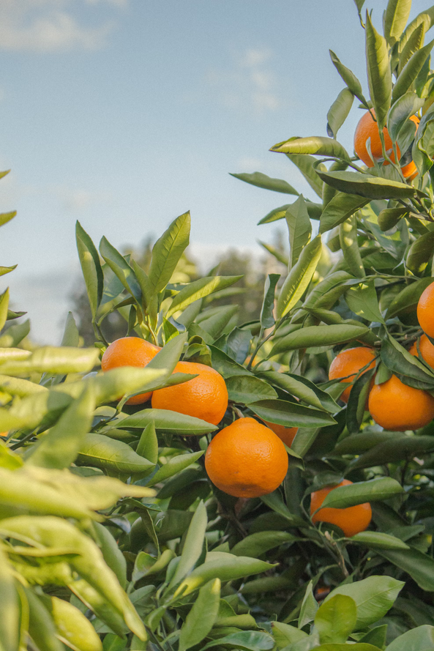
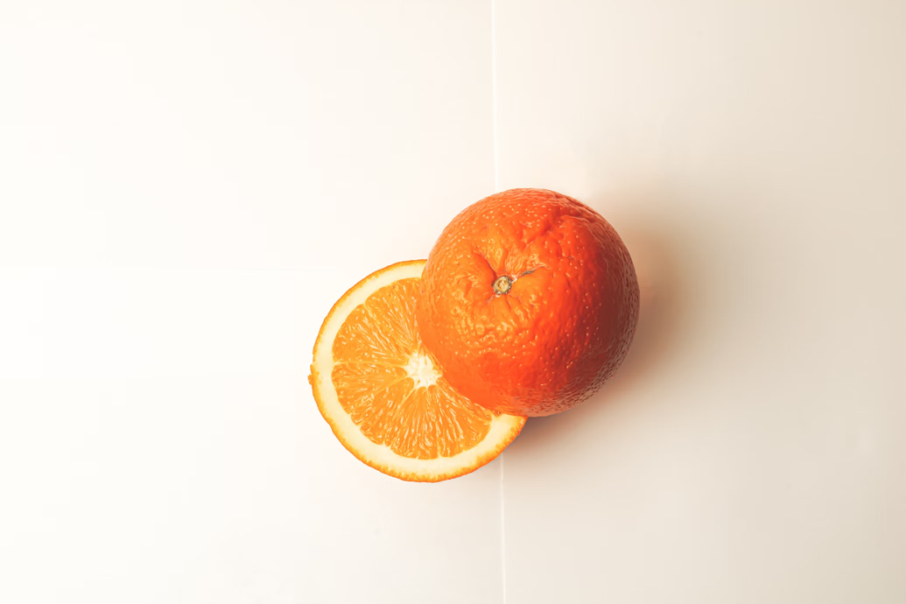
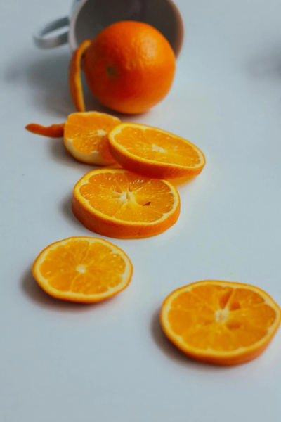
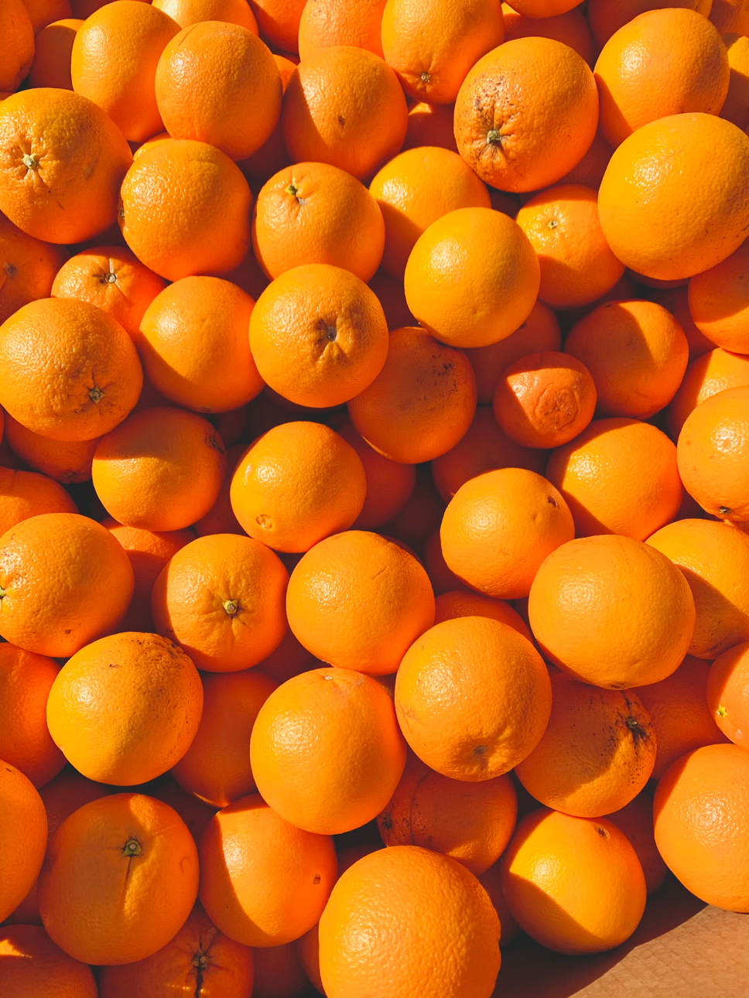
FROM
WASTE
50%
orange mass becomes waste
TO
ADDED-VALUE PRODUCT
Manakas et al., 2024

Slide 3
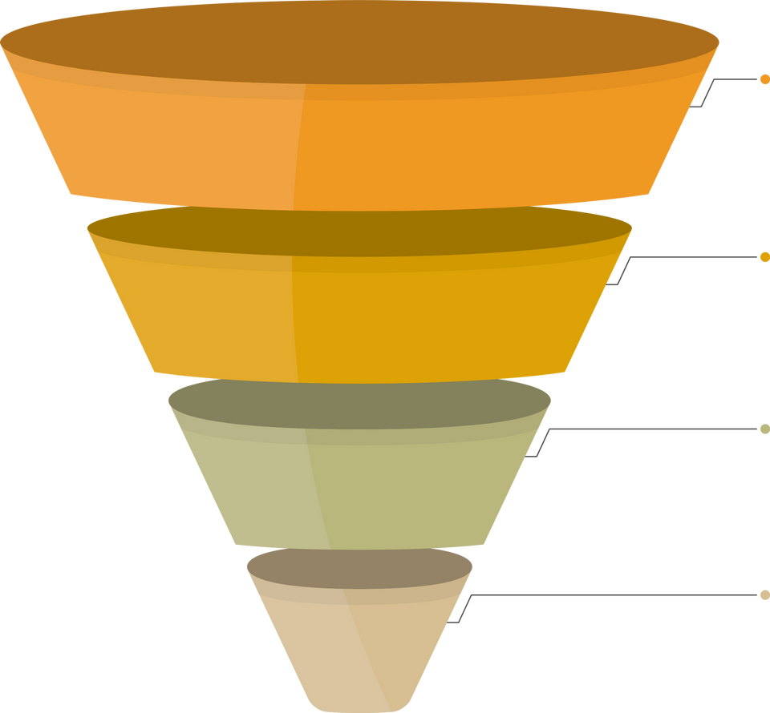

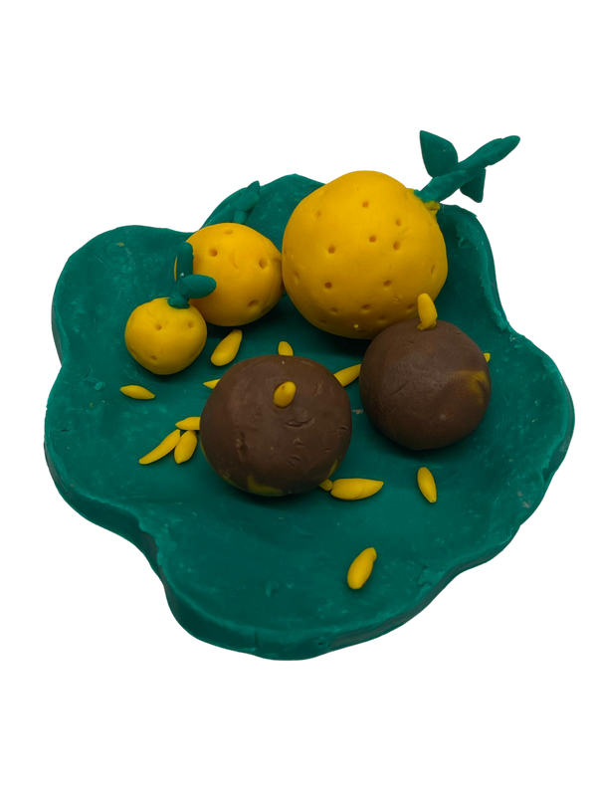
TARGET PUBLIC
Young Adults
Conscious Foodies
Curious Snackers
Laura

Slide 4
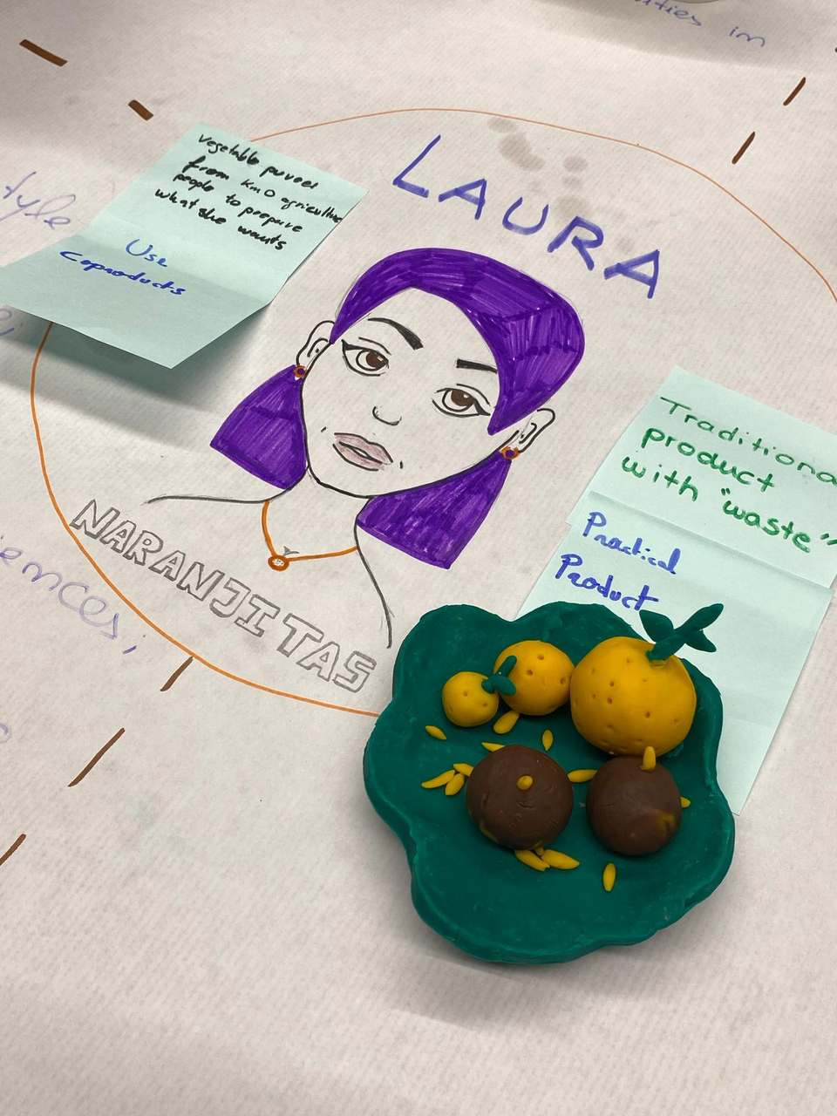
PRODUCT PROTOTYPE
Motivations
Eco-friendly person
Promote:
1. traditional products
2. by-products
New food experiences
Improve her lifestyle

Slide 5
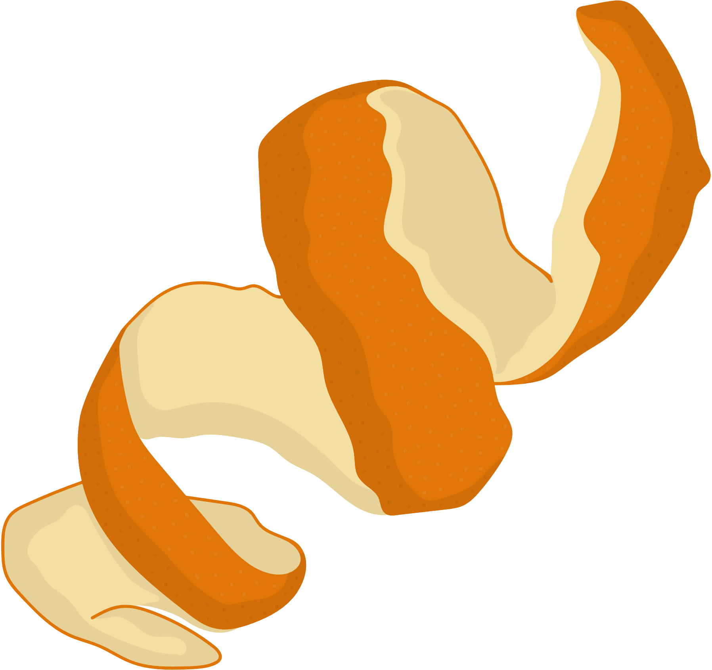

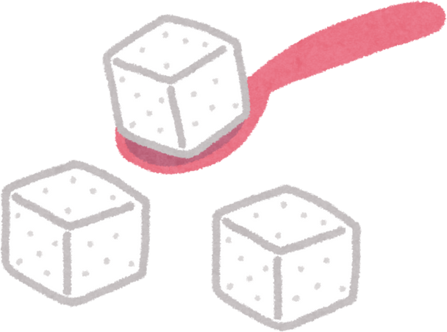




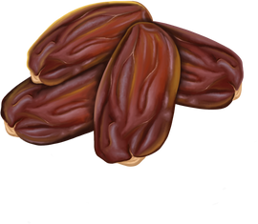
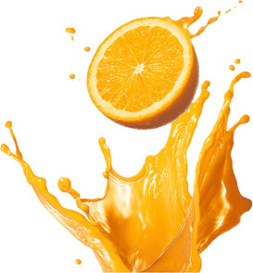
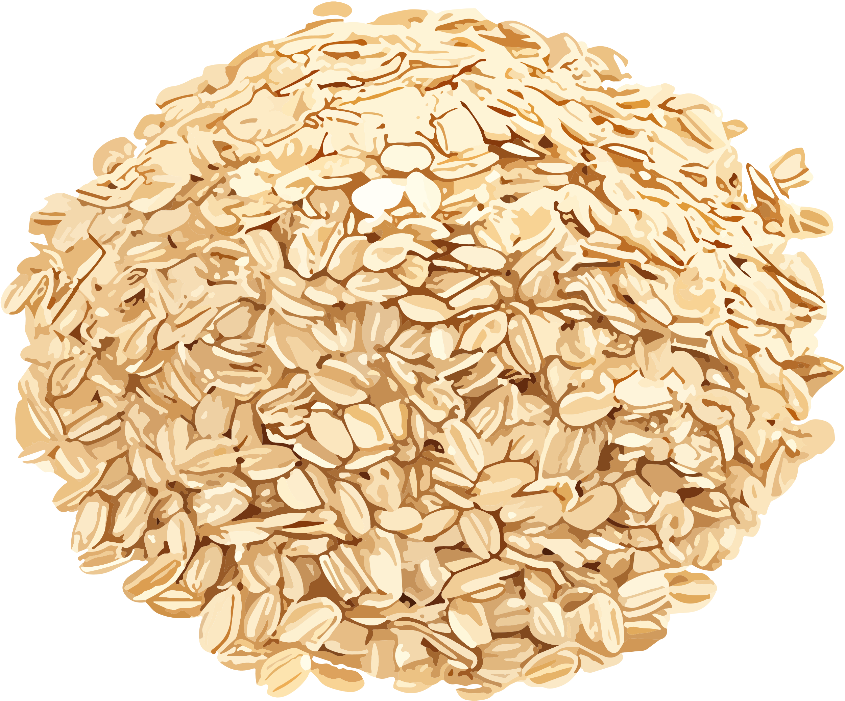
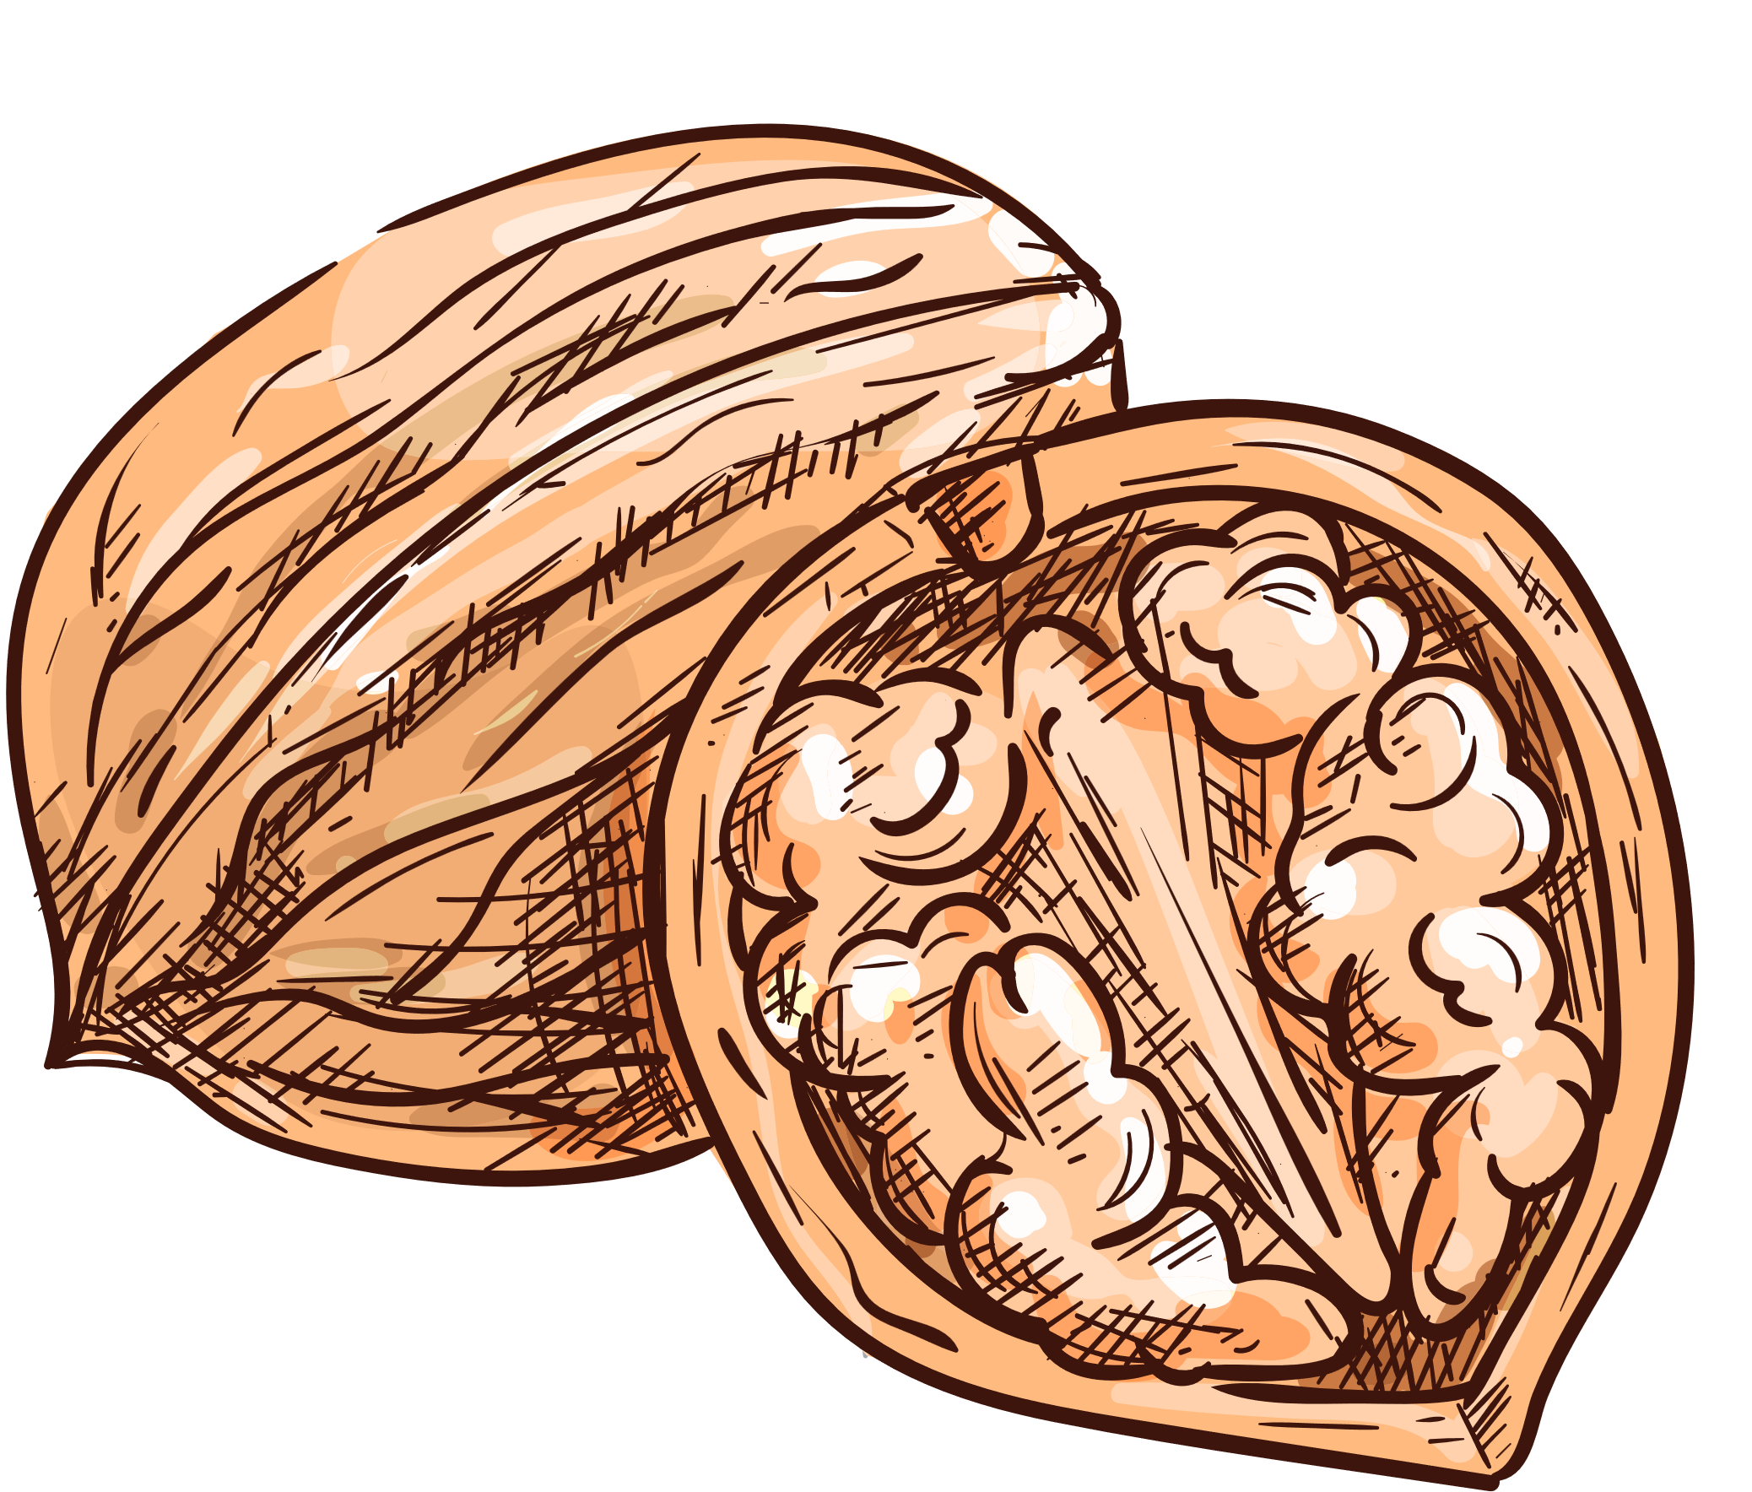


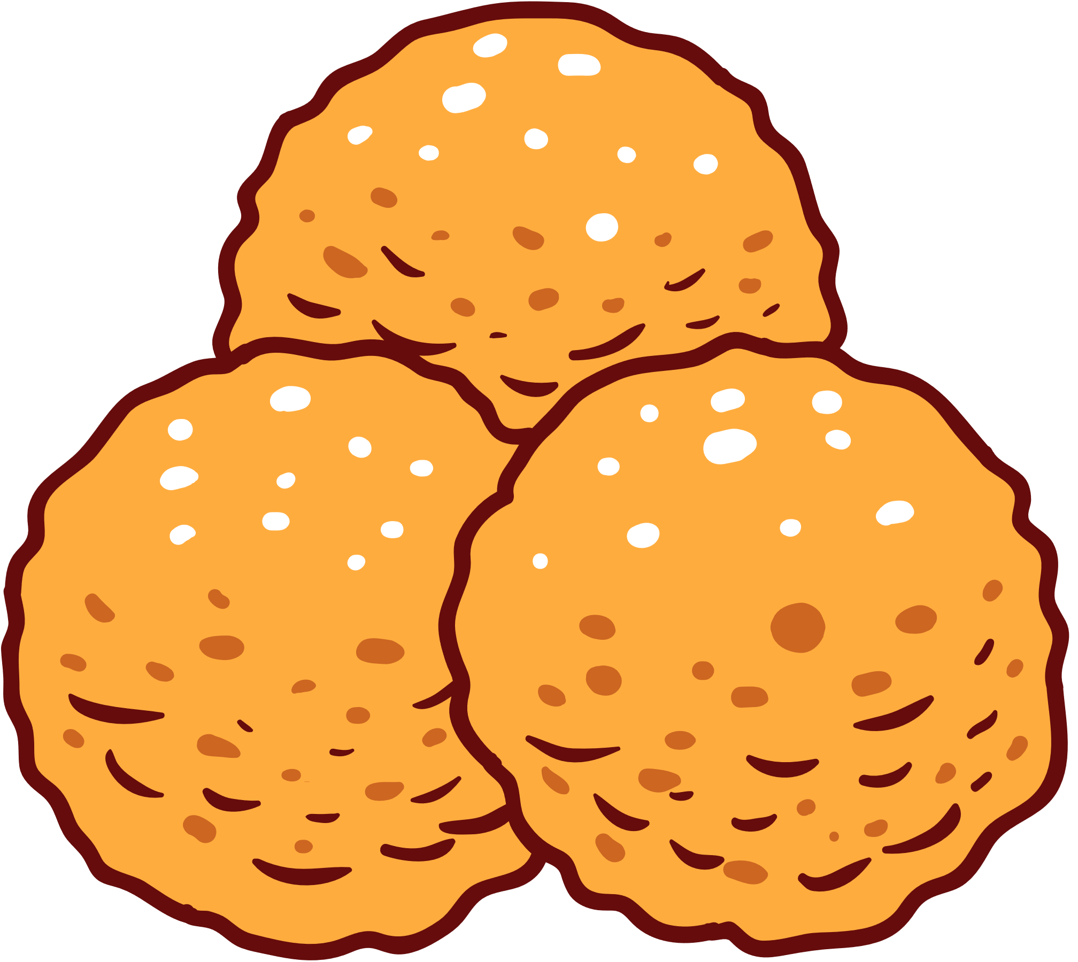


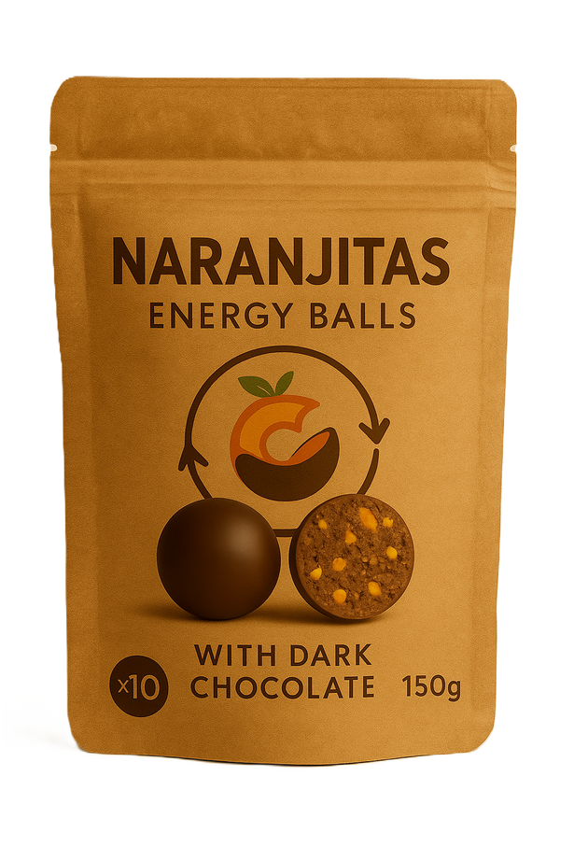
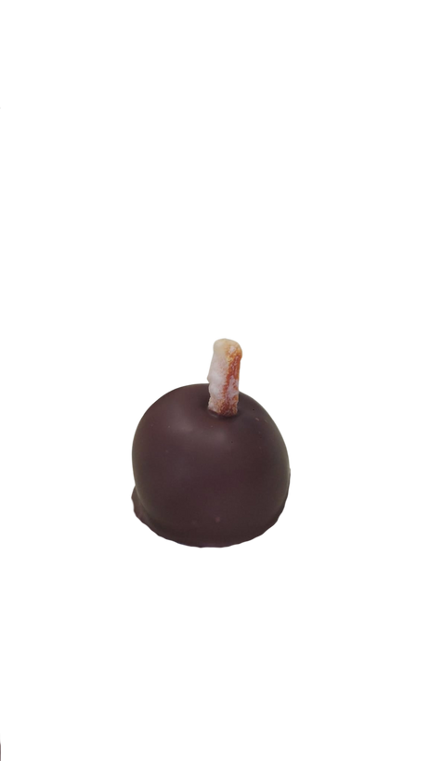


PRODUCTION FLOWCHART

Slide 6
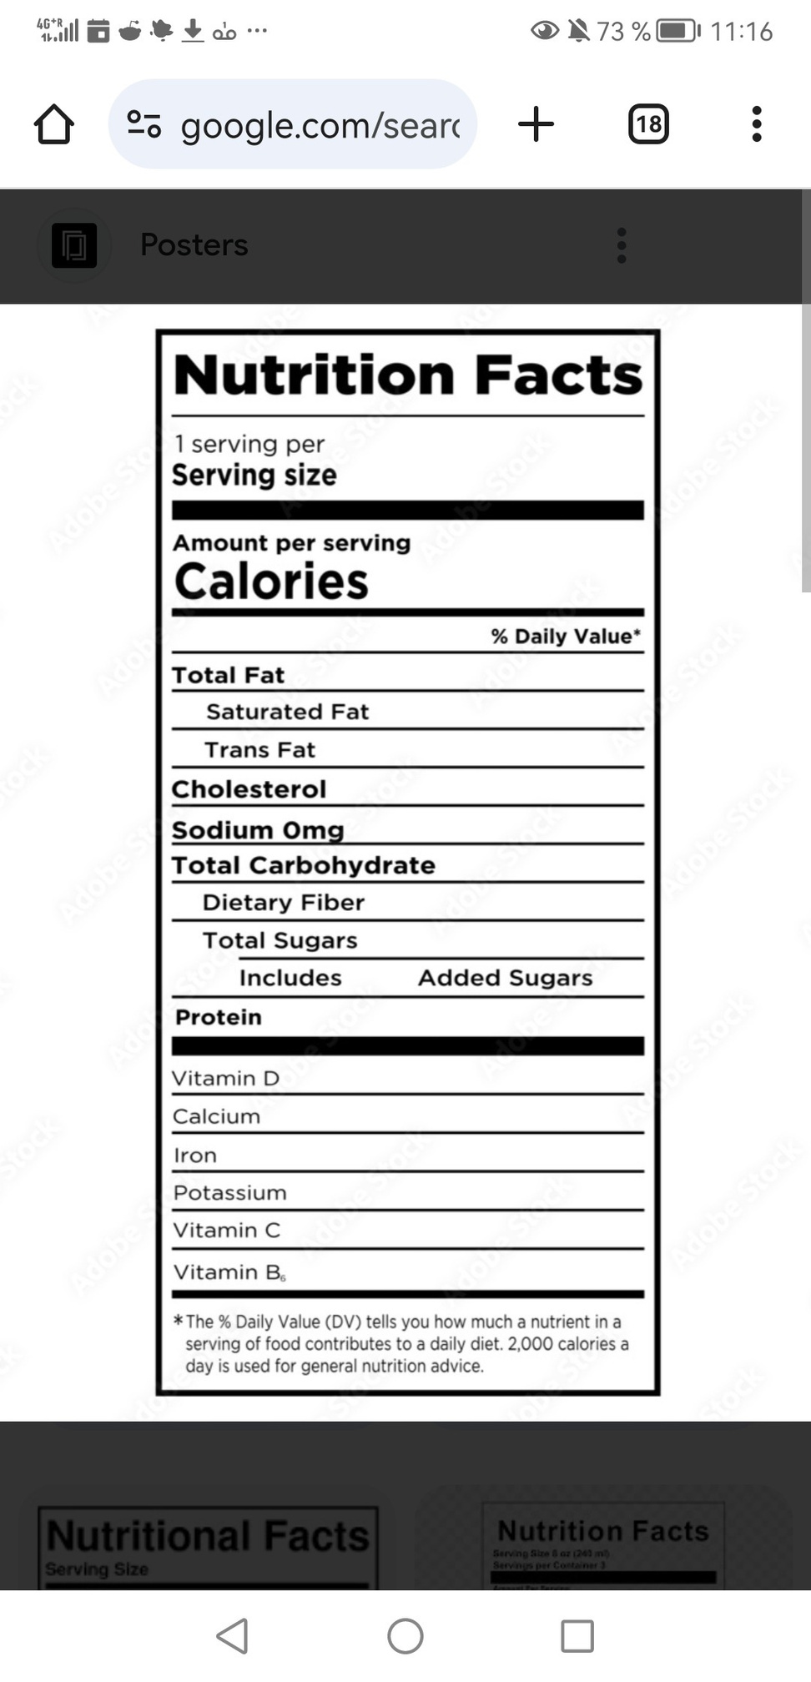

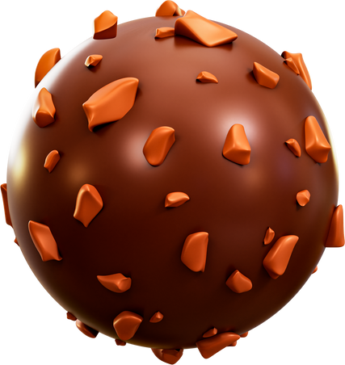
1
﻿Without sodium
﻿WITHOUT TRANSFAT
60
grams
2
﻿0.65
0
0
0
﻿6, 8
﻿Rich in Vit. C
1
﻿3, 4
﻿High in fiber
﻿1, 4

Slide 7

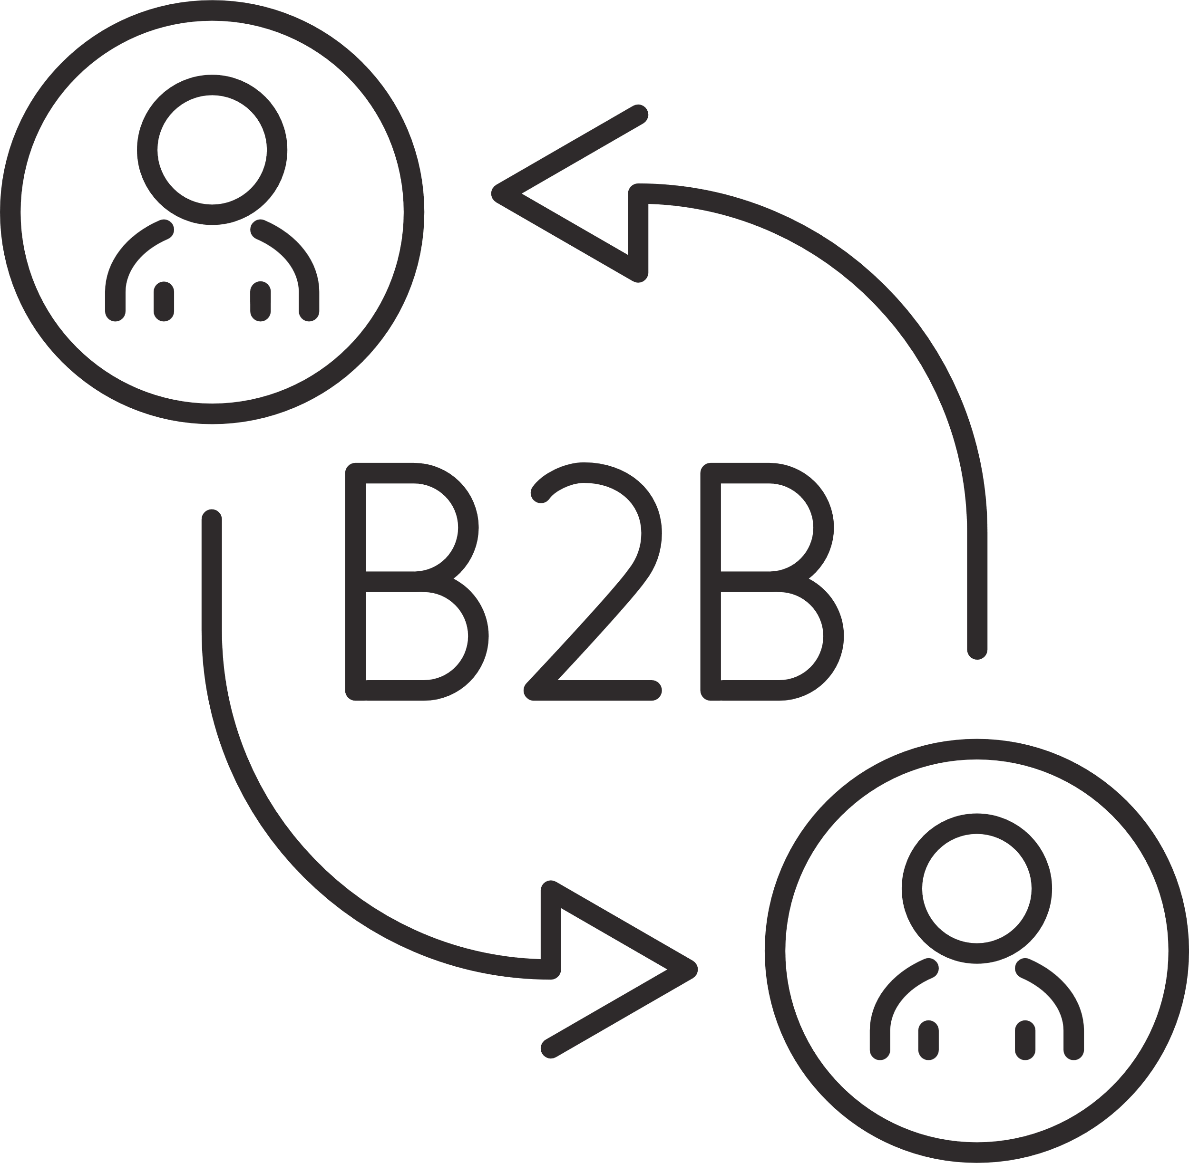

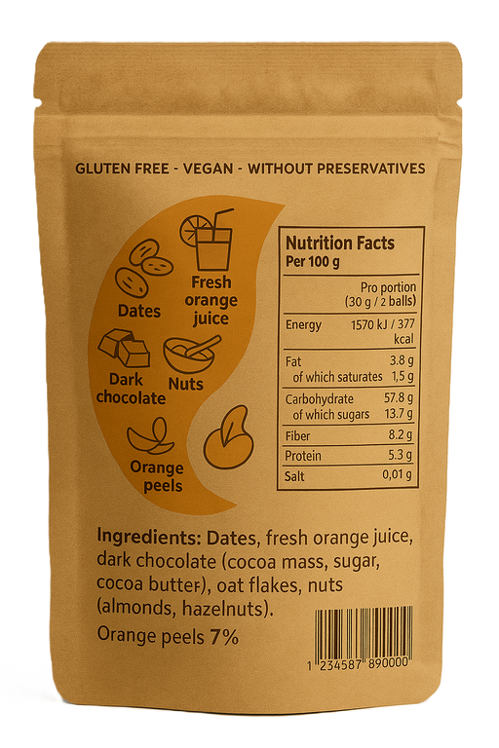
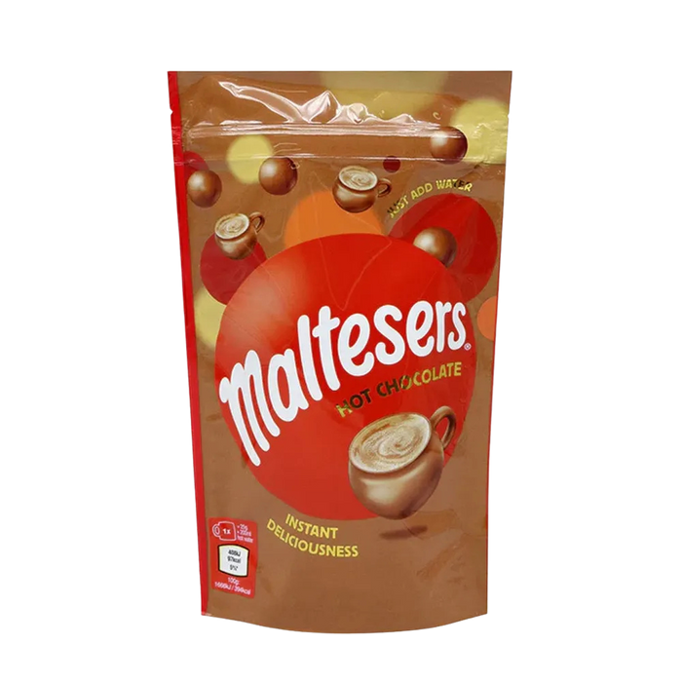
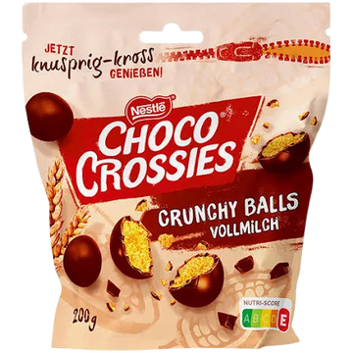
PACKAGING
3,50€
Paper

Slide 8
WHY US?
WHY US ?
amazing flavor
ECO-PACKAGING
high in FIBER
eco-innovative
nutritious
value for money

Slide 9
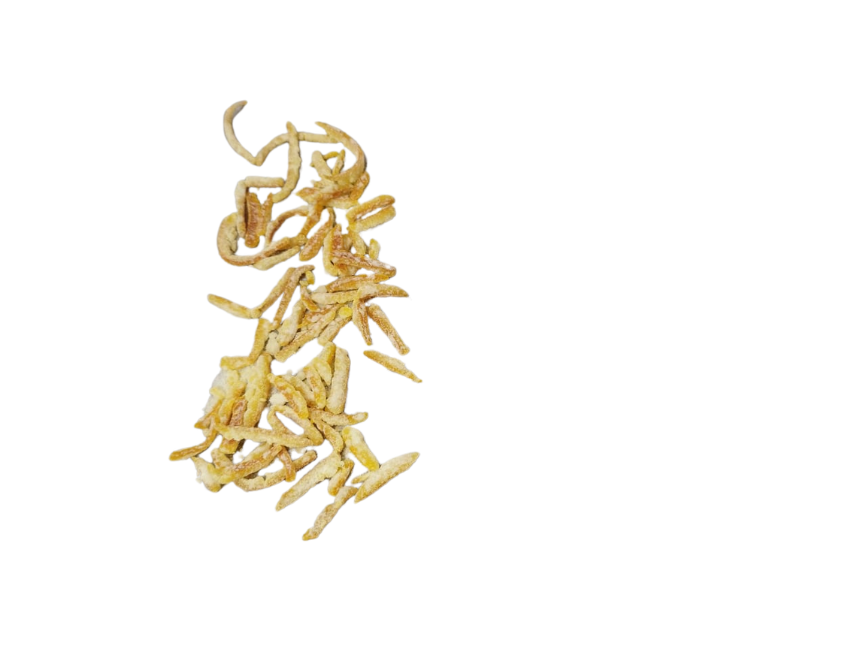
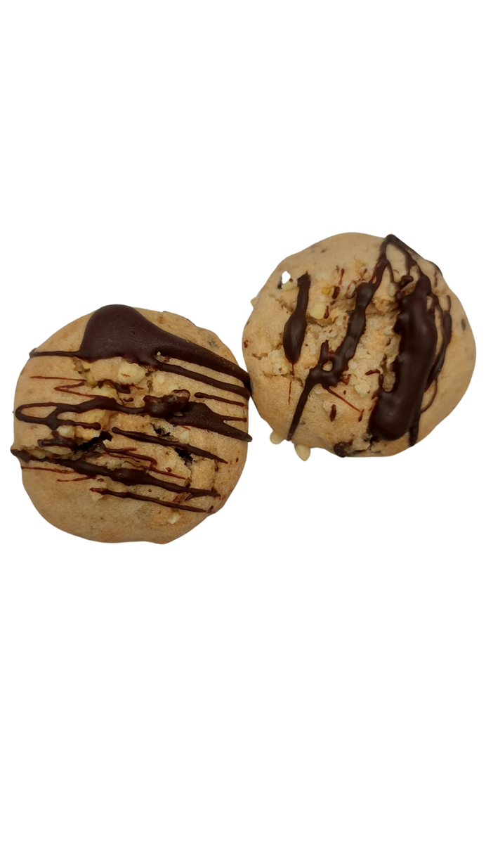
FUTURE PRODUCT
Orange Peel
Cookies

Slide 10
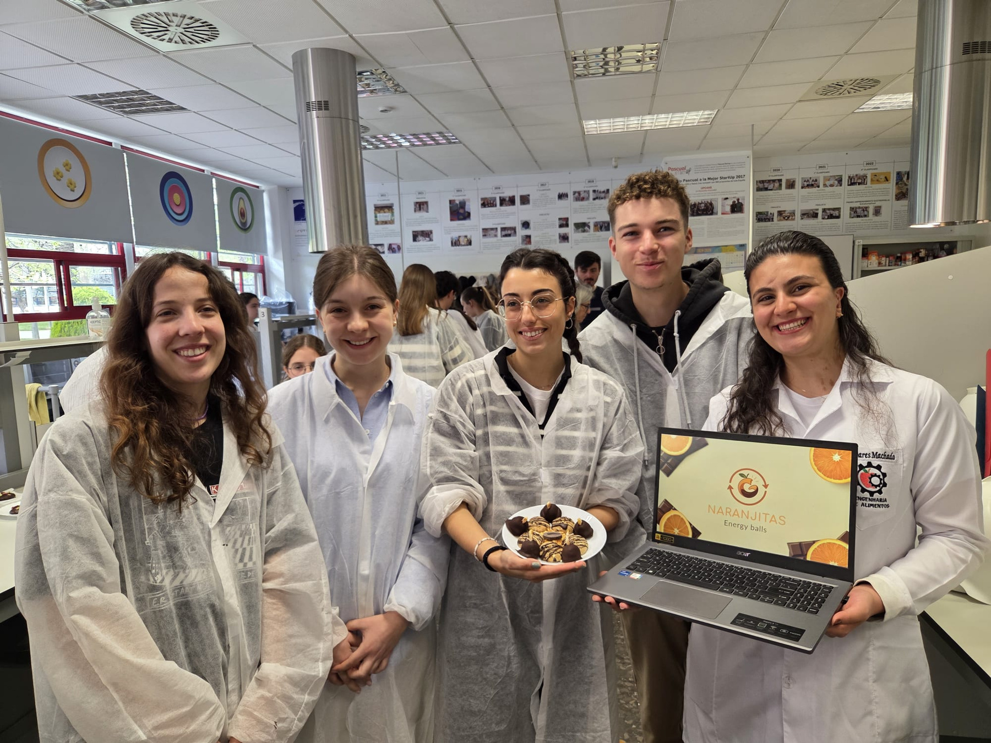
Thank you !!
NARANJITAS
NARANJITAS
a sustainable bite

Slide 11
ABSTRACT
It is estimated that around 50 per cent of the orange mass is wasted, which includes the peel, pulp and seeds (Manakas et al., 2024). The emergence of the Naranjitas brand is related to the reuse of the by-products of a product typical of the city of Valencia: Oranges.
The product developed for the launch of the brand are energy balls with a real balance of textures and flavours.
Our target audience are young adults, who have a healthy and eco-friendly lifestyle. They look for convenience, new experiences, care about sustentability and food wast reduction.
The process initiates with the preparation of candied orange peels, where orange peels is boiled with sugar. Meanwhile a mixture of dates, orange juice, oats, and walnuts is prepared and combined with cubed candied peels to form the base dough. This dough is shaped into small energy balls. Simultaneously, chocolate is melted and used to coat the formed energy balls. After enrobing, the product is packaged and made ready for distribution.
This product is of a great nutritional interest due to its richness in fiber and vitamin C and it´s a business to business product, with a final cost of 3.50 €.

