Slide 1

Name: Sofia
Age: 35
Location: Bologna, Italy

Slide 2






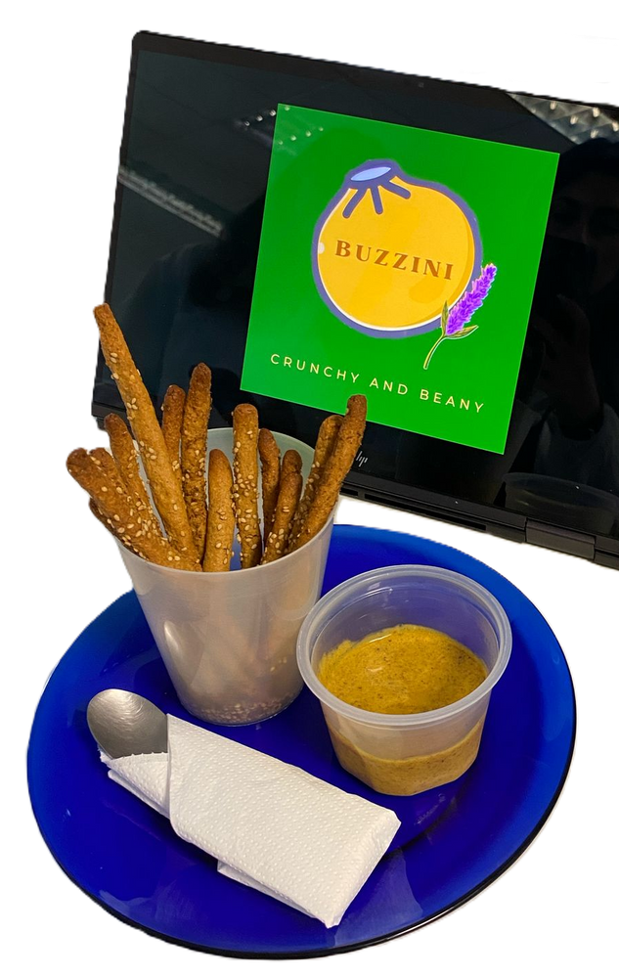

GROUP 2
BUZZINI
“CRUNCHY AND BEANY”
KONSTANTINA AVDALA
JOANA GOMES
BRUNA SILVA
RICARDO ISAÍAS
DIANA VICENTE JURADO

Slide 3
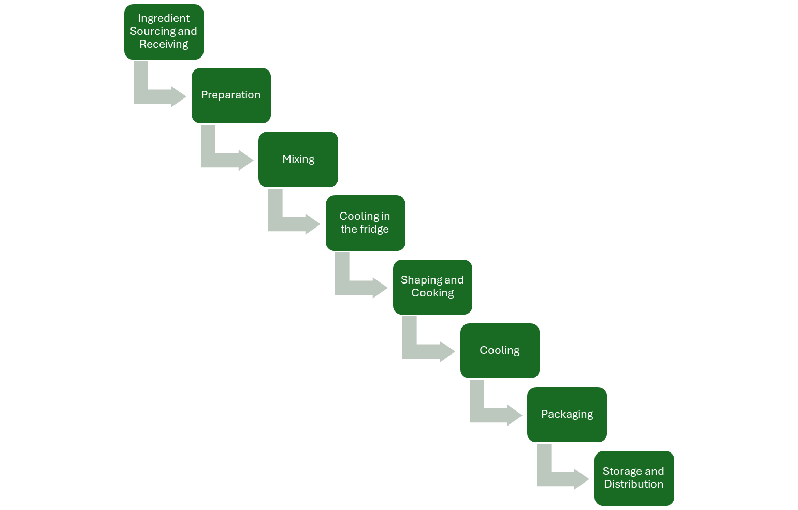
Formulation and process: “Grissini”
120 mL of water
75 g of oat flour
75 g of spelt flour
40 g of lupin concentrate
35 g of olive oil
4 g of salt
3 g of insect Tenebrio flour
3 g of nutritional yeast
3 g of stevia
2 g of sesame seeds
2 g of oregano
1 g of baking powder
Speed 3 for 30 min
2 ºC for 20 min
180 ºC for 20 min
120 ºC for 10 min
25 ºC for 30 min

Slide 4
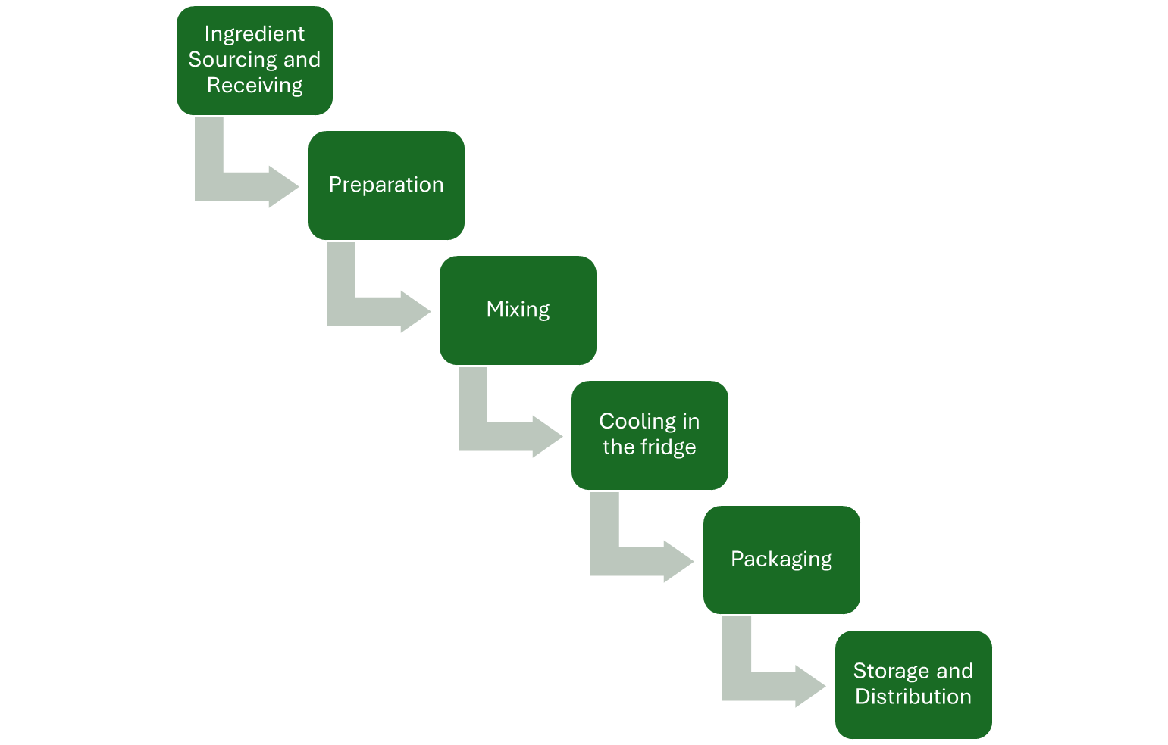
Formulation and process: “Lummus”
150 mL of water
30 g of lupin concentrate
30 mL of fresh lemon juice
20 g of tahini
15 mL of olive oil
5 g of insect Tenebrio flour
1 g of salt
1 g of pepper
1 g of paprika
1 g of garlic
2 ºC for 1 hour

Slide 5

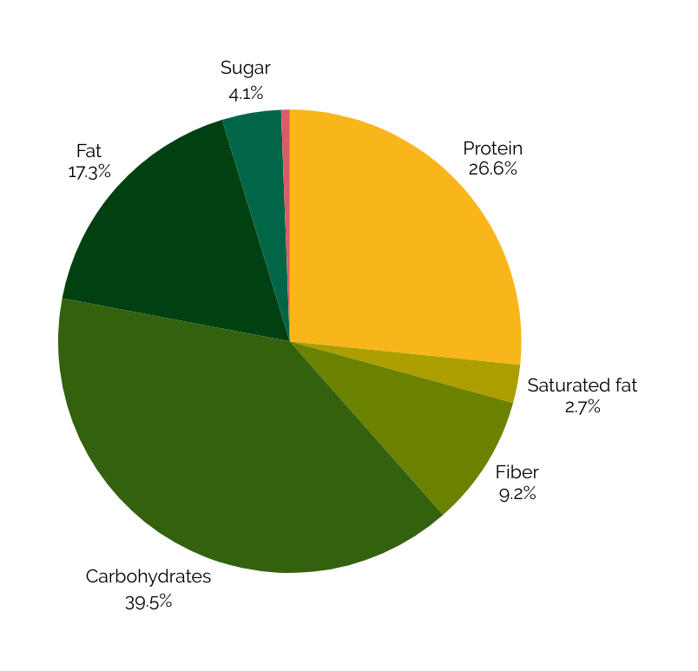
326 kCal
Salt
0.6%
Nutritional value
Buzzini offers a balanced nutritional profile, rich in plant-based protein, unsaturated fats, and dietary fiber.
Low in sugar, lactose-free, and suitable for gluten-sensitive individuals (326 kCal).

Slide 6





Packaging and branding

Slide 7
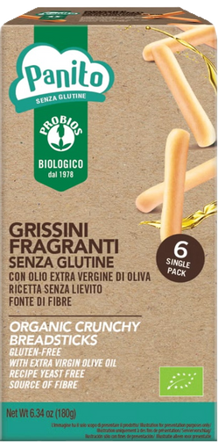
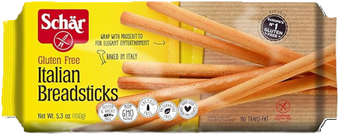

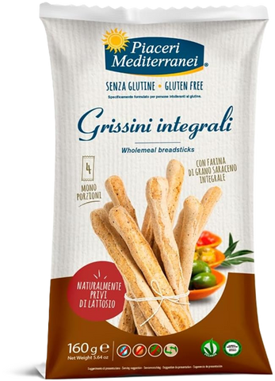
Market
Our product
Price: 0.83 €
Price: 4.50 €
Price: 4.55 €
Price: 5.20 €
Price: 3.80 €

Slide 8
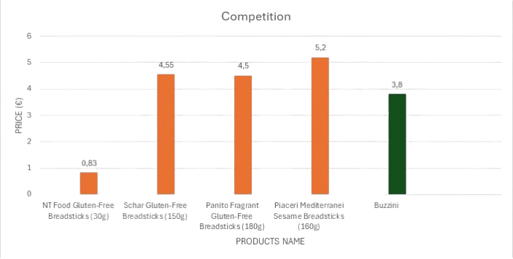





Finance
Advantages: Lower price, combining grissinis
with “lummus”.

Slide 9


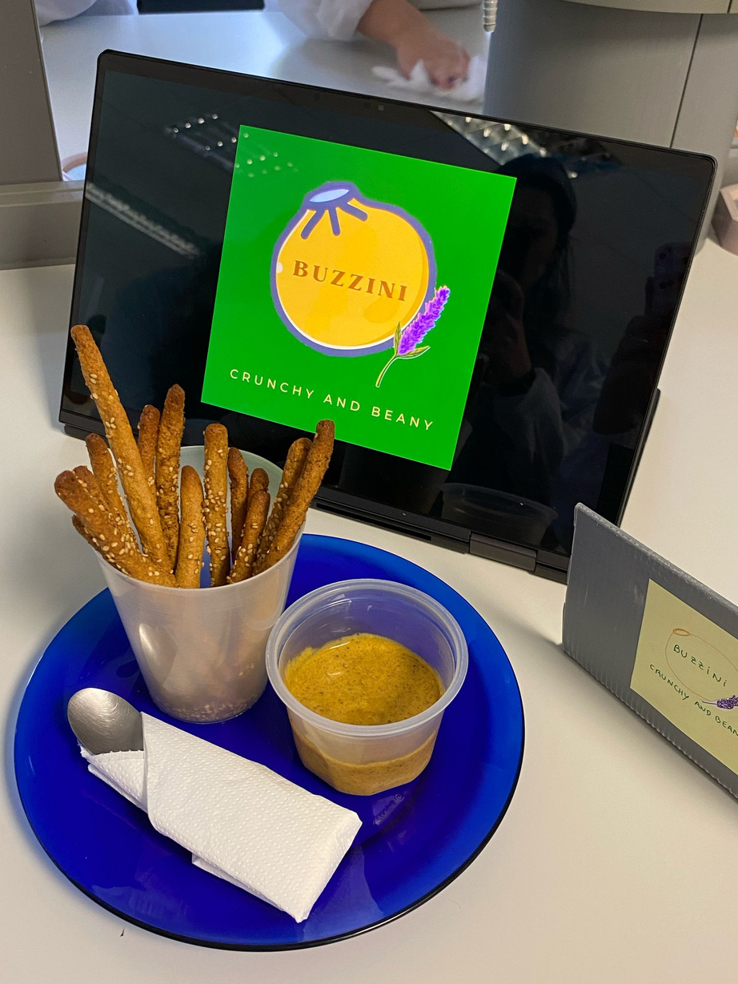
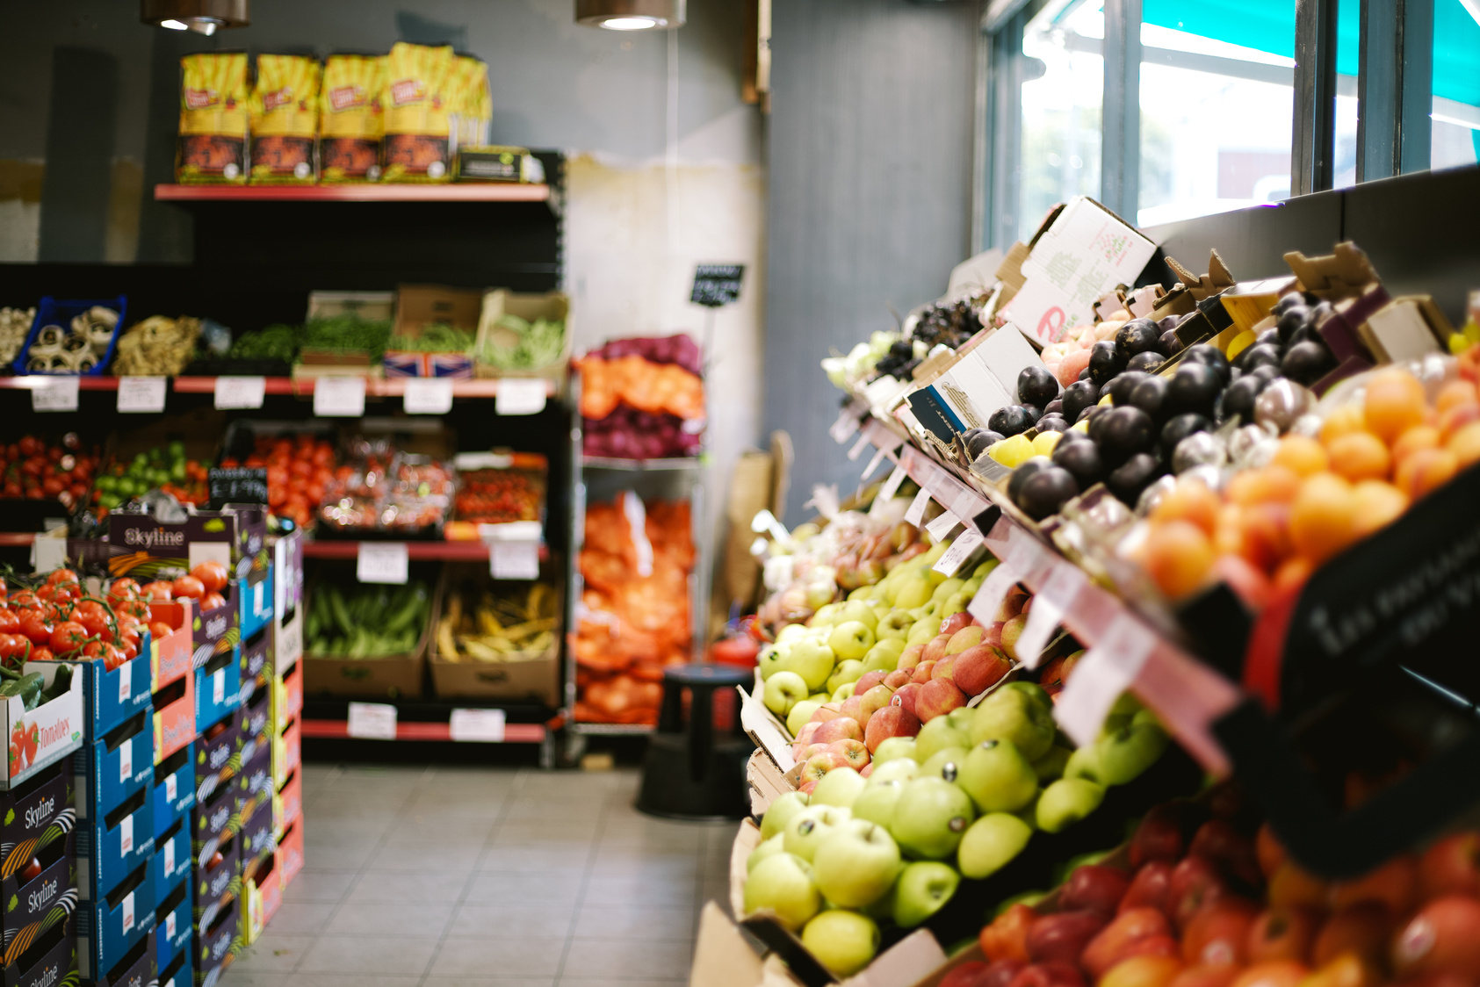
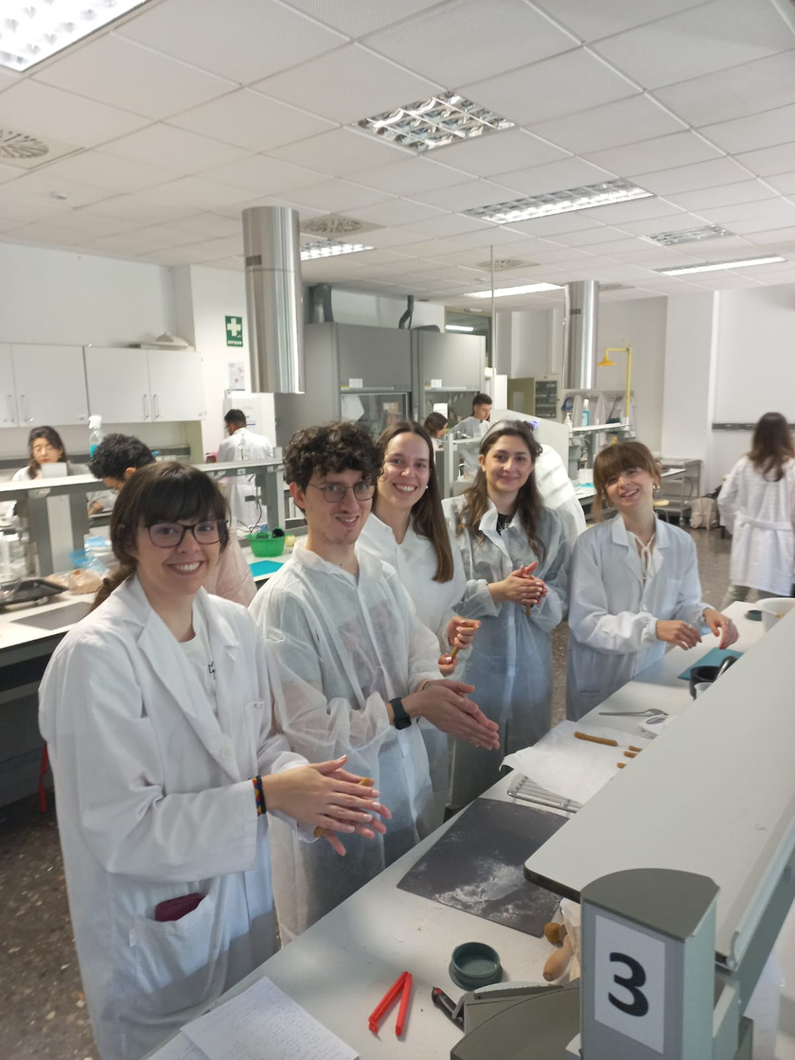


Distribution plan
3.80 €

Slide 10

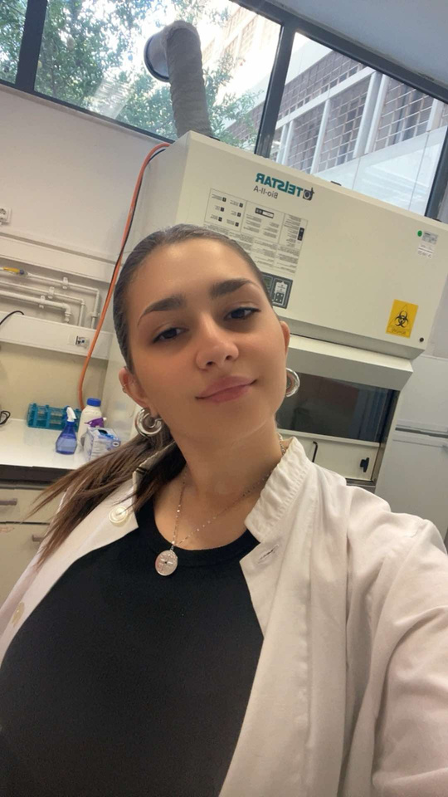





Our team
Tenebrio
Konstantina
Ricardo
Bruna
Joana
Diana

Slide 11
Conclusion
A snack combining health, sustainability and conscious living.
Design for active individuals with specific dietary needs.
With a clear market focus, strong nutritional profile and scalable production potential.

Slide 12

THANK YOU!
Gràcies
Ευχαριστώ
Obrigado
Grazie
Gracias
Merci

Slide 13
Abstract
Buzzini is an innovative, health-conscious snack that redefines traditional Mediterranean flavors by blending kritsini with a creamy, protein-rich “hummus” infused with sustainable ingredients. Developed by a multidisciplinary team passionate about nutrition and sustainability, Buzzini is tailored to meet the needs of modern consumers—particularly individuals like our buyer persona: a 35-year-old woman working in the fast-paced marketing industry in Italy. She lives alone with her dog, manages a busy lifestyle, practices Pilates, and prioritizes health, sustainability, and ethical consumption. With intolerances to gluten and lactose, she seeks plant-based, allergen-friendly, and functional food options that align with her values.
Buzzini is crafted with a unique combination of ingredients, including lupin bean concentrate, insect flour (as a sustainable protein source), tahini, olive oil, stevia, oat and spelt flours, and a curated blend of spices and herbs. It is completely free from lactose and added sugars, and rich in unsaturated fats, plant-based proteins, and dietary fiber—making it a smart and satisfying option for active individuals who snack with purpose.
Beyond nutrition, Buzzini is a product with a mission. With its sustainable protein sources and clean-label ingredients, it appeals to the conscious consumer looking for transparency and impact. Designed for on-the-go lifestyles, Buzzini offers a guilt-free indulgence that supports both personal wellness and environmental responsibility.
Buzzini isn't just a snack—it's a lifestyle choice. Bold, balanced, and sustainable, it's the perfect companion for those who do Pilates at dawn and power through strategy meetings by noon.

Slide 14



SOFIA
ABOUT SOFIA
Sofia lives alone, with her dog Zeus, and works in Marketing. She is active, healthy and does Pilates often.
MOTIVATIONS
High-Protein, Gluten-Free, Lactose-Free, Plant-Based
Organic
Eco-Packaging
Convenient, ready-to-eat
Nutritious
Re-Invented Tradition
MOMENT/SCENARIO
After exercise
Mid-morning snack
Easy to eat at home/bring to work
INTERESTS
SKILLS
Travel
Books
Cooking
Nature
Exercise
Walk trails
Digital skills
Finance
Social networks
Creativity
AGE: 35
LOCATION: BOLOGNA
MARKETING

Slide 15

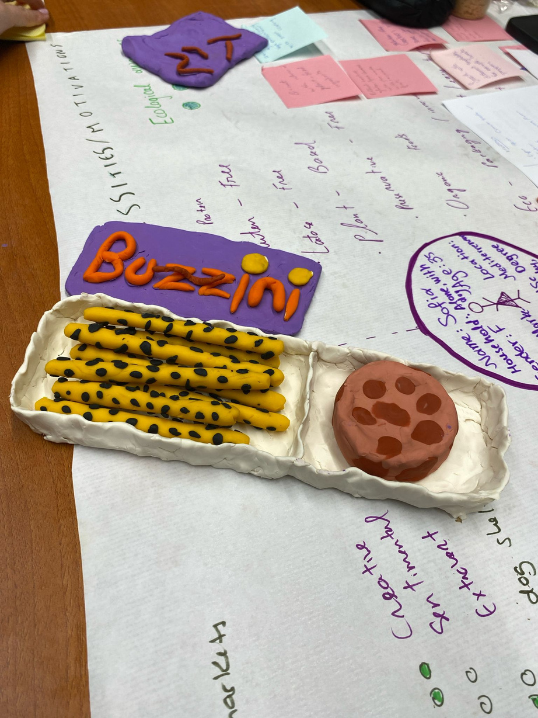

Introduction & Product definition
Buzzini is a modern, healthy snack combining grissini with a creamy, protein-rich “hummus”.
Developed for busy, health-conscious consumers with food intolerances and active lifestyles.
Made with gluten- and lactose-free ingredients, including lupin beans, insect flour, tahini, and oat flour.
Rich in plant-based protein, unsaturated fats, and fiber—with no added sugar.
Designed for sustainable snacking without compromising taste or nutrition.
Produced under strict food safety standards (HACCP) and aligned with EU regulations.

Slide 16
“Grissinis”
PROCESS OF THE PRODUCT
“Hummus”
2 ºC for 20 min
180 ºC for 20 min
120 ºC for 10 min
Buzzini is crafted through a controlled process that includes careful ingredient selection, hygienic mixing, shaping, baking, and packaging—ensuring quality, taste, and safety at every step.

Slide 17
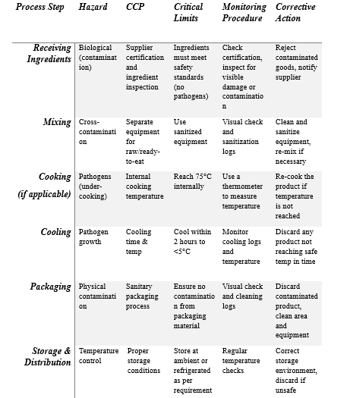
Safety
Buzzini is produced under strict HACCP food safety standards, ensuring every bite is safe, traceable, and compliant with EU regulations.

Slide 18
For the full experience
https://www.canva.com/design/DAGkJYqDZZc/_GDlQsvqJFRajNr3_Flmuw/edit?utm_content=DAGkJYqDZZc&utm_campaign=designshare&utm_medium=link2&utm_source=sharebutton

