Slide 1
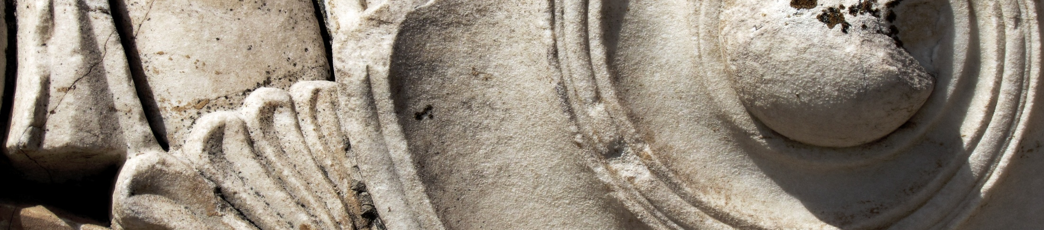
Ancient Greek art: an overview.
Dimitris Plantzos
dkplantzos@arch.uoa.gr

Slide 2
[ἀνάθημα] anathema
Lecture 3
Anathema:
gifts to the gods in Greek sanctuaries.

Slide 3
Course structure
Techne: what is ‘Greek’ about Greek art? (6/3)
Section 1: Early Greece, ca. 1200-480 BCE
Sema: commemorating the dead in Early Greece. (Dr Harokopos)
Anathema: gifts to the gods in Greek sanctuaries. (Dr Harokopos)
Kerameus: the art of Greek pottery. (Dr Harokopos)
Agalma: pleasing immortals and mortals alike. (3/4)
Section 2: Classical Greece, ca. 480-336 BCE
Mimesis: nature as aesthetic ideal. (10/4)
Skiagraphia: painting with shadows. (8/5)
Hieron: visiting a Greek sanctuary. (15/5)
Section 2: Art in the Hellenistic World, ca. 336-30 BCE
Pathos: sculpture in the Hellenistic period. (22/5)
Eikon: immortalising the mortals. (29/5)

Slide 4
Course structure
Techne: what is ‘Greek’ about Greek art? (6/3)
Section 1: Early Greece, ca. 1200-480 BCE
Sema: commemorating the dead in Early Greece. (Dr Harokopos)
Anathema: gifts to the gods in Greek sanctuaries. (Dr Harokopos)
Kerameus: the art of Greek pottery. (Dr Harokopos)
Agalma: pleasing immortals and mortals alike. (3/4)
Section 2: Classical Greece, ca. 480-336 BCE
Mimesis: nature as aesthetic ideal. (10/4)
Skiagraphia: painting with shadows. (8/5)
Hieron: visiting a Greek sanctuary. (15/5)
Section 2: Art in the Hellenistic World, ca. 336-30 BCE
Pathos: sculpture in the Hellenistic period. (22/5)
Eikon: immortalising the mortals. (29/5)

Slide 5
Reading:
Plantzos 2016: pp. 64-79.
National Archaeological Museum: https://www.latsis-foundation.org/content/elib/book_14/nam_en.pdf pp. 155-176 (Geometric) and 177-260 (Archaic)

Slide 6
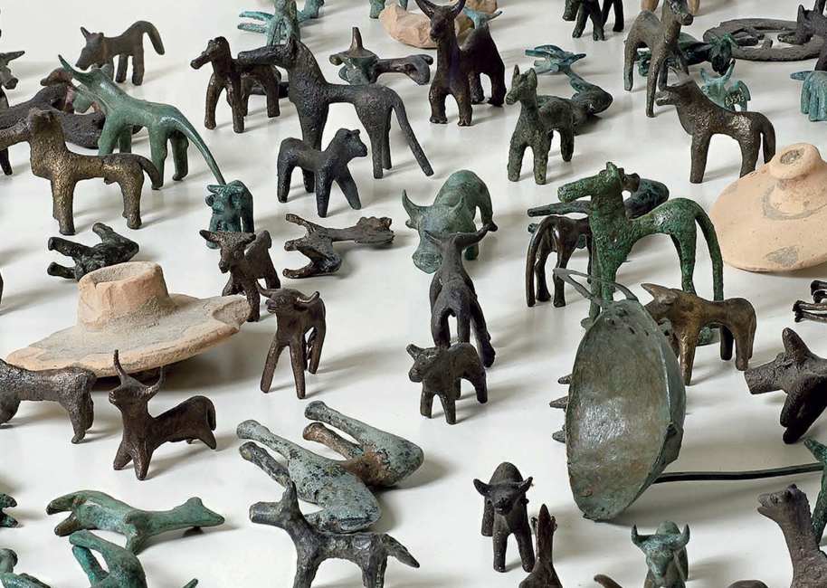
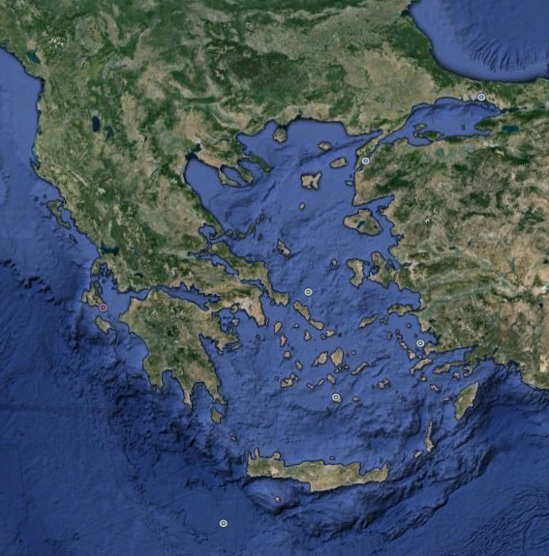
DODONA
DELPHI
SAMOS
OLYMPIA
DELOS

Slide 7
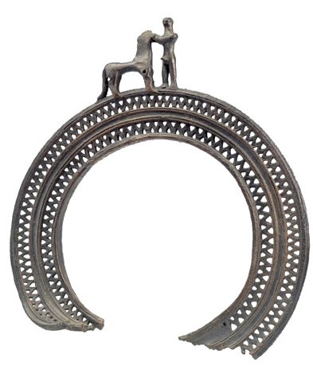
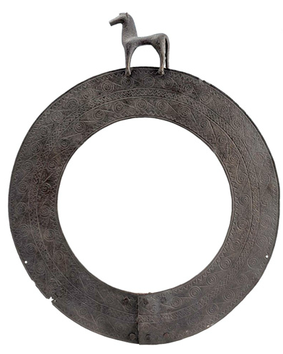
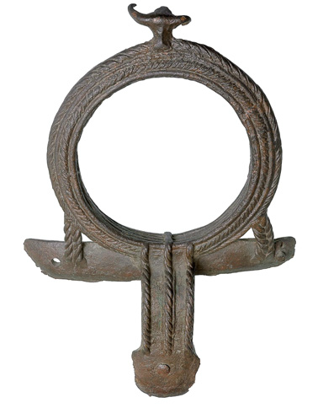
Olympia, bronze cauldron handles. 8th c. BCE

Slide 8
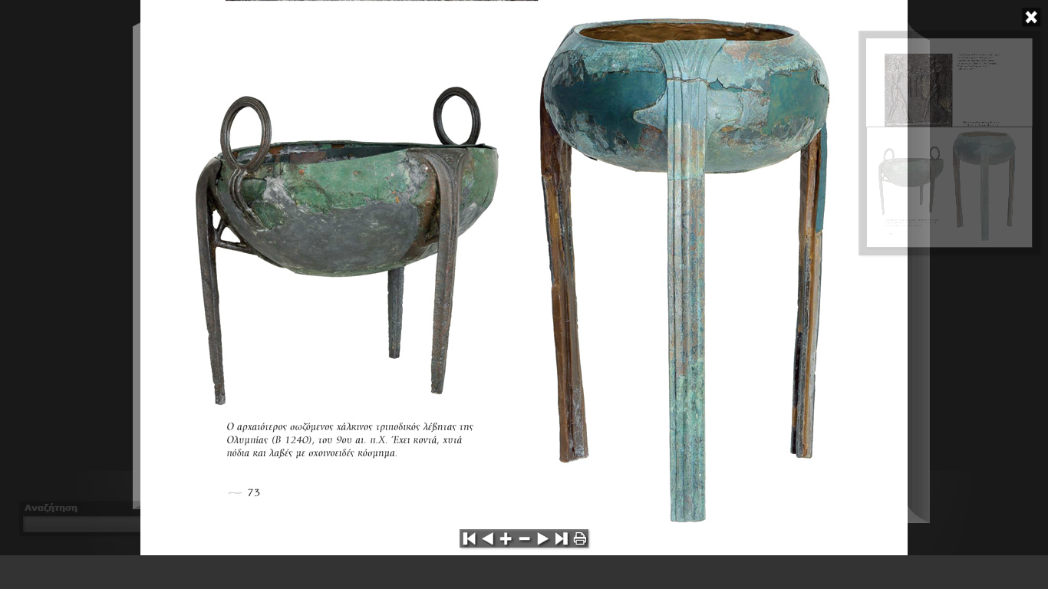
Olympia, bronze cauldrons. 9th-8th c. BCE

Slide 9
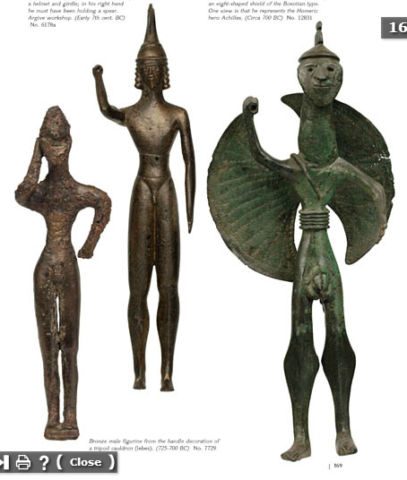
Bronze cauldron-handle fixtures. 8th c. BCE

Slide 10
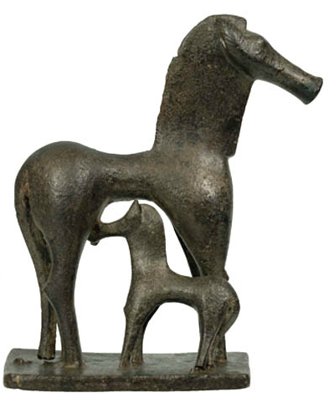

Slide 11
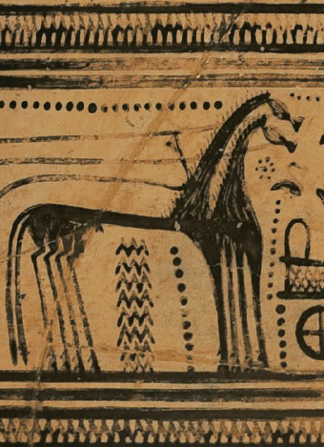
Olympia, bronze mare with foal.
8th c. BCE
Athens, pot detail with chariot.
8th c. BCE

Slide 12
Bronze cauldron-handle fixtures. 8th c. BCE

Slide 13
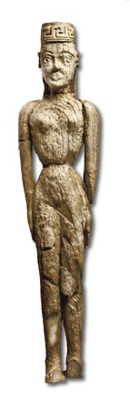
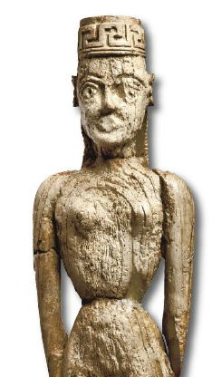
Athens, ivory statuette of a woman. Late 8th c. BCE

Slide 14
DODONA
ASIA MINOR
DELPHI
SAMOS
OLYMPIA
DELOS

Slide 15
Greek sanctuaries:
Olympia: https://www.latsis-foundation.org/content/elib/book_15/olympia_en.pdf
Delphi: https://www.latsis-foundation.org/content/elib/book_13/delphoi_en.pdf
Samos: https://www.latsis-foundation.org/content/elib/book_19/samos_en.pdf

Slide 16
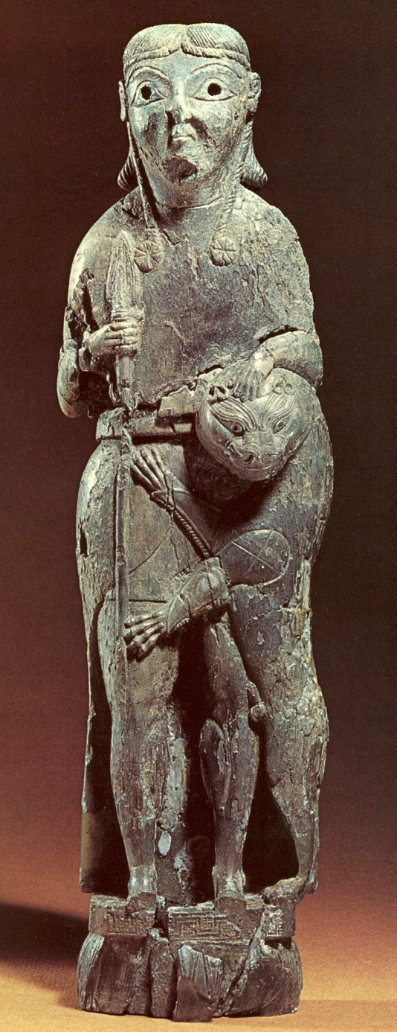
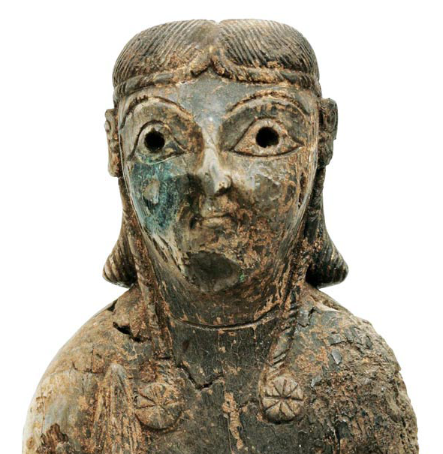
Delphi, ivory statuette of a male divinity. 7th c. BCE

Slide 17
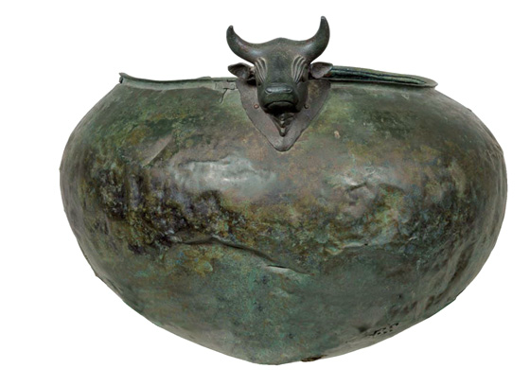
Olympia, bronze cauldrons. 8th-7th c. BCE

Slide 18
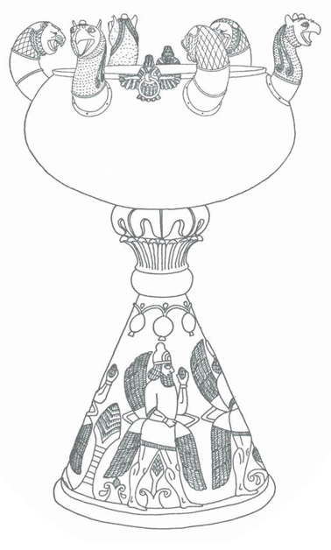
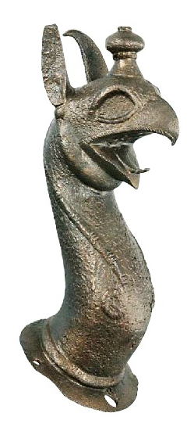
Olympia, bronze cauldron with griffin fixtures. 7th c. BCE

Slide 19
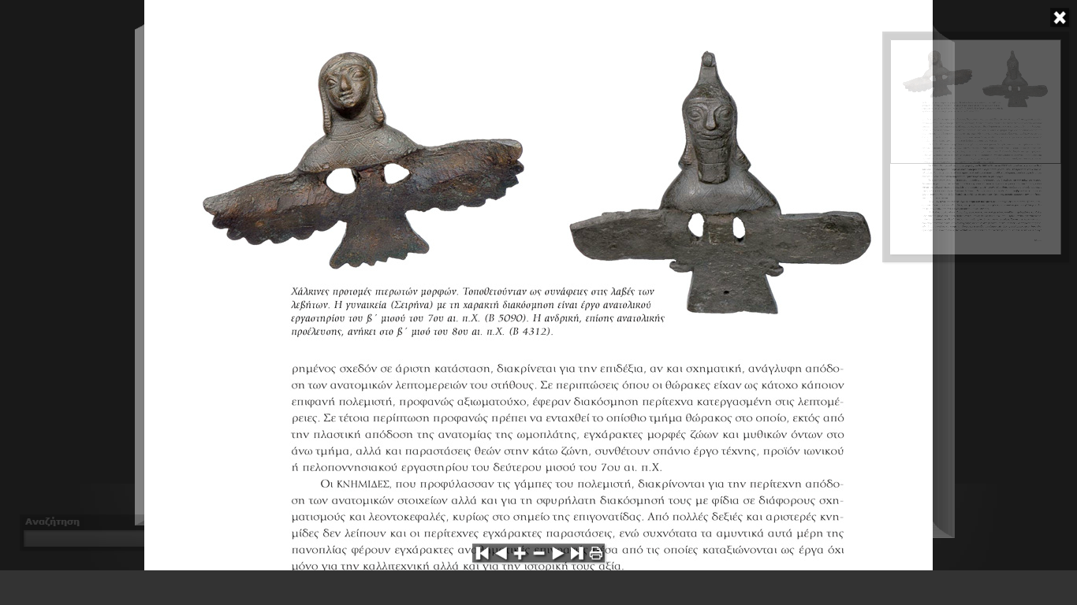
Sirens
Griffin

Slide 20
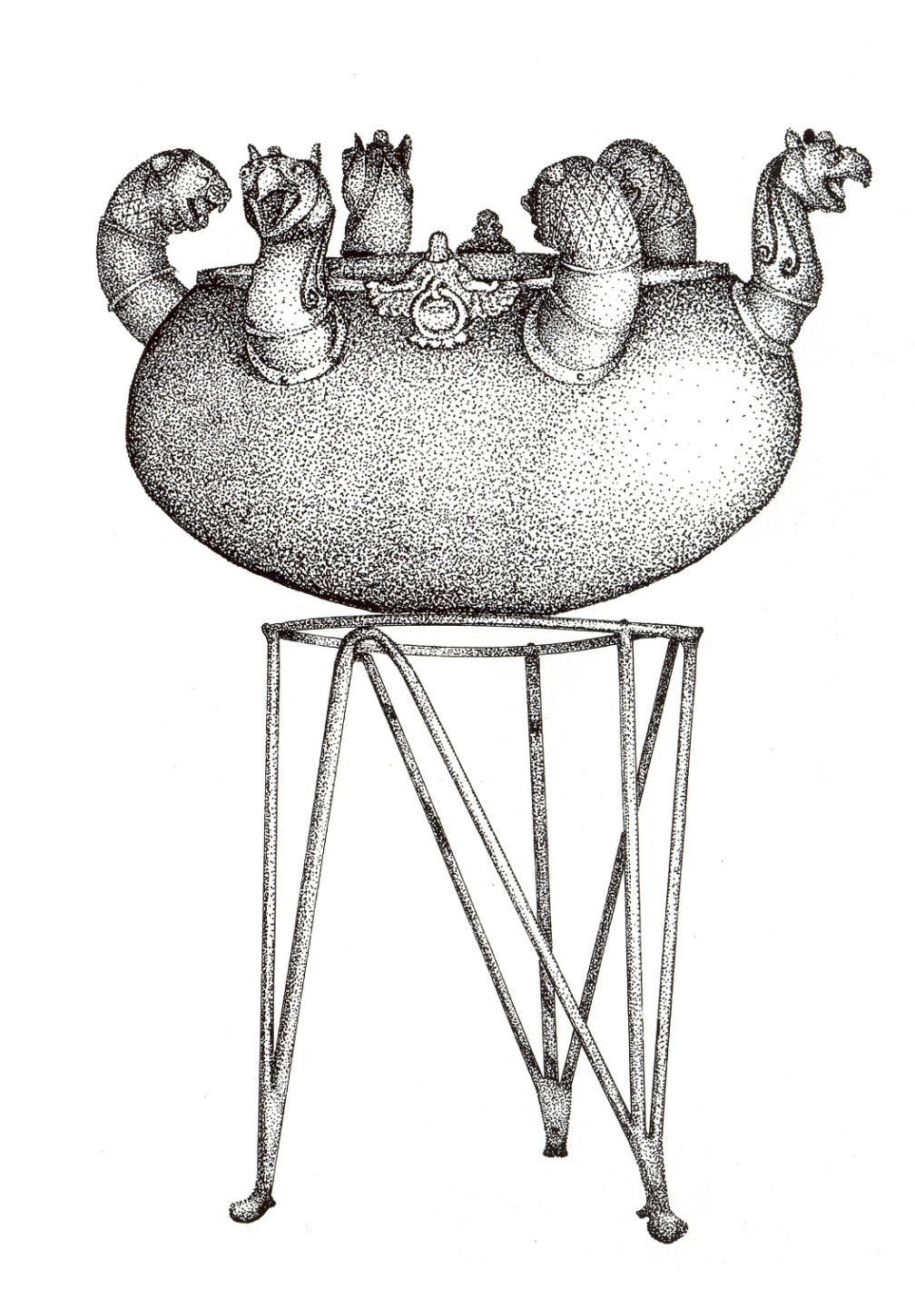

Slide 21
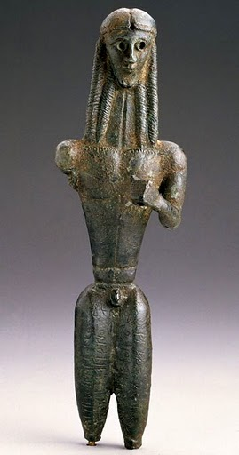
Thebes, bronze figurine of Apollo. Early 7th c. BCE

Slide 22
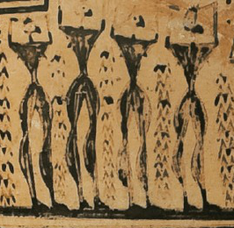
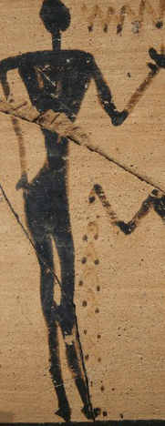
Thebes, bronze figurine of Apollo. Early 7th c. BCE

Slide 23
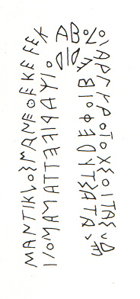
Thebes, bronze figurine of Apollo. Early 7th c. BCE

Slide 24
Mantiklos dedicated me to silver-bowed Apollo
as a tithe and you, Phoebus, give him a beautiful reward
Thebes, bronze figurine of Apollo. Early 7th c. BCE

Slide 25
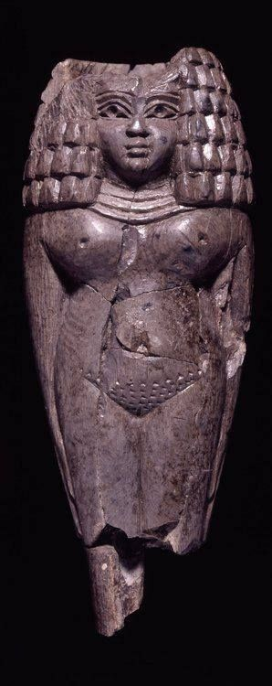
Greek, 8th c. BCE
Phoenician, 8th c. BCE

Slide 26
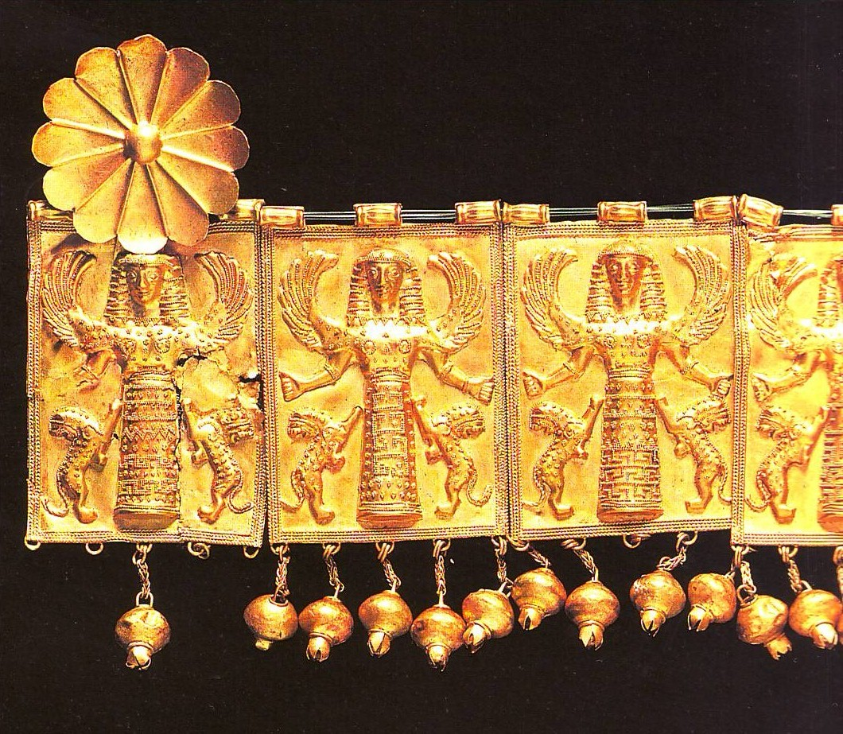
Rhodes, gold necklace. 7th c. BCE

Slide 27
“Daedalic” style:
figures are composed of simple geometric shapes
somewhat unnatural and rather frigid
sophisticated decoration
additional pattern work
not monumental, mainly decorative
figures do not represent humans or gods but act as their symbols

Slide 28
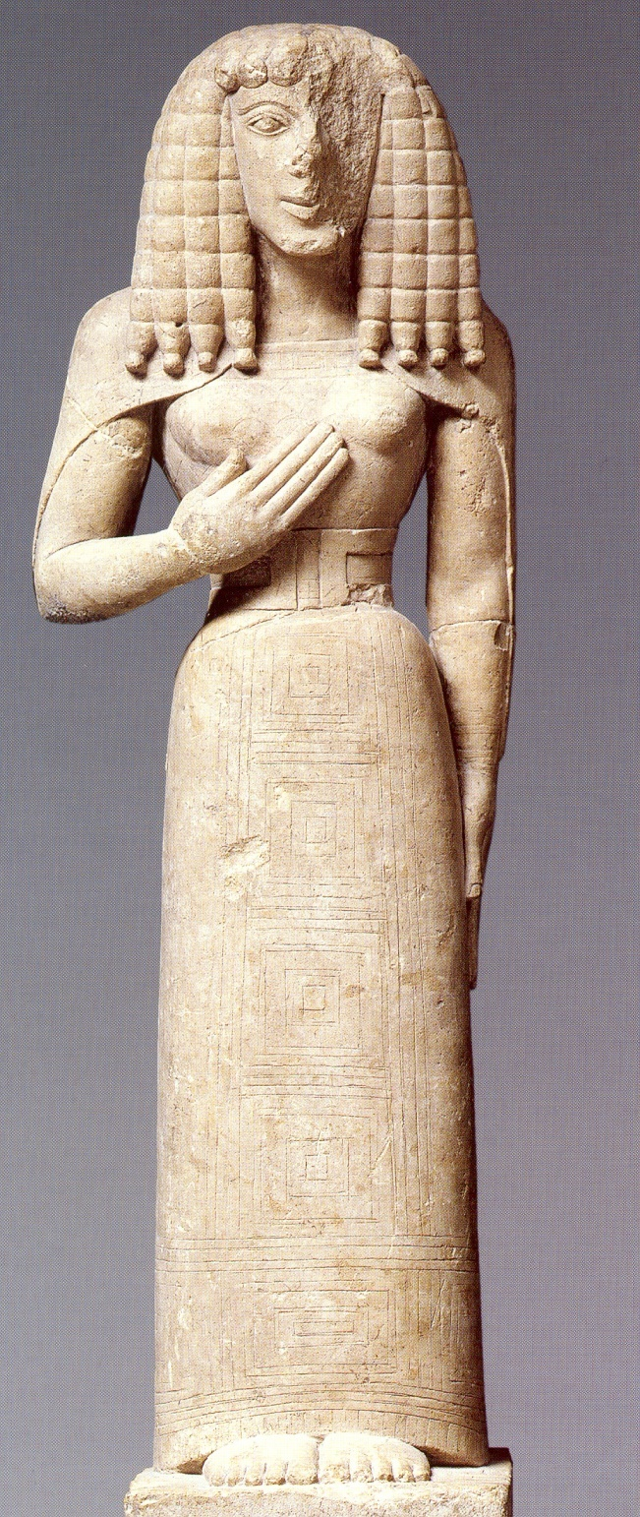
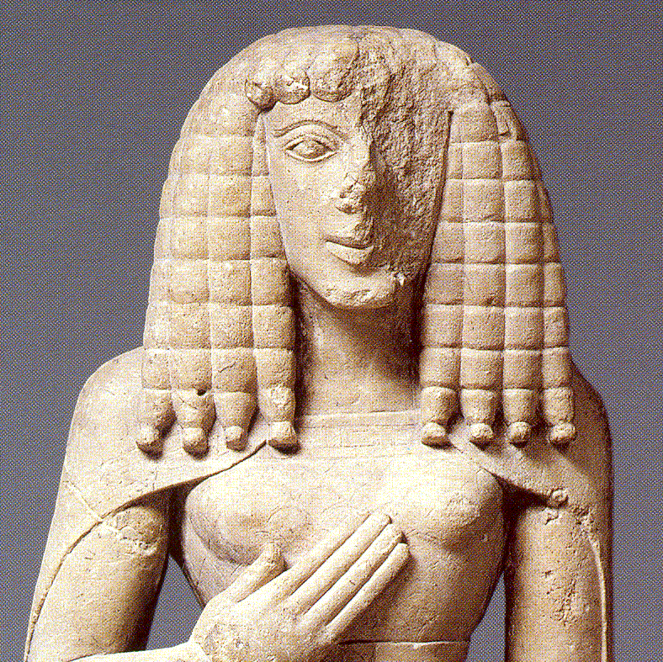
Limestone female statue.
c. 640-630 BCE

Slide 29
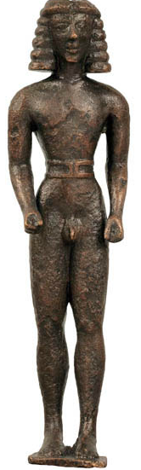
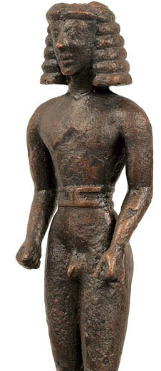
Delphi, male statuette. c. 630 BCE

Slide 30
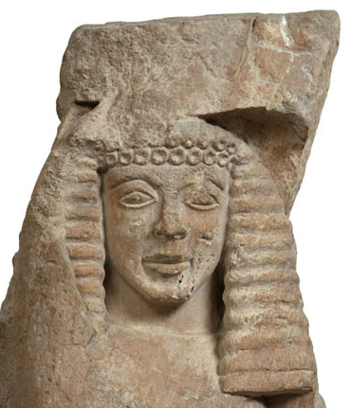
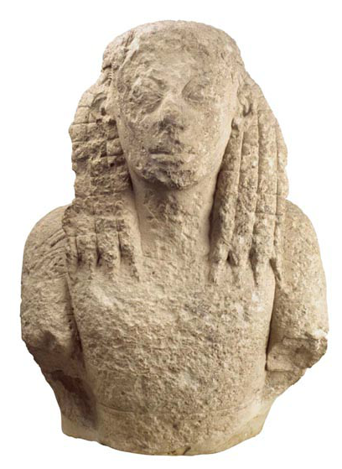
Mycenae, relief with female head.
7th c. BCE
Crete, female head.
7th c. BCE

Slide 31
Greek art chronological art:
Bronze Age (3200-1100 BCE)
Submycenaean (1100-1050 BCE)
Protogeometric period (1050-900 BCE)
Geometric period (900-700 BCE)
Archaic period (700-480 BCE)
Classical period (480-336 BCE)
Hellenistic period (336-31 BCE)

Slide 32
Archaic period (700-480 BCE):
Early Archaic period (700-600 BCE)
[“Orientalising”]
Mature Archaic period (600-480 BCE)

Slide 33
Archaic period (700-480 BCE):
economic expansion

Slide 34
Archaic period (700-480 BCE):
economic expansion
colonisation

Slide 35
Archaic period (700-480 BCE):
economic expansion
colonisation
political organisation

Slide 36
Archaic period (700-480 BCE):
economic expansion
colonisation
political organisation
“tyranny”

Slide 37
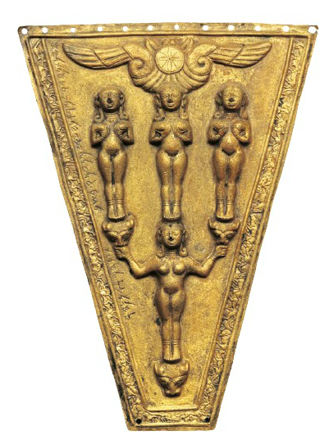
Samos, a 9th c. BCE Syrian ornament dedicated to Hera by a Greek in the 7th c. BCE

Slide 38
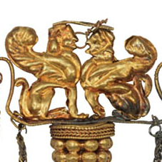
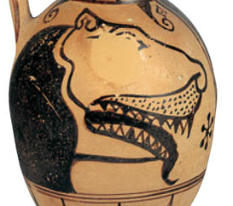
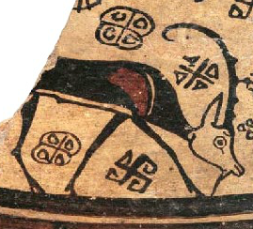
New iconography:
sphinx
griffin
siren
lion
wild goat

Slide 39
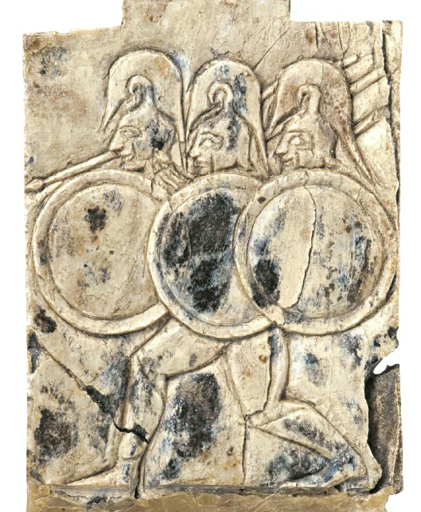
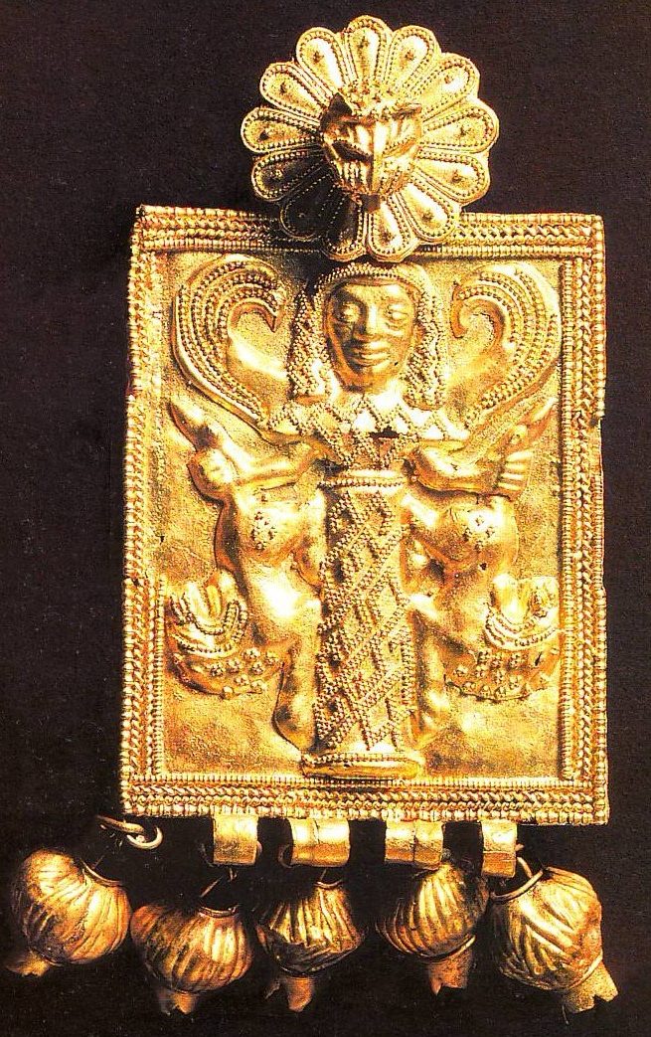
New techniques:
Rhodes, gold pendant.
7th c. BCE
Samos, ivory plaque.
7th c. BCE

Slide 40
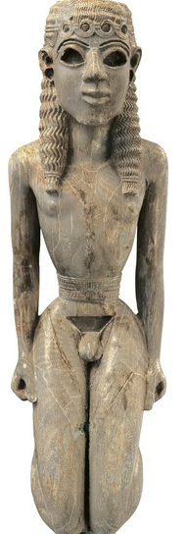
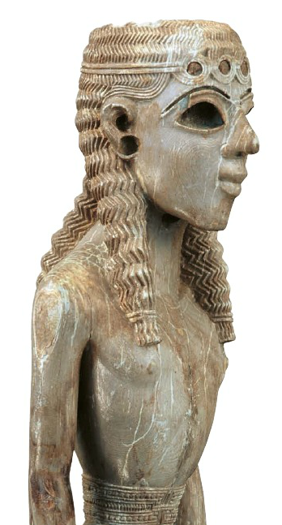
Sophistication:
Samos, ivory statuette of a young man.
7th c. BCE

Slide 41
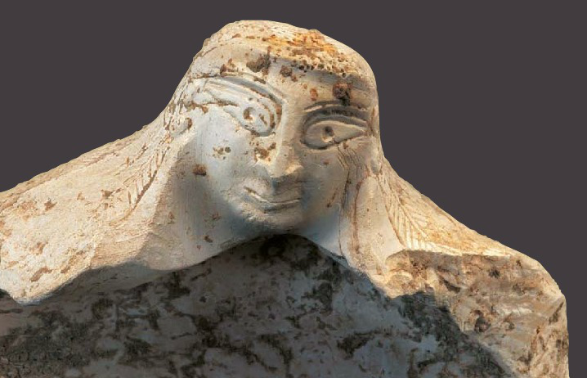
Exotic materials:
Samos, engraved clam shell.
8th c. BCE

Slide 42
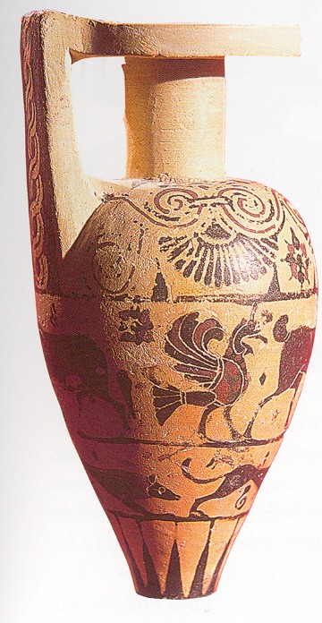
Protocorinthian pottery (720-630 BCE)
Early: 720-690 BCE
Middle 690-650 BCE
Late 650-630 BCE
Transitional 630-610 BCE

Slide 43
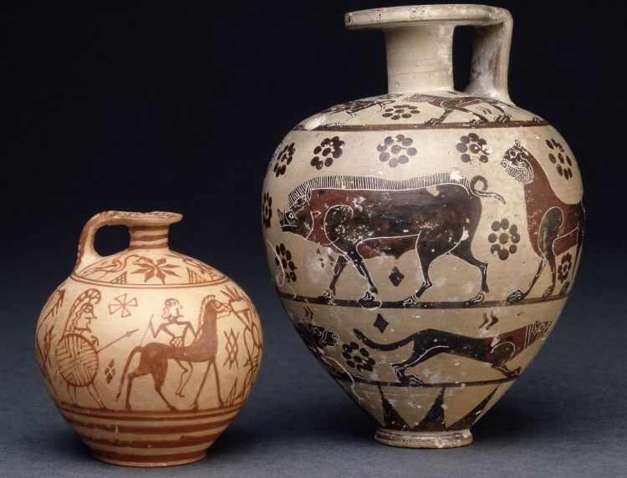
Protocorinthian aryballoi: a. hoplite and rider; b. animal friezes.
c. 650-620 BCE

Slide 44
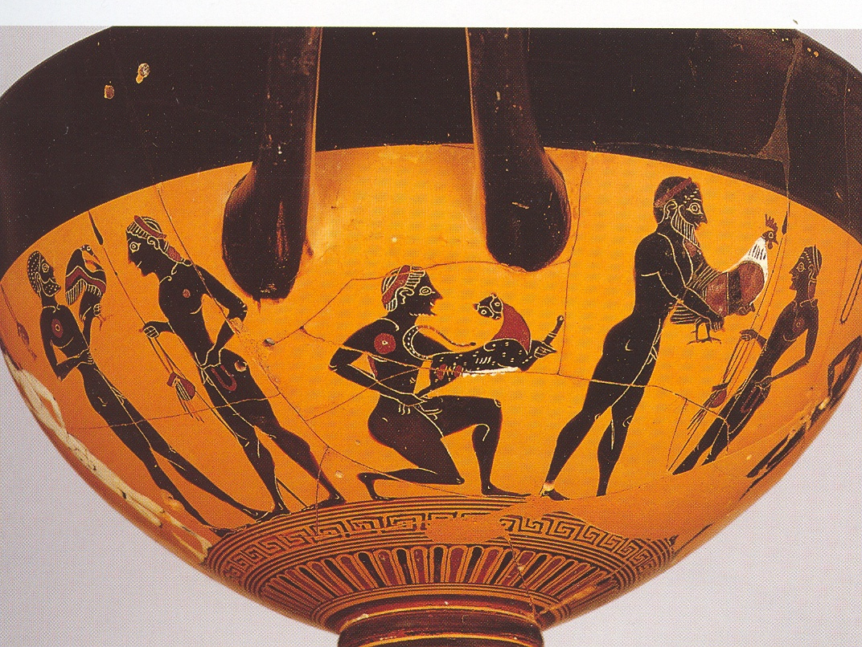
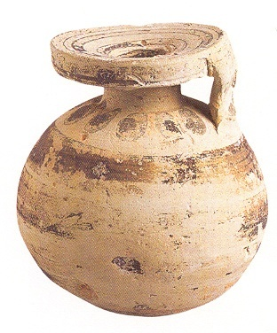

Slide 45
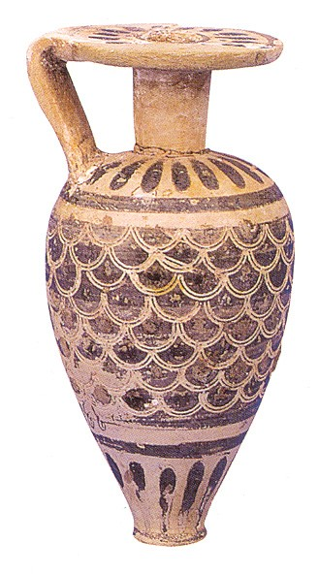
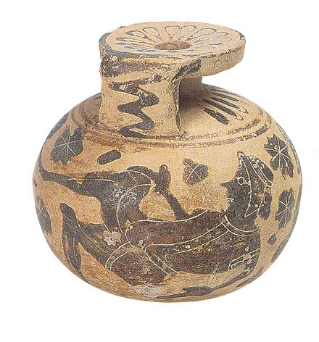

Slide 46
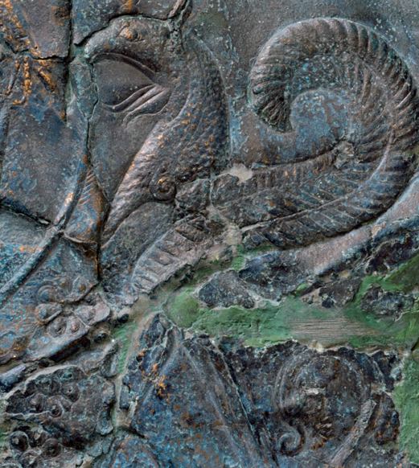

Slide 47
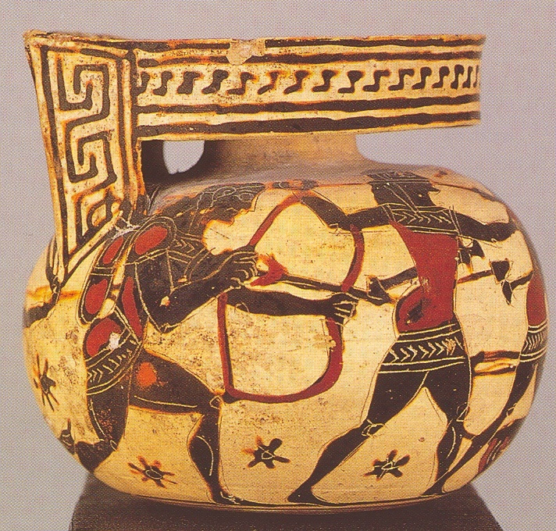
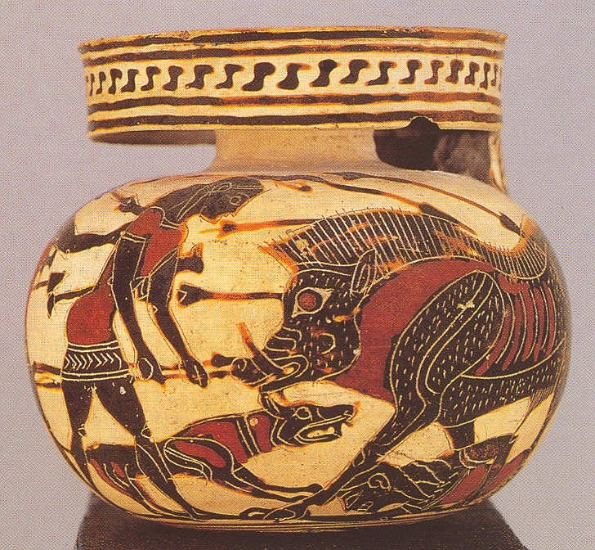
Corinthian aryballos with hunting scene. c. 580 BCE

Slide 48
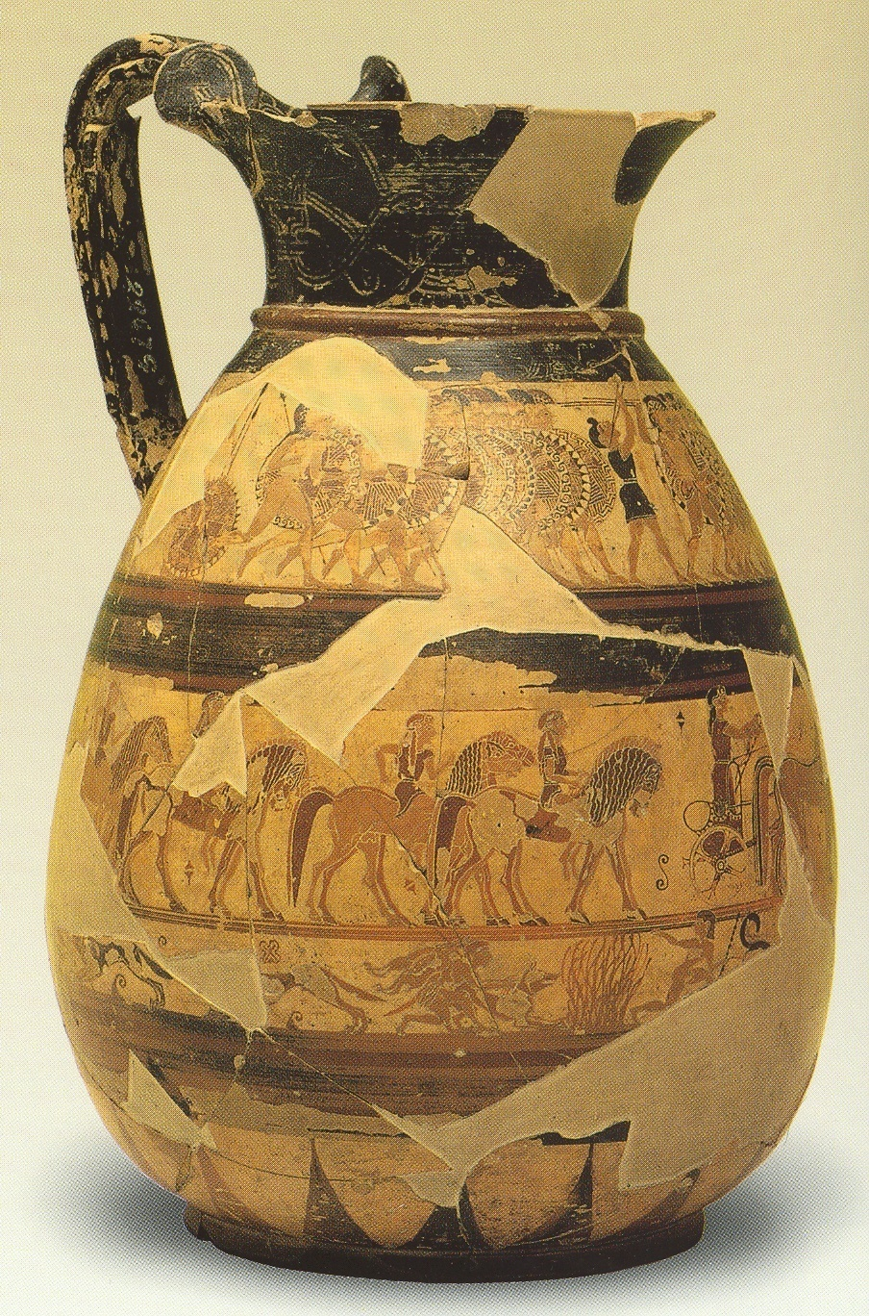


Corinthian olpe with marching hoplites. c. 650-640 BCE

Slide 49

Protoattic pottery (700-630 BCE)
Early: 700-675 BCE
Middle 675-650 BCE
Late 650-630 BCE

Slide 50


Protoattic amphora.
c. 660 BCE

Slide 51

Protoattic amphora.
c. 660 BCE

