Slide 1
Wassily Wassilyevich Kandinsky (1866-1944)

Slide 2


Slide 3
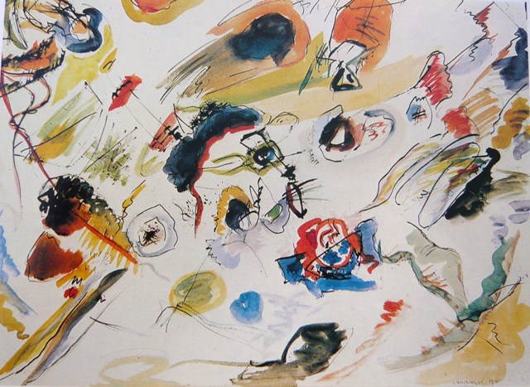

Slide 4
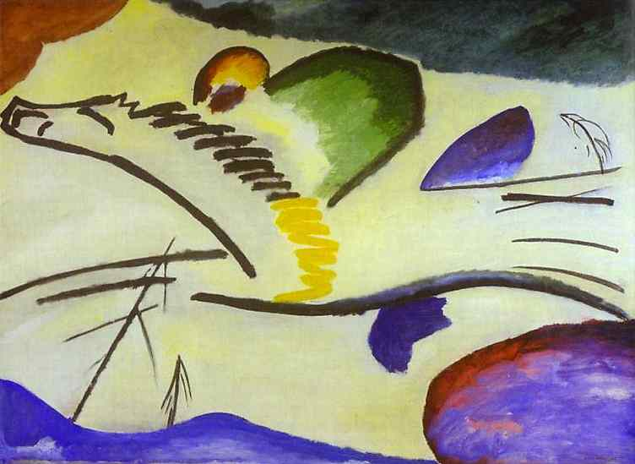

Slide 5
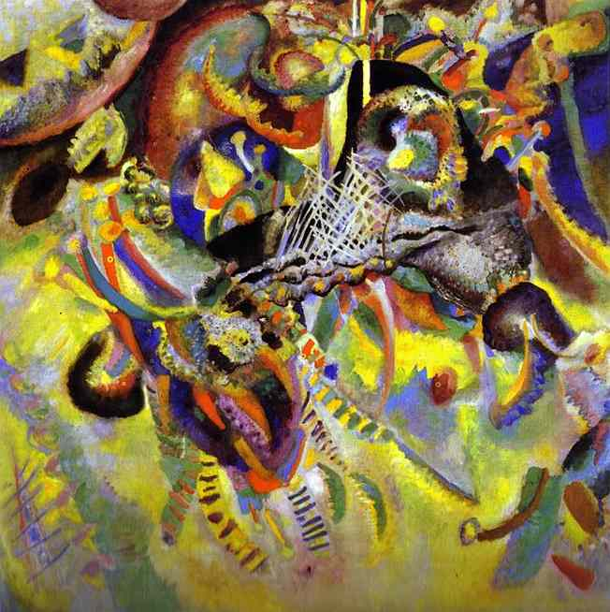

Slide 6
