Slide 1
INTERNATIONAL ICT WORKSHOP IMPROVING PATHOLOGY TEACHING October 23rd 2015 NATIONAL & KAPODISTRIAN UNIVERSITY OF ATHENS The teaching process is a sharing process: mutual challenges and benefits in the first 30 years of my experience.
Dr Andreas C. Lazaris, Pathologist

Slide 2
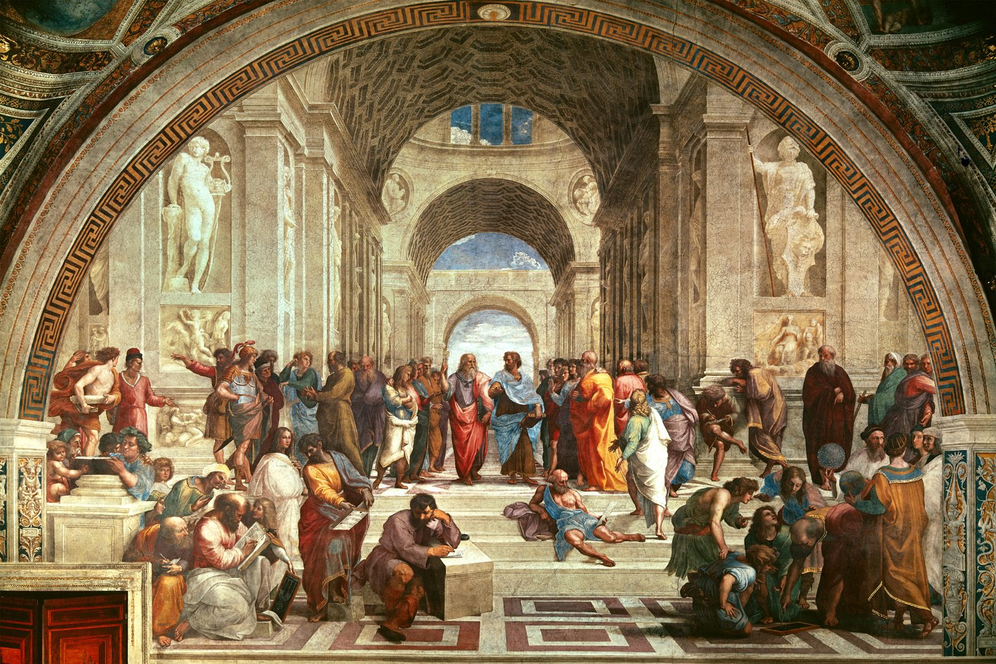
Despite amazing advances in Information and Communication Technology (ICT), people remain the most important factor of your environment to influence your self-education.
By building relationships with people who have skills,
the beliefs, attitudes and perceptions they have, will rub off on you.

Slide 3
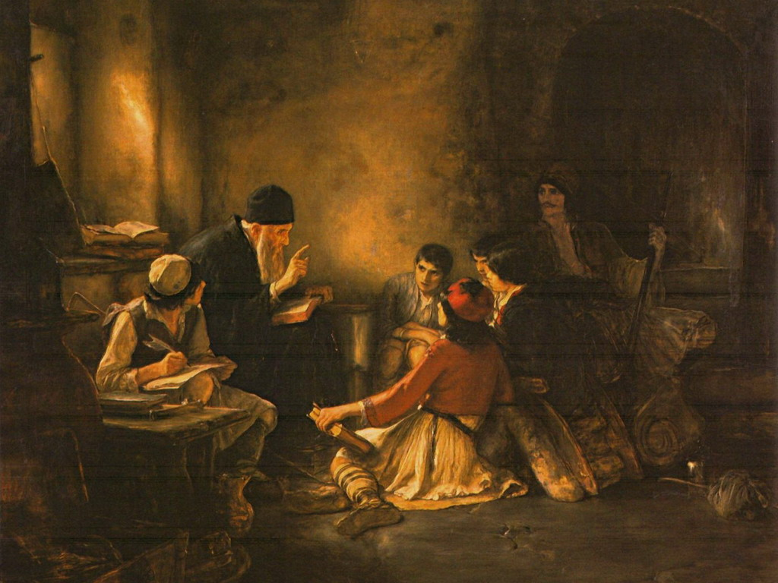
Despite the fact that experiential learning is not defined by the presence of a teacher/facilitator since its mechanism is the learner’s reflection on experience using analytical skills, the physical presence of a charismatic teacher remains indispensable
in the adventure of learning, especially because it
decisively fosters the appeal for
achievement of knowledge.
The acquisition of knowledge should not be the result of obsession or compulsion, internally or externally imposed,
but of a noble and stable internal need for self-development.

Slide 4
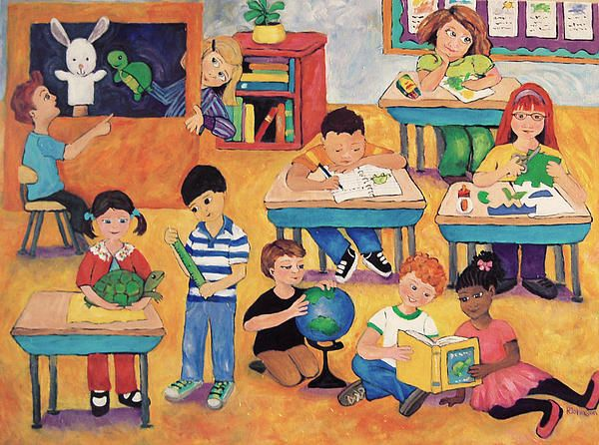
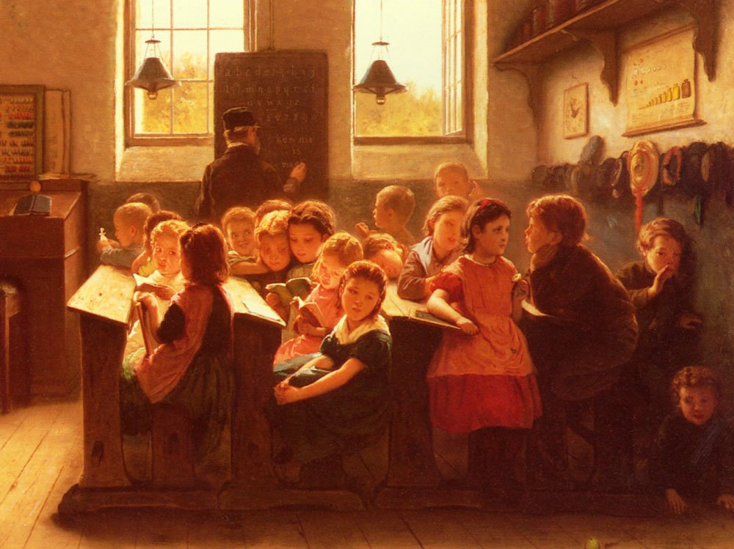
Restoring interest in learning is an imperative.

Slide 5
Any teaching event will be more successful if the teacher:
is enthusiastic
has organized the session well
has a feeling for the subject
can conceptualize the topic
is able to create an active learning environment in his/her class
is able to understand and share the feelings of the learners
understands how people learn, according to the modern trends in teaching learning process.
has skills in teaching and managing learning
is alert to context and “classroom” events
is teaching with the preferred teaching style
helps the students feel a sense of ownership for what was learned.

Slide 6
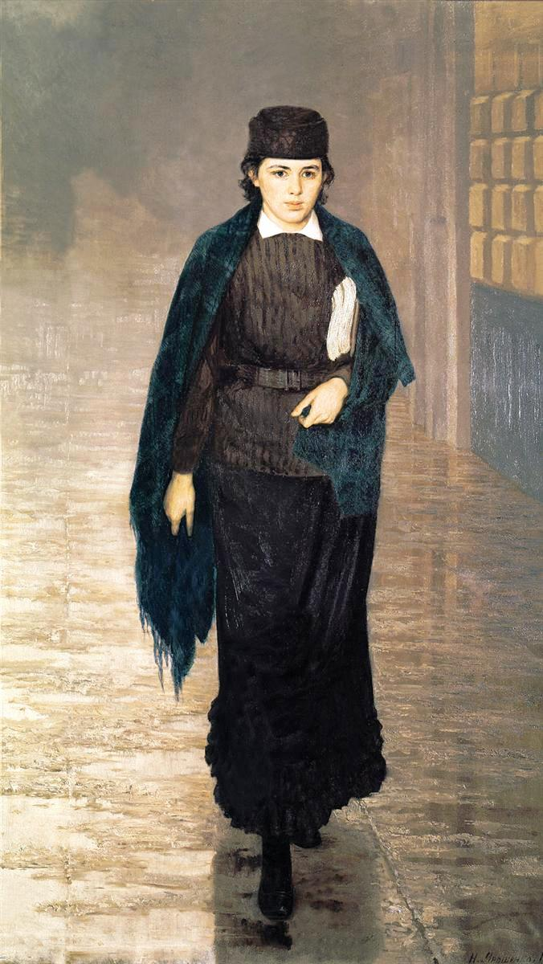
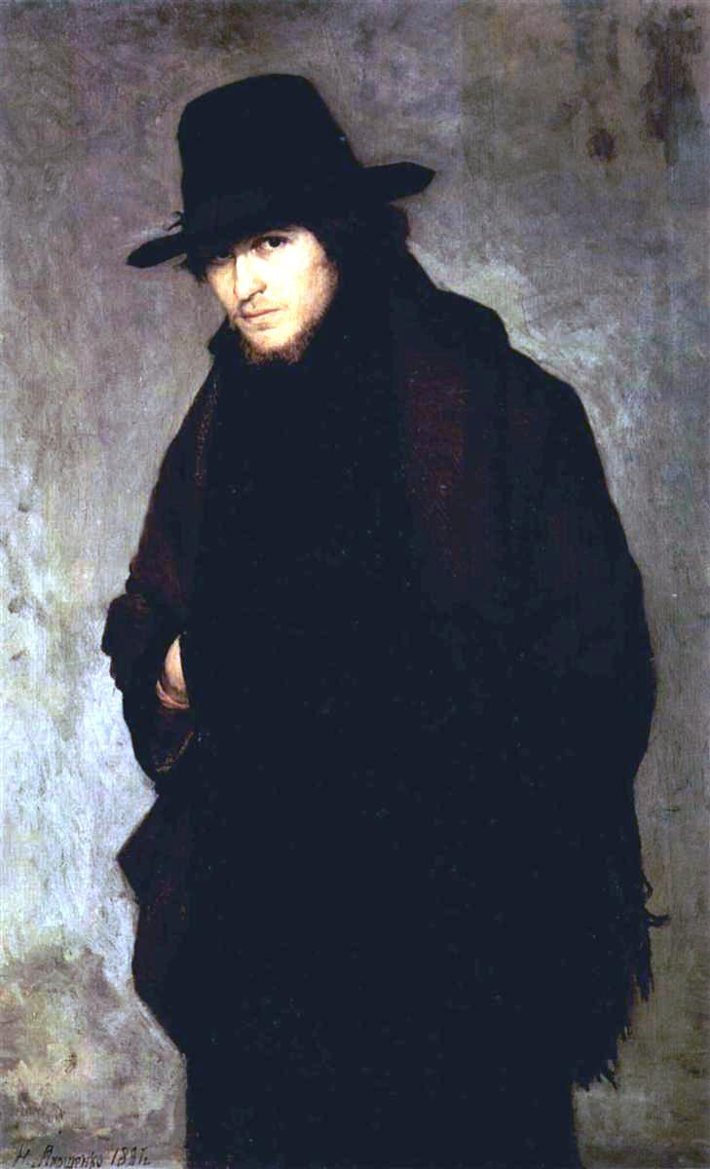
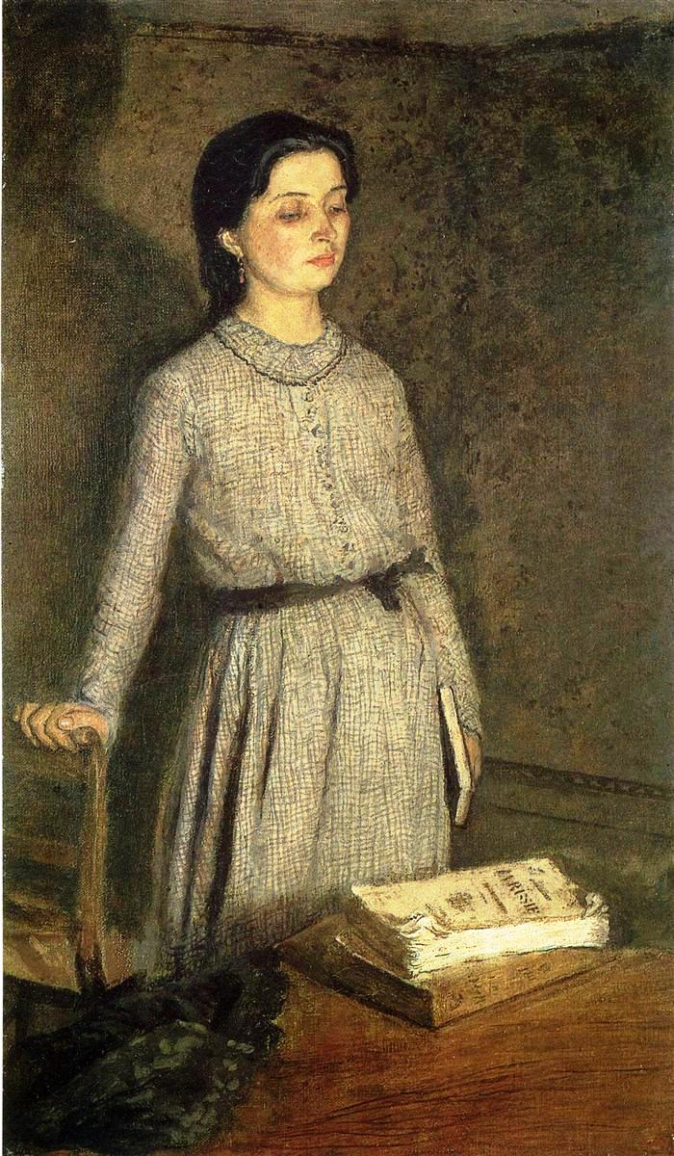
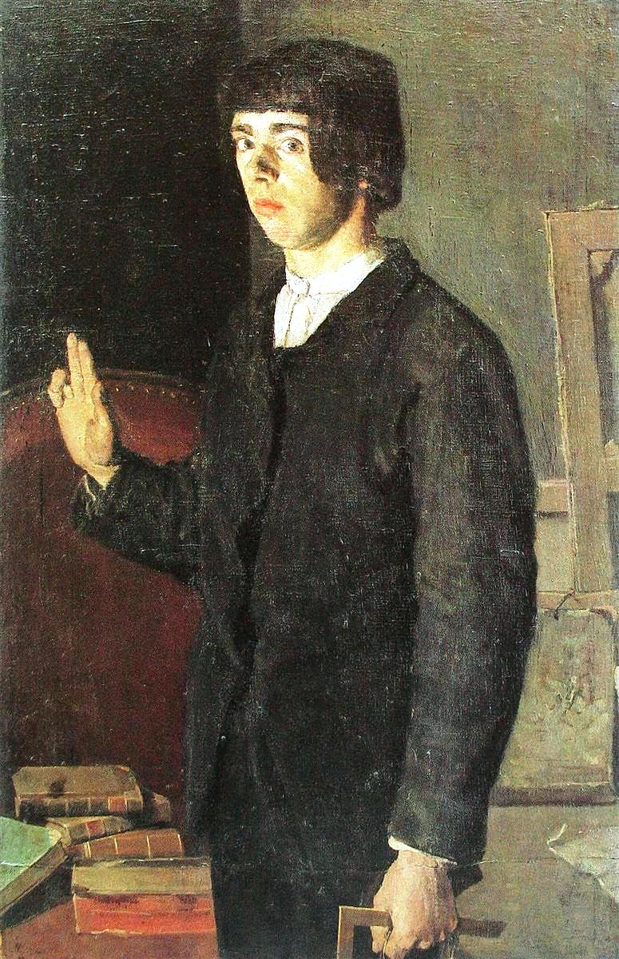
Why do you think these students look so half-hearted, incurious, glum and dispirited?

Slide 7
Read your books, study the material and practice, practice, practice!
- Disinclination to share knowledge ( or anything else, actually…).
Profuse theorizing: exclusive learning of concepts and theories through study and reflection on the abstract.
A sense of mere routine processing
regarding teaching tasks.
Sloth and complacency.
Lack of concern, inspiration, creative flair or communication mood.
Being unreachable, disdainful and megalomaniac
( the latter two with regard to several academic teachers)
Νο transmissibility
of appeal for learning.
Unwillingness to implement innovative methods.
The only incentive for any educational endeavor is reciprocation, determined solely on the basis of the financial benefit of those involved.
A prolonged era of
humanistic values decline,
crowding out any spirituality.
From a sociological standpoint: general social trend and individuals’ propensity towards materialistic wealth accumulation (deification of consumerism, pointless comforts, obsession for luxurious living).
Certainly, their teacher
has something to do with this.

Slide 8
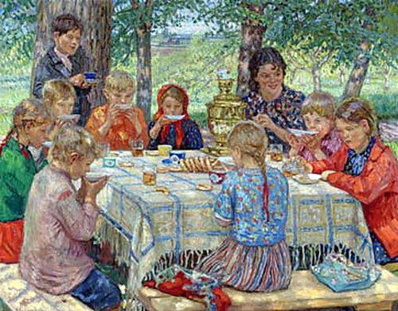
The teaching process is a sharing process.
What can a teacher actually share with his students?
Α passion for knowledge
Α positive worldview
A zest for a creative occupation
Α mood for
communication and offering

Slide 9
Losing interest in learning is a valid reason for protest aimed at upgrading teachers and teaching.
Why bother?
Life-changing teachers committed to excellence inspire and encourage students to strive for greatness and see the best in themselves.
Teachers are founts of experience; they have already been where their students are going, undergone what the latter will go through and are in a position to pass along lessons, not only regarding subject matter, but lessons on life.
Teachers should be reinventing themselves, their occupation, the tools and techniques they employ, their relationship with students in order to better serve schools and students.

Slide 10
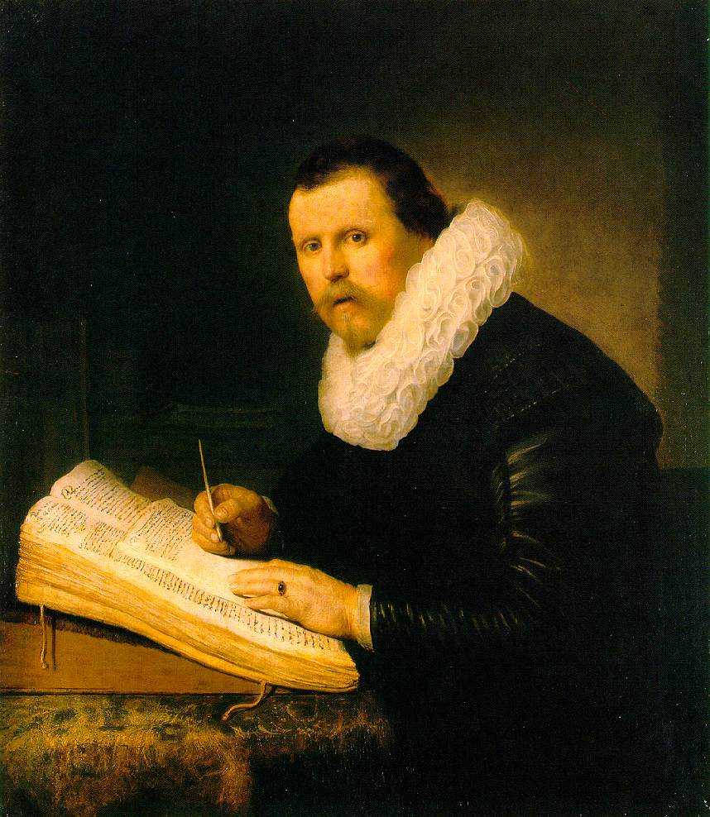
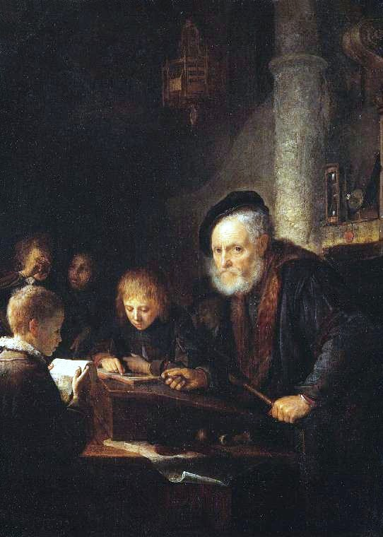
The conventional, formal approach to teaching. A current need for redefining and enriching the role of the teacher and his multifaceted profession beyond merely circulating information.

Slide 11
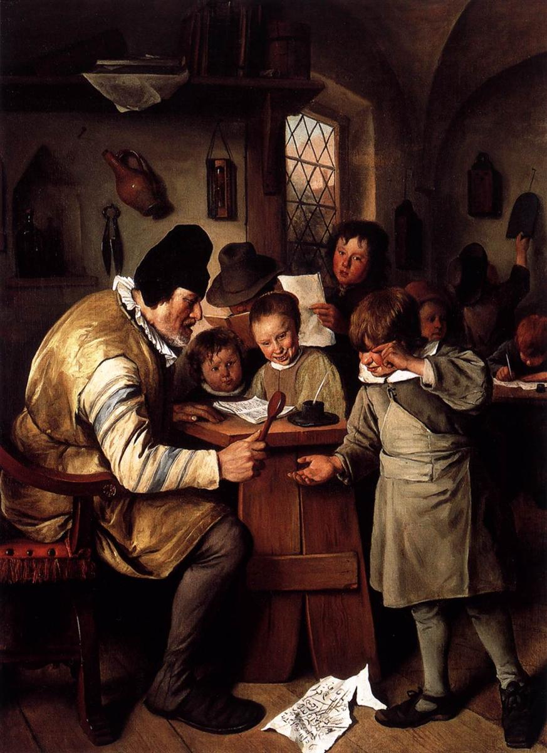
Reinventing the teacher’s role
Many teachers today are encouraged to adapt and adopt new practices that acknowledge both the art and science of learning.
They understand that the essence of education is a close relationship between a knowledgeable, caring adult and a secure, motivated student. They grasp that their most important role is to get to know each student as an individual in order to comprehend his or her personal qualities. Active learning methodologies are very effective to find out students creativity and talent.

Slide 12
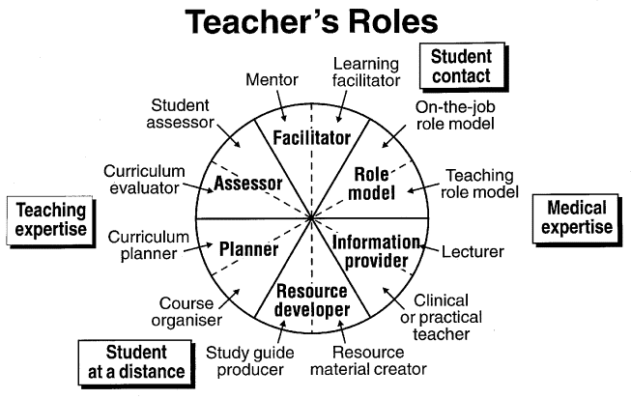
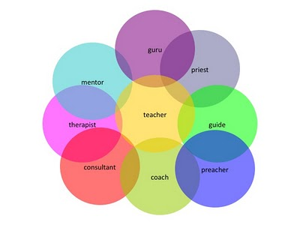
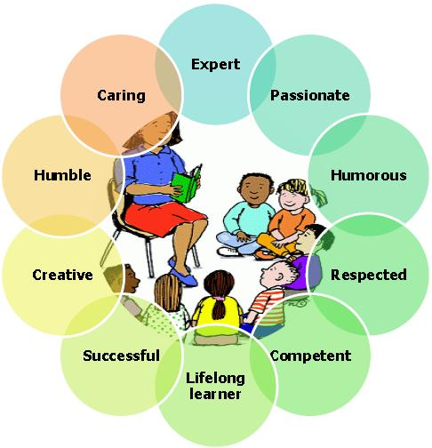
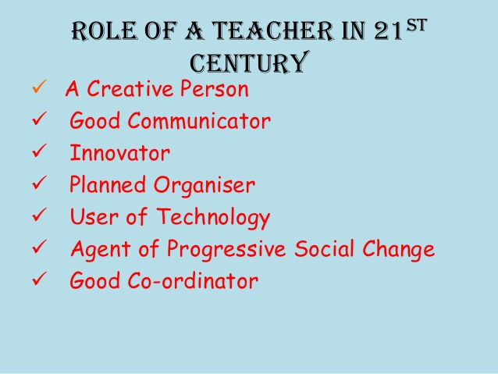

Slide 13
Α distinct teaching strategy - Α distinct teacher’s role.
- Teaching is an activity which is helping the student in learning. Teaching and learning are being modified due to innovations in education. Teachers have to understand the modern trends in teaching-learning process and make learning more interesting and interactive, so that students may be motivated to learn and learn better, after having personally experienced the value of a subject.
- By implementing experiential learning, there is a move to a more student-centered view of learning which has required a fundamental shift in the role of the medical teacher. No longer is the teacher seen predominantly as a provider of information, but rather as a facilitator or manager of the student’s learning; the learner is the self-teacher.
- Students must take control of their own learning. In the experiential learning procedure, the “instructor” is a guide, a cheerleader, a resource, and a support. Suitable experiences are carefully chosen for their learning potential by the teacher who commences the experience and guides students through the process of finding and determining solutions for themselves.

Slide 14
During experiential learning, the facilitator’s role is to:
-Select suitable experiences that meet the criteria above.
-Pose problems, set boundaries, support learners, provide suitable resource, ensure physical and emotional safety, and facilitate the learning process.
-Recognize and encourage spontaneous opportunities for learning, engagement with challenging situations, experimentation (that does not jeopardize the wellbeing of others) and discovery of solutions.
-Help the learner notice the connections between one context and another, between theory and the experience and encourage this examination repeatedly.

Slide 15
The teacher as a facilitator of learning
Making the shift from teacher as expert to facilitator is sometimes seen as diminishing a teacher’s power and authority, but this should not be the case.
Facilitating learning is empowering for both the learner and the teacher and frees the teacher from many of the burdens that having to be an ‘expert’ might entail. It would traditionally have been seen as a weakness for a teacher to say ‘I don’t know, let’s find out’ or ‘I don’t know, do any of you students know the answer?’ and clearly clinical teachers need to know more about many topics than their students or trainees, but medical science is changing so rapidly that no one can know everything. Implementing an evidence-based approach to clinical learning and to medical practice involves finding out about the latest research. Teachers can use these techniques and this approach to facilitate their own and their students’/trainees’ learning.

Slide 16
Instructor’s Roles in Experiential Learning
In experiential learning, the instructor guides rather than directs
the learning process where students are naturally interested in learning. The instructor assumes the role of facilitator and is guided by a number of steps crucial to experiential learning .
Be willing to accept a less teacher-centric role in the classroom.
Approach the learning experience in a positive, non-dominating way.
Identify an experience in which students will find interest and be personally committed.
Explain the purpose of the experiential learning situation to the students.
5. Share your feelings and thoughts with your students and let them know that you are learning from the experience, too.
6. Tie the course learning objectives to course activities and direct experiences so that students know what they are supposed to do.
7. Provide relevant and meaningful resources to help students succeed.
8. Allow students to experiment and discover solutions on their own.
9. Find a sense of balance between the academic and nurturing aspects of teaching.
10. Clarify students’ and instructor roles.

Slide 17
Student’s Roles in Experiential Learning
Qualities of experiential learning are those in which students decide themselves to be personally involved in the learning experience (students are actively participating in their own learning and have a personal role in the direction of learning). Students are not completely left to teach themselves; however, the instructor assumes the role of guide and facilitates the learning process.
Students will be involved in problems which are practical, social and personal.
Students will be allowed freedom in the classroom as long as they make headway in the learning process.
Students often will need to be involved with difficult and challenging situations, while discovering.
Students will self-evaluate their own progression or success in the learning process which becomes the primary means of assessment.
Students will learn from the learning process and become open to change. This change includes less reliance on the instructor and more on fellow peers, the development of skills to investigate (research) and learn from an authentic experience, and the ability to objectively self-evaluate one’s performance.

Slide 18
Despite the benefits of the experiential concept of learning and teaching , it is a fact that the formal concept is in no way uneducative by definition , and has certainly been well served in many cases by inspired and effective educators; the latter concept can contribute significantly to the organization of thought and the exercise of memory. Regardless of the teaching method, inspired teachers have a common motive.

Slide 19
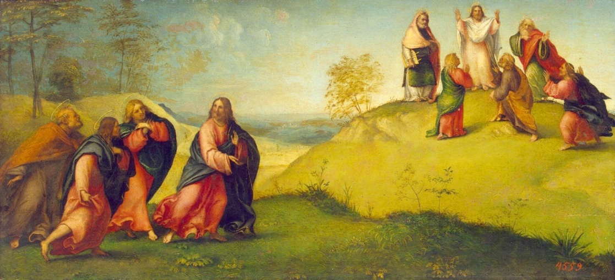
What incentives are there for teaching? How does the teacher benefit from exercising his/her profession?
Nowadays, self-psychotherapy of people through their work is linked to acquiring more and more wealth, power, glory etc., most often to the detriment of others, according to the individualistic world theory.
When personal benefit is the motivation of human activity, the person is entrapped by it; gradually he/she becomes indifferent to the activity itself and gets tied up on how to satisfy this increasingly unsaturated motivation of his/hers e.g. more and more money,
more and more fame, more and more publicity etc.

Slide 20
What incentives are there for teaching? How does the teacher benefit from exercising his/her profession?
Although the importance of the teaching task should, of course, be assessed by worthy financial rewards and social recognition, motivation for teaching always has to be intrinsic and rigidly associated with a hankering for offering to fellow beings. In this way, the self-psychotherapy that the teacher gets from his work will be combined with the benefit of others, pursuant to the sociocentric world theory. Any personal benefits should be the outcome of teaching and not the trigger for teaching.

Slide 21
“An effective teacher is passionate about teaching. It is passion that is an inner drive, that is not dependant on approval or compliments or seeing results right away. It is passion that prevents discouragement or burn-out because it is an inner fire that motivates and energizes. It is passion that also excites and inspires students”.
As good as intentions, thoughts and words sound, tangible work is the one that counts, eventually.
The teacher is not worthy of praise due to his/her theoretical positions, but
due to his/her courses taught in the classroom
or even through the computer.

Slide 22
The most complete answer to the question:
“Why should one teach?”
is simple and concise:
“ Teach to make a difference”.
How, where and to whom one makes a difference is up to him/her.
HIPON partners have frankly attempted to make a difference in pathology teaching through HIPON e platform in which students decide themselves to be personally involved in the learning, practical, problem-solving experience. Students learn through student -rather than instructor- centered experiences by doing, discovering, reflecting and applying. Through these simulating experiences students develop communication skills and self-confidence, and gain and strengthen decision making skills by responding to and solving real world problems and processes. Thereby, when they next find themselves in an environment that presents a challenge like the challenge presented in the simulation, they will more readily recall that experience and the things that they have learned from it.

Slide 23
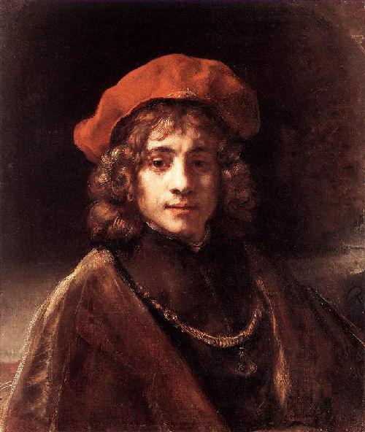
HIPON e platform
Let's inspect what has been achieved and let's discuss how we can develop the platform further.

