Slide 1
Modern Data Engineering for Data Science Projects
Optimization and use of User Defined Functions in data processing systems
Yannis Foufoulas (johnfouf@di.uoa.gr)

Slide 2
Motivation
•Modern data pipelines involve diverse data sources and complex processing tasks
Typical applications in data science, data analytics, edge computing, etc.
Many tools to assist developers design pipelines
But: Very complicated ecosystem to execute pipelines
•Relational databases provide many hooks for processing and managing efficiently large data volumes
Decades-old experience to provide optimized (distributed) query processing, efficient storage, acid properties etc.
But: SQL provides limited expressive power
•UDFs to the rescue
Extend the relational paradigm with syntactic and semantic support to capture complicated tasks and algorithms
But: Impedance mismatch between their relational (SQL) evaluation and procedural (Python) execution
Context switching overhead
Data conversion overhead

Slide 3
User Defined Functions (UDFs)
There are 3 standard types of UDFs as defined below:
Row/scalar functions. They get one row in input and they return one value in output. Row functions are not placed after the `from` of a query but they can be placed anywhere else.
Aggregate functions. They get one group of rows in input and they return one value in output. Aggregate functions are not placed after the `from` of a query but they can be placed anywhere else similarly to row/scalar functions.
Table functions. They may get a subquery in input (e.g., this is not necessary as they may get any other parameter to import data from outside the db) and they return a result set. Table functions are placed after the `from` of a query.

Slide 4
Systems
Python UDFs are supported in most data processing engines including:
PySpark
Dask
PostgreSQL
SQLite
MonetDB
Vertica
DuckDB
MongoDB
etc.

Slide 5
Python booster technologies
Systems based on translation of Python into an intermediate representation IR (e.g., Weld).
Systems based on translation of Python libraries into SQL (e.g., Grizzly-sql)
Python transpilers into C (Cython, Nuitka etc)
Python tracing JIT compilers (PyPy, Tuplex)

Slide 6
UDF Performance Issues
Black boxes for the optimizer, act as a barrier during query optimization
Impedance missmatch between relational and procedural evaluation
Context switches
Intermediate result materializations
Data copies and transformations
Each small UDF runs in isolation -> not many optimization opportunities for the UDF compiler

Slide 7
UDF expressiveness issues
Statically typed UDFs
Limited to the three UDF types (scalar, aggregate, table)
Stateless UDFs
No polymorphism in most cases
SQL was not initially designed to support pipelines with UDFs
Cumbersome SQL queries in case of UDF chaining

Slide 8
UDF Fusion
Fusion of UDFs with relational operators
Elimination of context switches and data transformation between C and Python
Questions:
What operators are fusable?
When to fuse 2 or more UDFs?
How to apply fusion?

Slide 9
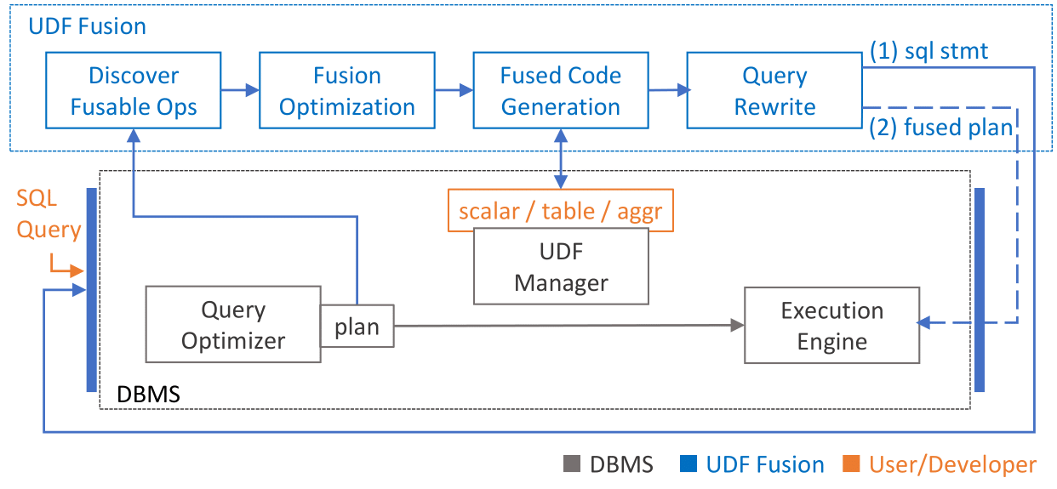
Query Optimization with UDFs

