Slide 1
ECP 2015 Belgrade European Society of Pathology (ESP)/ American Society for Clinical Pathology (ASCP) Special Session, 7.9.2015 HIPON e platform as a tool for pathology education. www.hiponproject.eu
Applying Experiential Learning in Pathology
Dr Andreas C. Lazaris, Pathologist

Slide 2
HIPON’s principal aim:
“ ICT e-modules on HistoPathology: a valuable online tool for students, researchers and professionals – HIPON ”
is a 3-year project supported and co-funded by the
Lifelong Learning Program
of the Education, Audiovisual and Culture Executive Agency,
The Commission of the European Union
(project reference number: 531203-LLP-1-2012-1-GR-KA3-KA3MP, Grant Agreement: 2012 – 4909 / 001 – 001, Key Activity 3- ICT Multilateral Projects)
Application of experiential learning principles in the field of Pathology,
namely, the integration of theory and practice in Pathology through experience-based ICT learning activities.

Slide 3
HIPON EU PARTNERS
-Medical Faculty of the National and Kapodistrian University of Athens (UoA, Head partner)
-University of Zagreb School of Medicine (UZSM)
-Radboud University Nijmegen Medical Centre (RUNMC)
-Centre for the Advancement of Research & Development in Educational Technology (CARDET), Nicosia
- Faculty of Computer Science and Engineering, Ss. Cyril and Methodius University, Skopje

Slide 4
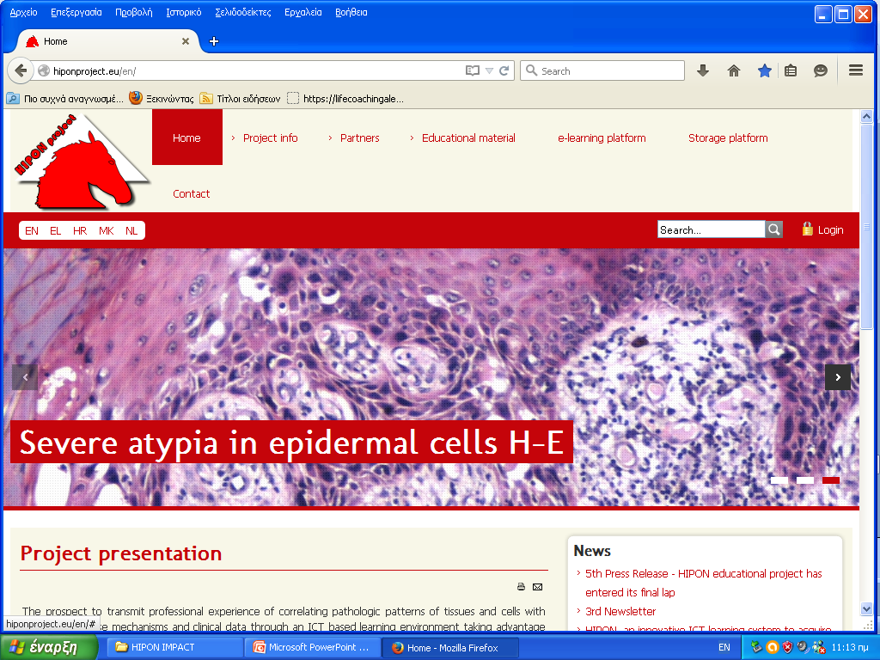
HIPON WEB PORTAL(www.hiponproject.eu)

Slide 5
HIPON e platform: central page

Slide 6
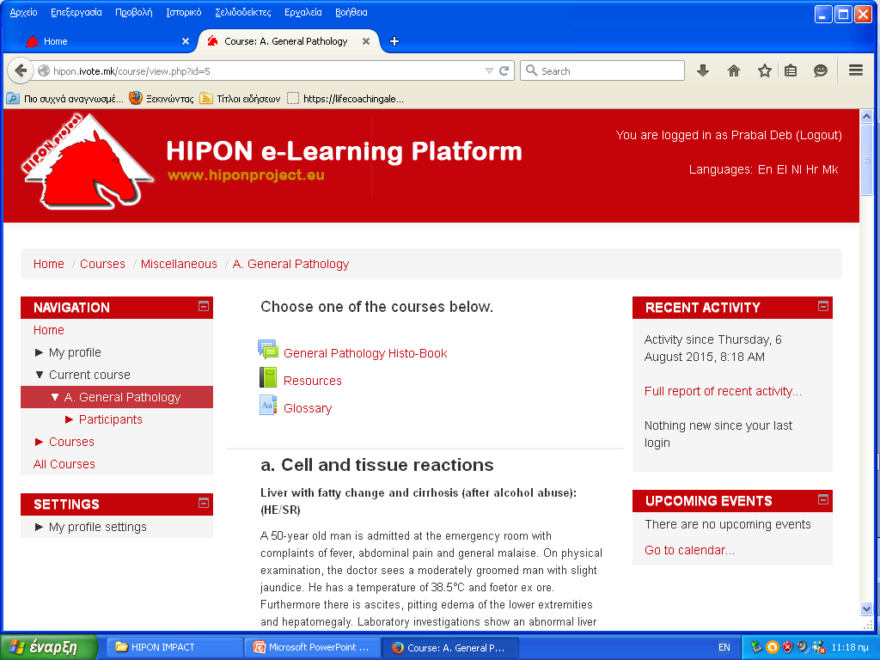
MODA: General Pathology Courses: Virtual slides of characteristic cases, a genuine source of experience-based learning. Clinical basics are mentioned initially. Content developer: RUNMC (NL)

Slide 7
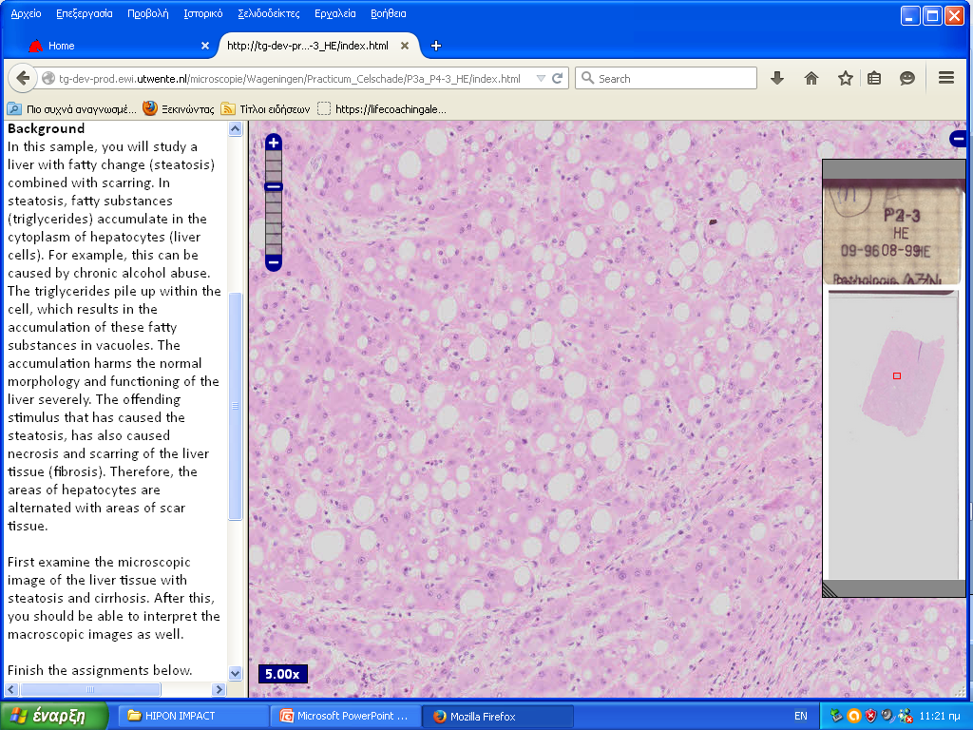
Liver with fatty change and cirrhosis. H-E virtual slide

Slide 8
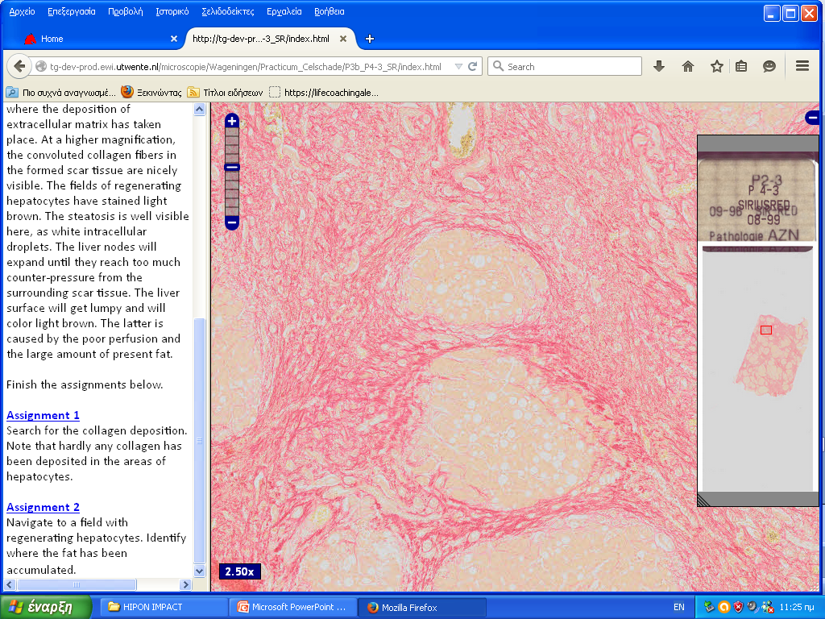
Liver with fatty change and cirrhosis. Sirius-red virtual slide

Slide 9
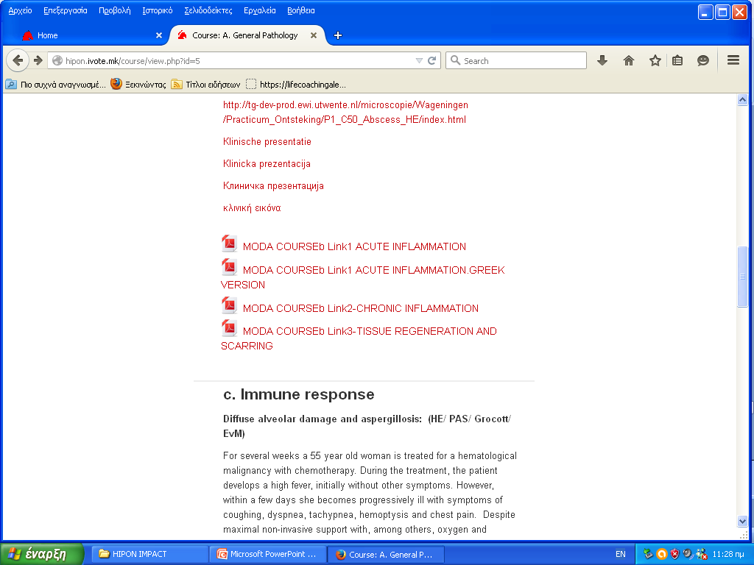
MODA: Inflammation course original links

Slide 10
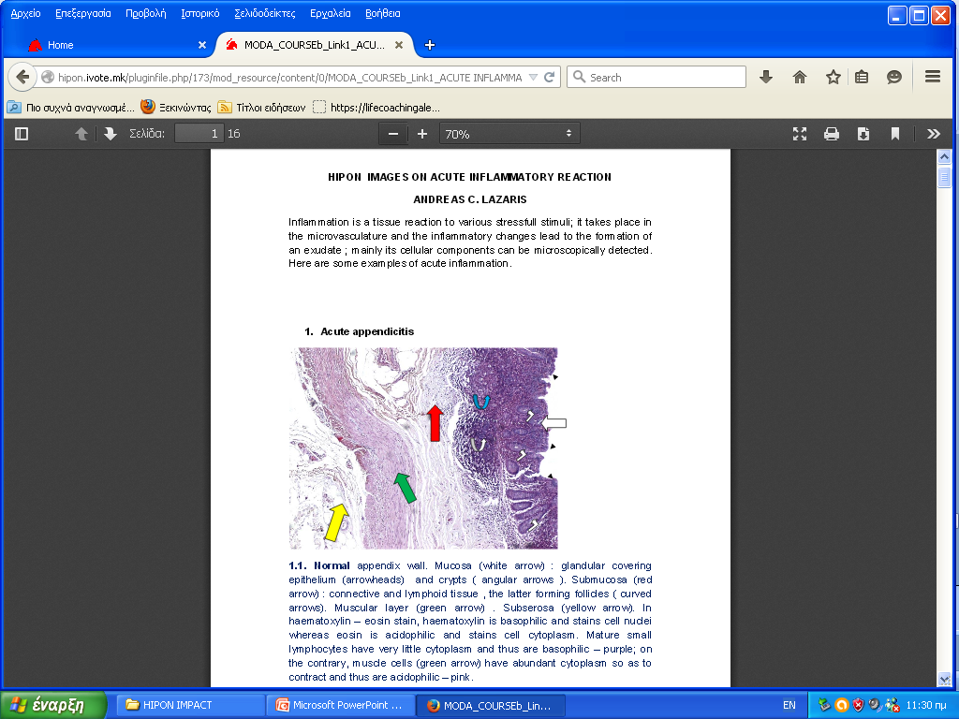
Acute inflammation. Still images PDF link.

Slide 11
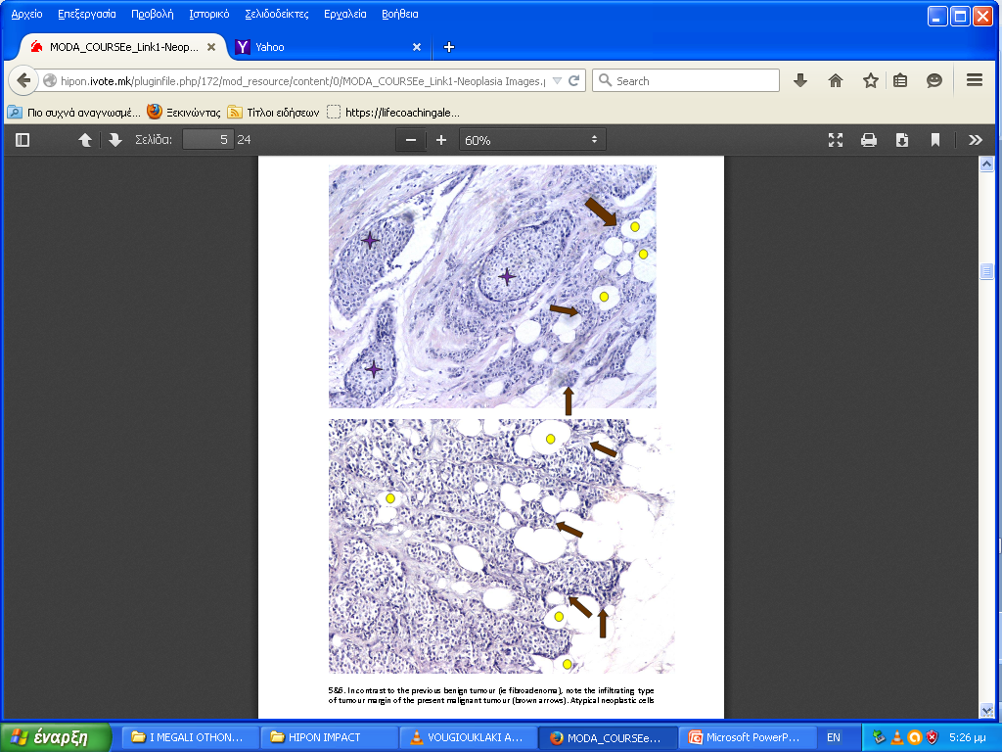
MODA: Neoplasia course. Static images PDF link.
The conventional way
of teaching/learning
is not neglected in HIPON.
Refined analysis
of general patterns of neoplasia in various tissues.
Crystallization of multiannual experience
teaching basic pathology to undergraduate medical students.

Slide 12
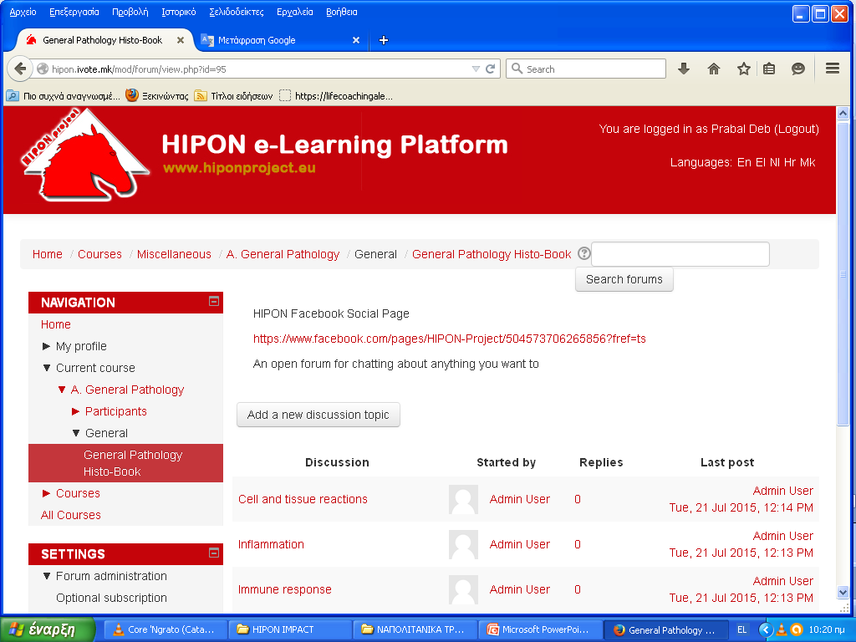
HIPON MODA: General Pathology Histo-Book

Slide 13
HIPON MODB: 31 Systemic Pathology Courses/Chapters. Content developers: UoA (GR) & UZSM (HR)

Slide 14
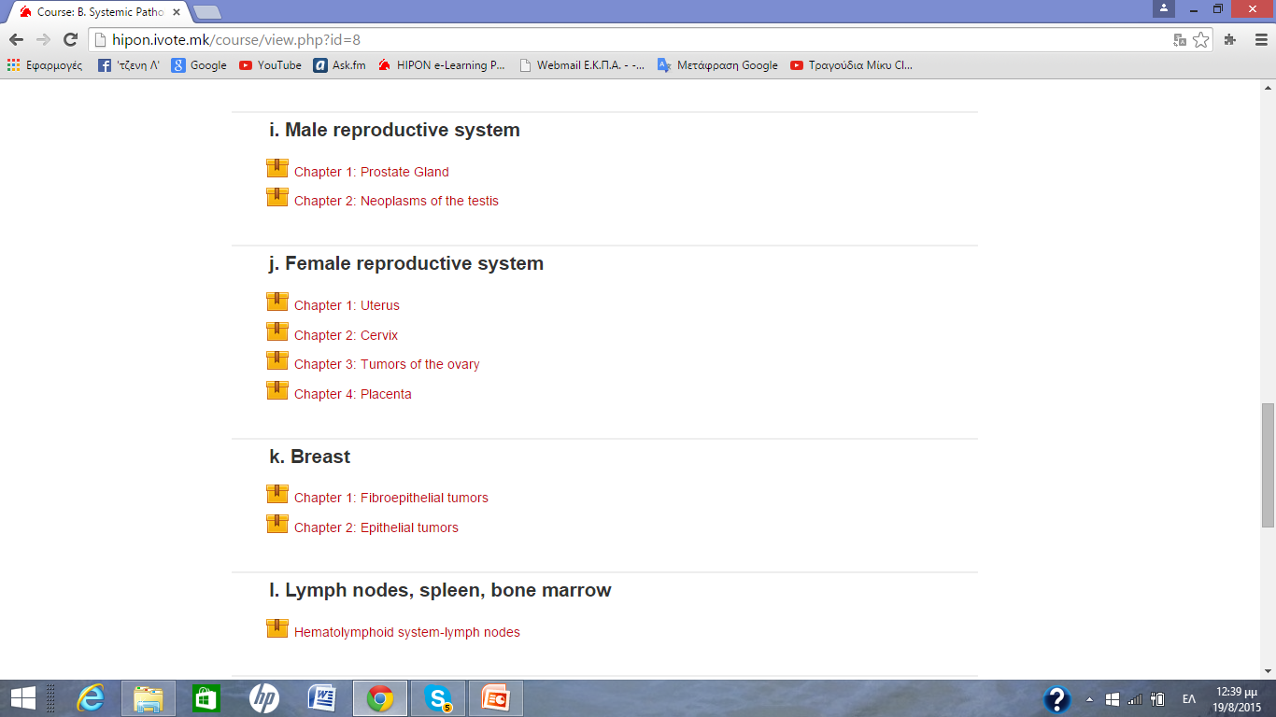
ΜΟDΒ - Unit i - Chapter1: Prostate Gland

Slide 15
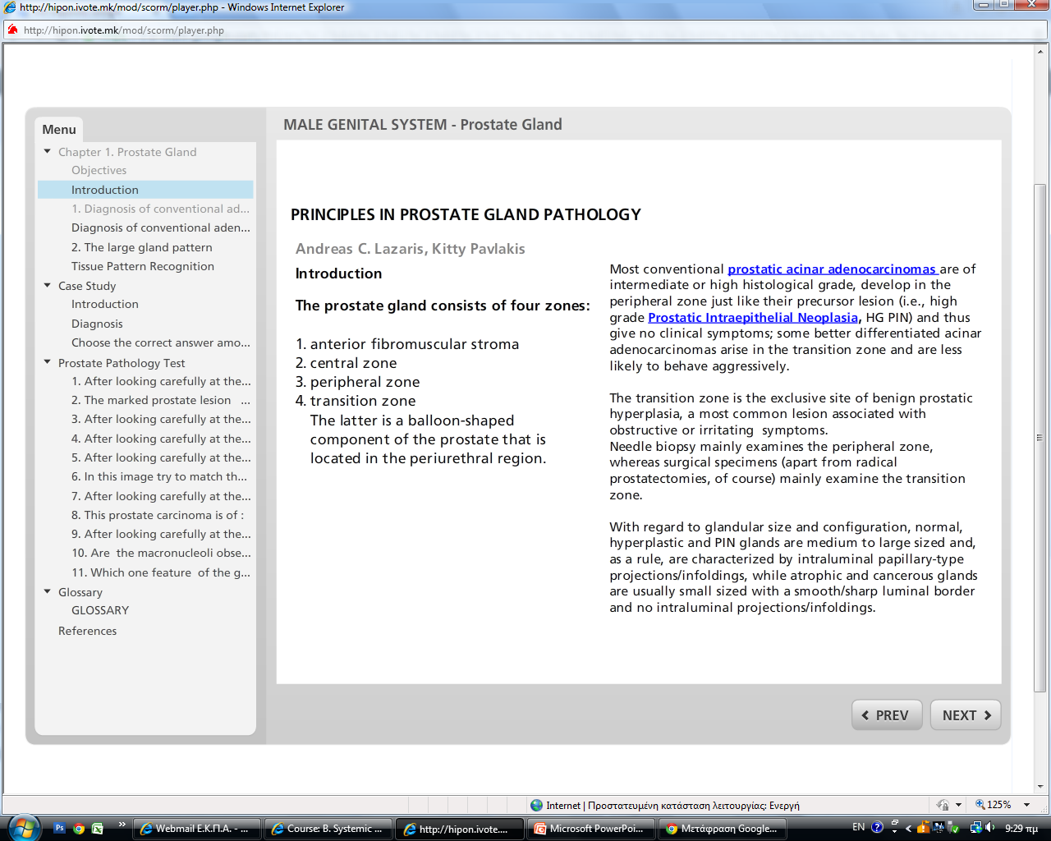
HIPON Prostate gland chapter theoretical section

Slide 16
Enlargeable images

Slide 17
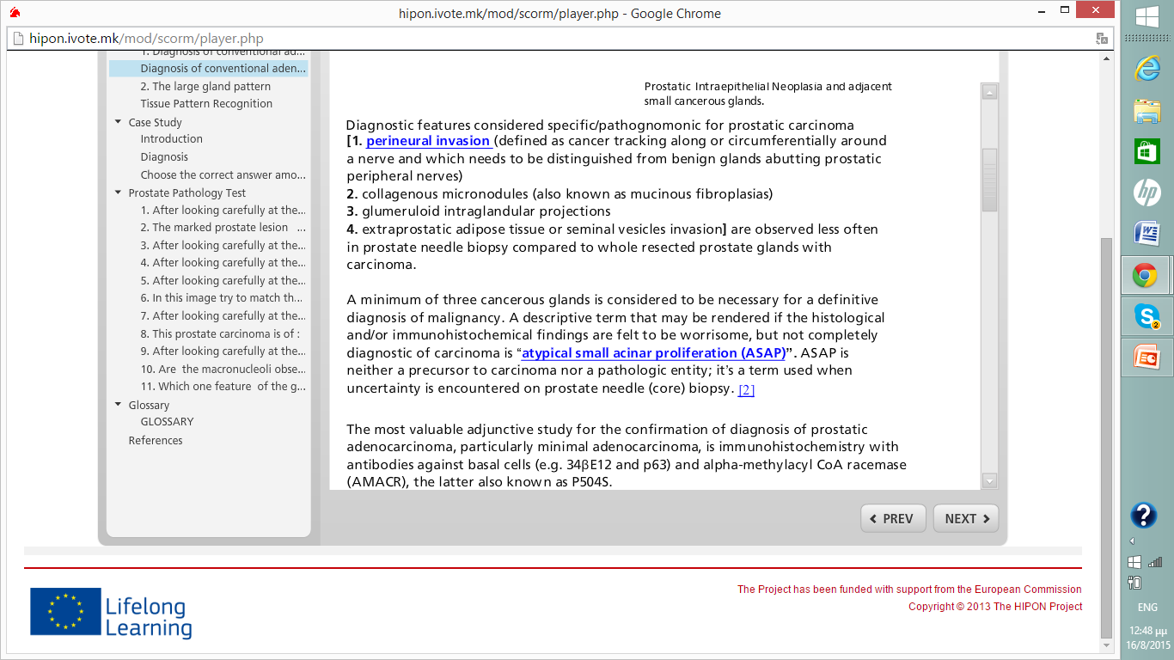
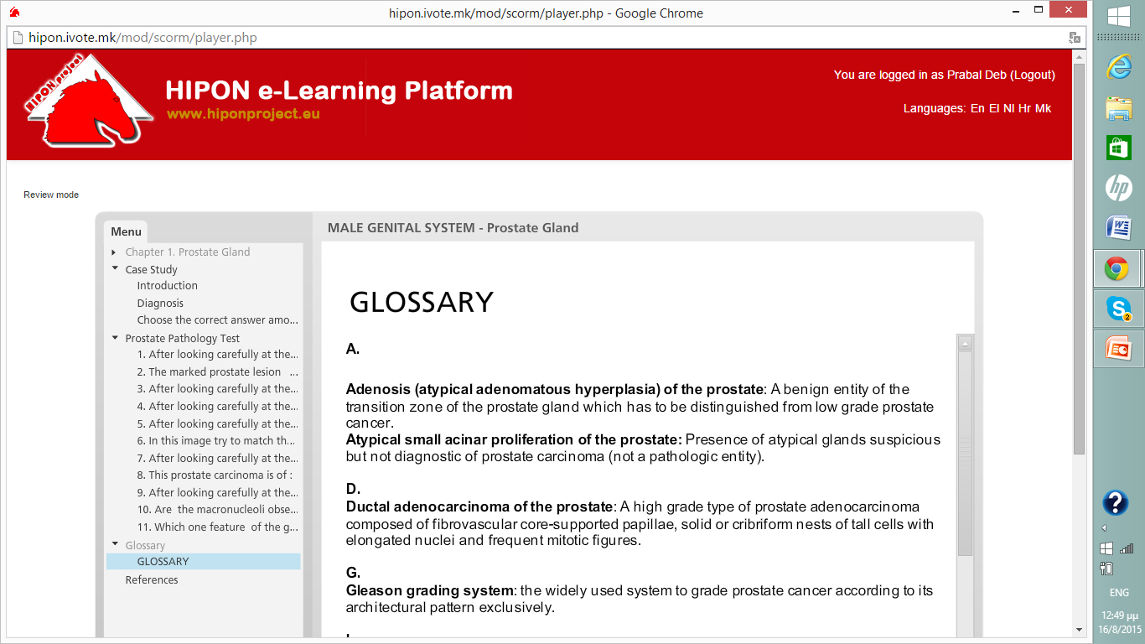
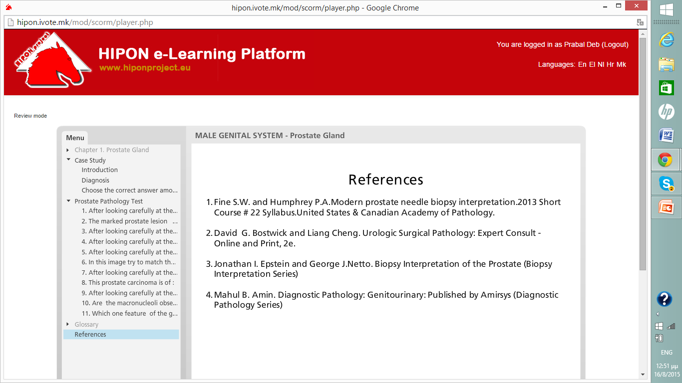
HIPON Prostate gland chapter. Glossary terms-resources clicks.

Slide 18
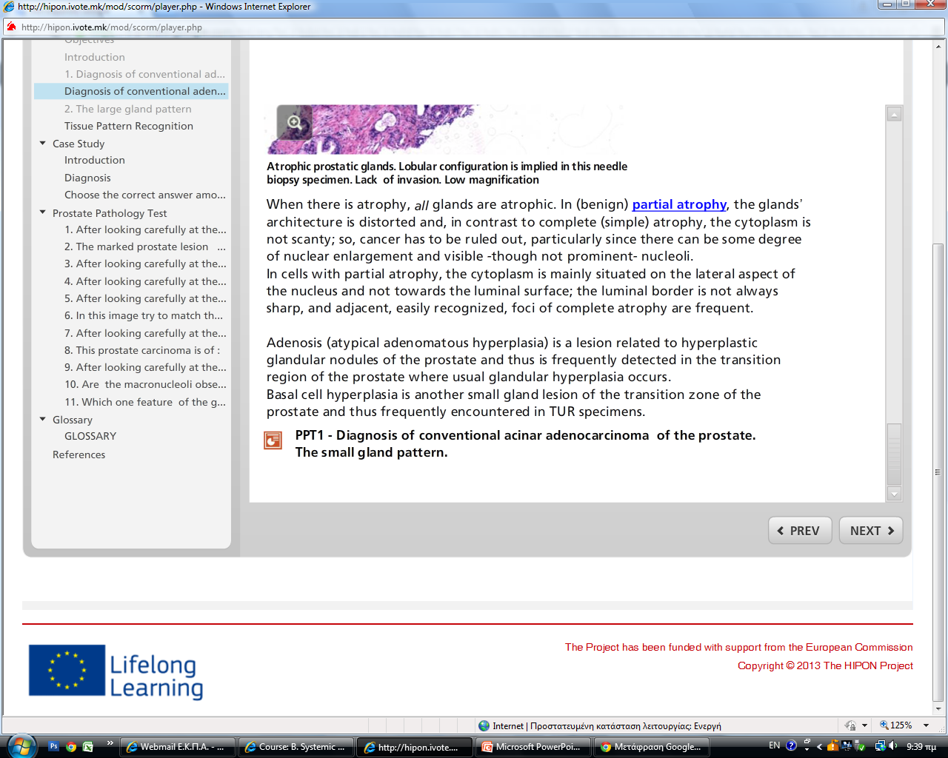
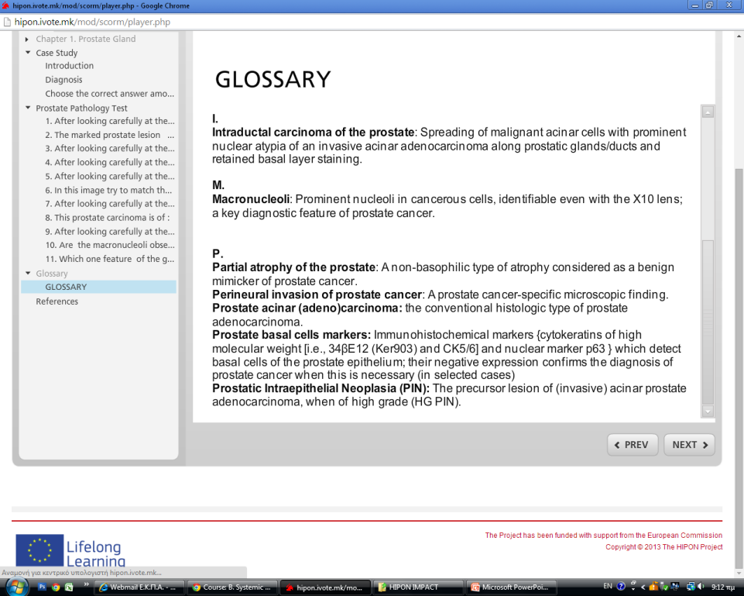
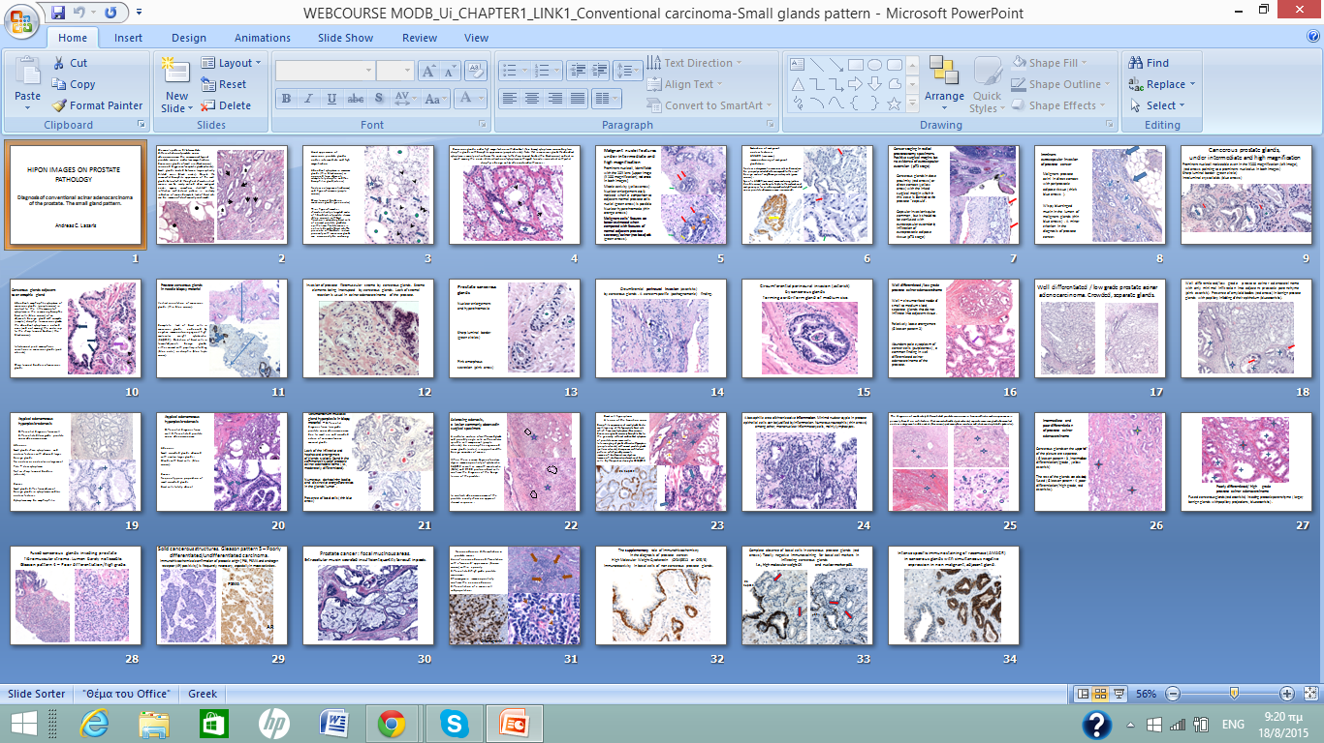
Original ppt file as a link to deepen knowledge

Slide 19
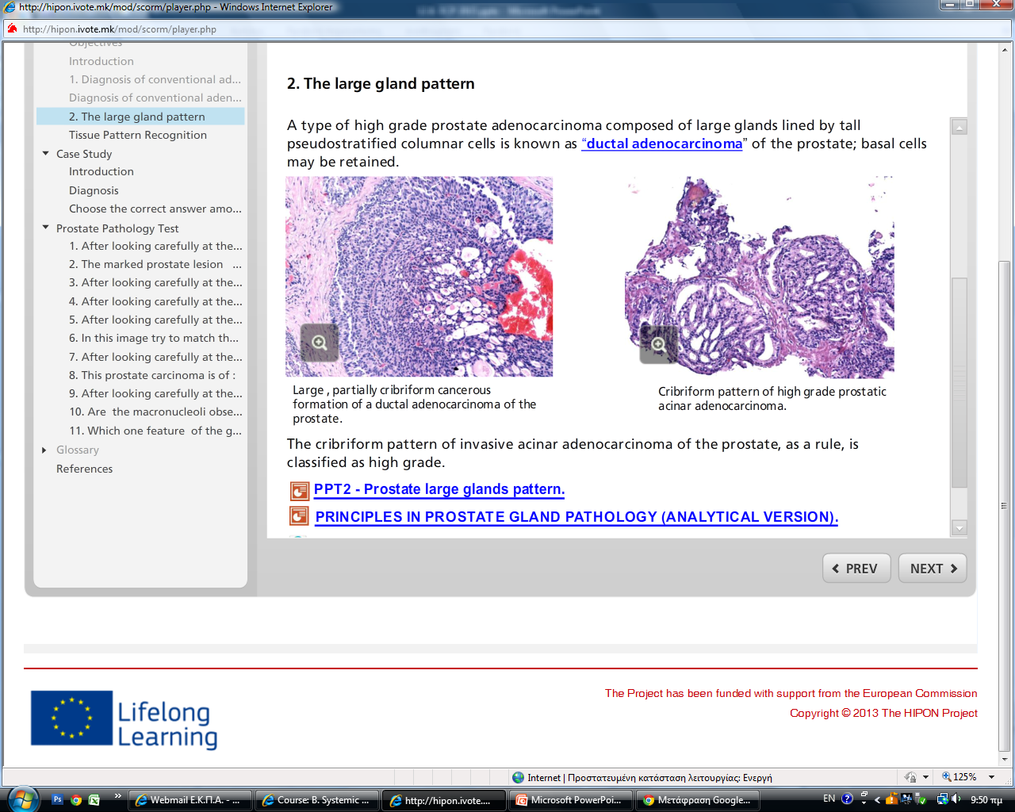
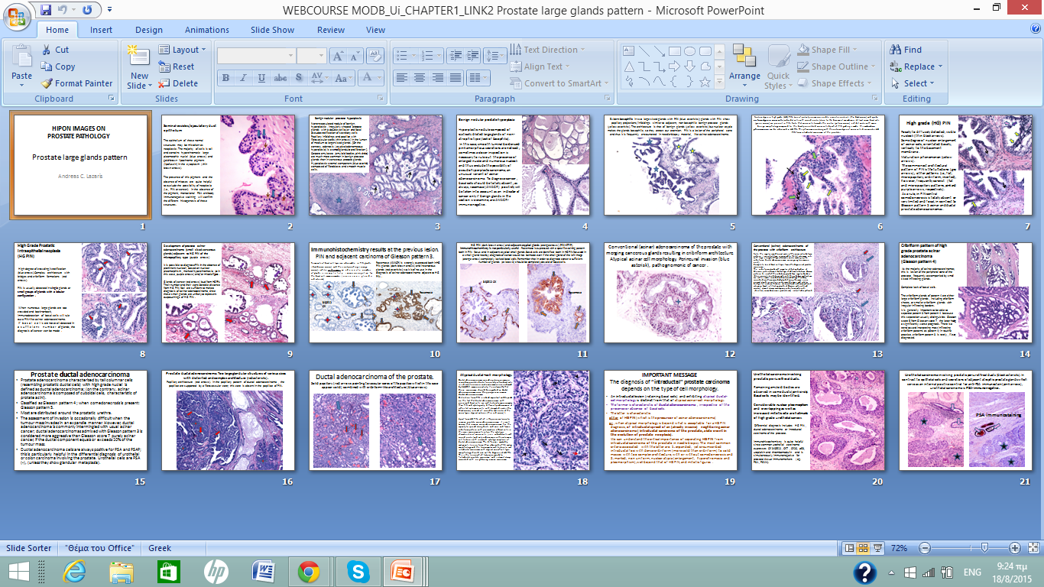
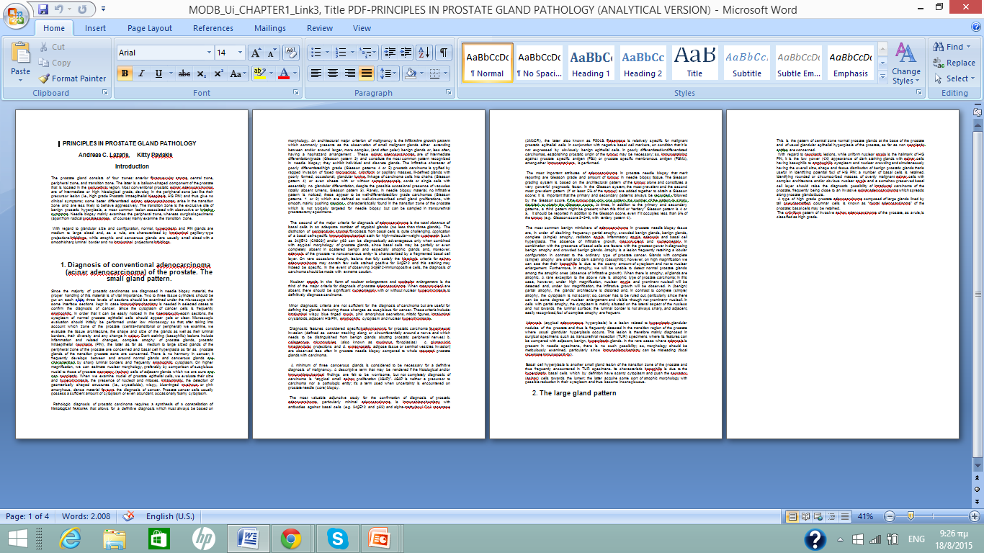
Additional
original files as links to deepen knowledge.
The conventional way of teaching/learning
Is notneglected in HIPON.

Slide 20
Prostate gland pathology. Educational video

Slide 21
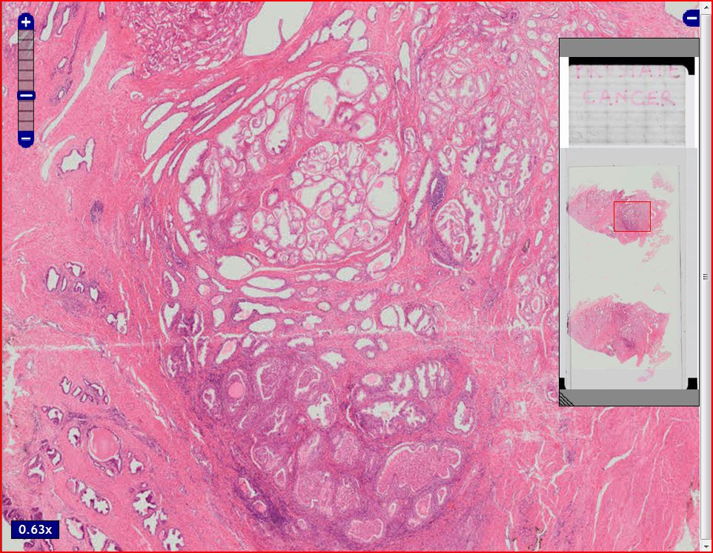
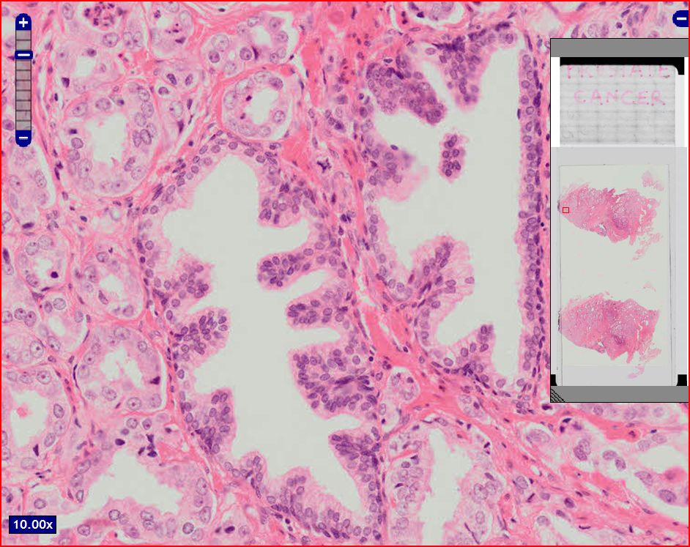
Prostate gland pathology. Virtual (digitalized) slide, corresponding to the video.
Α resolution
able to highlight the particular morphological features of
tumour glands
compared to
the entrapped benign ones.

Slide 22
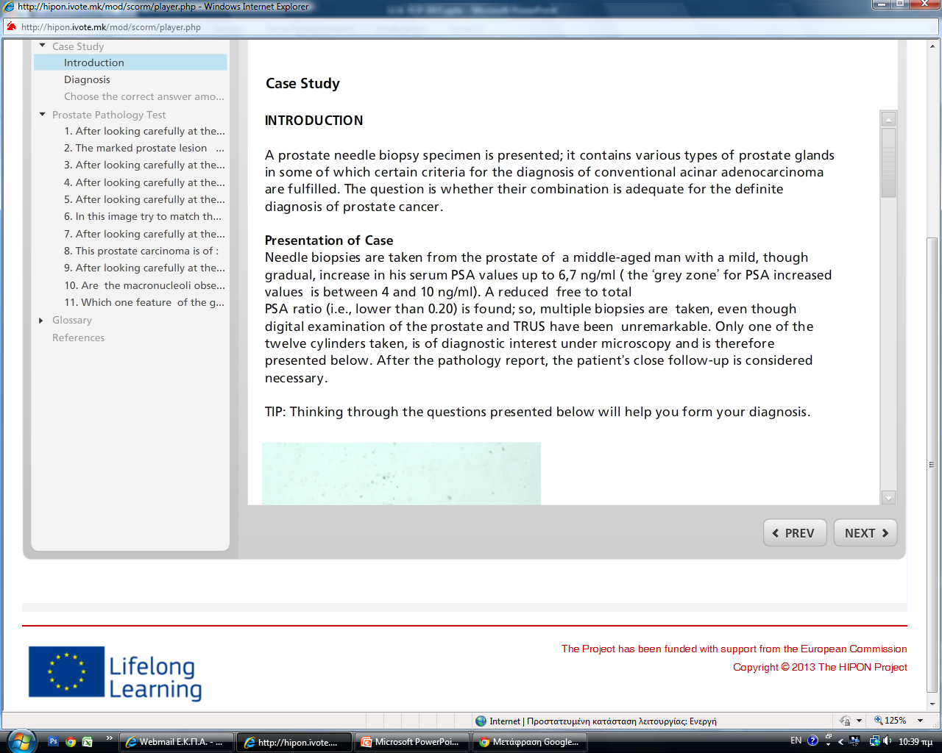
INTERACTIVE CASE PRESENTATION

Slide 23
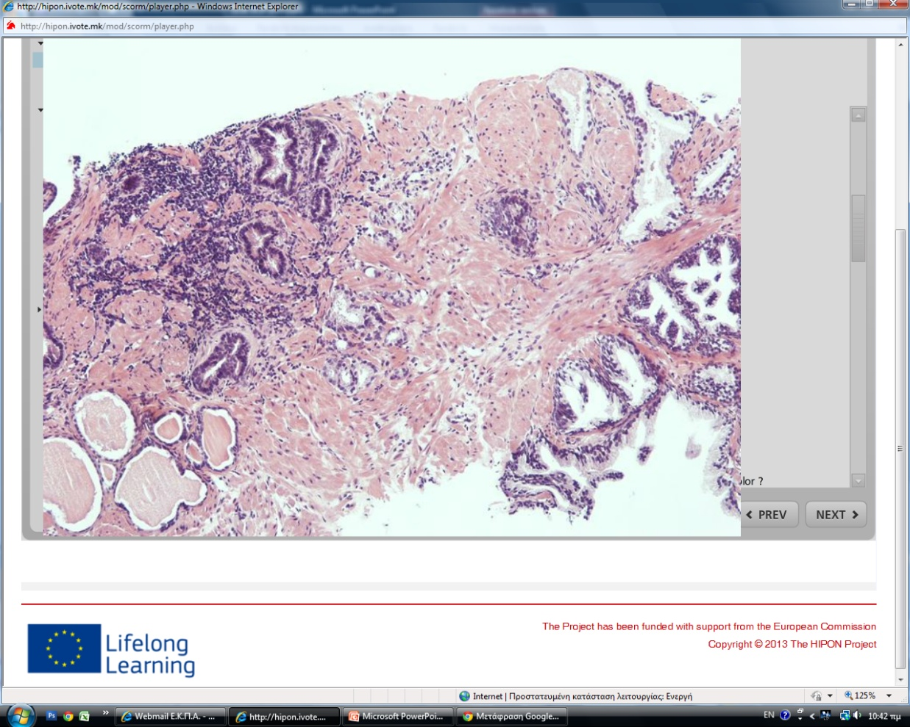
Educational methodology in presenting cases
- Booting from low magnifications; the latter are crucial for the proper assessment of histological patterns.
- Evaluating staining differences and size differences with regard to glandular structures.

Slide 24
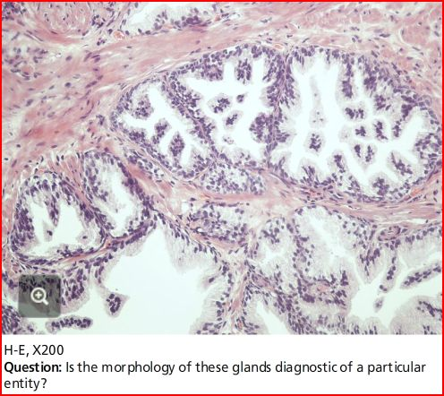
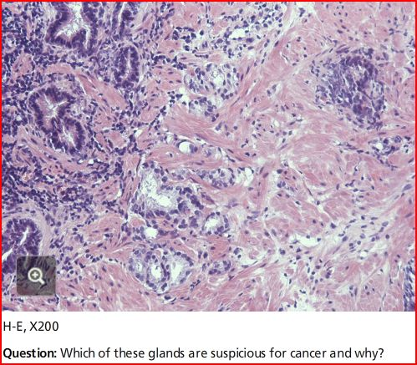
Guiding questions in order to distinguish and properly evaluate the diagnostic characteristics of various microscopic structures.

Slide 25
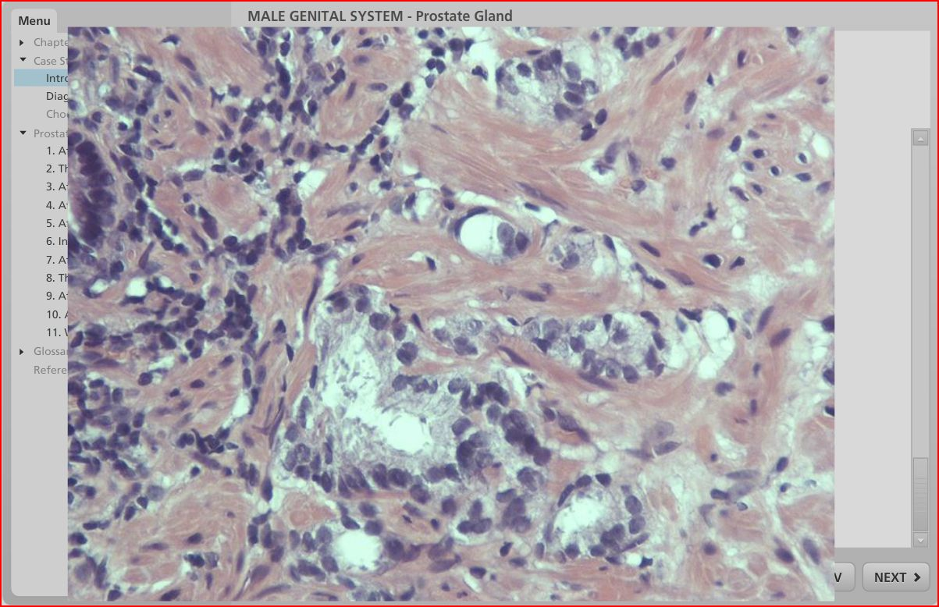
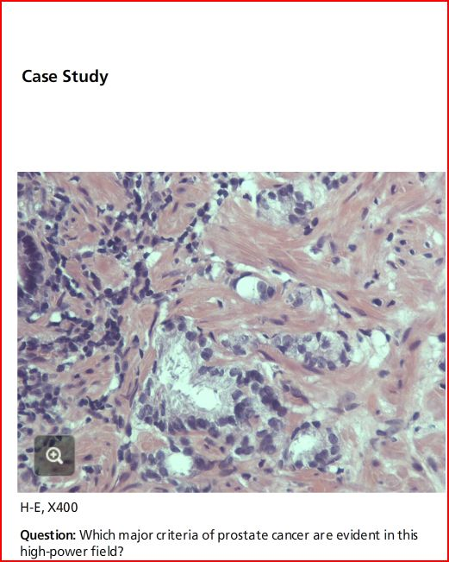
Focusing attention upon the most essential field for diagnosis.

Slide 26
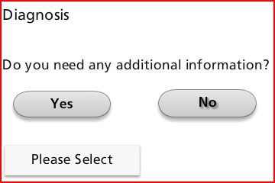
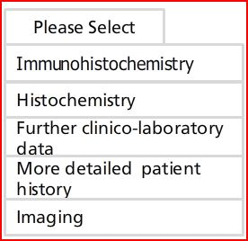
Simulation with daily practice and questioning

Slide 27
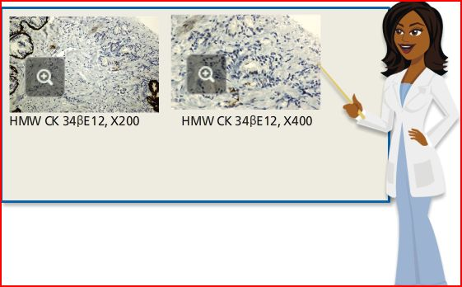
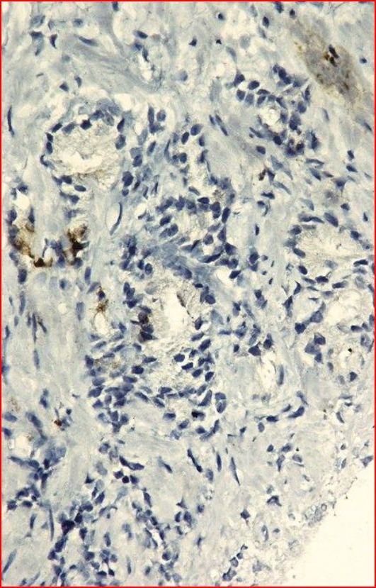
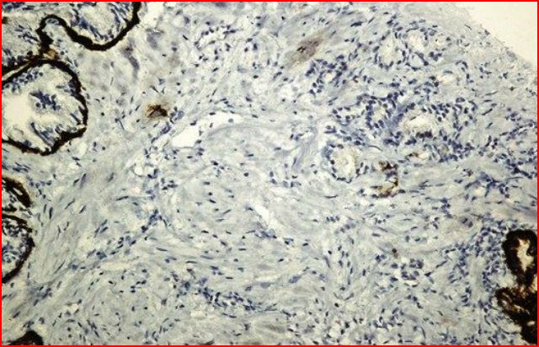
An apposite option!
Can this minimal staining be evaluated as specific for basal cells?
A frequent query in
daily practice
of prostate gland pathology.

Slide 28
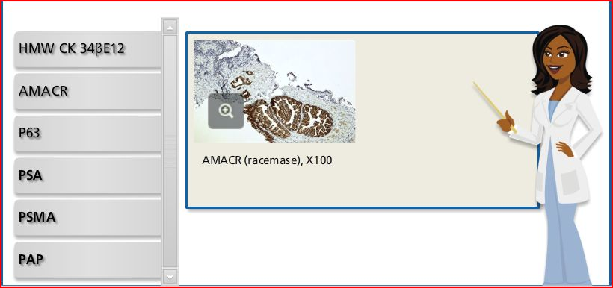
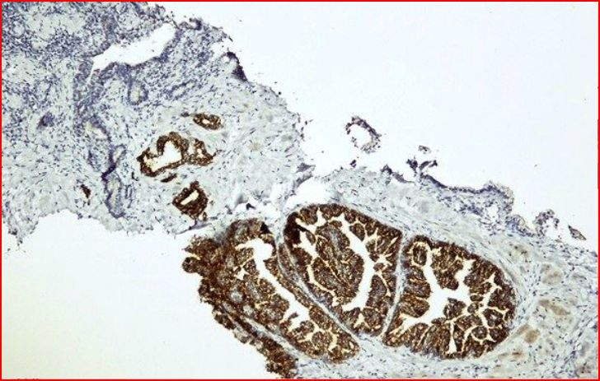
Another reasonable choice.
The critical appraisal of this staining
is imposed owing to its expression
in morphologically distinct structures,
already identified by the user
in hematoxylin-eosin staining.
The immunohistochemical findings
acquire meaning
only when related to the morphological data.

Slide 29
As regards HIPON cases, not all marker options are pertinent. The users need to exert themselves to select only immunomarkers
of essential diagnostic value.

Slide 30
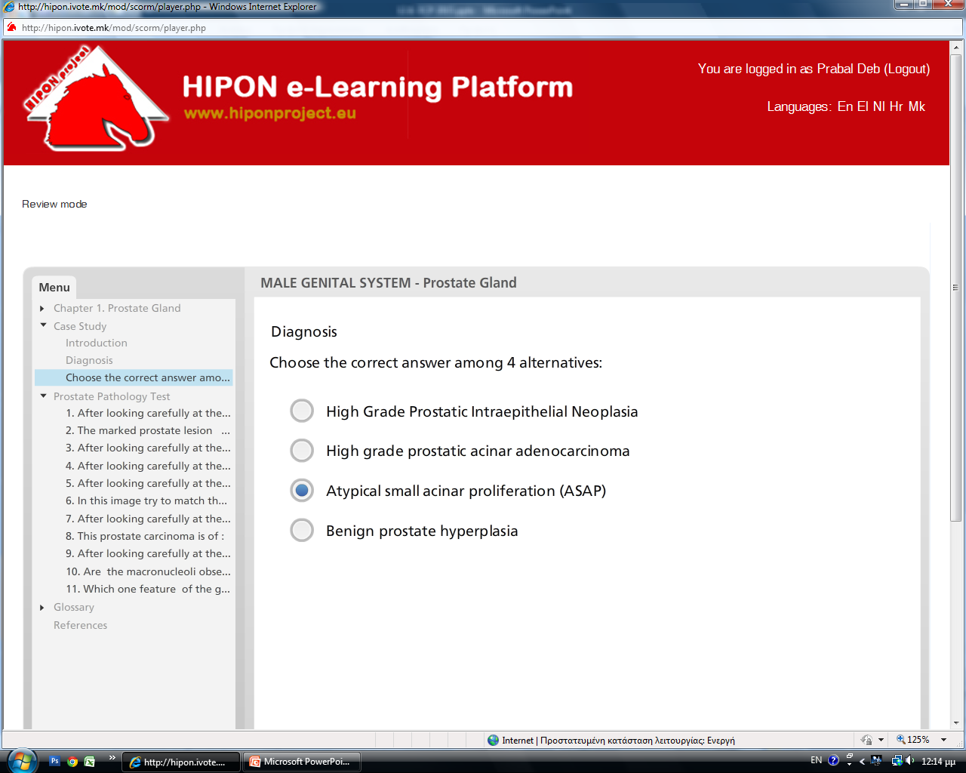
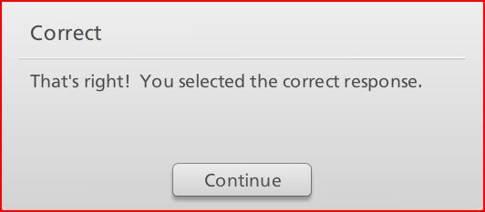

Slide 32
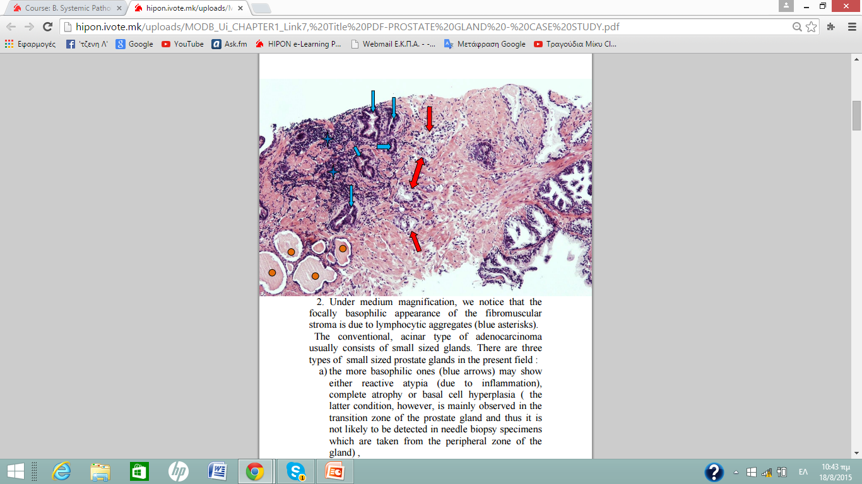
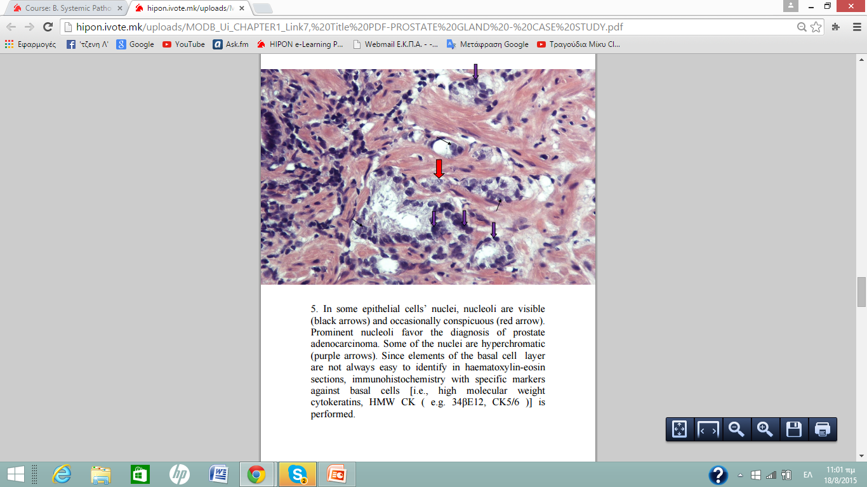
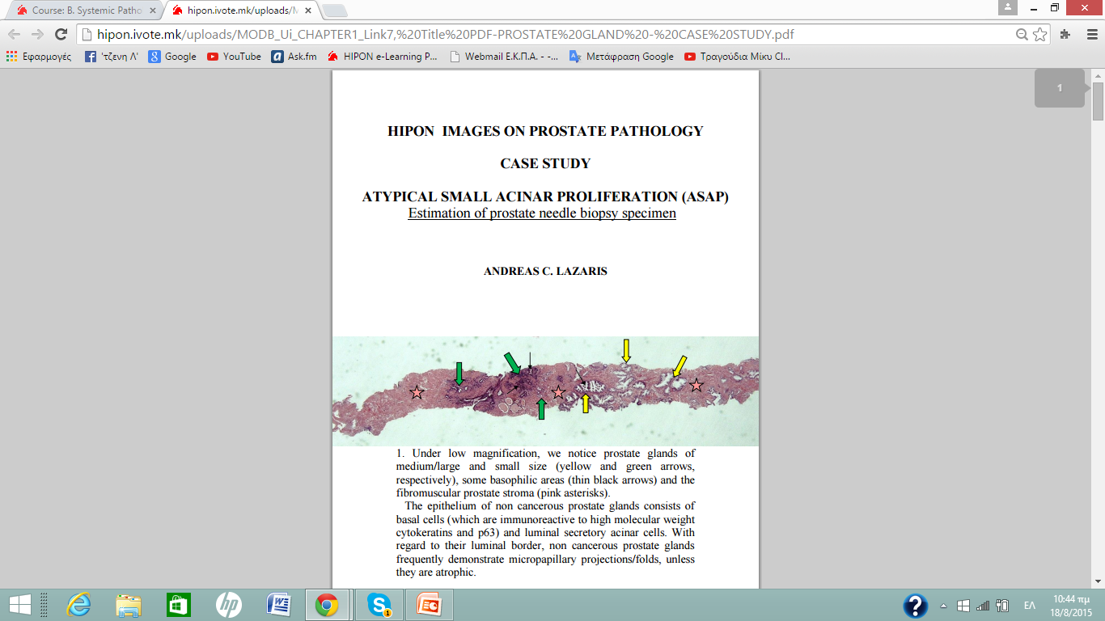
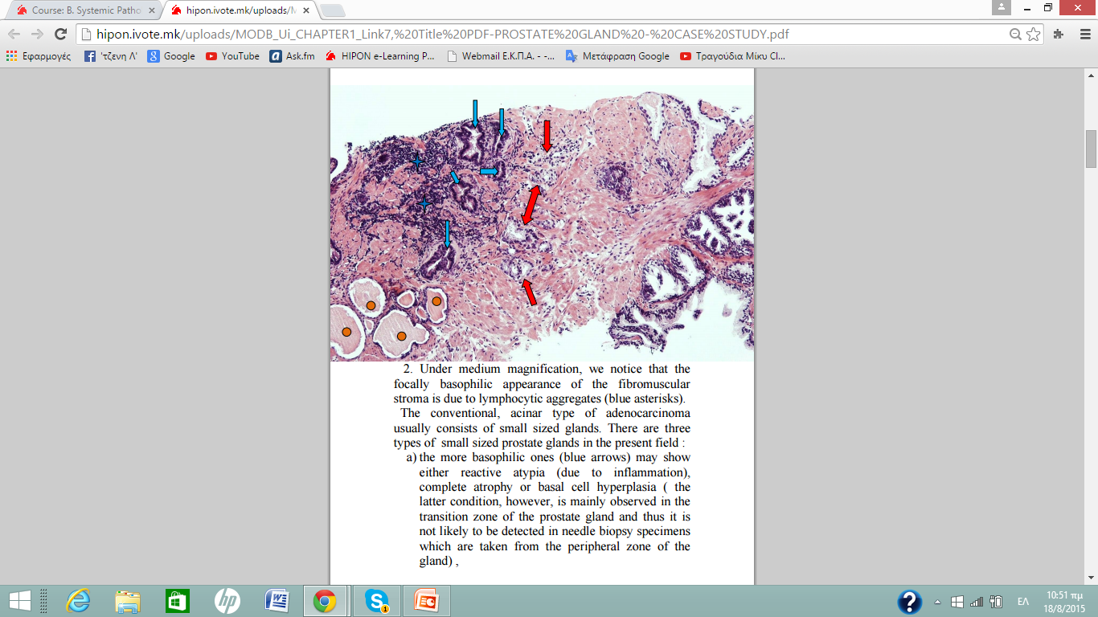
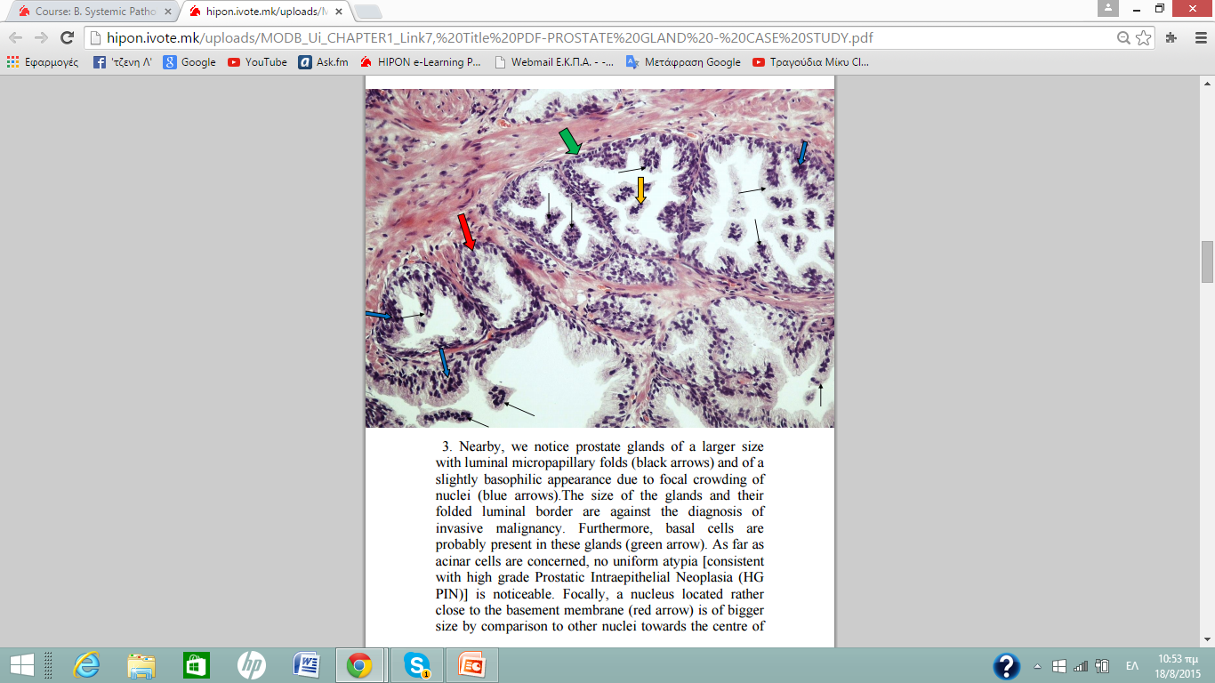
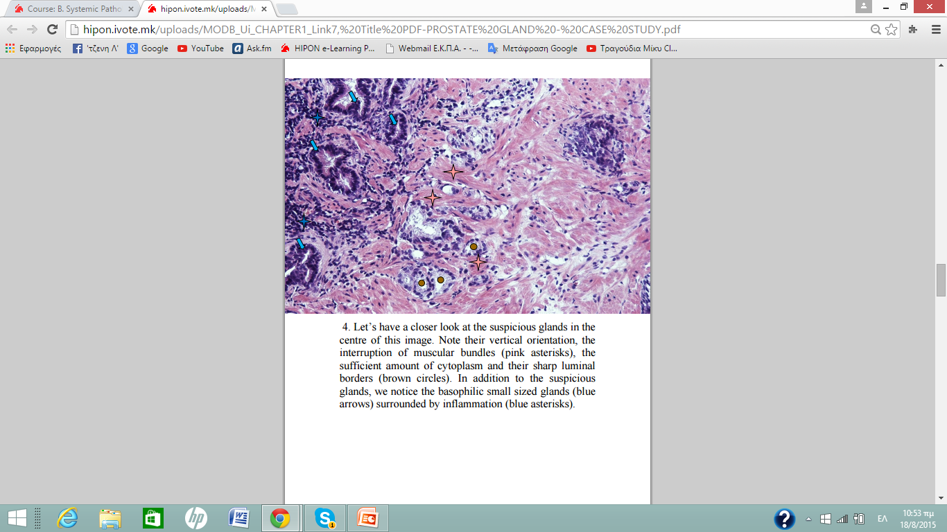
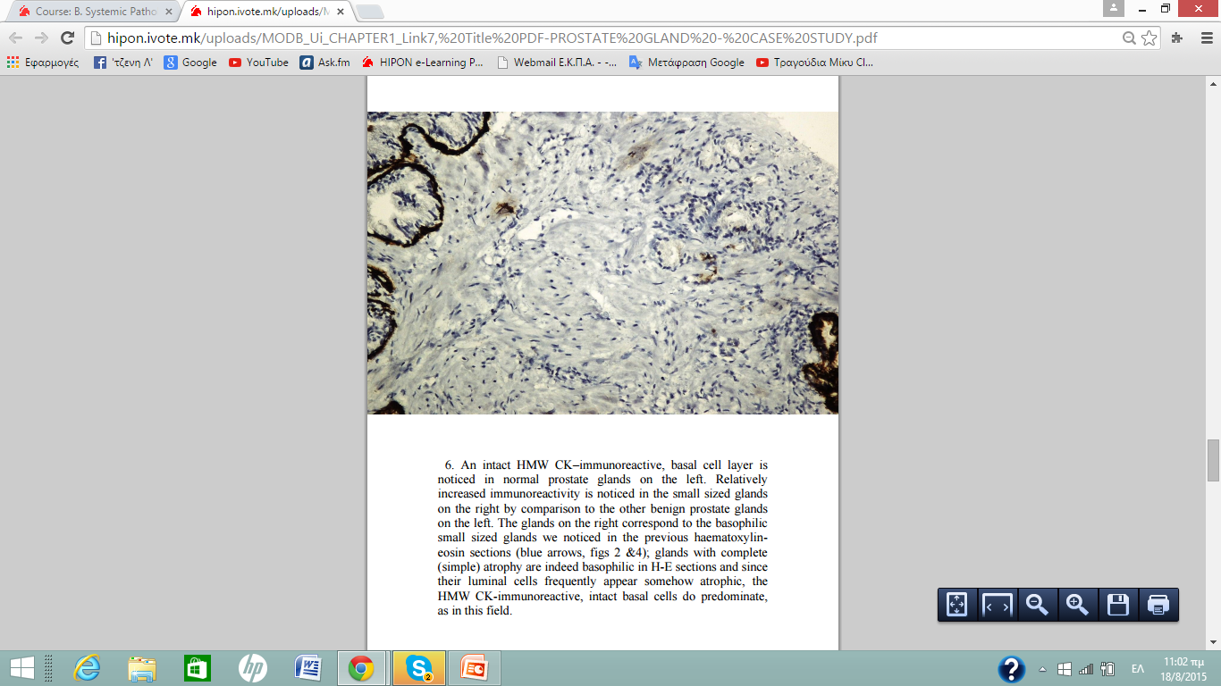
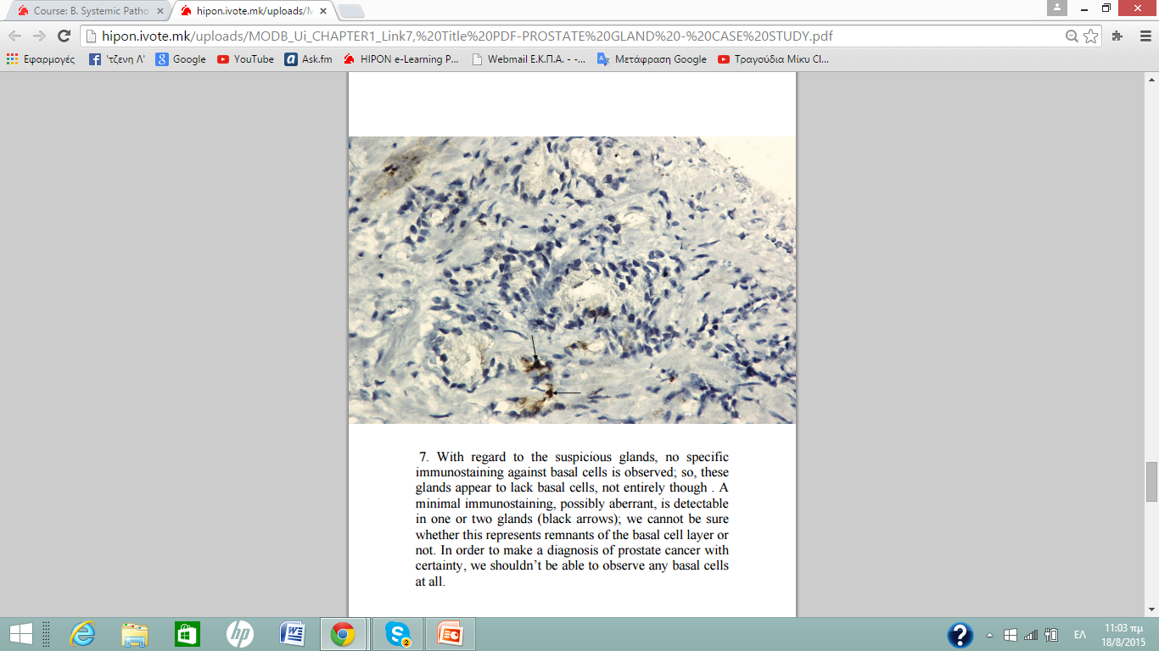
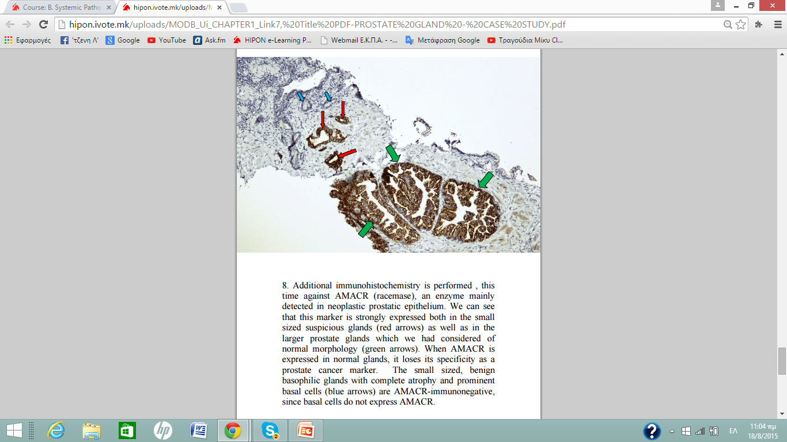
A step-by-step analysis of the correct diagnosis inductive reasoning.

Slide 33
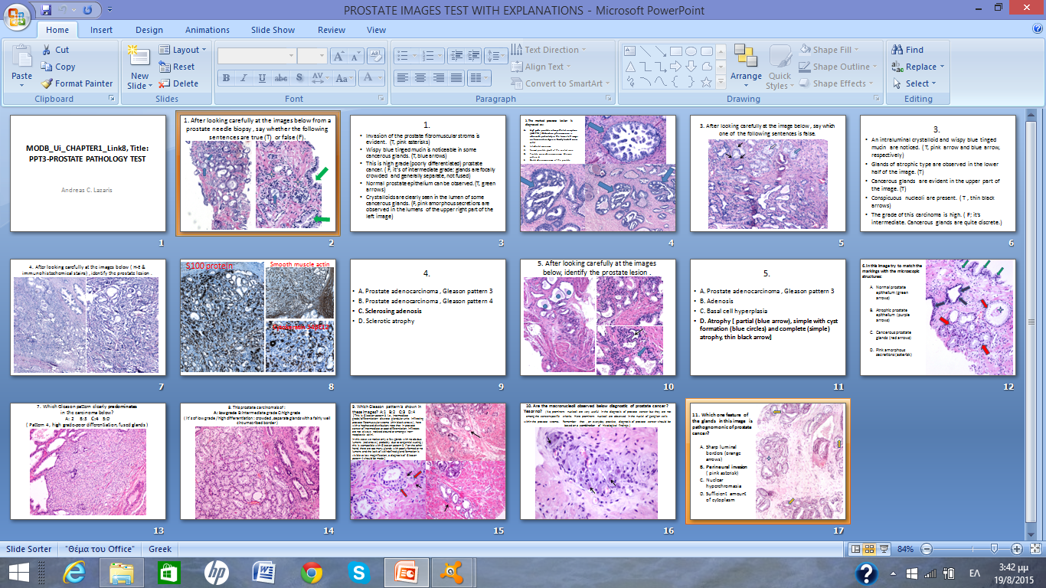
TEST ON IMAGES
AIMING AT CONSOLIDATING THE KNOWLEDGE
APPROACHED IN THE CHAPTER
Εxplanations
of all
answers,
available
as a link

Slide 34
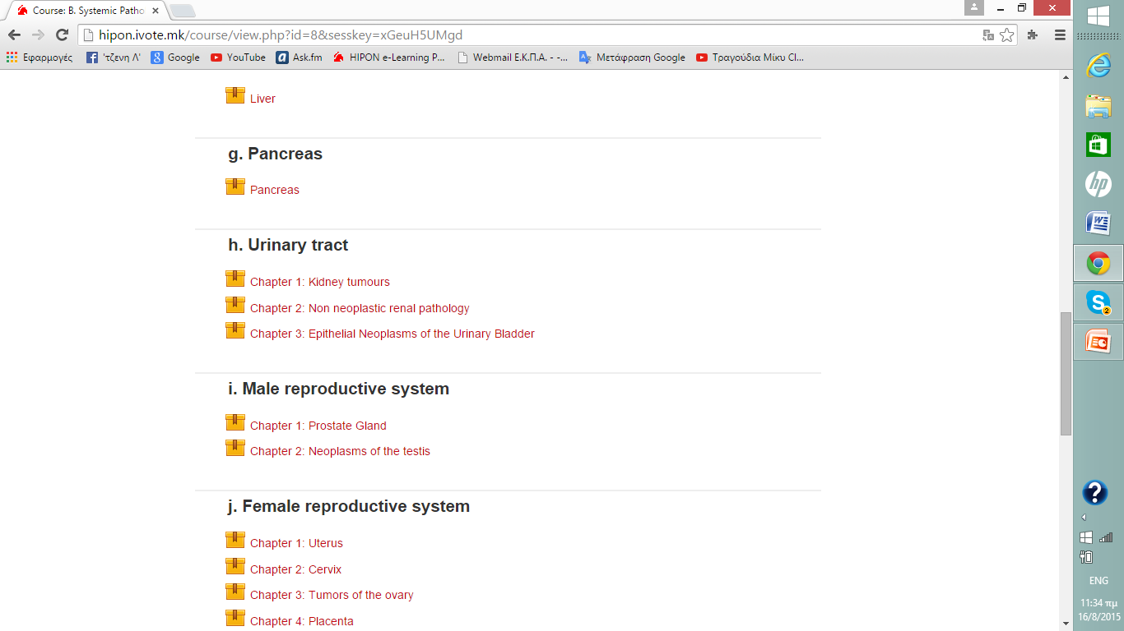
HIPON MODB - Unit h - Chapter 1: Kidney tumours

Slide 35
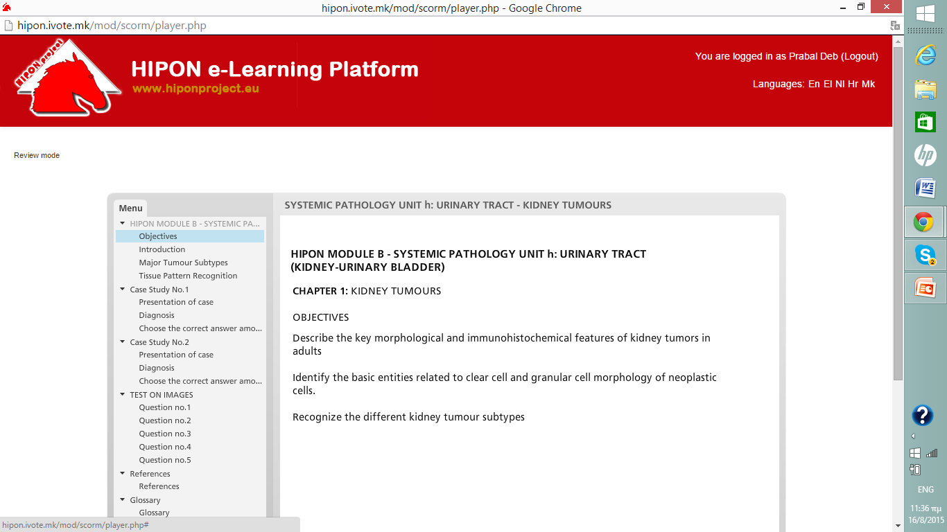
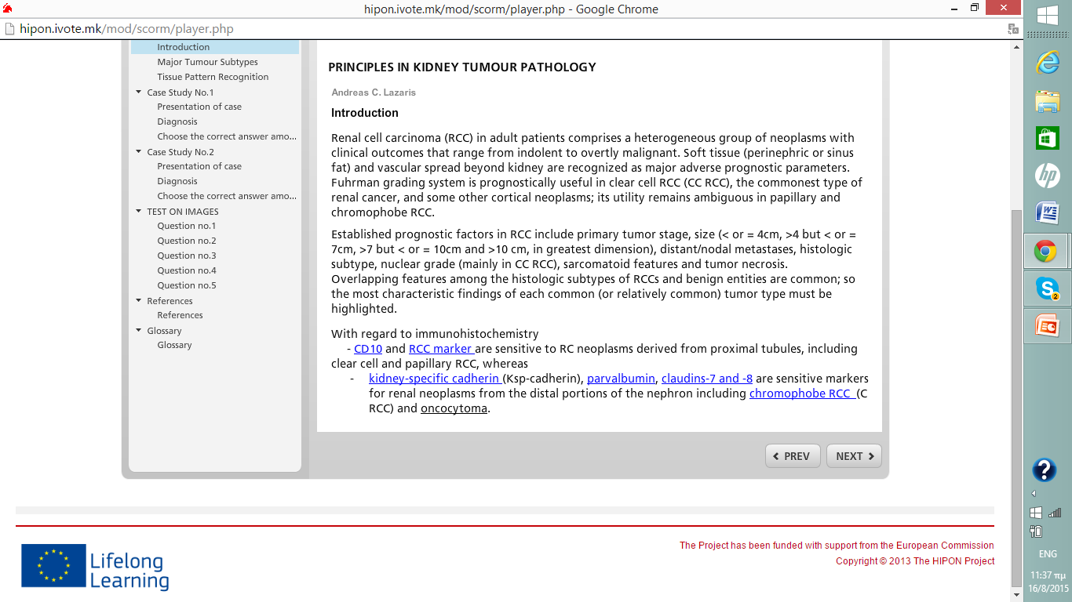
Unit h – Chapter 1: Βeginning of the theoretical section inside the chapter.
The conventional way of teaching/learning
is not neglected
in HIPON.

Slide 36
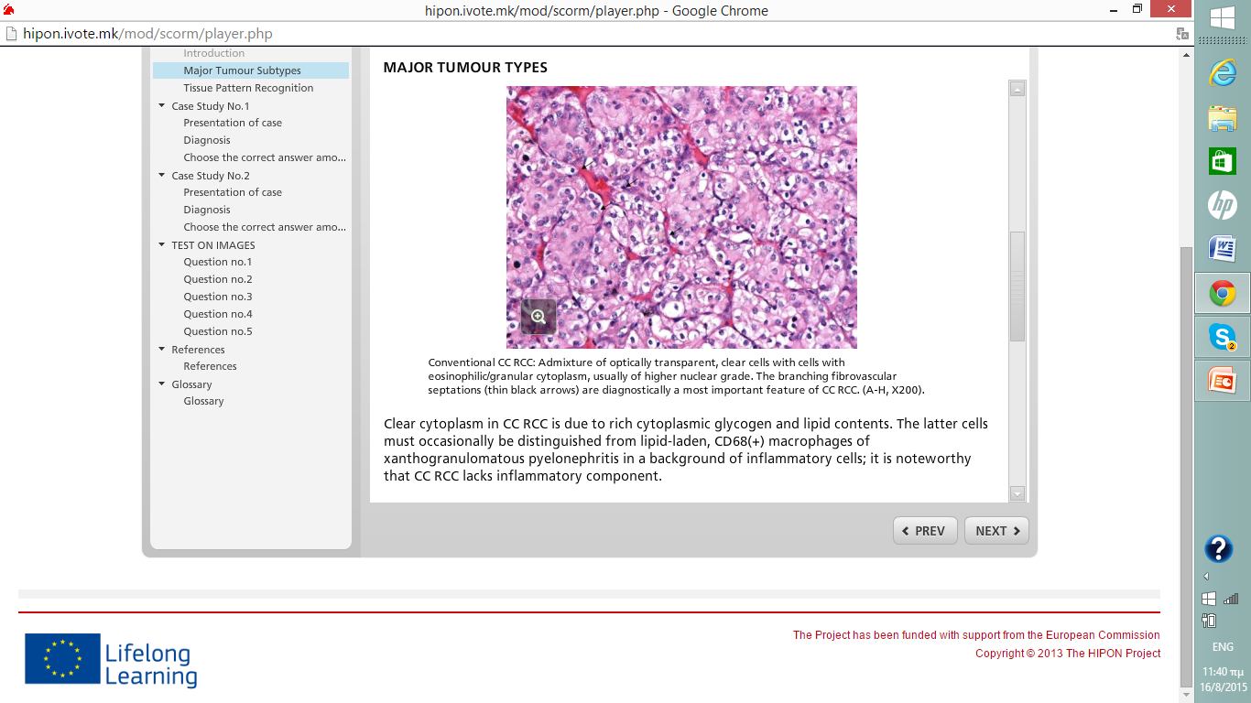
A concise and focused on the essentials development of the theoretical part.

Slide 37
HIPON Kidney tumours chapter. Glossary terms-resources-links clicks.

Slide 38
HIPON Kidney tumours chapter. Glossary terms-resources-links clicks.

Slide 39
Α video tutorial that highlights the key microscopic features of clear cell renal cell carcinoma.

Slide 40
Τhe video-corresponding digitalized slide, made available to HIPON users for study.
A pushing tumour border
Area of necrosis
“Water-clear” cytoplasm,
well developed fibrovascular septa around tumour nests

Slide 41
Recording of the step by step diagnostic approach of a kidney tumour. Assistive questions.

Slide 42
Simulation with the everyday concern for a proper diagnosis.

Slide 43
Selection of helpful markers

Slide 44
2 more right choices.

Slide 45
The useless options should be avoided not only for economic reasons but also for reasons of good scientific practice.

Slide 46
Time for decision!
Mistakes are actually opportunities for learning.
It’s obvious that if something in the diagnostic procedure goes wrong, there will be benefit in review and change.
This possibility is offered to HIPON platform users who can go back and retry the diagnostic test. At the end of each case, the correct as well as all the wrong alternative diagnoses are deftly analyzed.

Slide 47
A thorough analysis of the correct diagnosis and of the relative differential diagnoses at the end of each case presentation section .

Slide 48
Testing embedment of knowledge at the end of chapter.

Slide 49
True or false ?

Slide 50
Well done!

Slide 51
HIPON IMPACT
In order that the grounds and results of our efforts are promoted,
the following HIPON-related journal publications and conference speeches / announcements / papers have been carried out:
- Full paper publications
1. A Web-based Attempt to Acquire Professional Experience in Pathology: The HIPON Project. MedEdPublish 2013, www.mededworld.org .
2. HIPON Project: Acquiring Medical Experience through an E-learning Platform. A New Perspective in Pathology Education. New Perspectives in Science Education. Edition 4, 2015.
3. Learning Authentically through HIPON Platform. The Future of Education, 2015.
4. Acquiring experience in pathology predominantly from what you see, not from what you read: the HIPON e-learning platform. Advances in Medical Education and Practice 2015:6, 1-7.
5. Implementation of Experimental Learning in Pathology: Impact of HIPON Project Concept and Attainment. International Archives of Medicine 2015 Vol.8, No 211.
- Conference invited speeches on HIPON
25th European Congress of Pathology, Lisbon 2013.
9th International Forum of Medical Students and Young Doctors, Athens 2015
3. 27th European Congress of Pathology, Belgrade 2015.
Conference participations with abstracts
1. 25th European Congress of Pathology, Lisbon 2013. Abstract published in Virchows Archiv The European Journal of Pathology, Vol. 463, No 2: page227.
2. 26th European Congress of Pathology, London 2014. Abstract published in Virchows Archiv The European Journal of Pathology, Vol. 465, Suppl.1: pageS286.)
3. 38th European Congress of Cytopathology, Geneva, 2014.Abstract published in (Journal of ) Cytopathology, Vol. 25,Suppl.1,22-78.
4. 30th Congress of the International Academy of Pathology, Bangkok 2014. Selected by the Scientific Committee as one of the 17 out of 400 posters to be orally presented at a special session. Abstract published in Pathology Vol. 46, S2: page S124.
5. 39th European Congress of Cytopathology, Milan, 2015. Abstract published in Cytopathology Vol. 26, Suppl.1, 38-62.
6. 1st International Online BioMedical Conference (IOBMC 2015).
7. 26th ESC Medical Students' Conference, Berlin, 2015. Selected by the Scientific Committee for an additional presentation before a Professors’ Committee ( one amongst 20% of accepted abstracts ).

Slide 52
www.hiponproject.eu

Slide 53
HIPON perspectives
HIPON e platform was conceived and created in an earnest and conscientious attempt to record diagnostic expertise in Pathology interconnected with a pronounced educational benefit for its users, and is therefore worthy of enrichment.
A proposal of its insertion as a link at the educational portal of the ESP has been addressed to the ESP Education Subcommittee and is under consideration. The contribution of educational cases, structured according to HIPON template and principles, from the ESP working groups, preferably under the care of an ESP Education Subcommittee appointed representative, hopefully appears as an interesting perspective of HIPON expansion, provided there are colleagues who will truly believe in this endeavor and will seriously deal with it.

Slide 54
The theoretical background of HIPON
Learning is not just getting excellent grades in theory exams but getting useful skills.
Skills are developed partly unconsciously
as you soak up
the beliefs, attitudes and perceptions
of your environment.
An intelligence catalyst is an environment
that speeds up
your ability to learn.
If you need useful skills,
creating a catalyst is a must.
Learning by osmosis:
A need for
its instant enactment and institutionalizing.

Slide 55
Despite amazing advances in Information and Communication Technology (ICT), people remain the most important factor of your environment to influence your self-education.
By building relationships with people who have skills,
the beliefs, attitudes and perceptions they have, will rub off on you.

Slide 56
Despite the fact that experiential learning is not defined by the presence of a teacher/facilitator since its mechanism is the learner’s reflection on experience using analytical skills, the physical presence of a charismatic teacher remains indispensable
in the adventure of learning especially because it
decisively fosters the appeal for
achievement of knowledge.

Slide 57
Any teaching event will be more successful if the teacher:
is enthusiastic
has organized the session well
has a feeling for the subject
can conceptualize the topic
is able to create an active learning environment in his/her class
is able to understand and share the feelings of the learners
understands how people learn, according to the modern trends in teaching learning process.
has skills in teaching and managing learning
is alert to context and “classroom” events
is teaching with the preferred teaching style
helps the students feel a sense of ownership for what was learned.

Slide 58
Why do you think these students look so half-hearted, incurious, glum and dispirited?

Slide 59
Read your books, study the material and practice, practice, practice!
- Disinclination to share knowledge ( or anything else, actually…).
Profuse theorizing: exclusive learning of concepts and theories through study and reflection on the abstract.
A sense of mere routine processing
regarding teaching tasks.
Sloth and complacency.
Lack of concern, inspiration, creative flair or communication mood.
Νο transmissibility
of appeal for learning.
Unwillingness to implement innovative methods.
The only incentive for any educational endeavor is reciprocation, determined solely on the basis of the financial benefit of those involved.
A prolonged era of
humanistic values decline,
crowding out any spirituality.
From a sociological standpoint : general social trend and individuals’ propensity towards materialistic wealth accumulation (deification of consumerism, pointless comforts, obsession for luxurious living).
Certainly, their teacher
has something to do with this.

Slide 60
The teaching process is a sharing process.
What can a teacher actually share with his students?
Α passion for knowledge
Α positive worldview
A zest for a creative occupation
Α mood for
communication and offering

Slide 61
Losing interest in learning is a valid reason for protest aimed at upgrading teachers and teaching.
Why bother?
Life-changing teachers committed to excellence inspire and encourage students to strive for greatness and see the best in themselves.
Teachers are founts of experience; they have already been where their students are going, undergone what the latter will go through and are in a position to pass along lessons, not only regarding subject matter, but lessons on life.
Teachers should be reinventing themselves, their occupation, the tools and techniques they employ, their relationship with students in order to better serve schools and students.

Slide 62
Restoring interest in learning is an imperative.

Slide 63
Redefining educational needs. Students should also learn from experience.
Teachers know that in order to get students to truly take responsibility for their own education,
- the curriculum must relate to their lives; there must be “meaning for the student in the learning”
- learning activities must engage their natural curiosity and must be personally relevant to the student
- and assessments must measure real accomplishments and be an integral part of learning.
Today's world is awash in information from a multitude of print and electronic sources. The fundamental job of teaching is no longer to distribute facts but to help students learn how to use them by developing their abilities to think critically, solve problems, make informed judgments, and create knowledge that benefits both the students and society.

Slide 64
The conventional, formal approach to teaching. A current need for redefining the role of the teacher and his multifaceted profession beyond merely circulating information.

Slide 65
Reinventing the teacher’s role
Many teachers today are encouraged to adapt and adopt new practices that acknowledge both the art and science of learning.
They understand that the essence of education is a close relationship between a knowledgeable, caring adult and a secure, motivated student. They grasp that their most important role is to get to know each student as an individual in order to comprehend his or her personal qualities. Active learning methodologies are very effective to find out students creativity and talent.

Slide 66
Active involvement increases learning value
Imagine yourself
listening to a lecture.
Even if the content of the lecture is interesting to you, and the presenter does a reasonable job,
you may find your mind wandering.
This is because
the learning process,
which for a lecture is essentially one-way from the instructor as information provider to you as recipient,
does not require your active involvement to proceed.

Slide 67
Tuning in to how students really learn prompted HIPON educators to downgrade teaching that is primarily information-based in favor of instruction that challenges students to take an active role in learning through the interactive HIPON e platform and develop their abilities to think critically, solve problems and make informed judgments. Making something of this informal learning situation may indeed be initially confusing for a learner who is used to being “fed” information in lectures.

Slide 68
Experiential Learning is defined as Learning through Reflection on Doing.
Broadly, experiential learning is any learning that supports students in applying their knowledge and conceptual understanding to real-world problems or situations where the instructor/facilitator directs and facilitates learning.
In order that experiential learning of Pathology is literally conducted, a real Pathology lab should be at the learners’ disposal; I C T allowed us to create an online environment simulating that of actual daily Pathology practice. HIPON e-learning platform was designed to serve as an intelligence catalyst setting for experiential learning to the benefit primarily of medical students and residents in Pathology, through ICT-embedded activities such as virtual slides, case-based studies, guided inquiry, and simulations of everyday practice decisions. We took care to make the activities as real and engaging as possible.

Slide 69
By engaging in guided, authentic,
real-world experiences, individuals:
-deepen their knowledge through repeatedly acting and then reflecting on this action,
-develop skills through practice and reflection,
-support the construction of new understandings when placed in novel situations, and
-extend their learning as they bring their learning back to the classroom.

Slide 70
Why is experiential learning important?
- Experiential learning teaches students the competencies they need for real-world success.
- Experiential learning motivates students.
Experiential learning provides the conditions for optimally supporting student learning. When students are engaged in learning experiences that they see the relevance of, they have increased motivation to learn. Students are also motivated when they are provided opportunities for practice and feedback.
- Experiential learning creates self-directed learners.
Through experiential learning, students are confronted with unfamiliar situations and tasks in a real-world context. To complete these tasks, students need to figure out what they know, what they do not know, and how to learn it. This requires students to: reflect on their prior knowledge and deepen it through reflection; transfer their previous learning to new contexts; master new concepts, principles, and skills; and be able to articulate how they developed this mastery. Ultimately, these skills create students who become self-directed, life-long learners.

Slide 72
How does experiential learning work?
The experiential learning process includes the integration of:
knowledge—the concepts, facts, and information acquired through formal learning and past experience;
activity—the application of knowledge to a “real world” setting ;
and
reflection—the analysis and synthesis of knowledge and activity to create new knowledge.
( HIPON MODB chapters’
theoretical parts)
(HIPON case presentations,
virtual slides, decision making)
( HIPON Histo-book )

Slide 73
What does experiential learning look like? (I)
Experiences are carefully chosen for their learning potential (i.e. whether they provide opportunities for students to practice and deepen emergent skills, encounter novel and unpredictable situations that support new learning, or learn from natural consequences, mistakes, and successes).
Throughout the experiential learning process, the learner is actively engaged in posing questions, investigating, experimenting, being curious, solving problems, assuming responsibility, being creative, and constructing meaning, and is challenged to take initiative, make decisions and be accountable for results.
( HIPON case presentations, online game)
( HIPON Histo-book, case presentations and online game)

Slide 74
What does experiential learning look like? (II)
Reflection on learning during and after one’s experiences is an integral component of the learning process. This reflection leads to analysis, critical thinking, and synthesis.
Learners are engaged intellectually, emotionally, socially, and/or physically, which produces a perception that the learning task is authentic.
Relationships are developed and nurtured: learner to self, learner to others, and learner to the world at large. Learners discuss how issues raised can be useful in future situations.
( HIPON Histo-book,
social media HIPON pages)

Slide 76
Α distinct teaching strategy - Α distinct teacher’s role.
- Teaching is an activity which is helping the student in learning. Teaching and learning are being modified due to innovations in education. Teachers have to understand the modern trends in teaching-learning process and make learning more interesting and interactive, so that students may be motivated to learn and learn better, after having personally experienced the value of a subject.
- By implementing experiential learning, there is a move to a more student-centered view of learning which has required a fundamental shift in the role of the medical teacher. No longer is the teacher seen predominantly as a provider of information, but rather as a facilitator or manager of the student’s learning; the learner is the self-teacher.
- Students must take control of their own learning. In the experiential learning procedure, the “instructor” is a guide, a cheerleader, a resource, and a support. Suitable experiences are carefully chosen for their learning potential by the teacher who commences the experience and guides students through the process of finding and determining solutions for themselves.

Slide 77
During experiential learning, the facilitator’s role is to:
-Select suitable experiences that meet the criteria above.
-Pose problems, set boundaries, support learners, provide suitable resource, ensure physical and emotional safety, and facilitate the learning process.
-Recognize and encourage spontaneous opportunities for learning, engagement with challenging situations, experimentation (that does not jeopardize the wellbeing of others) and discovery of solutions.
-Help the learner notice the connections between one context and another, between theory and the experience and encouraging this examination repeatedly.

Slide 78
The teacher as a facilitator of learning
Making the shift from teacher as expert to facilitator is sometimes seen as diminishing a teacher’s power and authority, but this should not be the case.
Facilitating learning is empowering for both the learner and the teacher and frees the teacher from many of the burdens that having to be an ‘expert’ might entail. It would traditionally have been seen as a weakness for a teacher to say ‘I don’t know, let’s find out’ or ‘I don’t know, do any of you students know the answer?’ and clearly clinical teachers need to know more about many topics than their students or trainees, but medical science is changing so rapidly that no one can know everything. Implementing an evidence-based approach to clinical learning and to medical practice involves finding out about the latest research. Teachers can use these techniques and this approach to facilitate their own and their students’/trainees’ learning.

Slide 79
The introduction of experiential learning based on real cases, as presented in HIPON, is directly related to this fundamental change in the student-teacher relationship. In HIPON case presentations, practical teachers share with the user their thoughts as reflective practitioners, helping to illuminate, for the student, the process of clinic-pathologic diagnosis making. In this regard, the educator’s most important responsibility is to search out and construct meaningful educational experiences that allow students to solve real-world problems; the result is that any abstract, inert knowledge that students used to memorize from dusty textbooks …

Slide 80
comes alive as they participate in the practical application of knowledge. Experiential activities must allow the students to make connections between the learning they are doing and the world. Where one gets in touch with specific areas of knowledge from a teacher, one really learns how to implement that knowledge, how to live it, from a so called “mentor”.

Slide 81
Instructor Roles in Experiential Learning
In experiential learning, the instructor guides rather than directs
the learning process where students are naturally interested in learning. The instructor assumes the role of facilitator and is guided by a number of steps crucial to experiential learning .
Be willing to accept a less teacher-centric role in the classroom.
Approach the learning experience in a positive, non-dominating way.
Identify an experience in which students will find interest and be personally committed.
Explain the purpose of the experiential learning situation to the students.
5. Share your feelings and thoughts with your students and let them know that you are learning from the experience too.
6. Tie the course learning objectives to course activities and direct experiences so students know what they are supposed to do.
7. Provide relevant and meaningful resources to help students succeed.
8. Allow students to experiment and discover solutions on their own.
9. Find a sense of balance between the academic and nurturing aspects of teaching.
10. Clarify students’ and instructor roles.

Slide 82
Student Roles in Experiential Learning
Qualities of experiential learning are those in which students decide themselves to be personally involved in the learning experience (students are actively participating in their own learning and have a personal role in the direction of learning). Students are not completely left to teach themselves; however, the instructor assumes the role of guide and facilitates the learning process.
Students will be involved in problems which are practical, social and personal.
Students will be allowed freedom in the classroom as long as they make headway in the learning process.
Students often will need to be involved with difficult and challenging situations while discovering.
Students will self-evaluate their own progression or success in the learning process which becomes the primary means of assessment.
Students will learn from the learning process and become open to change. This change includes less reliance on the instructor and more on fellow peers, the development of skills to investigate (research) and learn from an authentic experience, and the ability to objectively self-evaluate one’s performance.

Slide 83
Experiential Learning
Selected References
-Ambrose, S. A., Bridges, M. W., DiPietro, M., Lovett, M. C., & Norman, M. K. (2010). How learning works: 7 research-based principles for smart teaching. San Francisco, CA: Jossey- Bass. -Association for Experiential Education. (2007-2014). Retrieved from http://www.aee.org/. -Bass, R. (2012, March/April). Disrupting ourselves: The problem of learning in higher education. EDUCAUSE Review, 47(2). -Boud, D., Cohen, R., & Walker, D. (Eds.). (1993). Using experience for learning. Bristol, PA: Open University Press. -Indiana University. (2006). Experiential learning notations on Indiana University official transcripts. Retrieved from http://registrar.iupui.edu/experiential-learning.html. -Kolb, D. A. (1984). Experiential learning: Experience as the source of learning and development. Englewood Cliffs, NJ: Prentice-Hall.
-Lave, J., & Wenger, E. (1991). Situated learning: Legitimate peripheral participation. New York: Cambridge University.
-Linn, P. L., Howard, A., and Miller, E. (Eds). (2004). The handbook for research in cooperative education and internships. Mahwah, NJ: Lawrence Erlbaum Associates. -Moore, D. T. (2010). Forms and issues in experiential learning. In D. M. Qualters (Ed.) New Directions for Teaching and Learning (pp. 3-13). New York City, NY: Wiley. -Schon, D. (1983). The reflective practitioner: How professionals think in action. New York City, NY: Basic books. -The University of Texas at Austin College of Natural Sciences. (2013). Freshman Research Initiative Retrieved from http://cns.utexas.edu/fri. -Wurdinger, D. D., & Carlson, J. A. (2010). Teaching for experiential learning: Five approaches that work. Lanham, MD: Rowman & Littlefield Education.

Slide 84
Comparisons
Experiential learning is most easily compared with conventional, formal, academic learning, the process of acquiring information through the study of a subject without the necessity for direct experience. While the dimensions of experiential learning are analysis, initiative, and immersion, the dimensions of academic learning are constructive learning and reproductive learning.
Though both methods aim at instilling new knowledge in the learner, academic learning does so through more abstract, classroom-based techniques, whereas
experiential learning actively involves the learner in a concrete experience; experiential activities are actually so interactive and dynamic, there are innumerable ways learning activities can turn out, especially in vocational education.

Slide 85
Differences between conventional , academic training and teaching and experiential learning.
Conventional training | Experiential learning
training-centred/focused - theoretical | learner-centered/focused - really doing it
prescribed fixed design and content | flexible open possibilities
for external needs (organisation, exams, etc) | for internal growth and discovery
transfers/explains knowledge/skills | develops knowledge / skills / emotions via experience
fixed structured delivery/facilitation | not delivered, minimal facilitation, unstructured
timebound measurable components (mostly) | not timebound, more difficult to measure
suitable for groups and fixed outcomes | individually directed, flexible outcomes
examples: powerpoint presentations, chalk-and-talk classes, reading, attending lectures, exam study, observation, planning and hypothesising, theoretical work, unreal role-play. | examples: learning a physical activity, games and exercises, drama and role-play which becomes real, actually doing the job or task, 'outward bound' activities, teaching others, hobbies, pastimes, passions.

Slide 86
It is a fact, however, that formal teaching, is in no way uneducative ab initio, and has certainly been well served in many cases by inspired and effective educators.

Slide 87
Therefore, traditional teacher’s roles are also apparent in HIPON platform, at a slightly secondary level, though:
-information acquired through formal learning and past experience and always directly relevant to the practice of pathology is provided in the theoretical section of each Systemic Pathology HIPON chapter and remains to be skillfully applied to the following “real world” setting of the cases’ diagnosis section. After all, a teacher remains to some degree a person who at first imparts to the student a given body of information (in addition to skill and capability); then, of course, the teacher should provide the student with valuable opportunities to apply theory to practice.
-the role of teacher as resource material developer is evident in the selected references and web pages links of each HIPON chapter. Implementing an evidence-based approach to pathology learning and practice involves finding out about the latest research and propose it as studying material.
-the assessment of the users’ competence is possible through the image-based, stimulating tests at the end of each Systemic Pathology chapter.

Slide 88
Εxperiencing the light of knowledge
Το sum up, teachers in general increasingly understand that they must
inspire a love of learning and share a positive world view and perception.
They no longer see their primary role as a benevolent dictator deciding what's best for the powerless underlings in their care. They've found they accomplish more if they somehow adopt the role of
educational guides, facilitators in learning,
and co-learners.

Slide 89
The most complete answer to the question:
“Why should one teach?”
is simple and concise:
“ Teach to make a difference”.
How, where and to whom one makes a difference is up to him/her.
HIPON partners have frankly attempted to make a difference in pathology teaching through HIPON e platform in which students decide themselves to be personally involved in the learning, practical, problem-solving experience. Students learn through student -rather than instructor- centered experiences by doing, discovering, reflecting and applying. Through these simulating experiences students develop communication skills and self-confidence, and gain and strengthen decision making skills by responding to and solving real world problems and processes. Thereby, when they next find themselves in an environment that presents a challenge like the challenge presented in the simulation, they will more readily recall that experience and the things that they have learned from it.

Slide 90
Experiential learning institutional establishment ( alongside formal / academic learning ) is a contemporary necessity.
A promising smile on students’ face
I hear and I forget, I see and I remember, I do and I understand.
Confucius, 450 BC
Tell me and I forget,
Teach me and I remember, Involve me and I will learn.
Benjamin Franklin, 1750
There is an intimate and necessary relation between the process of actual experience and education.
John Dewey, 1938

