Slide 1
Latvia
Policies of the EU member states / Winter semester 2023 / Julia Beuerle

Slide 2
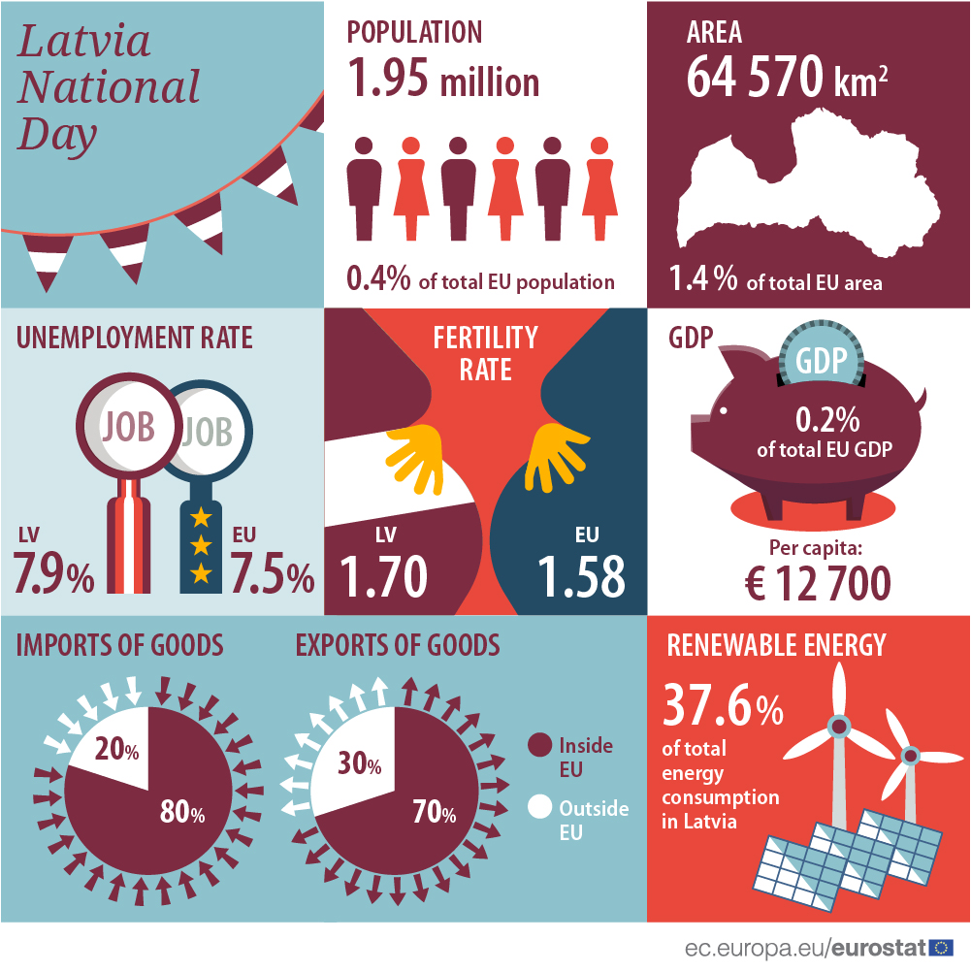
Outline
Country profile
History
National politics
Euroscepticism
Why and What Europe?
Economic crisis and Eurozone
Russia-Ukraine war
(Data from 2017)

Slide 3
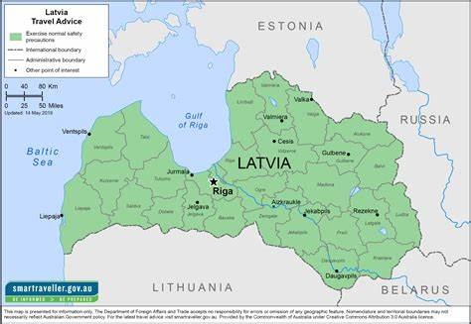
1. Country profile
Capital: Riga
283 km of border with Russia
Territory of 64,5 thousand square kilometer
Population of 1,83 million
A quarter of the population is Russian
GDP per capita: 74% of GDP in PPS
Fifth lowest in the EU
Services 74%, Industry 22%, Agriculture 4%
Intra-EU trade: 62% of exports and 76% of imports
In the EU mostly Baltic countries and Germany
14% of their imports come from and 7% of exports go to Russia

Slide 4
2. History
1920: First independence after Russian rule and two years of War of Independence
1940: Annexation to the Soviet Union
WW II: Invasion of Nazi Germany in 1941 → Strategic role between Germany and the Eastern world
Return of Soviet Red army in 1944
Several decades under the strict Soviet regime: Many Russians settling in Latvia
1988: Start of democratic movement and anti-Soviet demonstrations
1991: Declaration of independence after 73% voted in favour in a referendum
1995: Application for EU membership
2004: Latvia joins the EU and NATO
2007: Latvia joins the Schengen area
2014: Latvia joins the Eurozone

Slide 5
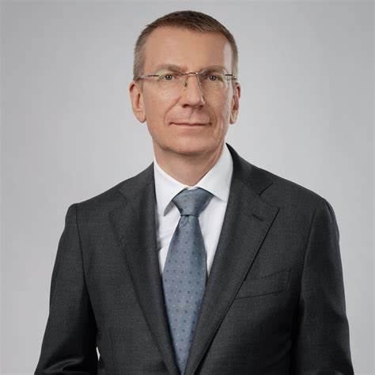
3. National politics
Parliamentary republic with the prime minister as head of government and the president as head of state
Saeima: Latvian parliament with 100 members
Multi-party system, several changes and electoral alliances
National elections in 2022
Russian war as the main topic
New Unity Party won
Karins stepped down as prime minister in 2023 after disputes in the coalition
President: Edgar Rinkevics
Prime Minister: Evika Silina
Policies of the EU member states / Jullia Beuerle

Slide 6
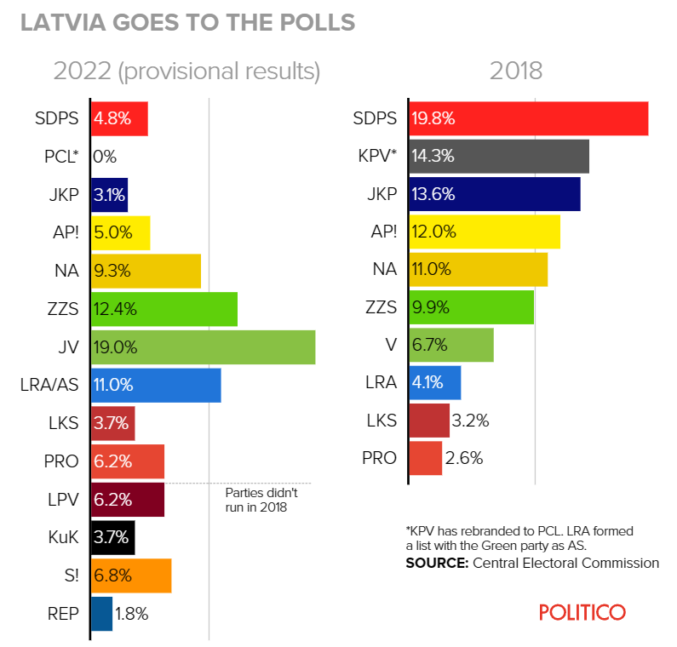
3. National politics
Current coalition (since 2023):
JV: New Unity
ZZS: Union of Greens and Farmers
PRO: The Progressives
Others:
JKP: The Conservatives
LRA/AS: United List/ Latvian Association of Regions
→ 5% electoral threshold

Slide 7
3. National politics
Pro Russian parties:
SDPS: Social Democratic Party Harmony
LKS: Latvian Russian Union
S!: For Stability!
→ Important change: Harmony party lost all its seats in parliament in 2022 elections
Eurosceptic parties:
KPV: Who owns the state?
NA: National Alliance
LPV: Latvia First

Slide 8
3. National politics
European parliament groups
Social Democratic Party Harmony: Progressive Alliance of Socialists and Democrats (S&D)
Latvian Russian Union: The Greens/ EFA
Development/For!: Renew Europe
New Unity: European‘s People Party (epp)
NA: National Alliance: European Conservatives and Reformists (ECR)
Total of 8 seats in European Parliament:
1 each of The Greens/EFA and Renew Europe and 2 each of S&D, epp and ECR

Slide 9
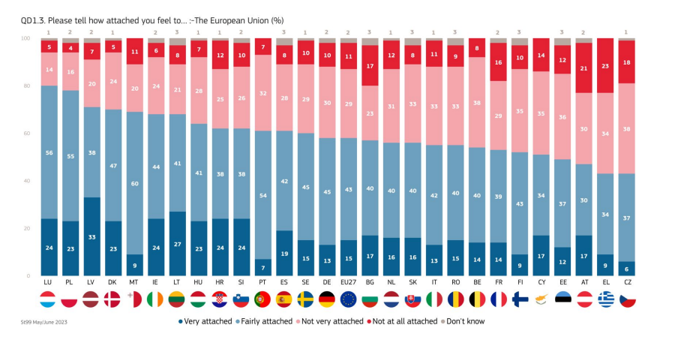
4. Euroscepticism

Slide 10
4. Euroscepticism
Hard Euroscepticism
24% think Latvia could face a better future outside of the EU
Below EU average of 30%
Soft euroscepticism
23% think things are currently going in the wrong direction in the EU
Lowest percentage in the EU (average is 48%)

Slide 11
5. Why and What Europe?
Reasons to join the EU
Development of the national economy
Further strengthening their independence from Russia
Stability and security in Latvia
EU as an international player in dealing with global crises
Possibility for a small country to project power
In a referendum 2003 about EU membership 67% of the Latvians voted in favour
Baltic states had more support in entering the EU by EU citizens at that time than other Soviet Republics

Slide 12
5. Why and What Europe?
What kind of Europe
Latvia held the presidency of the Council of the European Union from January till June 2015
Supports further enlargement and EU integration
Engaged in the accession talks with Ukraine and Moldova
Strong common security and defence policy
Ability to show united strength for example towards Russia
Called for a stricter course against Russia already before the war but especially France was against further measures
Wants to strengthen the EU‘s cooperation with Central Asia
Call for a more active role of the EU in the crisis in the Middle East
→ United Europe, military strength and active intervention in crises

Slide 13
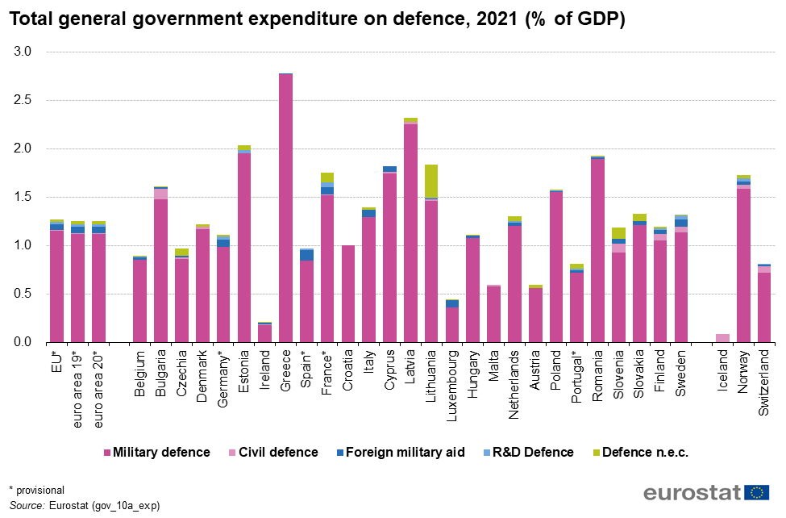
5. Why and What Europe
Already in 2021 Latvia had the second highest percentage of GDP spend on defence
Further increased their military spending since then
Further rise up to 3% of GDP in 2027 planned
Decision to reinstall military service in 2023

Slide 14
6. Economic crisis and Eurozone
Latvia had the worst depression among EU countries with a shrinking of the economy of 17,7% in 2009
Sharp rise of emigration rate: 9,1% of the population left the country from 2009 to 2013
Mostly driven by economic factors and growing poverty
Latvian politicians were pushing for the country‘s Eurozone membership
During the crisis they had to decide if they would stick to that plan or devalue the lat
Despite potential massive damage for the Latvian economy and decreasing wages they continued their way into the Eurozone
Polling in 2013 showed that 62% of the Latvians were against implementing the Euro
Fear of bailouts and paying for richer countries dept
Political choice that reflects their dedication for Europe

Slide 15
7. Russia-Ukraine war
„The only way to get peace is to ensure that Russia loses the war.“ – Former PM Krisjanis Karins
Russian independent TV channel that started working from exile in Latvia in February 2022
Was banned a few months later due to several Russian propaganda efforts
Russian community in Latvia (25% of the population) is affected by a lot of disinformation
Lowered economic growth in Latvia and caused problems with Russian gas supply
Latvian politicians repeatedly call for more military help and support for Ukraine from other EU countries
Military strength as crucial in facing Russia
Continuation or increase of sanctions against Russia

Slide 16
7. Russia-Ukraine war
The three Baltic states were the first ones to declare the Russian regime a terrorist state
Demolition of war monuments glorifying the Red Army‘s victory and thus Russia‘s war crimes in 2nd WW in all Baltic countries
A protest by the Russian community was not permitted by the authorities
Travel restriction for Russian citizens with Schengen visas through Baltic borders
No full ban because Finland wanted to wait for a decision on EU level

Slide 17
Sources
Latvia - The World Factbook (cia.gov)
Latvia – EU member country profile | European Union (europa.eu)
Latvia marks 18 years of its membership in the European Union | Ārlietu ministrija (mfa.gov.lv)
Lettland | bpb.de
Vor 30 Jahren: Estland und Lettland erklären Unabhängigkeit | Hintergrund aktuell | bpb.de
Facts and figures, EU demographics | European Union (europa.eu)
Latvia - The World Factbook (cia.gov)
Latvia – EU member country profile | European Union (europa.eu)
Latvia - The World Factbook (cia.gov)
POLITICO Poll of Polls — Latvian polls, trends and election news for Latvia – POLITICO
Lettland (LVA) | bpb.de
Latvia country profile - BBC News
2022 Latvian parliamentary election - Wikipedia
https://www.politico.eu/article/evika-silina-is-latvias-new-prime-minister/
Latvia parliament approves new broad coalition government – EURACTIV.com
Structure | Ārlietu ministrija (mfa.gov.lv)
Evika Siliņa is Latvia’s new prime minister – POLITICO
Latvia country profile - BBC News
POLITICO Poll of Polls — Latvian polls, trends and election news for Latvia – POLITICO
Parlamentswahl in Lettland 2022 | Hintergrund aktuell | bpb.de
European Union | Ārlietu ministrija (mfa.gov.lv)
Party of Latvia PM Kariņš wins election, provisional results show – POLITICO
Lettland (LVA) | bpb.de
Opinion des citoyens et des managers sur: adhesion des États baltes et des Republiques sovietiques à la CEE; Initiatives CE en Yougoslavie, Reforme sur la politique agricole commune; greves de l'été à la Commission - Oktober 1991 - - Eurobarometer survey (europa.eu)
A study on “Future of Europe – Latvia’s Viewpoint” reveals people’s opinions on EU-related priorities | Ārlietu ministrija (mfa.gov.lv)
EU-Russia relations expected to get even worse, says bloc’s top diplomat | European Union | The Guardian
Latvia marks 18 years of its membership in the European Union | Ārlietu ministrija (mfa.gov.lv)
A group of EU states formally express concerns over Macron’s Russia comments – Euractiv
Macron’s Russia dialogue to be tested on Baltic trip – POLITICO
National Alliance (Latvia) – Wikipedia
Social Democratic Party "Harmony" – Wikipedia
Development/For! – Wikipedia
Latvian Russian Union – Wikipedia
New Unity – Wikipedia
For Latvia, euro still attractive despite Europe's financial crisis | Latvia | The Guardian
Latvia becomes 18th state to join the eurozone - BBC News

Slide 18
Sources
Grenze zwischen Lettland und Russland – Wikipedia
Latvia’s Crisis: Eurozone Membership is the Answer (ft.com)
For Latvia, euro still attractive despite Europe's financial crisis | Latvia | The Guardian
Latvia – Immigration, Emigration, Diaspora | Northern Europe | bpb.de
Coordination of the European Union Affairs in Latvia | Ārlietu ministrija (mfa.gov.lv)
Latvia’s Presidency of the Council of the EU | Ārlietu ministrija (mfa.gov.lv)
Security and Defence Policy | Ārlietu ministrija (mfa.gov.lv)
File:Total general government expenditure on defence, 2021 (% of GDP).png - Statistics Explained (europa.eu)
Latvia set to join eurozone next year (ft.com)
Latvia’s Crisis: Eurozone Membership is the Answer (ft.com)
For Latvia, euro still attractive despite Europe's financial crisis | Latvia | The Guardian
Latvia – Immigration, Emigration, Diaspora | Northern Europe | bpb.de
For Latvia, euro still attractive despite Europe's financial crisis | Latvia | The Guardian
Latvia becomes 18th state to join the eurozone - BBC News
Latvia shuts down exiled Russian TV channel Dozhd – POLITICO
Russia’s exiled TV Rain licensed in Netherlands after Latvian removal – EURACTIV.com
Russia’s ‘cynical’ actions at border aim to sow discord, Finland says – POLITICO
Latvian PM: ‘Russia has to lose’ – POLITICO
West must brace for years of Putin pressure on Ukraine, Latvian PM says – POLITICO
Latvia’s foreign minister wants planes for Ukraine — and sees ‘momentum’ – POLITICO
More EU countries threaten to close Russian borders amid migrant surge – POLITICO
‘If a war starts, they will come here first’: Latvia mounts a wary border watch – POLITICO
Latvia to reinstate compulsory military service amid Russia’s war on Ukraine – POLITICO
Gazprom cuts gas supplies to Latvia – POLITICO
‘Call a spade a spade’ — Latvia urges terror sponsor label for Russia – POLITICO
Estonian parliament declares Russia a terrorist state – POLITICO
Latvia to topple Soviet war monument – POLITICO
Estonia, Latvia, Lithuania to restrict entry of Russians – POLITICO
Surveys - Eurobarometer (europa.eu)
The euro area - November 2023 - - Eurobarometer survey (europa.eu)
Microsoft Word - 2-03062005-en-bp.doc (europa.eu)
History of Latvia: A brief synopsis (mfa.gov.lv)

Slide 19
Image sources
Скачать - Флаг Латвии | Flagistrany.ru
Eurostat celebrates Latvia - Products Eurostat News - Eurostat (europa.eu)
Latvia Travel Advice & Safety | Smartraveller
Valdībā (jaunavienotiba.lv)
Evika Siliņa (jaunavienotiba.lv)
Krišjānis Kariņš (jaunavienotiba.lv)
POLITICO Poll of Polls — Latvian polls, trends and election news for Latvia – POLITICO
Parliament's seven political groups | News | European Parliament (europa.eu)
Surveys - Eurobarometer (europa.eu)
File:Total general government expenditure on defence, 2021 (% of GDP).png - Statistics Explained (europa.eu)

