Slide 1
Sweden
Svetlana Kováčová
The European Policies of the EU Member- States

Slide 2
Overview
Capital
Stockholm
EU member country
since 1 January 1995 (the 4. enlargement)
Currency
Swedish crown ( referendum in 2003- 55.9% rejected the euro, in 2021 it was almost 76%)
Schengen area
member since 25 March 2001

Slide 3
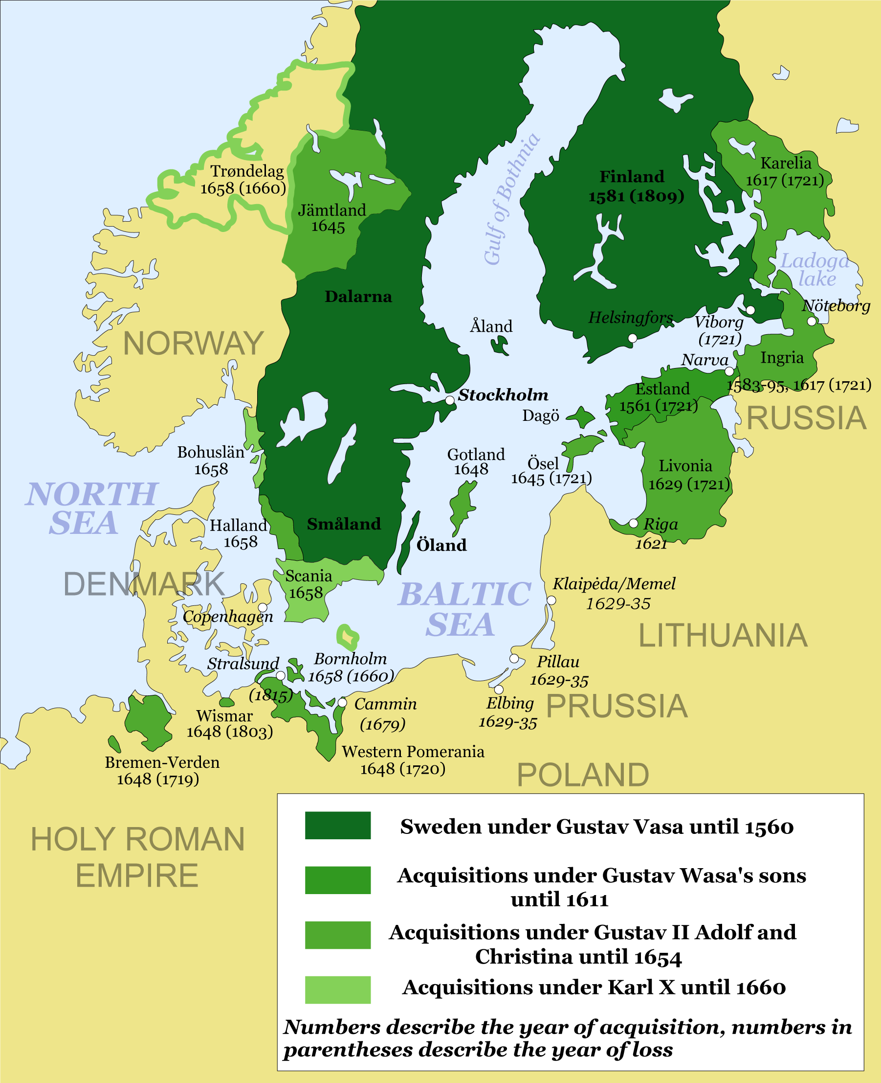
History of Sweden
Swedish empire
17th and early 18th century
Sweden became a European great power that exercised territorial control over much of the Baltic region
During the 17th century, despite having scarcely more than 1 million inhabitants, Sweden emerged to have greater foreign influence
→ after winning wars against Denmark–Norway, the Holy Roman Empire, Russia, and the Polish–Lithuanian Commonwealth
Its contributions during the Thirty Years' War under Gustavus Adolphus helped determine the political, as well as the religious balance of power in Europe

Slide 4
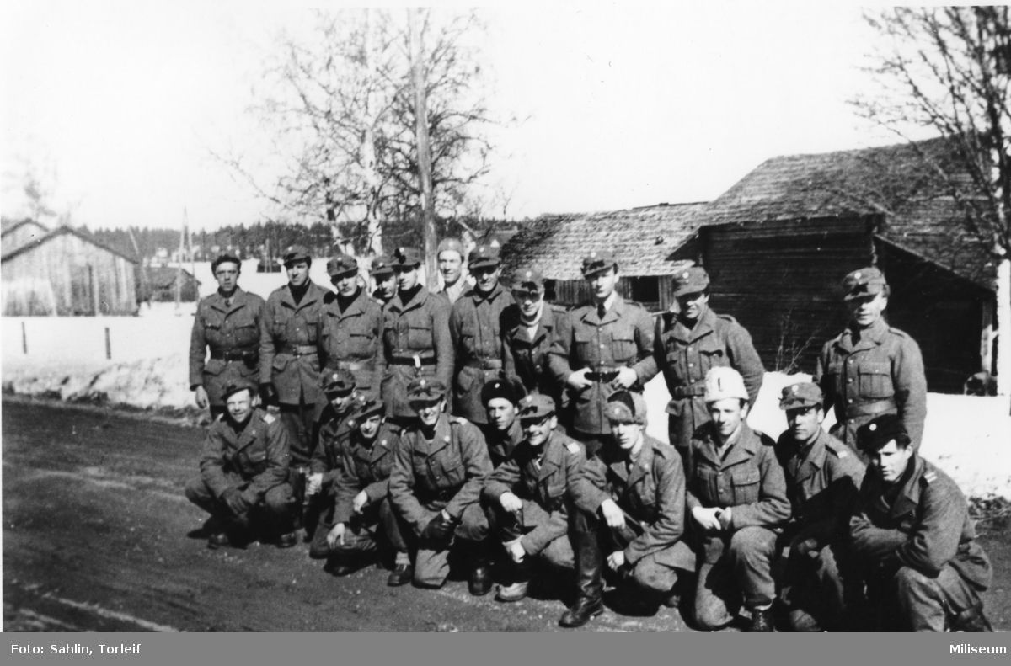
Emigration 1850-1930
Sweden was a poor country with poor people at that time
Farming in Sweden was difficult, particularly in the region of Småland due to large stones in the fields
Farmers heard about cheap land in the USA, so many of them emigrated (Minnesota)
World War I 1914-1918 / World War II 1939-1945
Sweden remained neutral

Slide 5
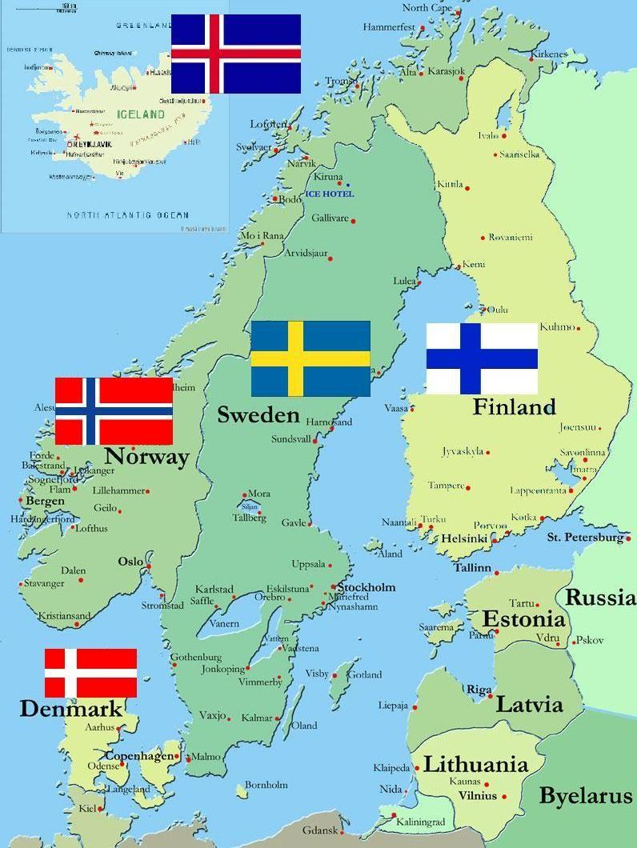
Political system
a constitutional monarchy and parliamentary democracy
Sweden in the EU
*are calculated by measuring the price of certain goods and services in each country relative to income in that country. This is done using a common national currency called the purchasing power standard (PPS). Comparing gross domestic product (GDP) per inhabitant in PPS provides an overview of living standards across the EU
21 seats in the European Parliament
Living standards

Slide 6
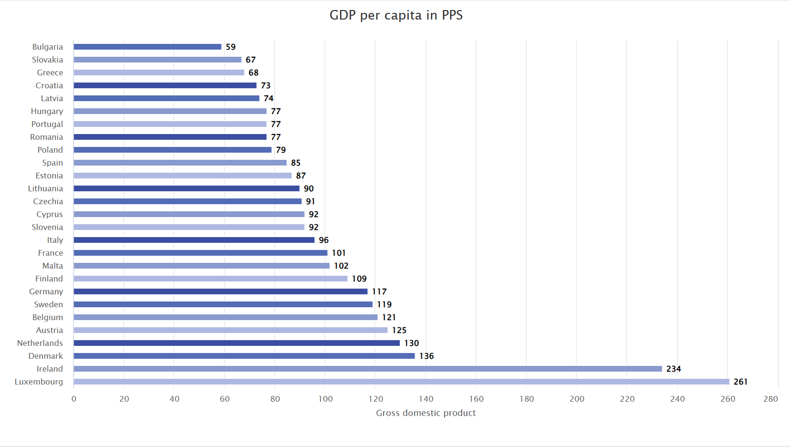
GDP per capita in PPS

Slide 7
Trade and economy
public administration, defence, education, human health and social work activities (21.6%), industry (17.1%) and wholesale and retail trade, transport, accommodation and food services (16.6%)
The most important sectors of Sweden’s economy
Exports
Intra-EU trade accounts for 52% of Sweden’s exports (Germany 11%, Denmark 8% and Finland 7%), while outside the EU 11% go to Norway and 8% to the United States
Imports
68% come from EU countries (Germany 18%, the Netherlands 10% and Denmark 7%), while outside the EU 9% come from Norway and 6% from China.

Slide 8
Euroscepticism
Sweden is a Eurosceptical country
The Sweden Democrats try to reform first, and then leave the EU
Elections 2022:
→Sweden Democrats stood at 21.5%, compared to the Moderate’s 17.4%, pitting the eurosceptic party only behind the ruling Social Democrats, who stood at 27.8%

Slide 9
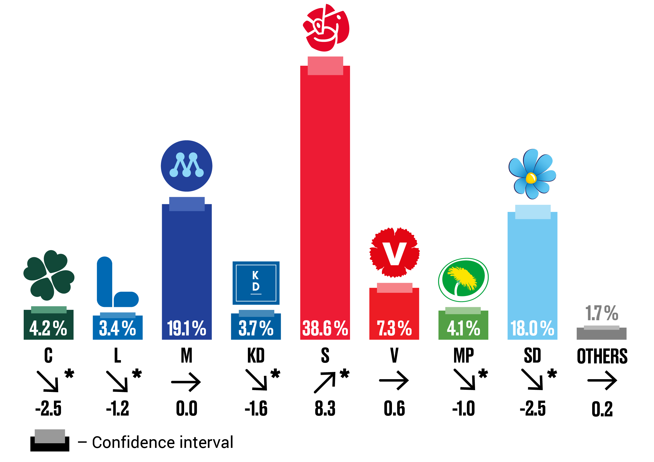
The Political Party Preference Survey presents election results if a parliamentary election were held in May 2023, as well as changes since November 2022 and since the 2022 parliamentary election
Social Democratic Party (S): 38.6 percent ± 1.3 percentage point Moderate Party (M): 19.1 percent ± 1.0 percentage point Sweden Democrats (SD): 18.0 percent ± 1.0 percentage point

Slide 10
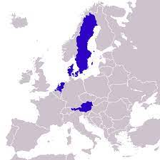
The Frugal Four
The nickname of an informal cooperation among like-minded fiscally conservative European countries
Austria, Denmark, the Netherlands and Sweden
It partly evolved to make up for the loss of the like-minded United Kingdom in the European political arena after Brexit
Along with like-minded Germany, the Frugal Four advocate for EU budget rebates and tight fiscal policies in the eurozone governed by the Stability and Growth Pact
Advocate against a large distributive European budget and collective EU debt

Slide 11
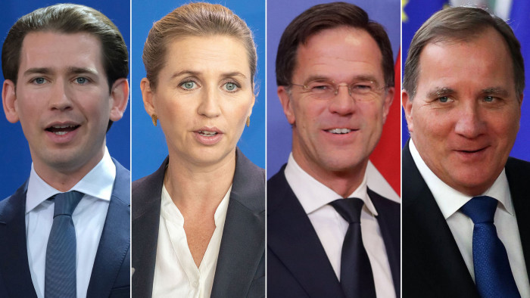
The Frugal Four
Sebastian Kurz Mette Frederiksen Mark Rutte Stefan Lofven,
(Austria) (Denmark) (the Netherlands) (Sweden)

Slide 12
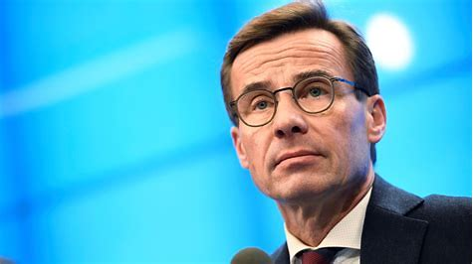
Ulf Kristersson
serving as Prime Minister of Sweden since 2022
the leader of the Moderate Party

Slide 13
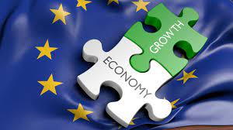
The Stability and Growth Pact (SGP)
A set of fiscal rules designed to prevent countries in the EU from spending beyond their means
A state’s budget deficit cannot exceed 3% of GDP
→changes in 2013: the Fiscal Compact (budget deficit can be 0.5% of GDP )
National debt cannot surpass 60% of GDP
The SGP is criticized for its strict fiscal rules, lack of compliance, and perceived favoritism toward certain nations

Slide 14
Relaxation of SGP Rules During COVID-19
In March 2020, the European Commission activated a general escape clause in the SGP, allowing member governments to exceed the normal deficit and debt limits due to the sudden economic shock caused by governments' reactions to the COVID-19 pandemic
In 2021, the Commission announced that these rules would remain suspended until the end of 2023
Sweden’s recovery plan within the EU Recovery and Resilience Facility In July 2020, EU heads of state and government agreed on a recovery package to mitigate the effects of the crisis
The package, called NextGenerationEU, comprises EUR 750 billion in loans and grants to the Member States
Sweden gets EUR 3.5 billion

Slide 15
Sweden’s Policy of Neutrality
For over 200 years, there has been no war on Swedish soil
the Swedish decision to apply for membership in NATO in 2022 after Russian invasion of Ukraine
According to a well-established narrative, Sweden’s policy of neutrality meant that Sweden should stay non-aligned with the intent to declaring itself neutral in the event of war
In 2009 Sweden agreed to enter into mutual self-defence treaties with the EU, and with other Nordic countries

Slide 16
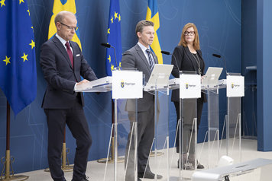
Russian-Ukraine war and Sweden
Sweden's support to Ukraine:
Since Russian invasion of Ukraine, Sweden has provided military, humanitarian and civil support to support Ukraine
Since February 2022, Sweden contributed more than SEK 25 billion (approx. EUR 2.1 billion) to various initiatives that support Ukraine
Together with the EU, Sweden has also adopted macroeconomic support and several sanctions packages against Russia

Slide 17
Thank you for your attention!

Slide 18
Resources
Facts and figures, EU demographics | European Union (europa.eu)
History of Sweden - 17 Most Important Events - Hej Sweden
sweden ww2 - Bing images
Softer but Strong: Euroscepticism and Party Politics in Sweden | Opposing Europe ? The Comparative Party Politics of Euroscepticism | Oxford Academic (oup.com)
sweden eurosceptic parties - Bing
Stability and Growth Pact (SGP): Meaning, History, and Criticism (investopedia.com)
Far-right eurosceptic party surge in polls ahead of Swedish elections – EURACTIV.com
Sweden’s Policy of Neutrality: Success Through Flexibility? | Successful Public Policy in the Nordic Countries: Cases, Lessons, Challenges | Oxford Academic (oup.com)
Sweden’s recovery plan within the EU Recovery and Resilience Facility - Government.se
Sweden's support to Ukraine - Government.se

